Slide 1
About OMICS Group
OMICS Group International is an amalgamation of Open Access publications and worldwide international science conferences and events. Established in the year 2007 with the sole aim of making the information on Sciences and technology ‘Open Access’, OMICS Group publishes 400 online open access scholarly journals in all aspects of Science, Engineering, Management and Technology journals. OMICS Group has been instrumental in taking the knowledge on Science & technology to the doorsteps of ordinary men and women. Research Scholars, Students, Libraries, Educational Institutions, Research centers and the industry are main stakeholders that benefitted greatly from this knowledge dissemination. OMICS Group also organizes 300 International conferences annually across the globe, where knowledge transfer takes place through debates, round table discussions, poster presentations, workshops, symposia and exhibitions.

Slide 2
About OMICS Group Conferences
OMICS Group International is a pioneer and leading science event organizer, which publishes around 400 open access journals and conducts over 300 Medical, Clinical, Engineering, Life Sciences, Phrama scientific conferences all over the globe annually with the support of more than 1000 scientific associations and 30,000 editorial board members and 3.5 million followers to its credit.
OMICS Group has organized 500 conferences, workshops and national symposiums across the major cities including San Francisco, Las Vegas, San Antonio, Omaha, Orlando, Raleigh, Santa Clara, Chicago, Philadelphia, Baltimore, United Kingdom, Valencia, Dubai, Beijing, Hyderabad, Bengaluru and Mumbai.

Slide 3

Development of Sisal Fibre Reinforced Cement Composites As substitute of Asbestos Cement Composites
-A Green Chemical Approach
Dr . Shipra Roy
Sarojini Naidu Government Girls
Postgraduate Autonomous College, Shivaji Nagar,
Bhopal, India.
Email: shipra59roy@gmail.com

Slide 4

Need for economical, sustainable and safe shelter - well pronounced globally.
Numerous challenges are unaddressed to produce eco-friendly construction materials which are structurally safe and durable.

Slide 5

Roofing - one of the most important components in housing.
Alone represents more than 25-30% of the total construction cost of a house.
In India, mostly asbestos cement roofing sheets are being used as one of the major roofing element.

Slide 6
There is need of millions of tons of asbestos roofing products.
Use of asbestos fiber for making asbestos cement roofing sheet causes many health problems.
It is a carcinogenic material.

Slide 7

Asbestos group of naturally occurring hydrated minerals silicates has been shown to induce:
-fibrosis, -lung cancer,- other kinds of intestinal cancer.
.
Long exposure to high concentrations of asbestos fibers is more likely to cause health problems.

Slide 8

Use of synthetic fibers frequently -
higher costs and greater consumption of
energy in the processing of fiber reinforced
cement composites.
Great need to replace asbestos
(mineral fibre) by eco-friendly materials.
Plant fibres - renewable, eco-friendly and
have good mechanical properties.

Slide 9

Plant fibres- an appropriate alternative to asbestos.
Plant fibers- deals with eco-friendly processing.
The environment - safe since the plant fibers require little energy with no toxic wastes.

Slide 10
Green Chemistry
The International Year of Natural Fibres 2009
aims at
raising global awareness of the importance of
natural fibres
not only to producers and industry,
but also to
consumers and
the environment.

Slide 11
CLASSIFICATION OF NATURAL FIBRES
Vegetable (Cellulose)
Animal
(Protein)
Wool, Silk
Mineral
Asbestos
Seed Hair Fibres
Cotton, Kapok, Coir
Bast Fibres
Flax, Hemp, Jute
Leaf Fibres
Sisal
Obtained from seeds and inner wall of the fruit
Short & single celled
Obtained from bast tissue of bark
Long multi-celled
Obtained from the leaves
Long multi-celled

Slide 12
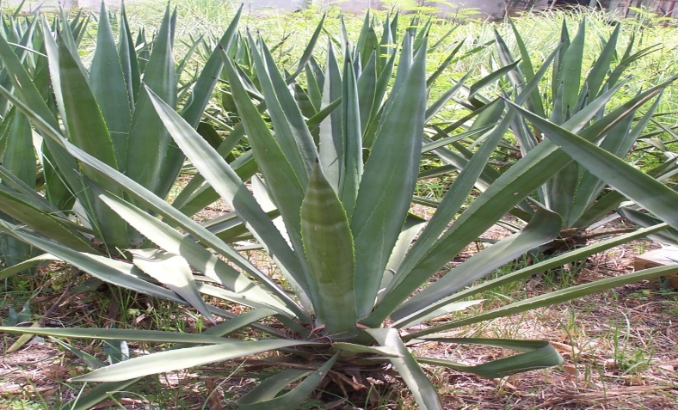

Sisal Plant

Slide 13

Sisal fibre
Agave sisalana :- family - Agavaceae
Sisal: Wide applications.
Present uses of Sisal fibre:
  Ropes, cordage, twines, cables, anchors, binders
  Coarse fabrics: nets, door mats, rugs,
  carpets etc.
  Others: hats, sandals, brushes
  Reinforcement in various polymeric
  matrices
Sisal fibre waste : Used for making paper
and paper board, biogas, electricity etc.

Slide 14

Sisal fiber - one of the widely available natural fiber.
Eco-friendly.
Good mechanical strength, locally available, and easy cultivation in all climatic conditions
Viable substitute for asbestos based
roofing sheet.

Slide 15

Why Sisal Fiber?
Low density
High specific strength
Renewable resource
Biodegradable
Thermal and acoustic insulation

Slide 16

Why Sisal Fiber?
Xerophyte.
Abundantly grown in wastelands and conserve soil.
Requires Minimum Maintenance
Bio renewable material.
Withstands many agro-ecological conditions.

Slide 17
Why Sisal Fiber?
Continuous fibre production for 6 - 8 years.
Require no fertilizers, herbicides or insecticides.
Largest export potential for ropes and binder twine.
Excellent engineering properties (light weight, high strength).
Compete with high end engineering product
while having tremendous employment potential.

Slide 18
SISAL FIBRE EXTRACTION
Manual Process – Retting
Microbial decomposition of sisal leave
  Boiling
  Leaves are boiled
  Beating
  Washing and Sun drying
  Mechanical
  By Raspador Machine
    Best method in all aspects
    Raspador Machine

Slide 19
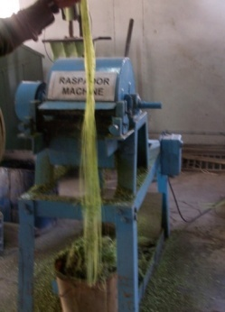

Slide 20
The raspador , run by electric motor is effecient, versatile, safe ,labor and cost effective.
It takes minimum time and is an eco-friendly process.
About 96 % residues available after extraction of fibre is useful for other applications
As biogas generation, composting, isolation of hecogenin, which is a steroid.
Also being used for making paper, paperboard, and biodegradable polymer, wax etc.

Slide 21
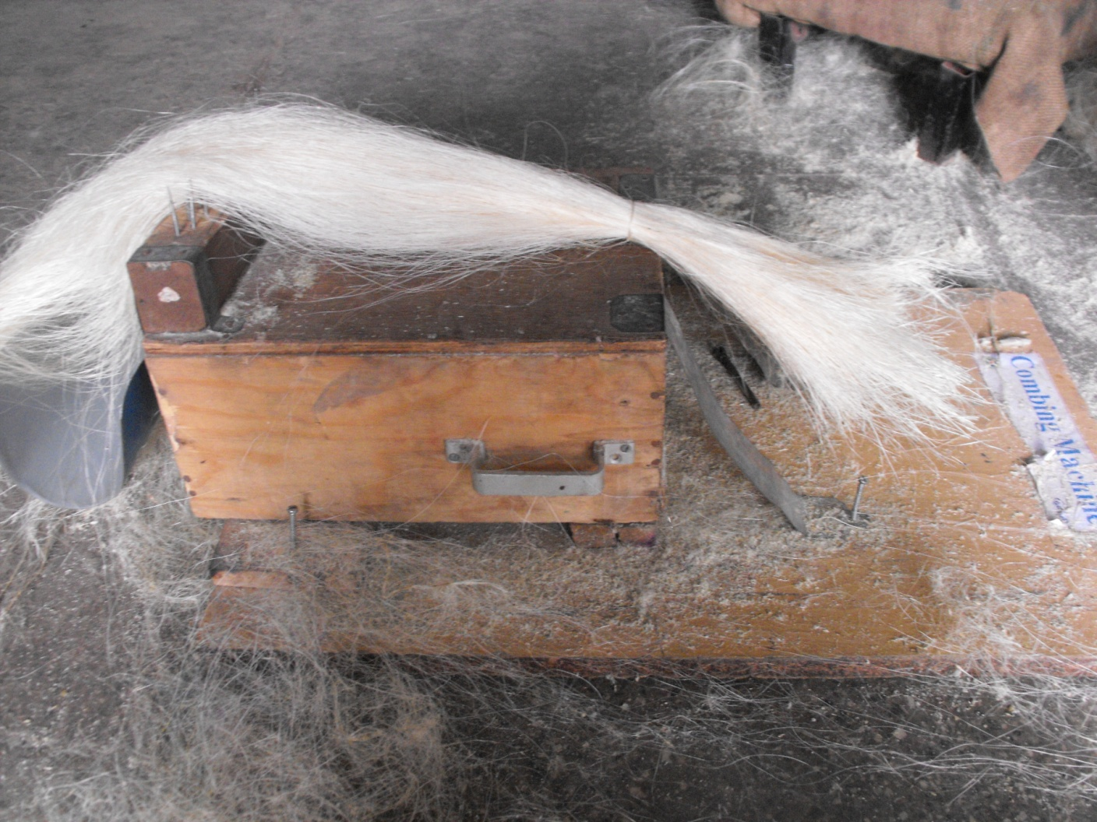
Combing Machine

Slide 22
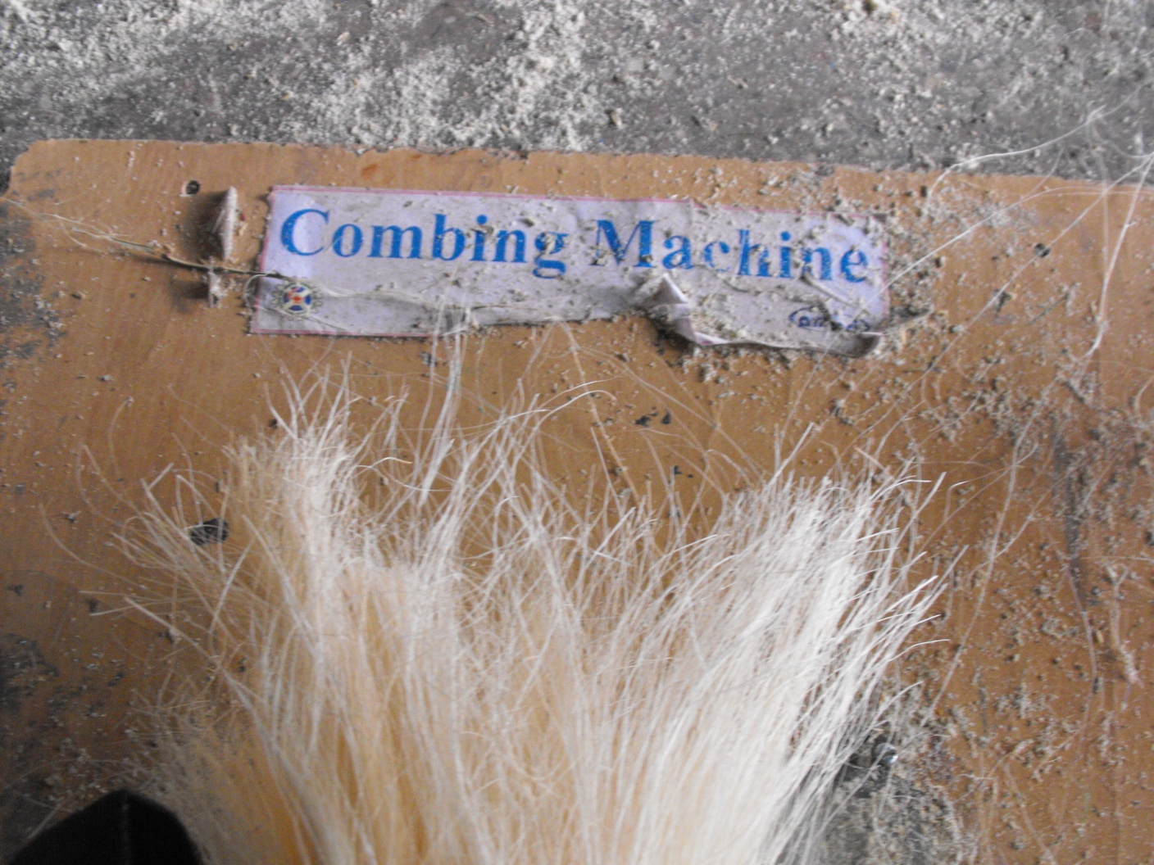

Slide 23
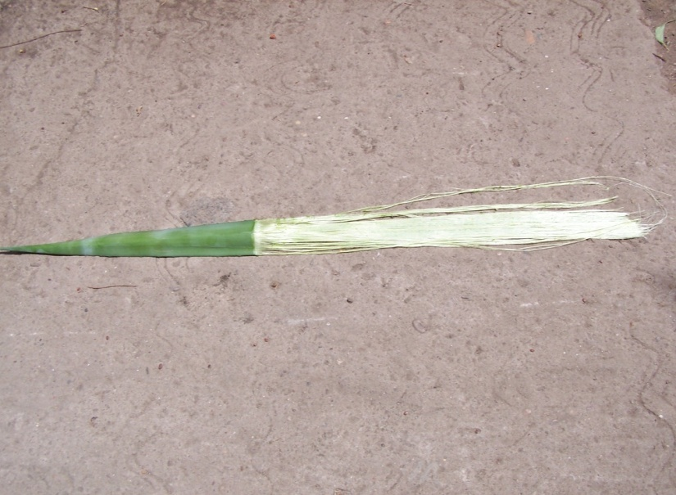
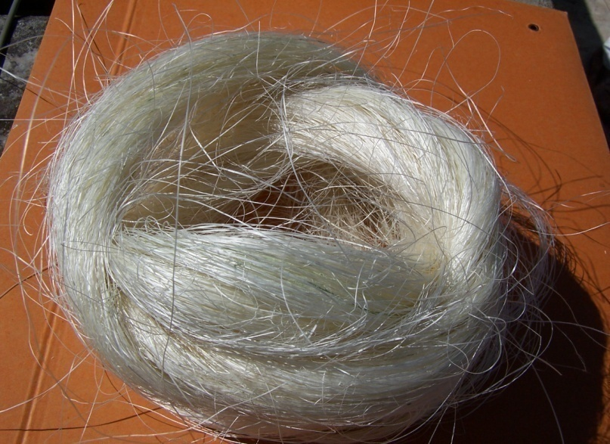
Sisal Plant
Green Sisal Fibre
Sisal Fibre

Slide 24
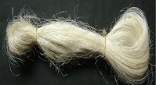

Sisal fiber, the green material-exceptionally durable with low maintenance and minimal wear and tear.
Tough for textiles and fabrics.
Biodegradable too.
Easily grow in every climate covering sub humid to arid and semiarid regions.

Slide 25

Sisal - 6th most commonly produced fibre globally.
Accounts for 2%of the world's plant fibre production.
Sisal plant - survives in almost all soil types.
Input costs - least for its survival, regeneration and maintenance on sustainable basis.
Tolerates prolonged droughts and high
tematures also.
It yields parallel hard fibers.

Slide 26
Physico-Chemical Parameters
Tensile Strength(Mpa)- 501.326 ± 119.5
Tensile Modulus (Gpa)- 50.57 ± 3.27
Elongation at break (%)- 0.78 ± 0.41 (ASTM)
Universal Testing Machine of
Ametek Lloyd
Moisture Content (%) - 14-16
By LCGC moisture absorption analyzer
Density (g/cm3) - 1.4 (ASTM)

Slide 27

Phytochemical Analysis
Carbon % - 40.0
Nitrogen % - 0.112
Sulphur % - 0.007
Hydrogen % - 6.523
By CHNS Analyzer, Elementar ,
Vario EL, Germany

Slide 28
Phytochemical Analysis contd.
Cellulose % - 45
Lignin (%) - 18
Hemi-cellulose(%) - 14
( Oladele et al 2010)

Slide 29
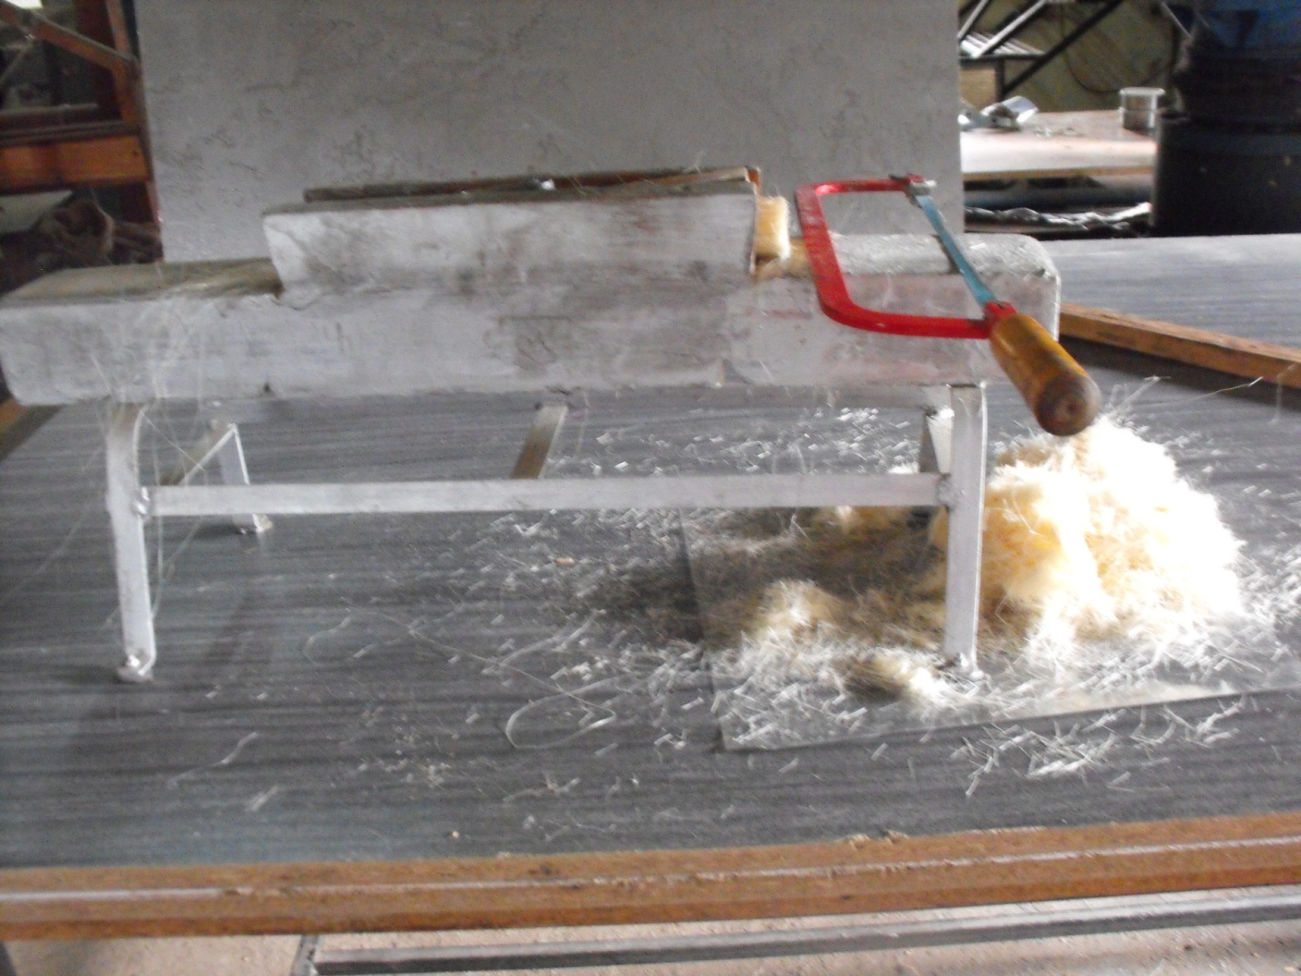
Chopping

Slide 30
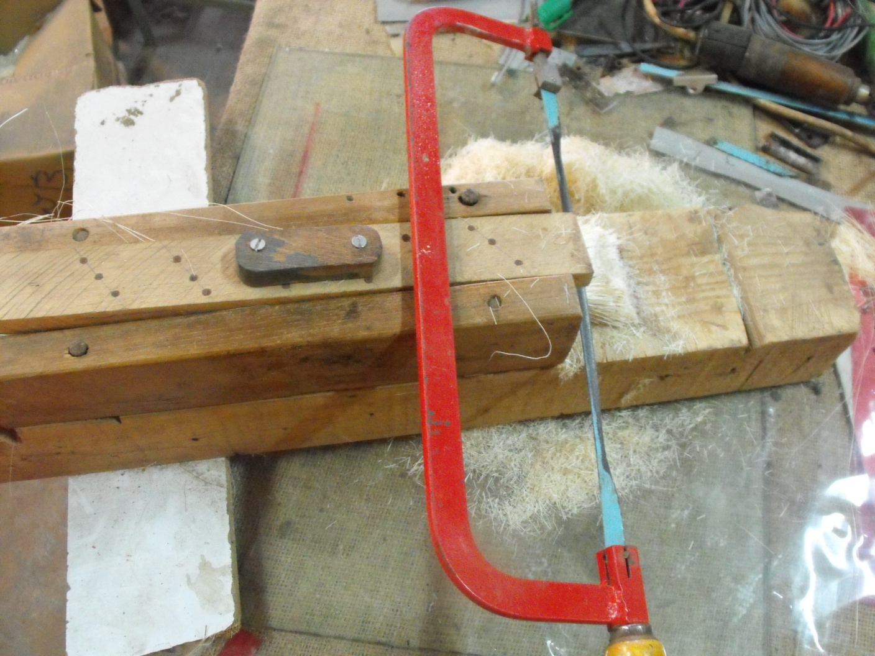
Chopping

Slide 31
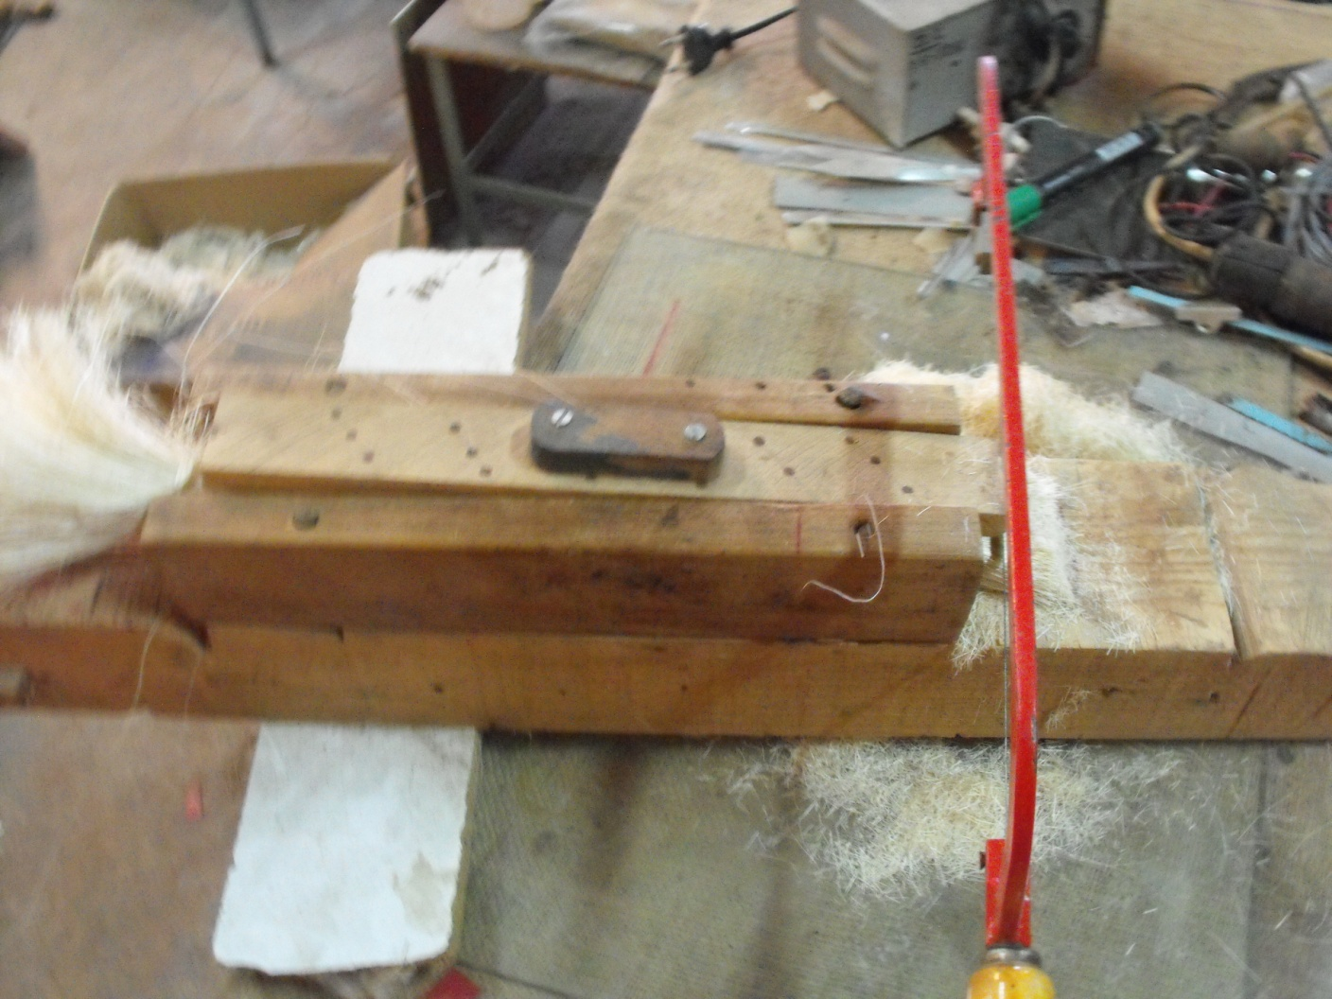
Chopping

Slide 32
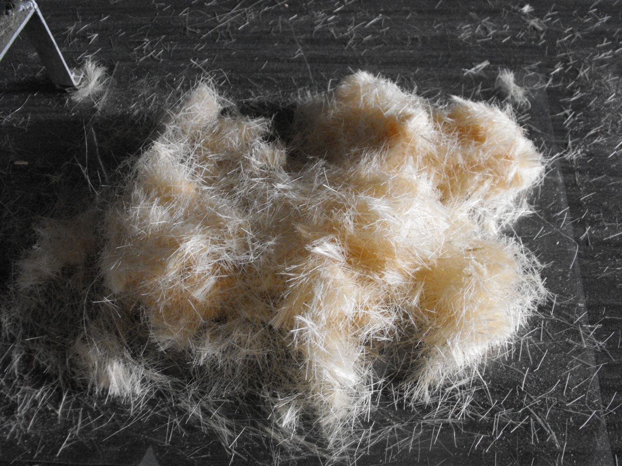
Chopped Sisal Fibre

Slide 33

The long fiber were chopped:
Different sized samples were tested till 22-25 mm.
The best results were observed with 5.0 mm size of the chopped fibre.
The fibre is given alkali treatment with
5% NaOH.
Through washing with water.

Slide 34

Excess alkali was neutralized.
Finally dried in oven at 50⁰C.
Sisal fibre is mixed with cement and fly ash to develop sisal fiber reinforced cement composites.
The green material was reinforced with cement/
cement and fly ash.
Flay ash is industrial waste of power plants.

Slide 35
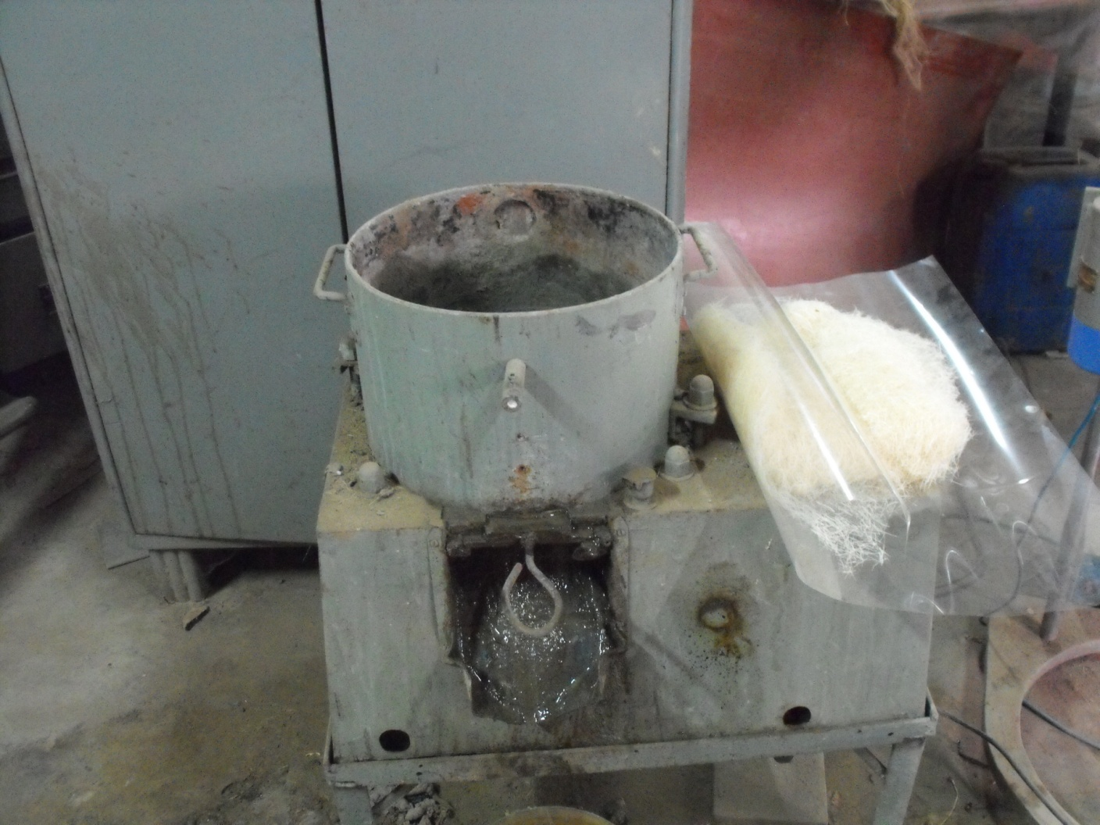
Mixing Drum

Slide 36
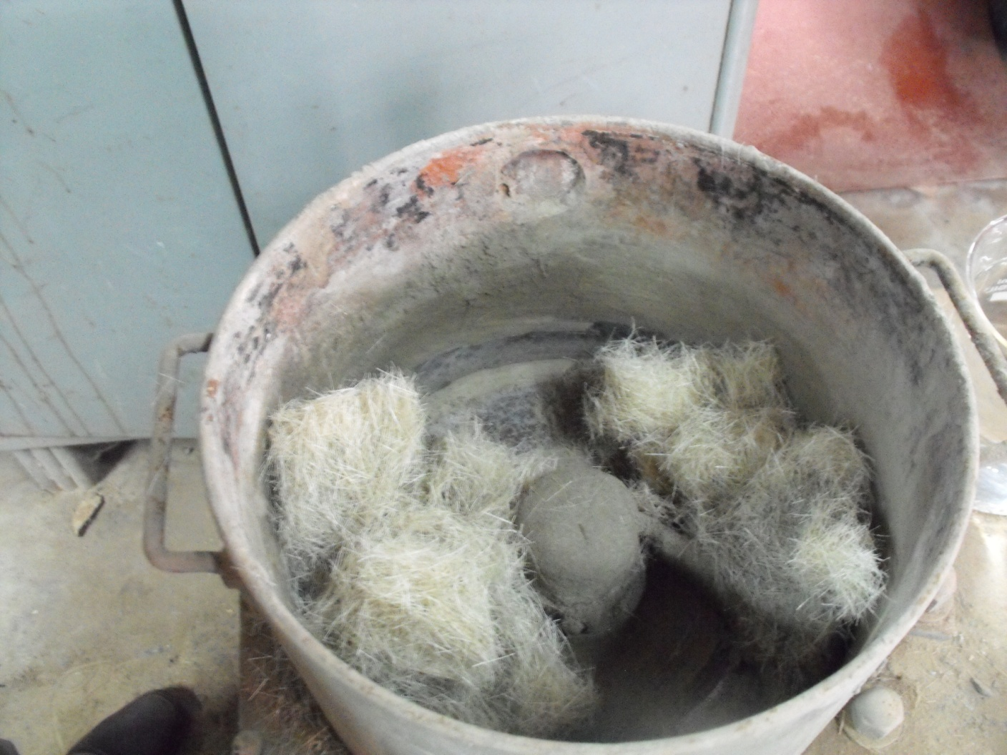
Mixing

Slide 37
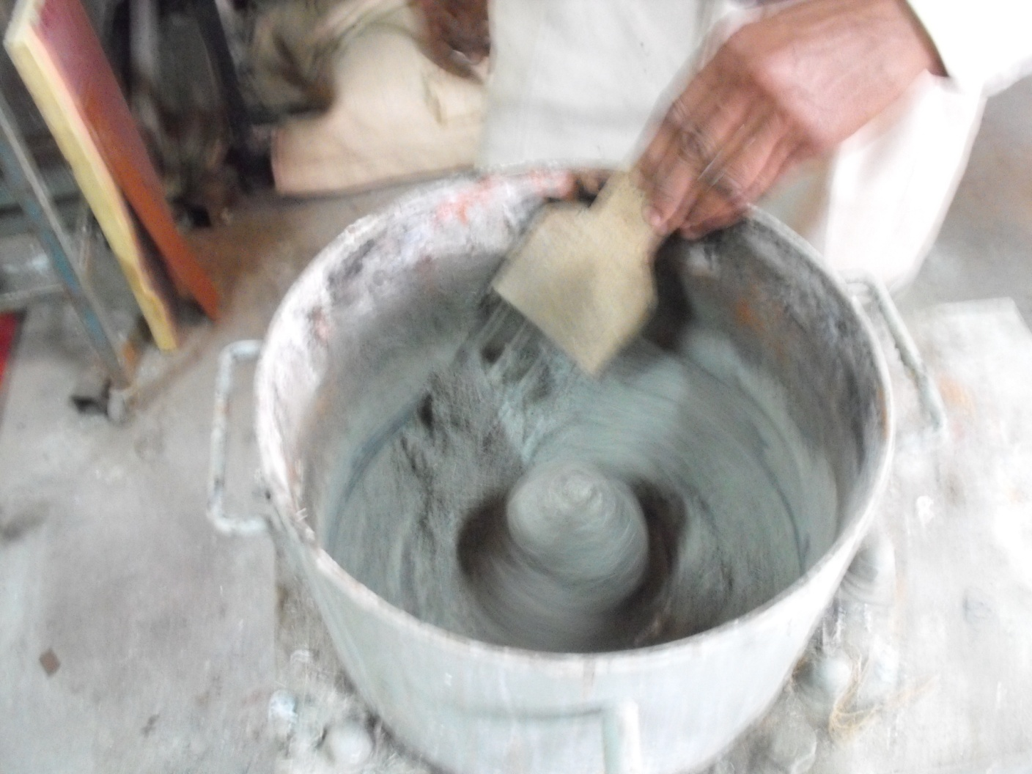
Manual Agitation

Slide 38
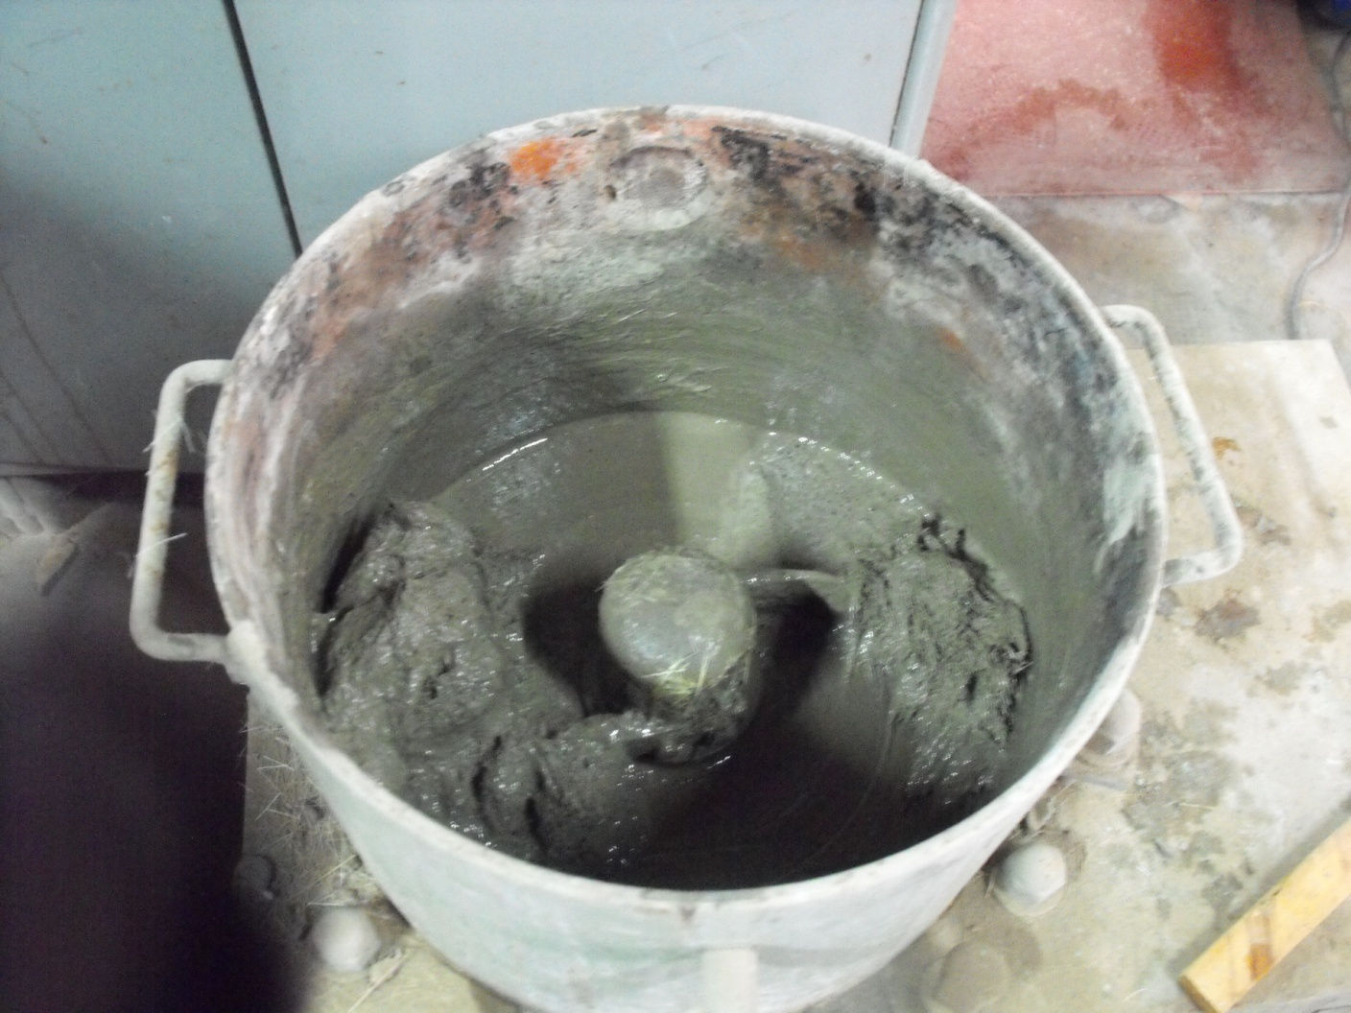
Mixing

Slide 39
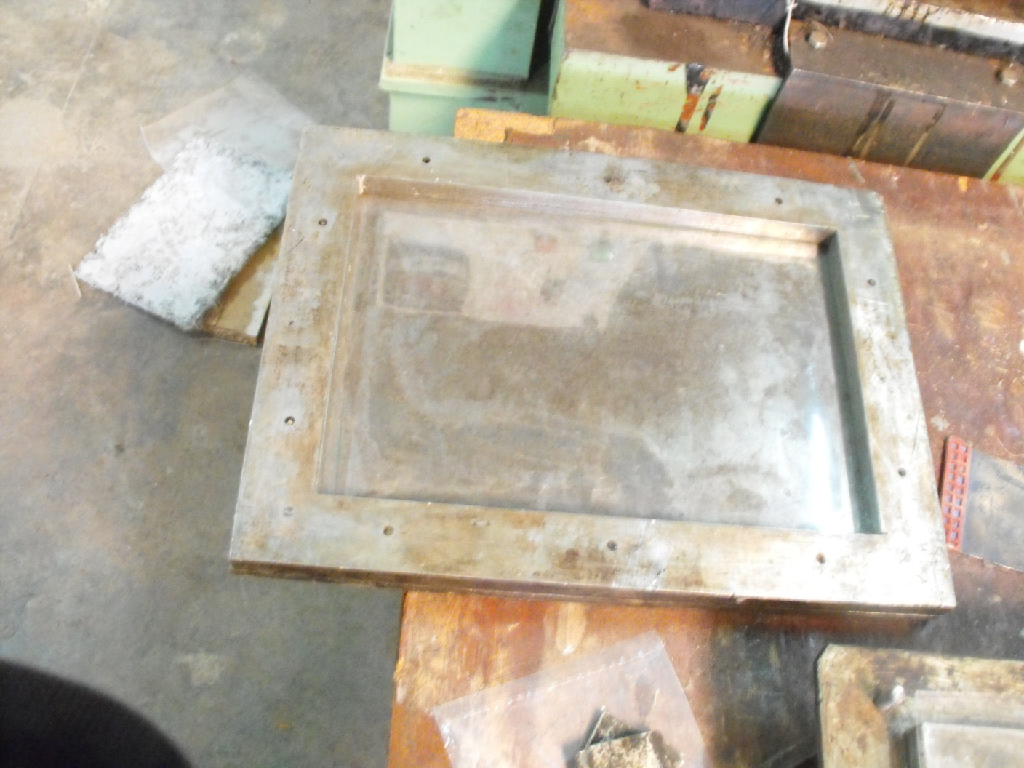
Composite Setting Mould

Slide 40
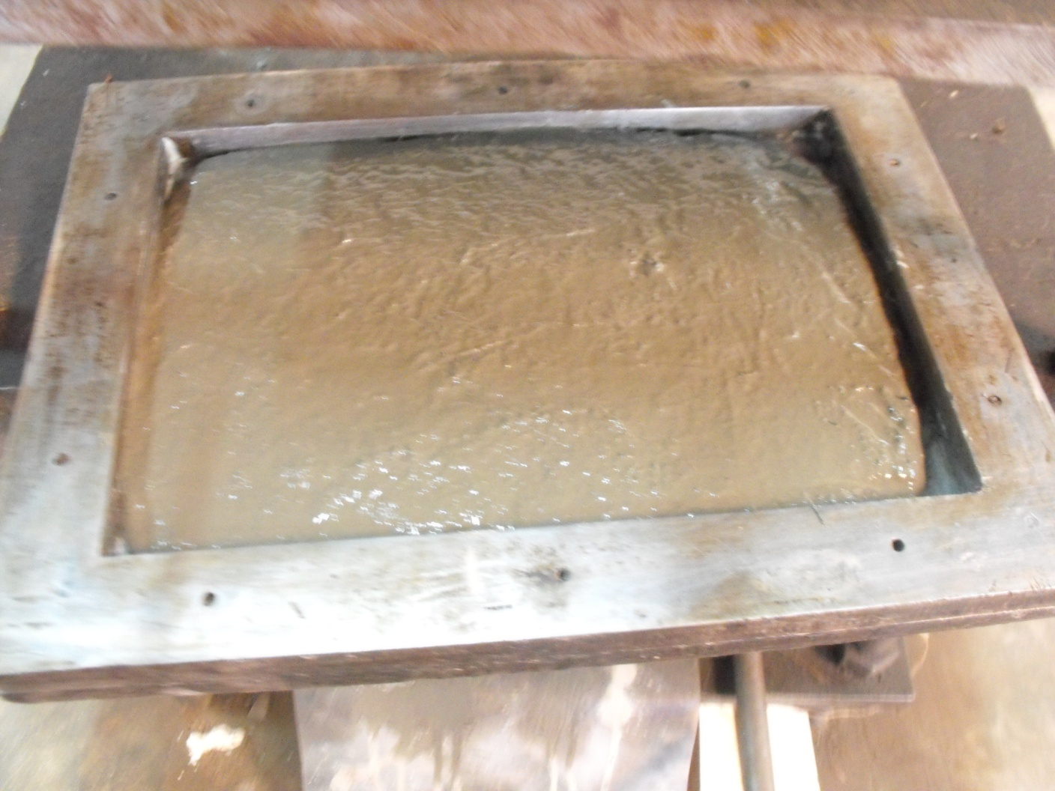
Composite Moulding

Slide 41
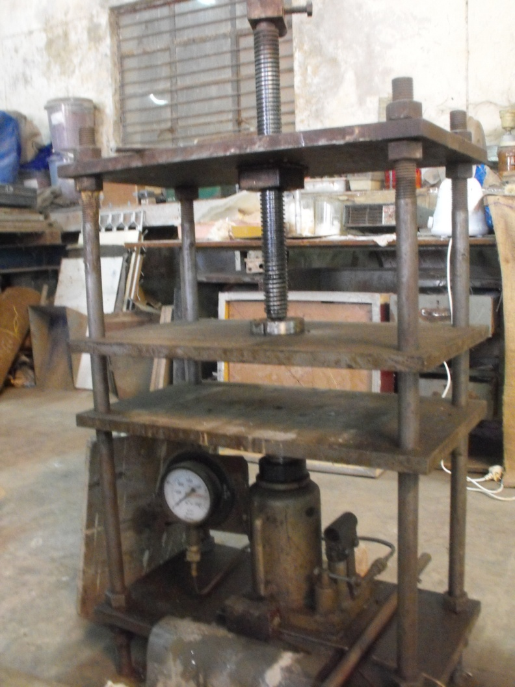
Hand Press Machine

Slide 42
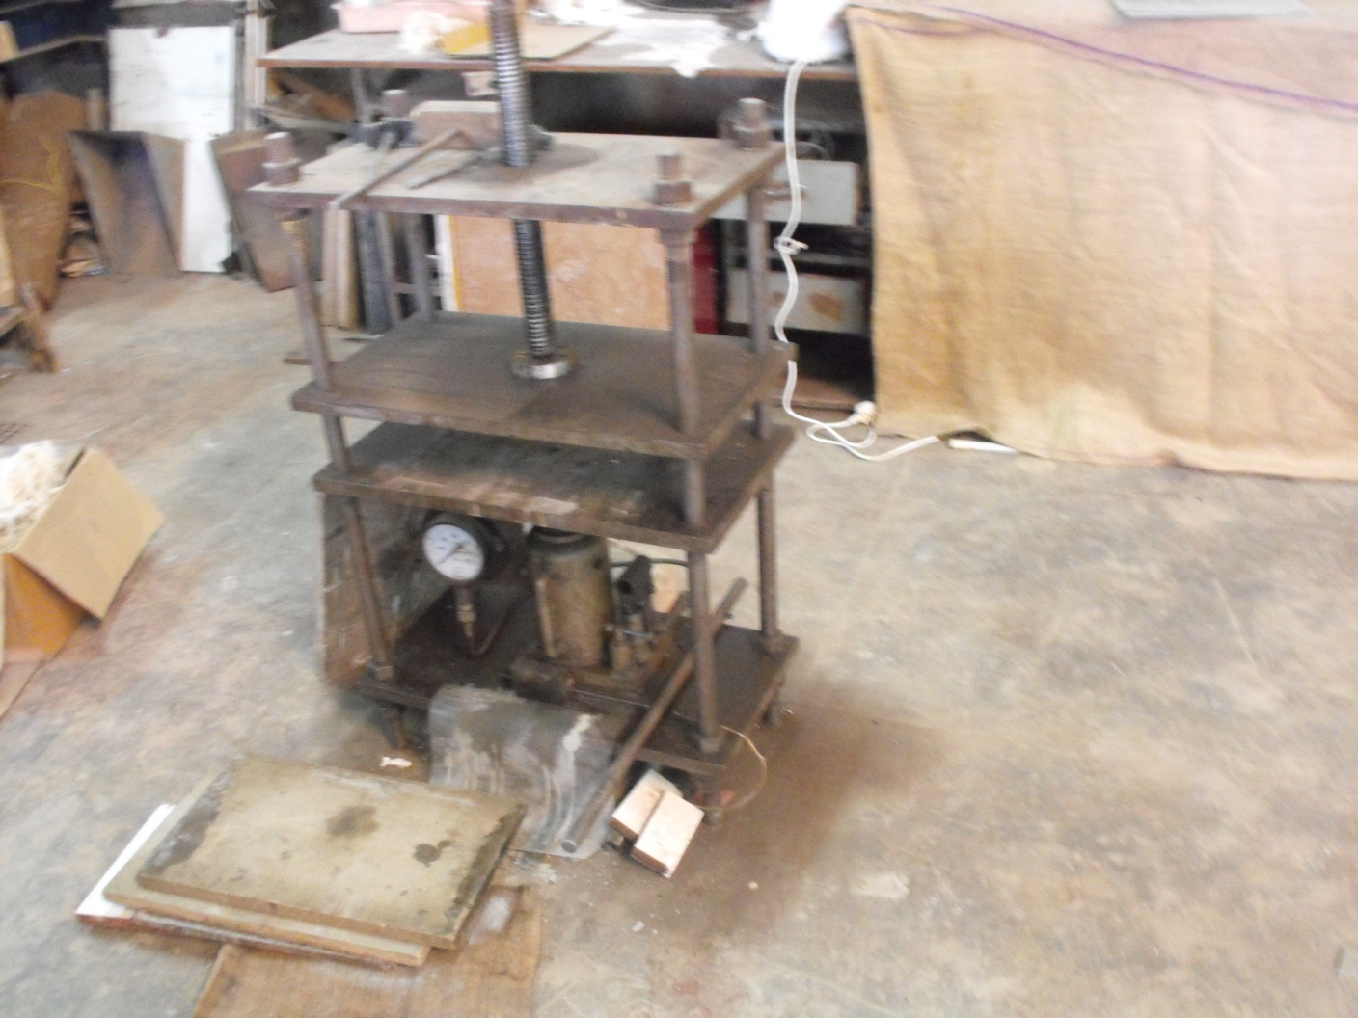
Hand Press Machine

Slide 43

Sisal Fibre - Cement Composite
Sisal Fibre (20gms,length 5mm)
Cement (700gm)
Water (400ml)
Pressure (1500lb/m²)

Slide 44
Sisal Fibre-Cement-Fly Ash Composite
Sisal Fibre (20gms,length 5mm)
Cement (600gm)
Fly Ash (100gm)
Water (400ml)
Pressure (1500lb/m²)

Slide 45
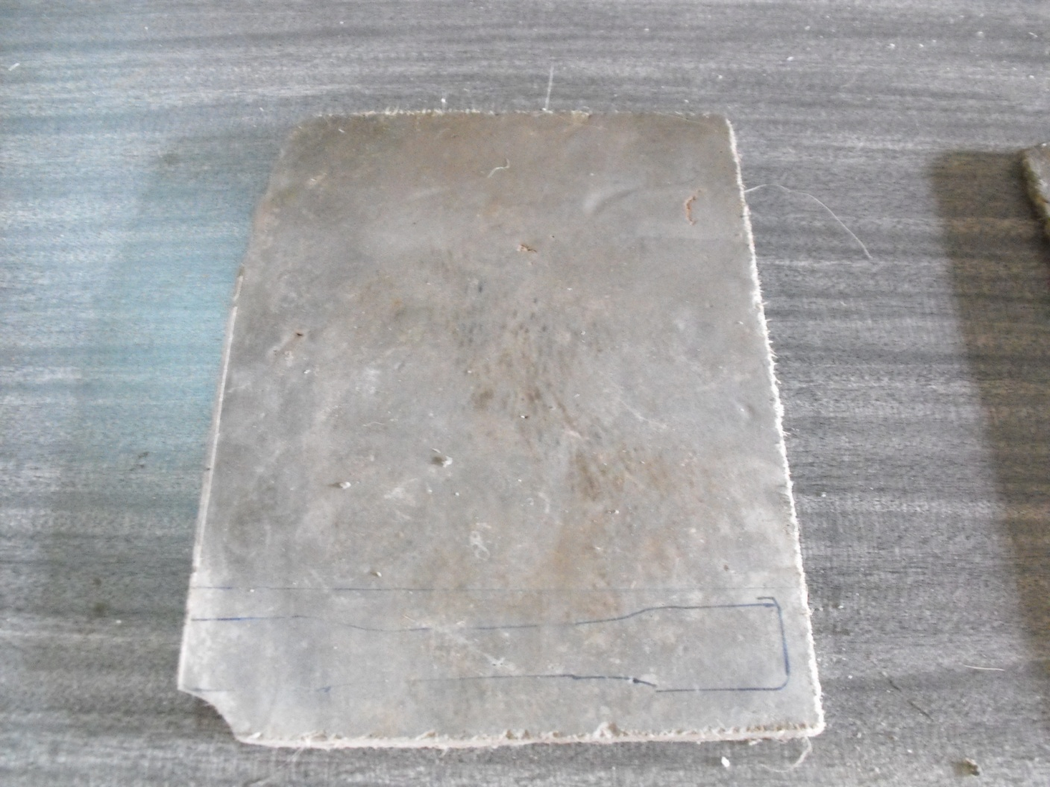
Sisal Fibre Reinforced Cement Composite Sheet

Slide 46
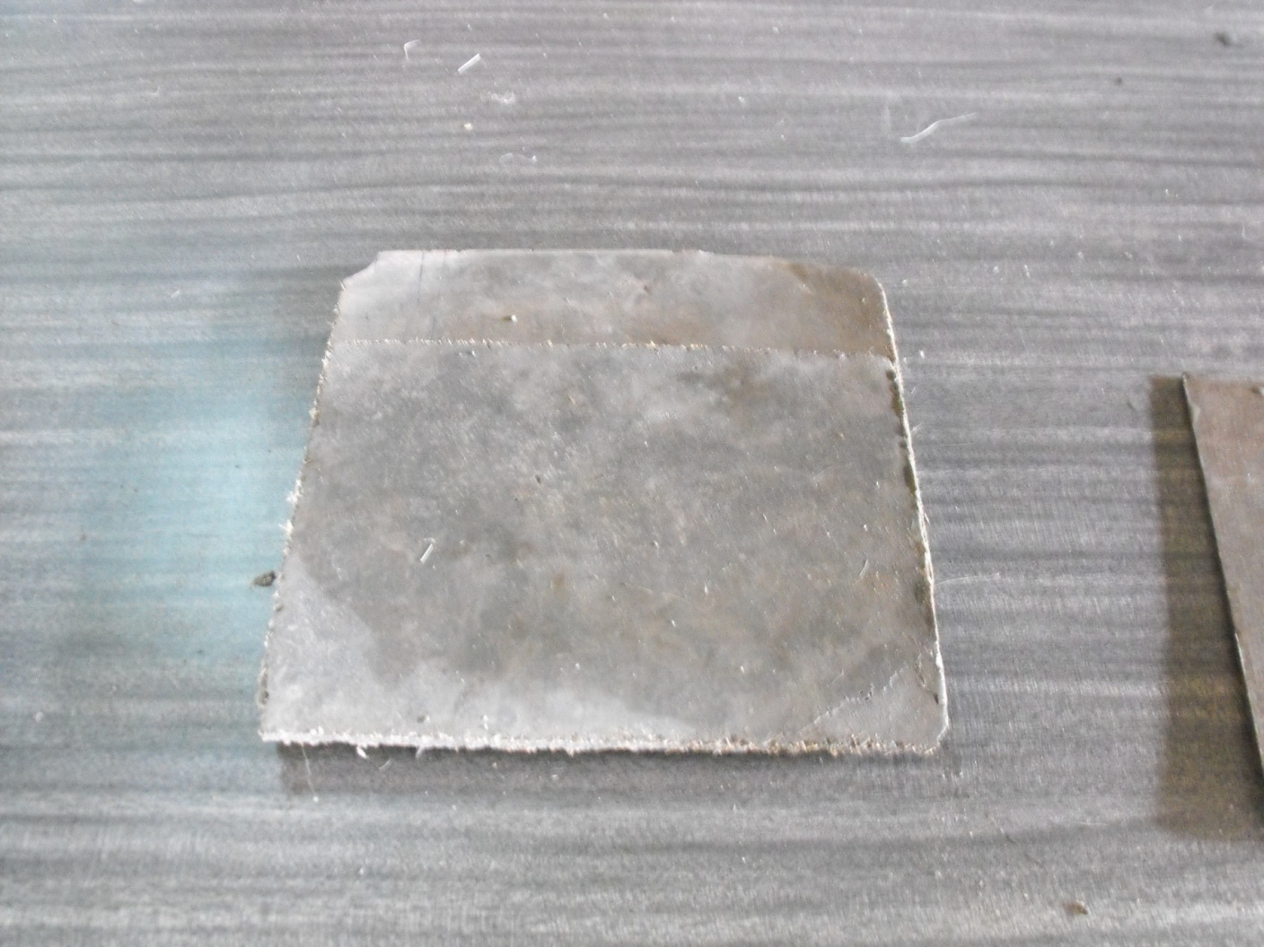
Sisal Fibre Reinforced Cement Composite Sheet

Slide 47
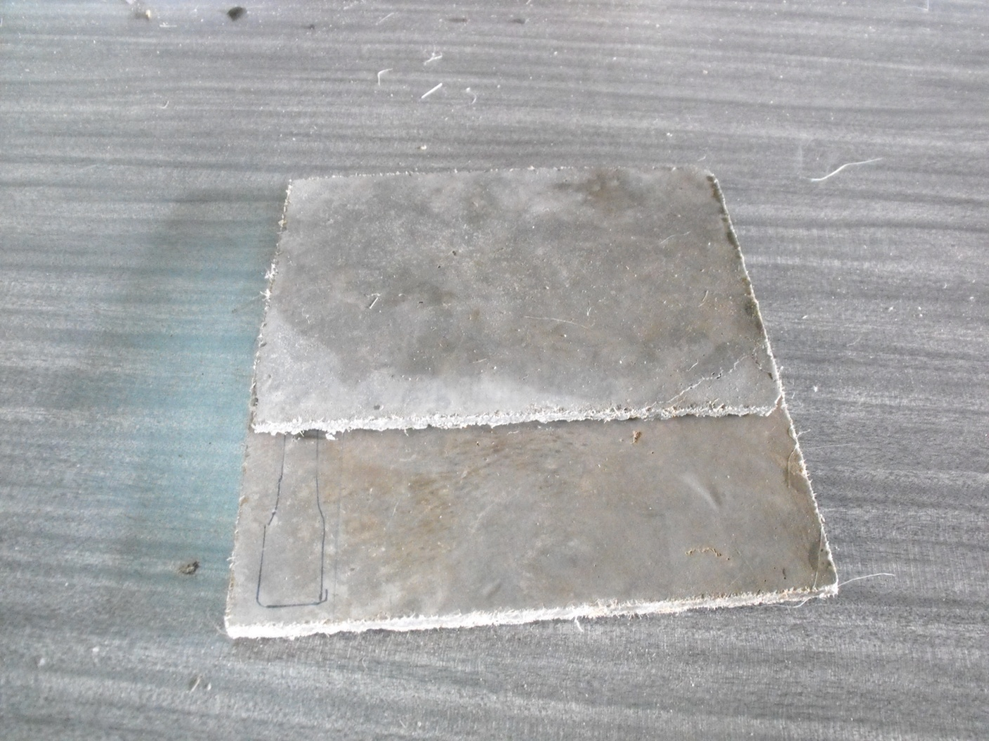
Sisal Fibre Reinforced Cement Composite Sheet

Slide 48
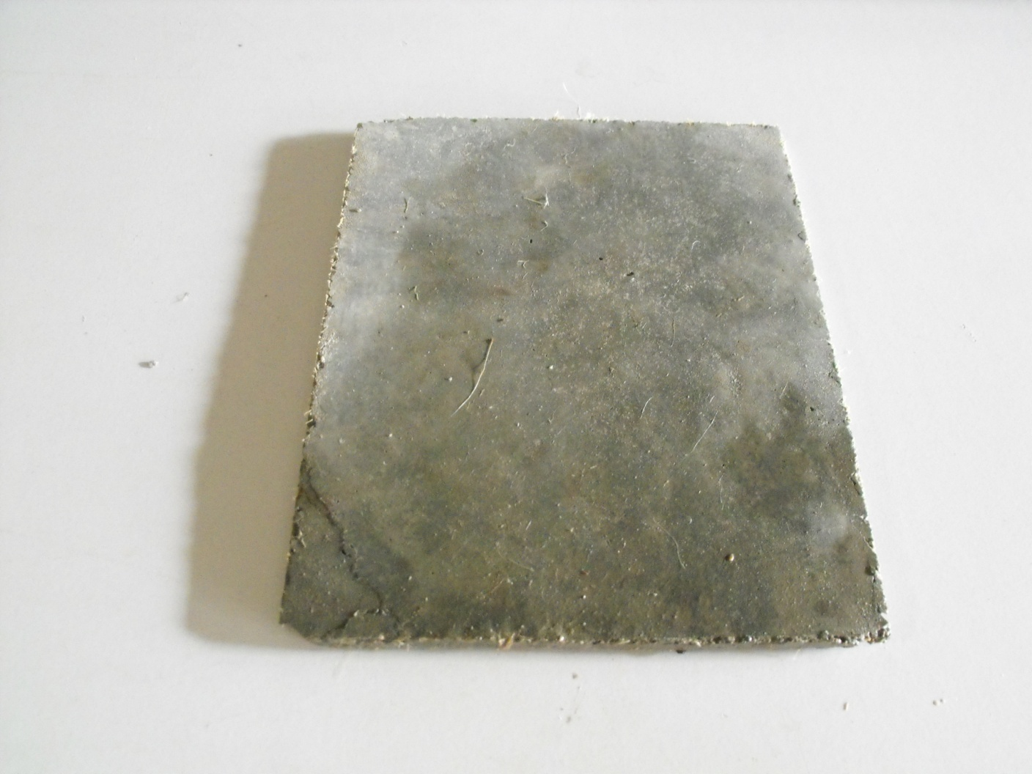
Sisal Fibre Reinforced Cement Composite Sheet

Slide 49
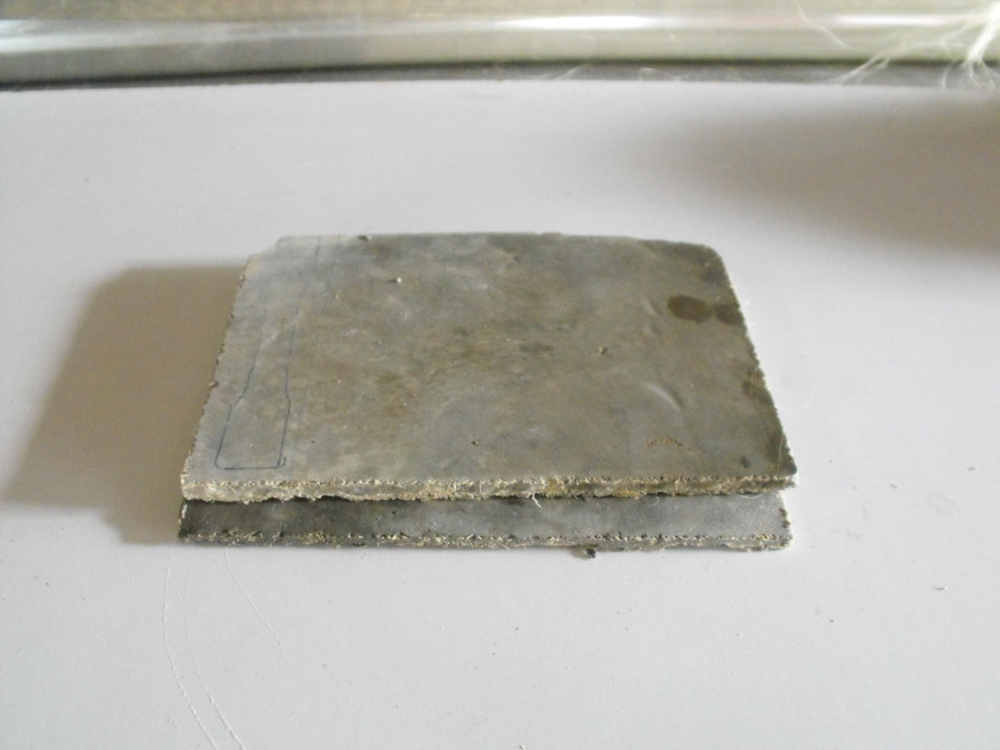
Sisal Fibre Reinforced Cement Composite Sheet

Slide 50
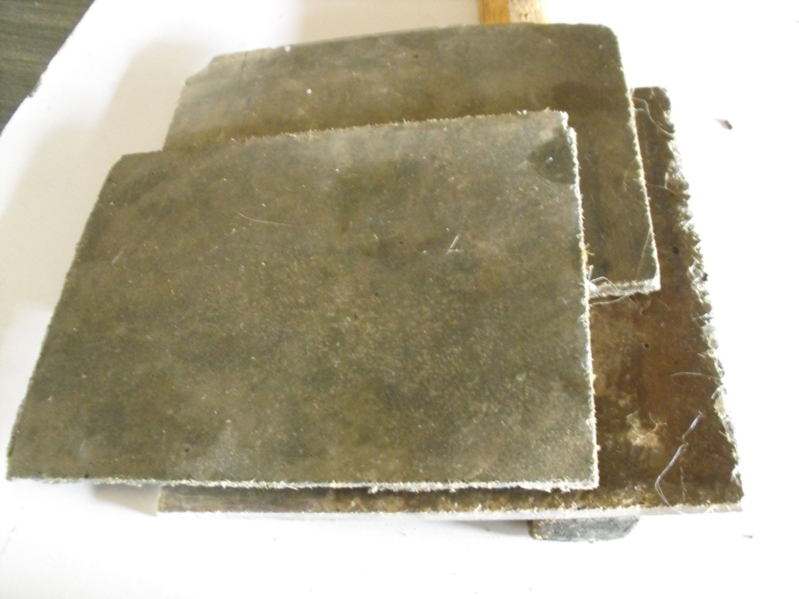
Sisal Fibre Reinforced Cement Composite Sheet

Slide 51
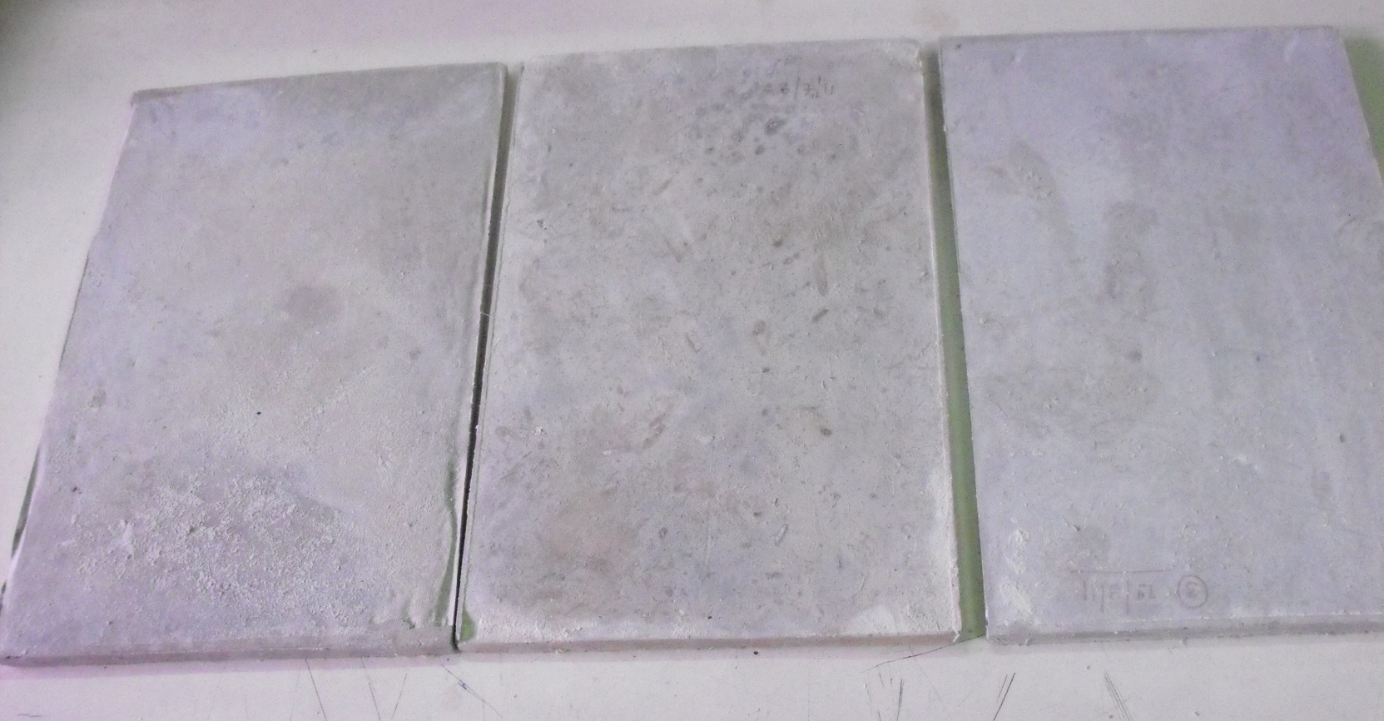
Sisal Fibre-Cement-Fly Ash Composite

Slide 52
Under Testing
Moisture Analysis
Water absorption
Morphological Study (SEM-Scanning by
Electronic Microscope)
Tensile Strength
Flexural Strength
Elongation at break ( %)
Impact Strength etc.

Slide 53

Utilization of a locally renewable resource (sisal) as a substitute of carcinogenic asbestos fibre.
Present proposed development may open new avenue to use sisal fiber cement sheet in buildings where presently asbestos cement sheets are used globally.
An Innovative and Inclusive Developmental Approach.

Slide 54
Biography:
Dr. Shipra Roy has had a distinguished career, so far with over 33 years of research, teaching, and public advocacy in science. She has published scholarly research in national and international publications in chemistry, biochemistry and their applications. The major emphasis of her work has been on herbal medicine for diabetes and plant fibre reinforced cement composites. She has supervised Master’s and Ph.D. level research work. Her research work has been patented in India and in the United States of America. During the course of her career, Dr. Roy has won several scholarships and awards. She holds M.Sc. and Ph.D. degrees from the University of Allahabad. For the M.Sc. she was first in merit. Currently, she is an Assistant Professor of Chemistry at the Sarojini Naidu Post Graduate Autonomous College and also an approved Ph.D. supervisor for the Barkatullah University, Bhopal, India.
Official Website: WWW.shipraroygreenchemistry.com

Slide 55

Thank You

Slide 56
Let Us Meet Again
We welcome you all to our future conferences of OMICS Group International
Please Visit:
www.omicsgroup.com
www.conferenceseries.com
www.pharmaceuticalconferences.com

