Slide 1
About OMICS Group
OMICS Group International is an amalgamation of Open Access publications and worldwide international science conferences and events. Established in the year 2007 with the sole aim of making the information on Sciences and technology ‘Open Access’, OMICS Group publishes 400 online open access scholarly journals in all aspects of Science, Engineering, Management and Technology journals. OMICS Group has been instrumental in taking the knowledge on Science & technology to the doorsteps of ordinary men and women. Research Scholars, Students, Libraries, Educational Institutions, Research centers and the industry are main stakeholders that benefitted greatly from this knowledge dissemination. OMICS Group also organizes 300 International conferences annually across the globe, where knowledge transfer takes place through debates, round table discussions, poster presentations, workshops, symposia and exhibitions.

Slide 2
About OMICS Group Conferences
OMICS Group International is a pioneer and leading science event organizer, which publishes around 400 open access journals and conducts over 300 Medical, Clinical, Engineering, Life Sciences, Phrama scientific conferences all over the globe annually with the support of more than 1000 scientific associations and 30,000 editorial board members and 3.5 million followers to its credit.
OMICS Group has organized 500 conferences, workshops and national symposiums across the major cities including San Francisco, Las Vegas, San Antonio, Omaha, Orlando, Raleigh, Santa Clara, Chicago, Philadelphia, Baltimore, United Kingdom, Valencia, Dubai, Beijing, Hyderabad, Bengaluru and Mumbai.

Slide 3
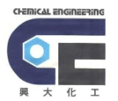
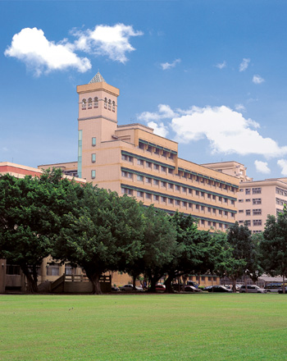
Green Chem-2014 Philadelphia
Green Processes to Diisocyanates and PU Elastomers
via Carbonate Raw Materials: New NPR and NIR Processes
Green Chemistry
NPR to MDI,DDI,HDI:DPC
NIR to P-Urea:DPC
NIR to PU through Cyclic Carbonate
Other Carbonate Routes to PU and PA
Summary
Prof. Shenghong A. Dai
National Chung-Hsin University
Taichung, Taiwan
1
Shdai-140727

Slide 4
Green Chem-2014 Philadelphia
Winterton: 12 Green Engineeing Principles
( Green Chem., 2001, 3 G73.)
1. Identify and quantify by-products. (副產物鑑定及量化)
2. Report conversions, selectivity's, and productivities. (明示程序之轉化率/產率/選擇率)
3. Establish full mass-balance for the process. (建立完整質量平衡)
4. Measure catalyst and solvent loses in air and aqueous effulent.
5. Investigate basic thermochemistry.
6. Anticipate heat and mass transfer limitations.
7. Consult a chemical or process engineer. (與化工人咨詢要點)
8. Consider the effect of overall process on choice of chemistry. (作完整化學選項之考量)
9. Help develop and apply sustainability measures.(發展永續發展之要項)
10. Quantify and minimize the use of utilities.
11. Recognize where safety and waste minimization are incompatible. (安全及減廢之考量)
12 Monitor, report, and minimize the laboratory waste emitted.
3
Shdai-140727

Slide 5
Green Chem-2014 Philadelphia
Green Chemistry– NPR, NIR Processes
Green chemistry is a way to minimize chemical threat to human being and environment.
Anastas and Wnerer: (12 principles) chemical reliability, safety, high selectivity, energy efficiency, re-usability.
NPR / NIR- Our Green Research Goals:
- Non-phosgene process of producing isocyanates
- Minimize chlorine-containing reagents and products
- Ambient synthesis condition
- Use low-toxic chemicals – avoid isocyanates in PU making
- Employ sustainable low-cost raw materials
NPR: Non-phosgene Route (非光氣製程- Isocyanates)
NIR: Non-isocyanate Route (非異氰酸鹽製程- PU)
4
Shdai-131227

Slide 6
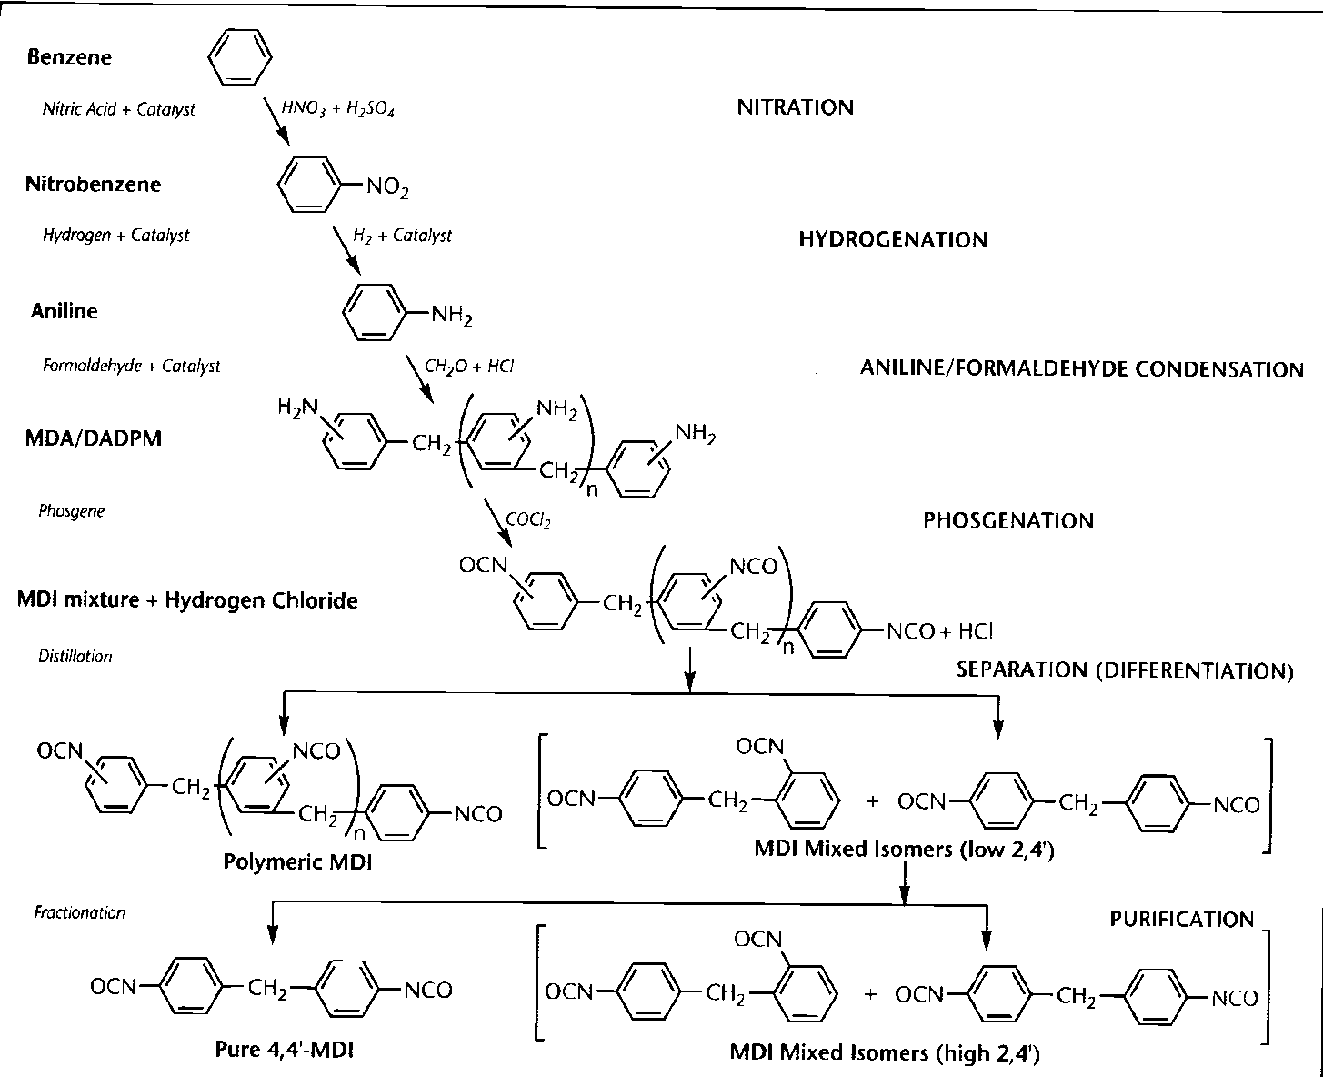
Green Chem-2014 Philadelphia
Phosgene Process-MDI from Benzene
( Polyurethane Handbook by Huntsman)
Con. H2SO4/HNO3
Formaldehyde
Phosgene
Toxic chemicals
5
Shdai-140727

Slide 7
Green Chem-2014 Philadelphia
Phosgene Process- p-MDI from p-MDA
Crude MDA
P-MDA
PhNCO &
low Boilers
4,4’-MDI
(>98.5%)
2,2-;2,4’-;4,4’-
MDI
Bottoms
MCB
Dist..
PU
(MDI)
(p-MDI) x= 1 to 6
MDI Isomers Mp (C) Bp(C)
2,2’-MDI 46 140 / 0.5
2,4’-MDI 35 152 / 0.5
4,4’-MDI 41 161 / 0.5
60:40/2,4’:4,4’ 14
Ternary <0
Rigid Foams
Ref: H. Ulrich in “Chemistry and Technology of Isocyanates, John Wiley, p385 (1996)
6
Shdai-140727

Slide 8
Green Chem-2014 Philadelphia
The Problems Associated with Phosgene Process
Safety problem: Phosgene is a highly toxic chemical with low Lethal threshold.
Phosgene process generates large amount of HClg .
HClg is a highly corrosive agent, and hence requires high-cost of maintenance.
HClg needs to be managed into PVC or oxidized to recover as chlorine.
MDI will contain hydrolyzable and non-hydrolyzable chlorides impurities.
MDI process requires highly safety facilities to prevent accidents/fatality.
Require large sum of initial cost for a large integration site and safety facilities.
7
Shdai-140727

Slide 9
Green Chem-2014 Philadelphia
Non-phosgene Routes to MDI
Over 40 plus years of research but with no practical process in use
DPC (1)
(2)
(3)
R= Me, Et, Ph
8
Shdai-140727

Slide 10
Carbonylation Reagents
Green Chem-2014 Philadelphia
Phosgene still is the most efficient/cheap raw materials.
Olin
ARCO
Asahi
Bayer, BASF
Dow, Eni Chem,
Asahi
Monsanto
(current)
15
Shdai-140727

Slide 11
Green Chem-2014 Philadelphia
NPR to MDI – Prior Arts
ARCO : Three-Step Process from Nitrobenzene (1974)
(1) Reductive Cabonylation:
(2) Condensation:
(3) Thermolysis:
Se
Toxic catalyst and hart to recover [Step (1)]
High temperature to crack carbamate [Step(3)]
9
Shdai-140727

Slide 12
Green Chem-2014 Philadelphia
NPR to MDI – Prior Arts
Asahi : Three Step Process from Aniline (1978)
1. Oxidative Carbonylation:
2. Condensation:
3. Decomposition:
“Pd”
NHCOOEt + H2O
NH2 + CO + EtOH + 1/2 O2
(EPC)
COOEt
- H2O
NHCOOEt + CH2O
H+
N-CH2-- NHCOOET
COOEt
(N-benzyl compound)
N-CH2-- NHCOOET
(EPC)
EtOCONH
CH2-- NHCOOET
EtOCONH
CH2-- NHCOOET
-2 EtOH
O=C=N
CH2-- N=C=O
(MDU)
240℃
(MDI)
Similar problems to ARCO’s; Being Scaled-up in pilot
10
Shdai-140727

Slide 13
Green Chem-2014 Philadelphia
Lynodell’ DPC Route to MDI
[ R. W. Mason, US Patent 6,781,010 (2004) ]
MDA Condensation with Formic Acid:
Carbonylation of Formamaide with DPC and Thermolysis:
Trans-esterification of MDA with Phenyl Formate:
180℃~200℃
+ HCOOPh
180℃~200℃
HCOOPh + MDA
13
Shdai-140727

Slide 14
Green Chem-2014 Philadelphia
Lynodell’ DPC Process to MDI
[ R. W. Mason, US Patent 6,781,010 (2004) ]
Advantages:
- Themolysis temperature of biscarbamate into MDI seems milder (<200 ℃)
- The yields to MDA-formamaide and MDI are high.
- Phenyl formate, the by-product, could be re-used.
Disadvantages:
- MDI needs to be re-distilled to separate from solvent/by-product.
- Highly corrosive formic acid was used as the carbonylation agent.
14
Shdai-140727

Slide 15
Green Chem-2014 Philadelphia
NPR to Aliphatic Diisocyanates
Monsanto: CO2 Carbonylation-Dehydration Process
1) CO2, CH3CN
2) 0 C; Dehydration
agent/ CH2Cl2
C8H17NH2 + 2 base
C8H17N=C=O
( 5mm) (10 mm) 25 ml
BASE PRESSURE CO2 DEHYD. AGENT % YIELD
NEt3 1 ATM POCl3 98%
NEt3 1 ATM PCl3 96%
NEt3 1 ATM SO3 99%
CyTEG 80 PSI (CF3CO)2O 91%
CyTEP 80 PSI SOCl2 70%
Applicable only to aliphatic diamines
Require strong tertiary amine to stabilize the initial carbamic acid
12
Shdai-131227

Slide 16
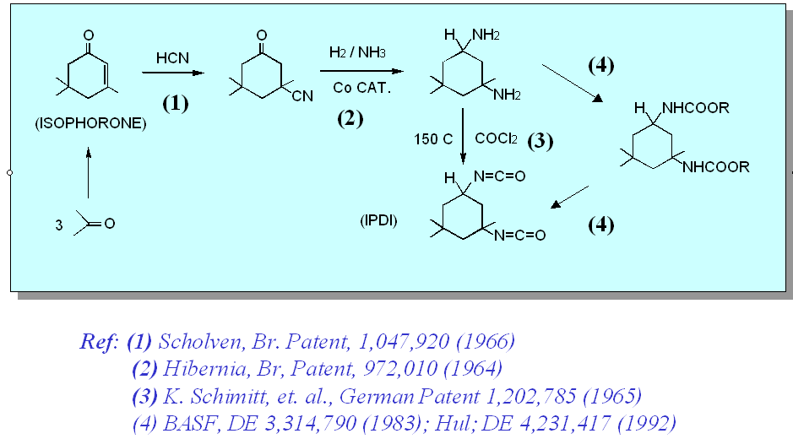
Green Chem-2014 Philadelphia
NPR to IPDI : Urea Route
Applicable only to aliphatic diamine. (Bayer, Huls, BASF)
11
Franz M, USP 4,596,678(1986)
Shdai-140727

Slide 17


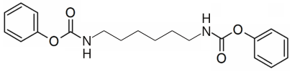


Green Chem-2014 Philadelphia
NPR to Aliphatic Diisocyanates : Review of Prior Arts
200g/hr
5L storage tank
＋
2
50℃
Continuous
Process
Excess
1,6-Hexanediamine
(HDA)
Diphenyl carbonate
(DPC)
Phenol
Hexane-1,6-bis(phenyl carbamate)
(4) Carbonylation
MW=116.21
【244g/116.21=2.1mol】
MW=214.22
【1350g/214.22=6.3mol】
MW=94.11
【987g/94.11=10.5mol】
Vacuum
Distillation
Thin film
Distillation
Column
(D=5cm 、L=2m)
● Total operation time= 10 day
● Hexane-1,6-bis(phenyl carbamate) Yield= 99.5%
● DPC recycling rates= 99.9% ( 232℃、15KPa、119g/hr )
● Phenol recycling rates= 99.9% ( 230℃、1atm、200g/hr )
● HDI Yield= 95.3% ( 150℃、1.5KPa、140g/hr )
● HDI Purity= 99.8% ( L.C )
Japan Asahi ( phenol system )
＋
Thermolysis
( 150~230℃ )
( 1.3~15KPa )
Phenol
(5) Thermolysis
Phenol as solvent and DPC as carbonylation agent
Most similar to our approach for aliphatic iso
Slow processing speed
Hexamethylene-1,6-diisocyanate
32
[24] M. Shinohata, N. Miyake, EP 2275405(2011) to Asahi
Shdai-131227
Shdai-131227
Shdai-140727

Slide 18
Green Chem-2014 Philadelphia
Principal Carbonylation Agents
>>
>>
>
(Phosgene) (di-t-butylcarbonyl carbonate) (DPC, diphenyl carbonate)
(di-alkyl carbonate) (DMC, dimethyl carbonate) (urea) (carbon monoxide) (carbon dioxide)
>
>
>
>
16
Shdai-140727

Slide 19
Green Chem-2014 Philadelphia
Dai’s Group - 4,4’-MDI and P-urea Processes
(1) DPC carbonylation of MDA (2) Thermolysis to make MDI (3) NIR to Polyurea
MDA
Aniline
Benzoic acid
(1) Carbonylation
(2) Thermolysis
MDA-DPC
MDI
(3) Trans-esterification
Polyurea
17
Shdai-140727

Slide 20
Green Chem-2014 Philadelphia
Potential Sources of DPG for NPR to MDI
(1) DPC/Benzoic acid /cat.
(2)
(3) Transesterification
18
Shdai-140727

Slide 21
NPR- Our Optimization of 4,4’-DP-MDC Synthesis
Green Chem-2014 Philadelphia
Benzoic acid
identified
DPC/MDA = 6.0
5m% >
Fig 1. Effect of carboxylic acids
of different pKas on
4,4’-DP-MDC yields.
Fig 3. Effect of diphenyl carbonate
concentrations on
4,4’-DP-MDC yields.
Fig 2. Effect of different benzoic acid
amounts on 4,4’-DP-MDC yields.
Compositionª | Biscarbamate Yield (%) | Urea Yield(%)^{b}
4,4’-MDA/DPC/Benzoic acid(1/6/0.2/0) | 65 | 1.06
4,4’-MDA/DPC/Benzoic acid/Pyridine(1/6/0.2/0.009) | 97 | 0.15
4,4’-MDA/DPC/Benzoic acid/TEDA(1/6/0.2/0.009) | 99 | 0.15
ªMolar ratio. At 40 C ~60 C ^{b}Calculated by ¹H-NMR analysis.
Catalyzed by pyridine or TEDA.
19
Shdai-140727

Slide 22
Green Chem-2014 Philadelphia
NPR-Mechanism of Carbonylation:
Co-catalyzed by benzoic acid/tertiary amine
(carbamate)
Key active intermediate anhydride A in carbonylation of amine
20
Shdai-140727

Slide 23
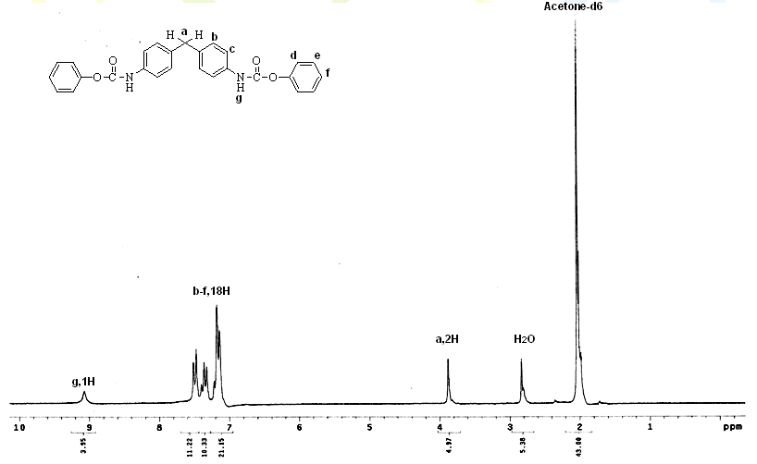
Green Chem-2014 Philadelphia
NPR- MDA Carbonylation with DPC
( IR and ¹H-NMR of the MDA-DPC; mp 194 ℃)
IR ¹H-NMR
MDA-DPC/dodecane: No detection of diphenyl urea formation
21
Shdai-140727

Slide 24
Green Chem-2014 Philadelphia
NPR-Thermolysis of MDI-DPC into MDI (a)
(Monitoring Thermolysis of MDA-DPC 200℃in Dodecane )
22
Shdai-140727

Slide 25
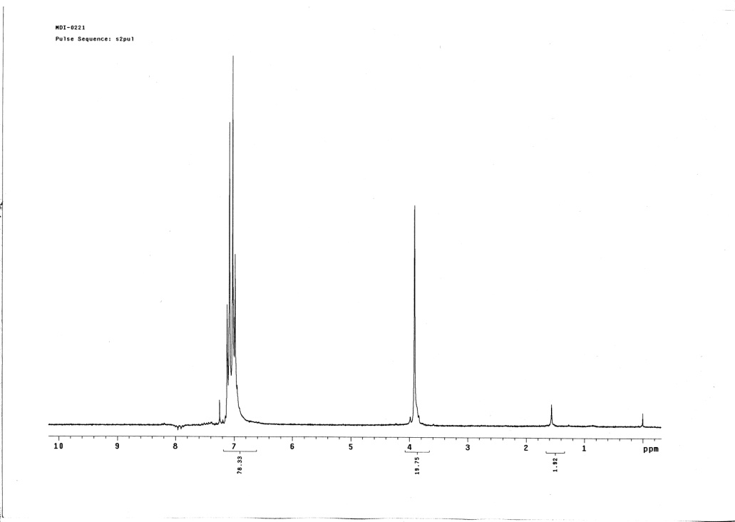
Green Chem-2014 Philadelphia
NPR- Thermolysis of MDA-DPC into MDI
Isolated MDI (76%) after fractionation
23
Shdai-140727

Slide 26
Green Chem-2014 Philadelphia
NPR- Thermolysis of MDA-DPC into MDI (b)
Summary of Lab-scale MDI Synthesis
Carried out in dodecane (bp:216℃) at boiling temperature
MDA-DPC conversion rate at 100%
MDI crude yield >95%; Purified after distillation >76 %
Recovered solvent and phenol >95%
Little (CDI) by-product formation in the heating
No chlorine content in the product
The use of polar solvent resulted in complicated products.
24
Shdai-140727

Slide 27
Green Chem-2014 Philadelphia
Trans-amination of Ph-carbamate in Different Solvents
( B. Thavonekham, Synthesis, 1997, 1189-1194 )
Solvent | DMSO | DMF | THF | MeCN | Dioxane | DME | CHCl₃ | MeOH | Pyr | TMS
結構式
Bp(℃) | 189 | 153 | 65 | 81 | 100 | 64 | 60 | 65 | 115 | 285
Relative Polarity (water=1) | 0.444 | 0.404 | 0.207 | 0.46 | 0.164 | - | 0.259 | 0.762 | 0.3 | 0.41
Condition | rt | rt | reflux | rt | reflux | rt | rt | rt | rt | 70
Time | 15min | 15min | 5h | 1h | 5h | 24h | 24h | 24h | 2.5h | 2h
Yield(%) | 96 | 74 | 92 | 79 | 65 | 92 | 90 | 74 | 85 | 89
25
Shdai-140727

Slide 28
Green Chem-2014 Philadelphia
NIR-MDA-DPC and Diamines into Polyurea
NIR to P-urea
MDA-DPC Short Chain Extender Long Chain Diamine
Polyurea Elastomers
26
Shdai-140727

Slide 29
Green Chem-2014 Philadelphia
NIR: Polyurea from MDA-DPC and Diamines
Solvent Diamines Extender Hard Segment% Mol. Wt
DMSO Jeffamine-2000 1,6-HAD 57 54,400
DMSO Jeffamine-2000 PPG-230 61 71,000
DMSO Jeffamine-2000 1,8-diamino-3,6-dioxetane 58 131,000
TMS Jeffamine-2000 1,6-HAD 46 79,000a
(59,676)b
TMS Jeffamine-2000 H12-MDA 40 84,269a
(68,000)b
TMS Jeffamine-2000 IPDA 40 61,338a
(57,170)b
Run at 60~100℃ in DMSO as the solvent. (Hard to separate with PhOH )
Run at 60~140℃ in TMS with recovering of phenol/TMS
a. Distilled phenol+ TMS b. just distill phenol after the reaction
27
Shdai-140727

Slide 30
Green Chem-2014 Philadelphia
NIR- Polyurea Prepared in TMS
Run No. | Polyurea | Tdª (℃) | Tg (℃) | Yield (%) | Tensile Strength (MPa) | Elongation (%) | η_{inh} | TMS Recovery (%) | Phenol Recovery (%)
9 | H₁₂MDA-90-DBª | 290 | -56.9 | 97 | 25.5 | 425.4 | 0.71 | 95 | 88
12 | HDA-90-DB | 287 | -59.3 | 86 | 10.4 | 547.8 | 0.42 | 92 | 79
14 | m-XDA-90-DB | 280 | -58.4 | 98 | 3.6 | 186.1 | 0.35 | 94 | 87
15 | IPDA-90-DB | 282 | -57.3 | 100 | 16.9 | 1003.4 | 0.46 | 95 | 91
ª 5% weight loss. ^{B} Distillation (140℃, 7×10⁻³ mmHg, 1h).
28
Shdai-140727

Slide 31
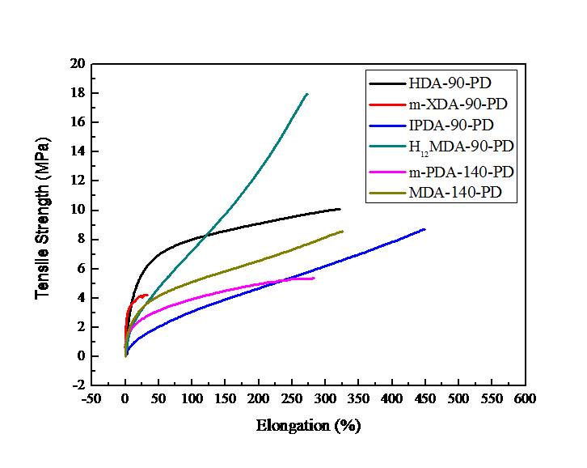
Green Chem-2014 Philadelphia
NIR-MDA-DPC Polyurea Prepared in TMS
29
Shdai-140727

Slide 32
“Non-Phosgene Route (NPR) to Aliphatic Diisocyanates”
NPR to Aliphatic Diisocyanates
Wei-Hsing Lin (Lin, W-S; Ph. D Candidate; NCHU)
30
Shdai-140727

Slide 33
Green Chem-2014 Philadelphia
Our Overall 2-Step NPR Scheme: HDI, DDI, BDI, IBI (4) (5)
Advantages: a. Reactivity DPC>> DMC; b. Lower temperature for isocyanate generation
Aliphatic ISO:
Mixed ISO:
Pyrolysis
DDA
DM-BPC
DDI
EGDEE
Diphenyl ether
25℃ for 2hr
Pyrolysis
DPC
HDA
HM-BPC
HDI
(4) Carbonylation (5) Pyrolysis
Pyrolysis
BDA
BM-BPC
BDI
EGDEE
Benzoic acid
Pyrolysis
60℃ for 9hr
1-isocyanato-4-
(isocyanatomethyl)benzene; IBI
DPC
ABA-DP-Biscarbmate
33
Shdai-140727

Slide 34
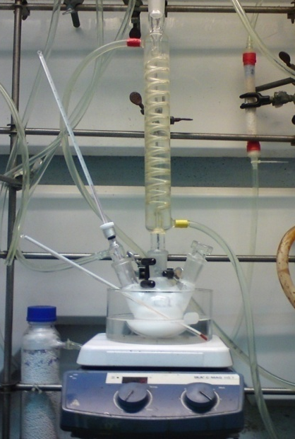
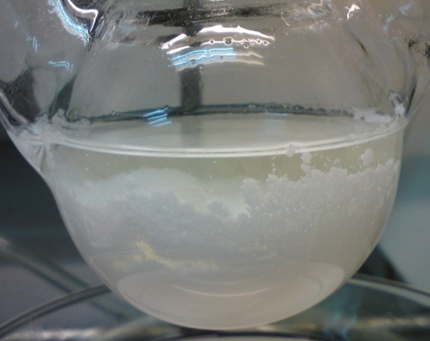
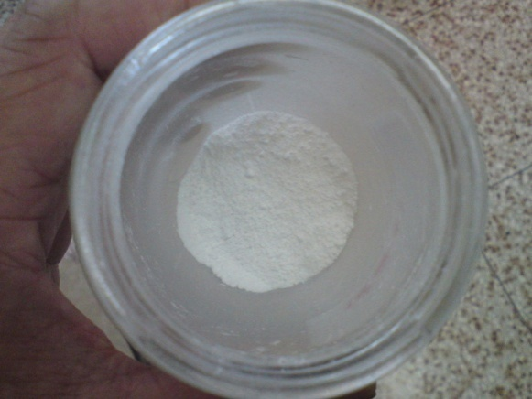
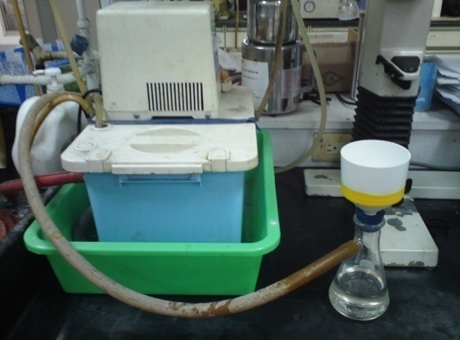
Green Chem-2014 Philadelphia
(4) NPR First Step: Carbonylation of 1,12-dodecane Diamine
Overnight
(RT)
25℃、2hr
75℃、20min
EGDEE; Recrystallization
Filtration
65℃、2hr
(Vacuum)
34
Shdai-140727

Slide 35
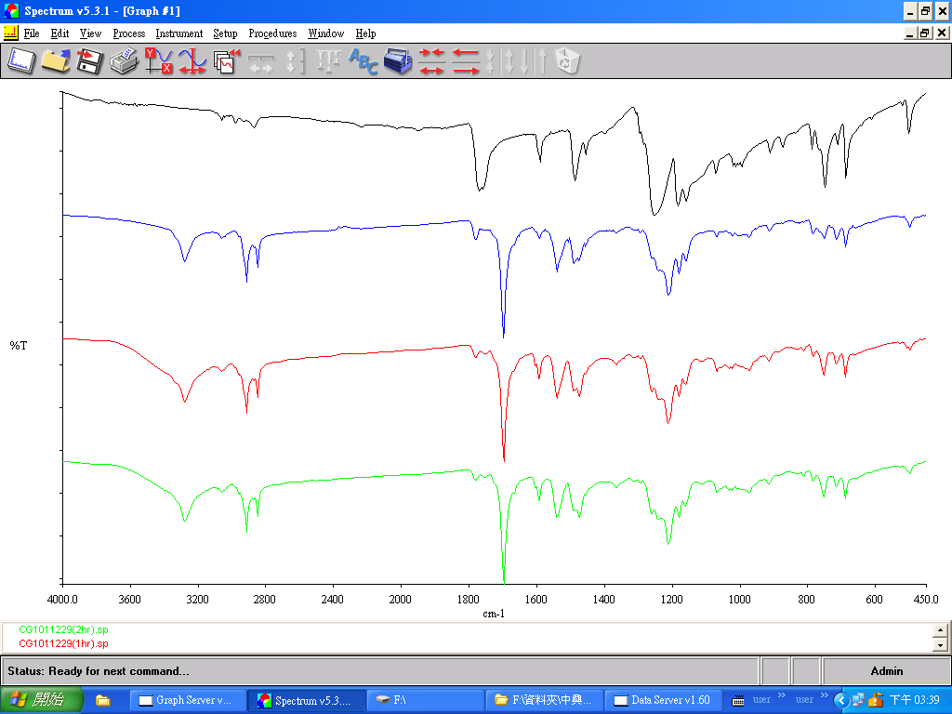
Green Chem-2014 Philadelphia
NPR- Monitoring of Carbonylation by IR: C12 Diamine
1777cm⁻¹(C=O)
【DPC】
25℃、0hr
25℃、10min
3280cm-1(N-H)
【Stretching 】
25℃、1hr
1698cm⁻¹(C=O)
【DMBPC】
25℃、2hr
35
Shdai-140727

Slide 36
Green Chem-2014 Philadelphia
NPR First Step: Carbonylation Data of 1,12-dodecane Diamine
 | C-12 –biscarbamate preparation
Molar ratio | DDA：DPC＝ 1：2.05
Weight ratio | DDA：DPC＝ 5 g：10.96 g
Catalyst | Catalyst-free
Nitrogen flux | N2 =0.3L/min
Reaction solvent | EGDEE＝ 48 g （S.C=25% ）
Reaction Temp. | 25℃
Reaction time | 2hr
DMBPC Yield | 98％
Urea yield | Non
Melting point | 121.5℃ ~ 122.4℃
36
Shdai-140727

Slide 37
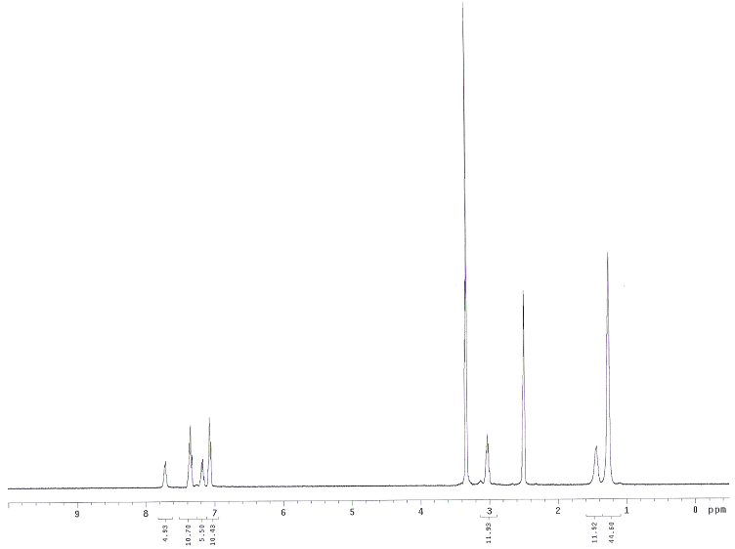
Green Chem-2014 Philadelphia
NPR- NMR of 1,12-Dodecamethylene-Bis-phenyl carbamate
37
Shdai-140727

Slide 38
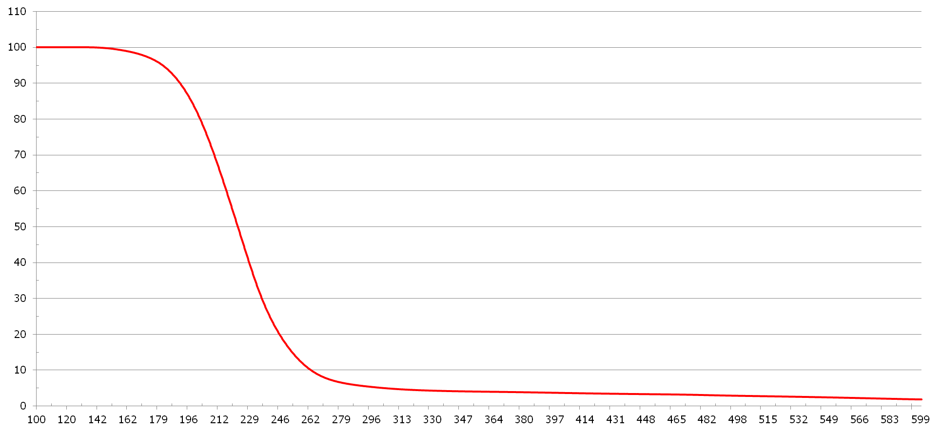
Green Chem-2014 Philadelphia
Thermo-Data of 1,12-Dodecamethylene-Bisphenyl carbamate
Td(5%)= 181.6℃
Td(50%)= 228℃
Mp =123 ℃
38

Slide 39
Green Chem-2014 Philadelphia
NPR to 1,6-hexamethylene-bis(phenyl carbamate)
 | C-6-biscarbamate preparation
Molar ratio | HDA：DPC＝ 1：2.05
Weight ratio | HDA：DPC＝ 215 g：813 g
Catalyst | Catalyst-free
Nitrogen flux | N2 =0.3L/min
Agitation speed | 200rpm
Reaction solvent | EGDEE＝ 2500 ml
Reaction Temp. | 25℃
Reaction time | 2hr
HMBPC Yield | 95％
Urea yield | Non
Melting point | 127℃ ~ 128.2℃
39
Shdai-140727

Slide 40
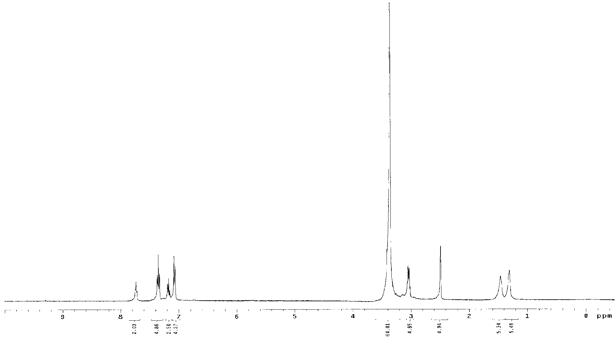
Green Chem-2014 Philadelphia
NPR- NMR of 1,6-Hexamethylene-Bis(phenyl carbamate)
[27] Luc Ubaghs, Isocyanate-free Synthesis of（Functional）Polyureas, Polyurethanes, and Urethane-
containing Copolymers , 2005, P.49
40
Shdai-131227
Shdai-140727

Slide 41
Green Chem-2014 Philadelphia
(4) Summary : Bis-Carbamate Preparations
Biscarbamates | DDI (C12) | HDI (C6) | BDI (C4)
Biscarbmate Yield | DMBPC 98% | HMBPC 98% | BMBPC 89%
Melting point (DSC) | 122.5 ℃ | 126.6 ℃ | 162℃
Td (TGA; 5%) | 181.6 ℃ | 147.4 ℃ | 167.7 ℃
1-isocyanato-4-(isocyanatomethyl)benzene
ABA-DP-Biscarbamate 85%
175.8 ℃
167.7 ℃
Aliphatic Bis-carbamates Mixed
Excellent yield of biscarbamates could be prepared from C12, C6 and C4 diamine/+DPC.
C4-biscarbamate crystal was contaminated ~ 6% of phenol that could not be separated.
Preparation of ABA-biscarbamate is best done in two step.
41
Shdai-140727

Slide 42
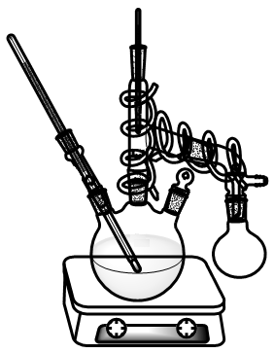
Green Chem-2014 Philadelphia
Typical Set-up for Thermolysis of Biscarbamates
Benzoyl chloride as stabilizer
Thermolysis
2
1,12-dodecamethylene-bis(phenyl carbamate)
Diphenyl ether
( bp = 82℃ at 3mmHg or
250 ℃ at atm pressure )
Dodecamethylene-1,12-diisocyanate
( bp = 168℃ at 3mmHg )
Themal sensor
(distillation)
Fractionation
column
Themal sensor
(inner)
Heating belt
Themal sensor
(outer)
Ice cool
42
Shdai-140727

Slide 43
Green Chem-2014 Philadelphia
NPR- (5) Data on Isolation C-12 -Diisocyanate
 |  | CG1020317
Weight |  | DMBPC＝ 5 g
Catalyst |  | Benzoyl chloride＝ 0.013 g
Nitrogen flux |  | Non
Solvent |  | Diphenyl ether＝ 45 g （S.C=10% ）
Pyrolysis | Initial NCO | 180℃
 | Maximum NCO | 254℃（ HMBPC disappeared after 0.5hr at 240 ℃ ）
 | Final | All NCO peaks disappear
Reactor byproduct |  | No yellow coking by-products
Flask (Ice cool) | Initial product | 240℃（ Phenol appeared for 0hr at 240 ℃ ）
 | Final product | 254℃（ Phenol appeared for 0.5hr at 240 ℃ ）
1,12-diisocyanatododecane Yield |  | 84％
Phenol recycling rate |  | 100％
43
Shdai-140727

Slide 44
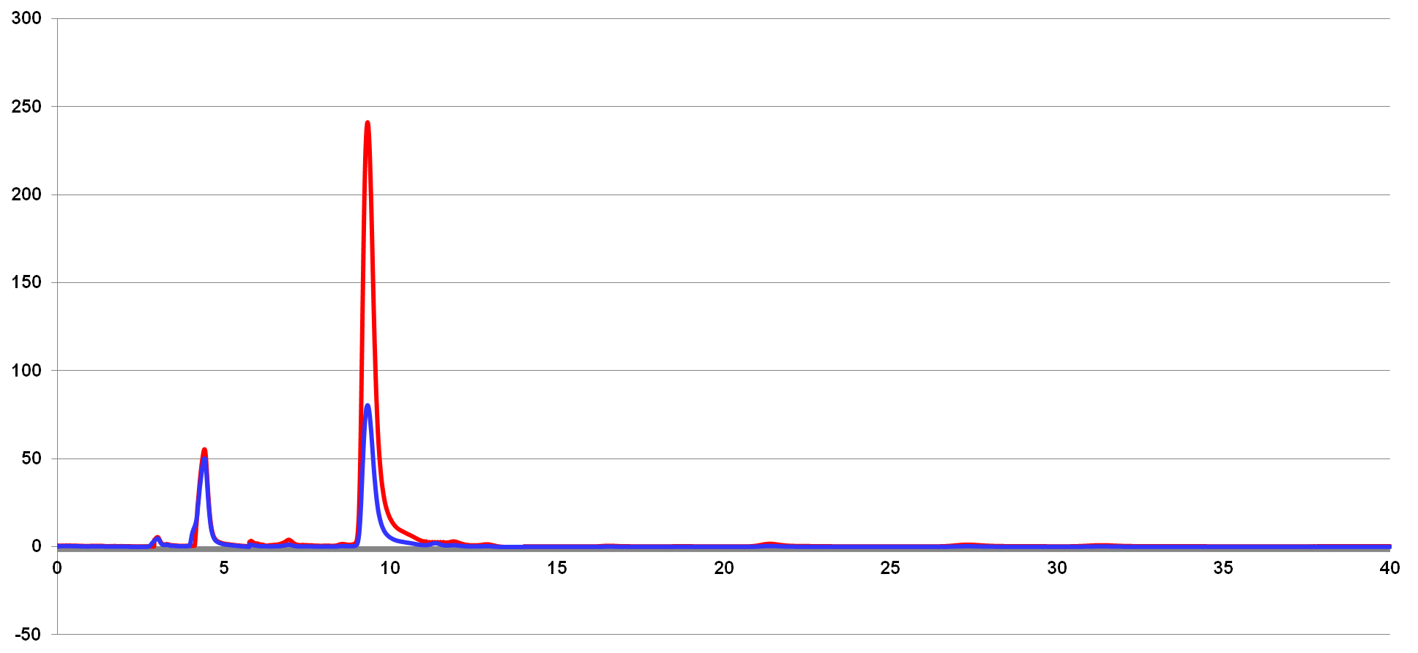
Green Chem-2014 Philadelphia
Quantitative Analyses of C12-(NCO)2 by Quenching
(by HPLC)
9.3
（DDU）
(1) Mobile phase= 55%Methanol + 45%H2O
(2) Wave length= 205nm
(3) Flow rate= 0.5ml/min
(4) Const flow rate
C12-(NCO)2 + MeOH
50mg DDU + 1ml Methanol
15mg DDU + 1ml Methanol
4.4
（Methanol）
Yield＝84%
minutes
44
Shdai-140727

Slide 45
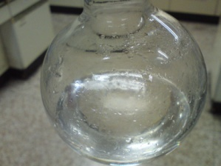
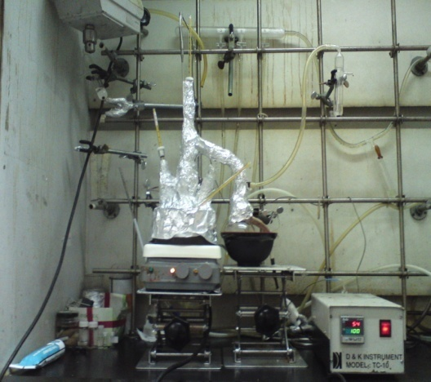
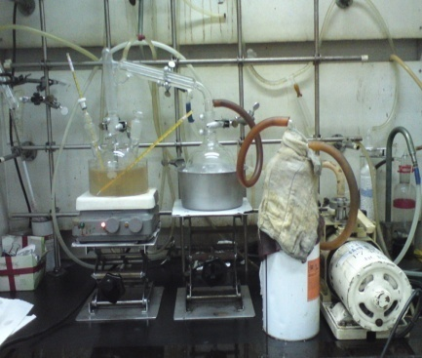
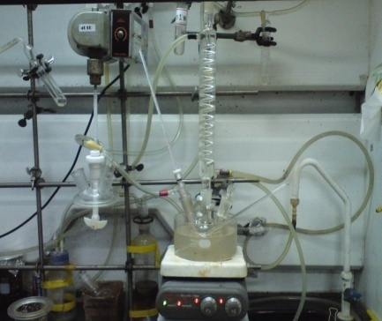
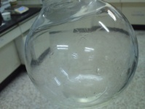
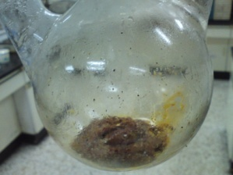
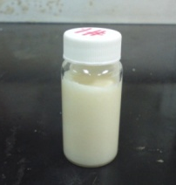
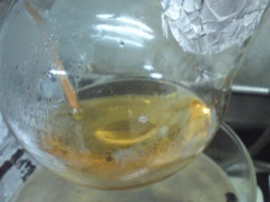
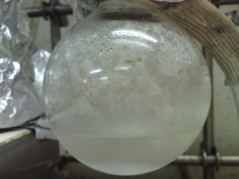
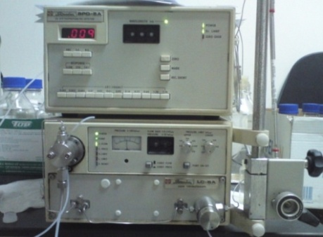
Experiment (3) – One-pot two-stage NPR process
DMBPC → DDI
SC = 18%
Pure Diphenyl Ether
(99%)
Separated by DDI and
Diphenyl Ether (Vacuum)
Pyrolysis
Pure DDI
(80%)
240℃、0.5hr
Monitoring
DDI by IR
Capped by 10X MEOH
(90 ℃ 1hr)
Quantitative analyses of DDU by HPLC
Reactor
(1) Mobile phase= 55%Methanol+ 40%H2O
(2) Wave length= 205nm
(3) Flow rate= 0.5ml/min
Reactor
Flask (100%phenol)
28

Slide 46
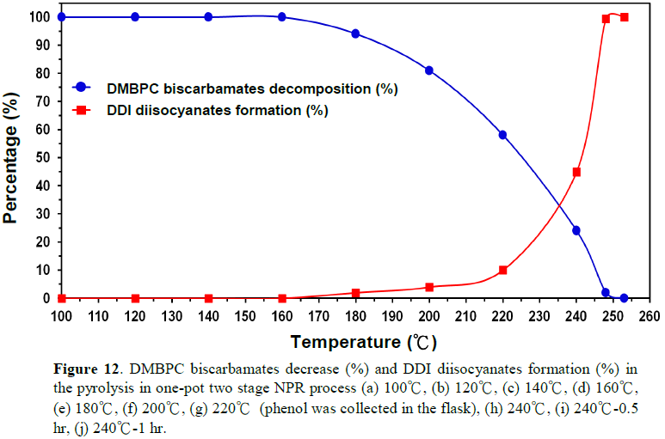
Experiment (3) – One-pot two-stage NPR process
DDI
(S.C= 18%)
Phenol appeared
(One-pot)
Figure 12. DMBPC biscarbamates decrease (%) and DDI diisocyanates formation (%) in the pyrolysis in one-pot two stage NPR process under 18% solid content in Diphenyl Ether at (a) 100℃, (b) 120℃, (c) 140℃, (d) 160℃, (e) 180℃, (f) 200℃, (g) 220℃ (phenol was collected in the flask), (h) 240℃, (i) 240℃-0.5 hr, (j) 240℃-1 hr.

Slide 47
Experiment (3) – One-pot two-stage NPR process
DMBPC → DDI | CG1030203
Molar ratio | DDA：DPC＝ 1：2.05
Weight ratio | DDA：DPC＝ 10 g：21.9 g ( SC=25% )
Catalyst | Catalyst-free
Nitrogen flux | N2 =0.3L/min
Agitation speed | 200rpm
Carbonylation solvent | Diphenyl Ether ( DPE )＝ 96 g
Carbonylation Conditions | 60℃、2hr
DMBPC Yield ( HPLC ) | 100％
Pyrolysis solvent | Diphenyl Ether ( DPE ) as pyrolysis solvent ( SC=18% )
Stabilizer (Benzoyl chloride) | None
Pyrolysis Conditions | 240℃、0.5hr ( 220℃→NCO, 220℃→Phenol )
Recycling rate | Phenol =100％、Diphenyl Ether =99％
Isocyanate Yield (HPLC) | Pure DDI=80%、Trimer=20%
22

Slide 48
Green Chem-2014 Philadelphia
Summary：One-pot two-stage NPR process
Summary：One-pot two-stage NPR process
Summary：One-pot two-stage NPR process
Summary：One-pot two-stage NPR process
Summary：One-pot two-stage NPR process
Two step (original process)
One-pot two-stage NPR process
 | DDI | HDI
Carbonylation solvent (Reaction S.C%) | EGDEE (25%) | EGDEE (25%)
Molar ratio | DDA : DPC =1 : 2.05 | HDA : DPC =1 : 2.05
Catalyst | none | none
Reaction condition | 25℃、2hr | 25℃、2hr
Biscarbmate Yield | 98% (DMBPC) | 98% (HMBPC)
Pyrolysis solvent (Reaction S.C%) | DPE (10%) | DPE (2.5%) | DPE (10%)
Cracked time (carbamate disappeared) | 240℃、0.5hr (254℃) | 240℃、2hr (254℃) | 240℃、1.5hr (254℃)
Stabilizer (Benzoyl chloride) | Exist (1 / 145 ) | none | Exist (1 / 145 )
Isocyanate Yield | DDI=84% Trimer=16% | HDI=76% Trimer=12% Biuret=8% | HDI=47% Trimer=14% Biuret=4% Allophanate=35%
DDI | HDI
DPE (25%) | DPE (25%)
DDA : DPC =1 : 2.05 | HDA : DPC =1 : 2.05
none | none
60℃、2hr | 60℃、2hr
100% (DMBPC) | 100% (HMBPC)
DPE (18%) | DPE (16%)
240℃、0.5hr (260℃) | 240℃、1hr (258℃)
none | Benzoyl chloride / HMBPC = 1 / 145 (molar ratio)
DDI=80% Trimer=20% | HDI=42% Trimer=34% Biuret=16% Allophanate=3%
Shdai-140727

Slide 49
Green Chem-2014 Philadelphia
Non isocyanate / Phosgene Route (NIR/NPR)
Chen, H.Y.; Pan, W. C.; Lin, C. H.; Huang, C.Y.; and Dai, S. A., Journal of Polymer Research, 19(2), 9754-9765,2012.
(DPC)
(5)
(4)
NIR
NPR
(DPC) (6) Trans-esterification
47
Shdai-140727

Slide 50
Green Chem-2014 Philadelphia
NIR- Method 1: One Step-One Pot Process
48
Shdai-140727

Slide 51
Green Chem-2014 Philadelphia
NIR- Method 2: Two-step Process with
Hard Segment Prepared First
49
Shdai-140727

Slide 52
Green Chem-2014 Philadelphia
NIR- Method 3: Two-step Process with
Soft Segment Prepared First
50
Shdai-140727

Slide 53
Green Chem-2014 Philadelphia
NIR- Monitoring by FT-IR in Method 3
51
Shdai-140727

Slide 54
Green Chem-2014 Philadelphia
Properties of NIR-PUaE
Methodª | HS^{b} (%) | Yield (%) | phenol recycle ratio (%) | η_{inh} | T_{d}^{c} (℃) | T_{g} (℃) | T_{c} (℃) | Elongation (%) | Tensile strength (MPa)
1 | 30 | 100 | 88 | 0.25 | 268 | -62 | / | 174 | 3.84
2 |  | 97 | 82 | 0.49 | 262 | -64 | 187 | 469 | 18
3 |  | 94 | 89 | 0.26 | 231 | -65 | 170 | 92 | 3.28
1 | 40 | 94 | 78 | 0.29 | 250 | -60 | 181 | 315 | 17.6
2 |  | 96 | 85 | 0.42 | 251 | -60 | 192 | 160 | 15.2
3 |  | 89 | 84 | 0.28 | 243 | -64 | / | 208 | 11.79
ª: Method of synthesis(1 :one pot ; 2: two steps-Hard first ; 3: two steps-Soft first) ^{b}: Hard segment ratio ^{c}: 5% weight lose temperature
52
Shdai-140727

Slide 55
NIR- Polyurea Analysis of GPC
Green Chem-2014 Philadelphia
Section 2
Section 3
Section 1
Method | Area (%) |  |  | η_{inh}
 | A1 High Molecular Region | A2 Median Molecular Region | A3 Low Molecular Region
1 | 37% | 45% | 18% | 0.25
2 | 44% | 33% | 23% | 0.49
3 | 11% | 83% | 6% | 0.26
53
Shdai-140727

Slide 56
Green Chem-2014 Philadelphia
NIR- Method 4: Three-steps Process
54
Shdai-140727

Slide 57
Green Chem-2014 Philadelphia
NIR- Monitoring by FT-IR in Method 4
55
Shdai-140727

Slide 58
Green Chem-2014 Philadelphia
Properties of NIR-Polyurea(Method 4)
short chain diamine (1) | short chain diamine (2) | long chain diamine | HSª (%) | Yield (%) | phenol recycle ratio (%) | η_{inh} | T_{d}^{b} (℃) | T_{g} (℃) | Elongation (%) | Tensile Strength (MPa)
HDA | IPDA | D2000 | 30 | 94 | 96 | 0.56 | 264 | -56 | 664 | 15.6
HDA | IPDA | ED2003 |  | 89 | 100 | 0.64 | 298 | -60 | 1462 | 0.98
MDA | IPDA | D2000 |  | 68 | 65 | 0.23 | 283 | -55 | 64 | 0.43
HDA | IPDA | D2000 | 40 | 83 | 44 | 0.62 | 284 | -61 | 469 | 33.4
ª: Hard Segment ratio ^{b}: 5% weight lose temperature
56
Shdai-140727

Slide 59
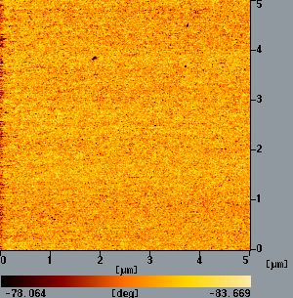
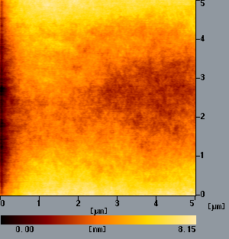
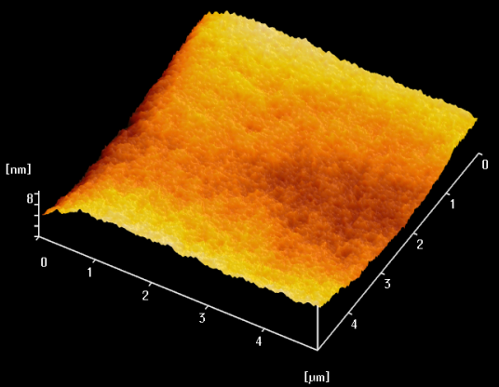
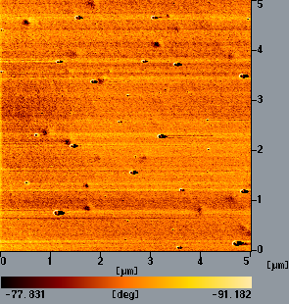
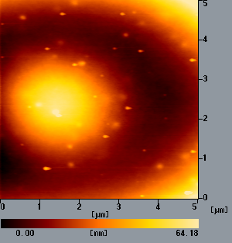
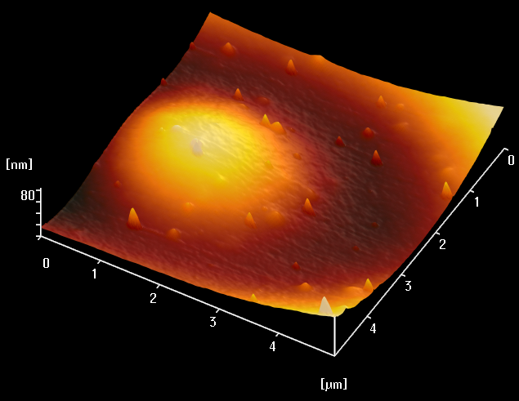
Green Chem-2014 Philadelphia
Analysis of AFM
3D-display
Method 1
pmPUaE(DPC-D2000-IPDA)
roughness:1.09nm
Method 2
hSPUaE(DPC-IPDA-D2000)
roughness:11.06nm
57
Shdai-140727

Slide 60
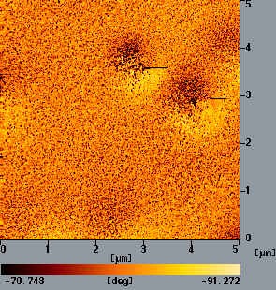
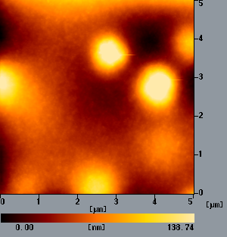
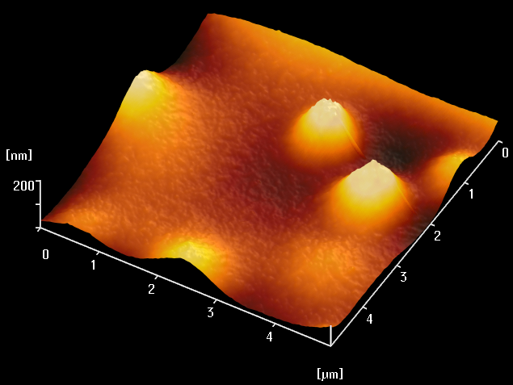
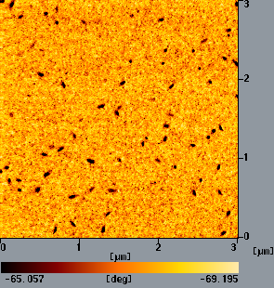
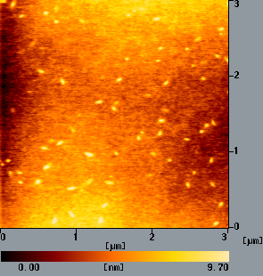
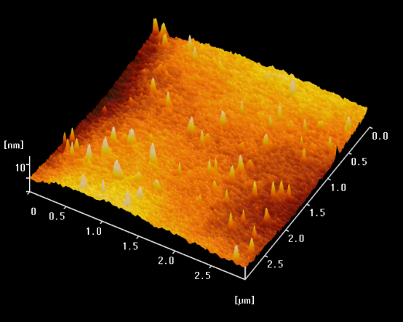
Green Chem-2014 Philadelphia
Analysis of AFM
Method 3
sSPUaE(DPC-D2000-IPDA)
roughness:18.85nm
Method 4
SPUaE(HDA-DPC-D2000-IPDA)
roughness:12.7nm
58
Shdai-140727

Slide 61
Green Chem-2014 Philadelphia
NIR -Conclusion
Method 1：One step → Random → no phase separation
Method 2：Hard segment first →gathered hard segment → clear phase separation and better properties
Method 3：Soft segment first → scattered hydrogen bond → small phase separation and poor properties
Method 4：Three steps → high MW and phase separation
59
Shdai-131227

Slide 62
Green Chem-2014 Philadelphia
NIR Process with DPC
Advantages of our PUaE:
  Raw materials (DPC and diamines) are inexpensive.
  Low chlorine in PUaE
  Can synthesize segmented PU elastomers
  Mechanical and thermal properties of PUaE are better than traditional PU.
  In line with the principles of green chemistry
  Lower capital expenses for scaling-up
Disadvantages:
- phenol/TMS recovery and recycle
60
Shdai-131227

Slide 63
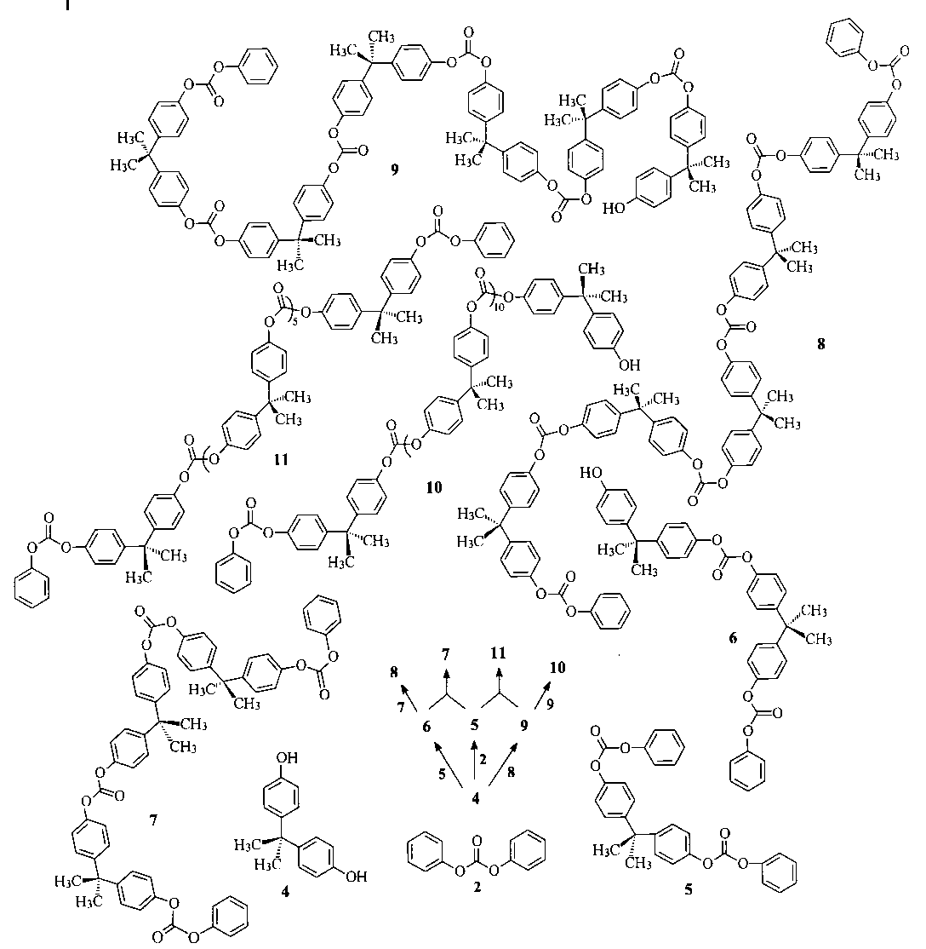
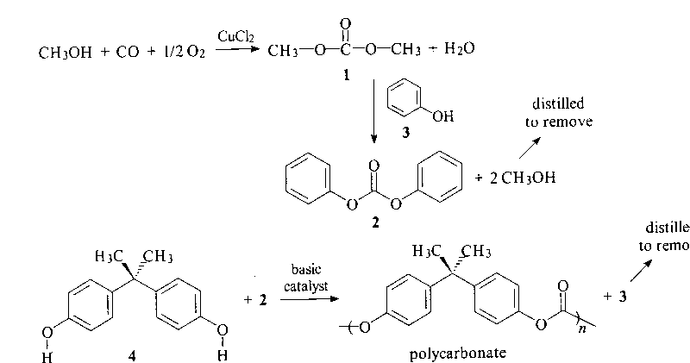
Green Chem-2014 Philadelphia
Non-phosgene Route to PCs
In essence, our NPR process to PU is comparable to that BPA to PC of Asahi’process both using DPC as the key reagent. (taken from Principle of Indstrial Organic Chemistry)
59a
Shdai-140727

Slide 64
Green Chem-2014 Philadelphia
Non-Isocyanate Route to Polyurethane
via Cyclic Carbonates
Ring-opening reaction with no by-product generation
+
Cyclo bis(carbonate)s
Diamine
Polyurethane
Oleg L.Figovsky,Features of Reaction Amino-cyclocarbonate for Production of New Type Nonisocyanate Polyurethane Coatings. Macromol.Symp, 2002,187(325~332)
63
Shdai-140727

Slide 65
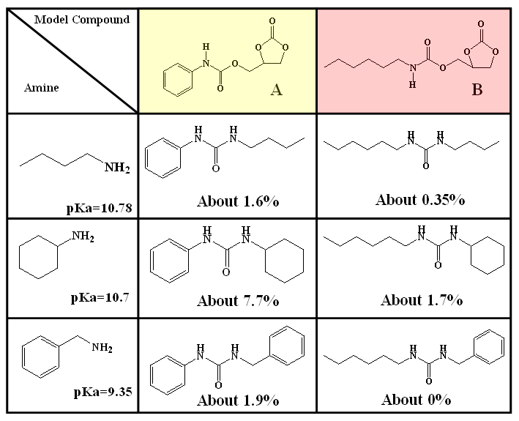
Green Chem-2014 Philadelphia
(7) Products Found in CC-Amine Reactions
a
a
(ring-opening)
b
b
+
(trans-amination)
Ring-opening of Glycerin cyclic carbonate
formed un-desirable urea by-products in 0.3~8%
使用Model compound C (由epoxy合成之CC) 並無出現副產物的問題
所以在製備NIPU時,盡量使用Compound C types之CC進行non-isocyanate為佳.
65
Shdai-140727

Slide 66
Green Chem-2014 Philadelphia
(7) Comparison of PU and NIPU
Conventional PU (Iso/alc.)
NIPU using CC/ amines
The system must be strickly free from water until used.
The hydrolytically unstable chemical bonds.
The use of toxic/reactive isocyanate.
Porous-free and moisture-insensitive.
Intermolecular hydrogen bond endow NIPU with good properties.
Without using isocyanate.
66
Shdai-140727

Slide 67
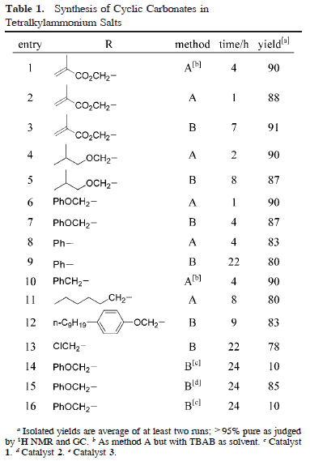

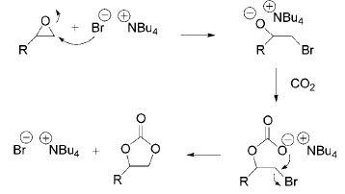
Green Chem-2014 Philadelphia
(7) Cyclic Carbonate Formation from CO₂ and Oxiranes
V. Calo, A. Nacci, A. Monopoli,Org. Lett. 2002,4,2561-2563
67
Shdai-140727

Slide 68
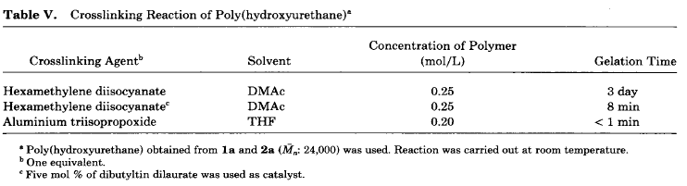
Green Chem-2014 Philadelphia
(7) Crosslinked PU from HAD/CC from BPA-DGE
CO2
BPA-DGE (Epoxy)
HDI
Aluminium triisopropoxide
Crosslinking PU
68
N. Kihara, T. Endo, J. Polym, Sci, 1993,31,2765-2773
Shdai-140727

Slide 69
Green Chem-2014 Philadelphia
Chen Kan-Nan’s Crosslinking Approach
J. Polym. Res., 2012, 19, 9900
69
Shdai-140727

Slide 70
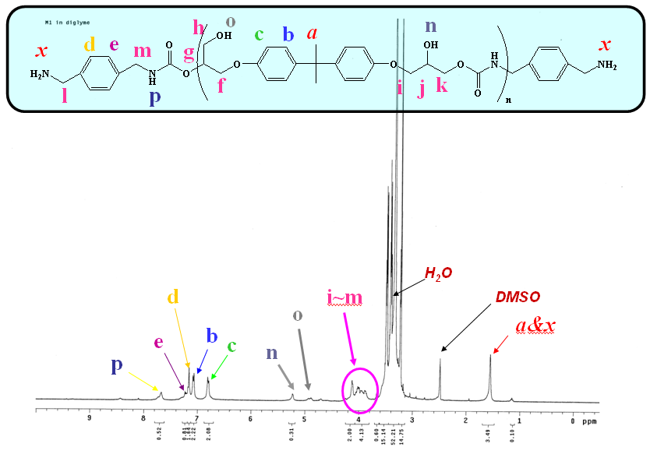
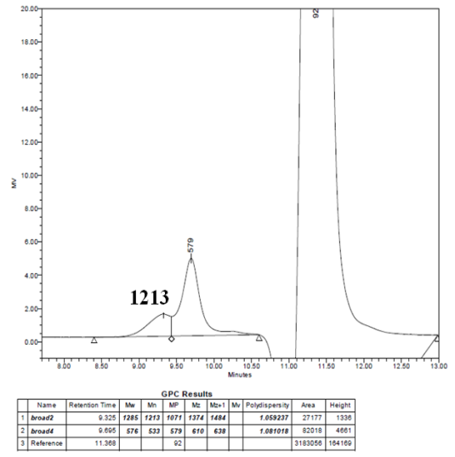
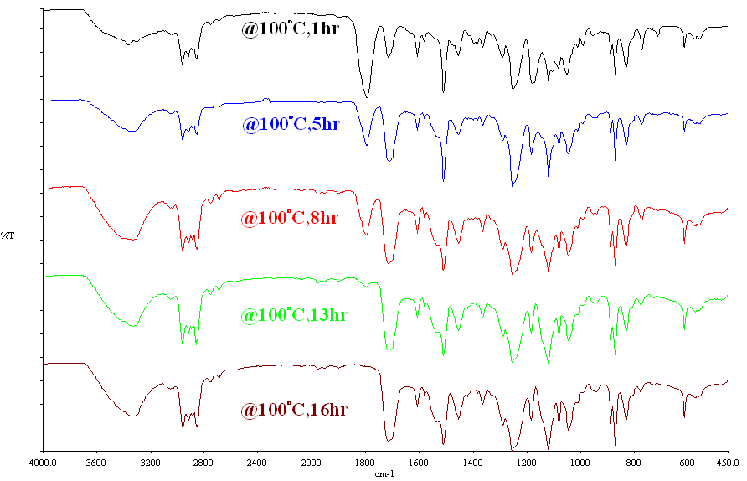
Green Chem-2014 Philadelphia
(7) : Synthesis of M1 Prepolymer
Diglyme
BCS
@ 100°C，16hr
M1
GPC
IR
¹H-NMR
70
Shdai-140727

Slide 71
Green Chem-2014 Philadelphia
(7): Chain Extending of M1 Prepolymer with Blocked Isocyanate
BI-7950(50%,75%,100%)
BI-7960(50%,75%,100%)
BI-7982(50%,75%,100%)
Chain Extending by Adding Blocked
Isocyanate
其中(50%,75%,100%)
代表其末端胺的反應程度
PU(MBI-79XX-XX)
1.由Epoxy Resin(BE-188)合成出的Amine-terminated prepolymer 不會出現 urea by-product, 但其分子量約在1200左右,而加入了商業化的Blocked isocyanate作鏈長時,其分子量呈現多區塊的分布,無法避免仍存在小區塊分子產生.
2. 由添加的blocked isocyanate之不同,交聯程度增加,可看見大分子區塊面積些微增加,第一區塊比例由4%~10%,區塊由三個(MBI 7950)變為四個(MBI-7982)最佳.
3.但主區塊的分子量成長有限,此部份仍未完全作最佳化.
71
Shdai-131227

Slide 72

Green Chem-2014 Philadelphia
FTIR Monitoring of Preparing
BCS I+ 1,4-Bis(3-aminopropyl)-piperazine at eq ratio 1.25:1
in DMAc
產物命名: BCS type-amine-BCS過量比例-solvent-溫度-solid content
若沒特別註明溫度為100°C solid cotent 為 low
72
Shdai-140727

Slide 73

Green Chem-2014 Philadelphia
Reaction of BCS II with1,4-Bis(3-aminopropyl)-piperazine
+
1,4-Bis(3-aminopropyl)-piperazine
@100°C
In anisole
Tg = 78.1 C
Td (5%) = 274 C
Char Y = 1.64%
E% = 7%
TS = 20.84 Mpa
%wt increase in water = 0.23% (2wks)
 | Mn | MW | PD
20130903 | 56,192 | 846,578 | 15.0657
73
Shdai-140727

Slide 74
Green Chem-2014 Philadelphia
Reaction of BCS II with1,4-Bis(3-aminopropyl)-piperazine
In Anisole Solution
Cyclic carbonate
Carbamate
No sign of urea
74
Shdai-140727

Slide 75
Green Chem-2014 Philadelphia
Keys to High Molecular Weights PUs from Ring- Opening of CC
Selection of reactive diamines and bis-cyclic carbonates
Suitable solvent to maintain efficient mixing
High shear mixing of high viscosity products
Mild reaction without by-product formation (< 100 C)
Promoted by efficient catalyst: (Data obtained in different reaction time)
75
Shdai-131227

Slide 76
Green Chem-2014 Philadelphia
Summary
Successful NPR Developed Using DPC as Carbonylating agent:
MDA MDI
HMDA + DPC Biscarbamates HDI
DDA DDI
Successful Polyurea Elastomers Development via NIR
△
200-240℃
Biscarbamates
DPC
Polyurea Elastomers
HMDA/Jeffamine2000/IPDI
(One-pot three step)
PU Plastics Synthesized through NIR:
CC from Epoxy(BPA DGE)+Diamine
△
△
PU (In Progress)
76
Shdai-140727

Slide 77
Green Chem-2014 Philadelphia
Other NIR Process under Study(Dai Group)
(PC recycle and re-use as PU)
(GMA to ODMA to PU-acrylate/ DSM)
(Biscarbamate as blocked isocyanate)
Poly-(IPP-cyclic carboanate)
A.
B.
C.
D.
77
Shdai-140727

Slide 78
Green Chem-2014 Philadelphia
Acknowledgements
大東公司(GRECO) 新力美(DSM)
National Science Concil of Taiwan
Chen, S. Y ^{(MDI) ;}
Pan, Elisa ^{(Polyurea elastomers)}
Lin, W-S ^{(HDI,DDI)}
Ku, K.T.^{(CC to PU)} Li, 紫菁^{(CC to PU)}
78
Shdai-140727

Slide 79


Green Chem-2014 Philadelphia
(4)
(3)
Dai’s Group - 2013
Chen, 陳學永
Ku, 顧冠增
Pan, 潘玫蓁
Li, 李紫菁
Lin, 林維興
(2)
(1)
(3)
Dai’s Group - 2012
79
Shdai-140727

Slide 80
Let Us Meet Again
We welcome you all to our future conferences of OMICS Group International
Please Visit:
www.omicsgroup.com
www.conferenceseries.com
www.pharmaceuticalconferences.com

