Slide 1

Caring for the older patient with cancer
Ranjita Pallavi, MD
Fellow, Department of Hematology and Oncology
Westchester Medical Center
New York

Slide 2
Overview
Cancer is the leading cause of death for those 60-79 years
60% of all cancers occur in patients who are 65 years or older
Older individuals are more prone to develop cancer due to physiological changes associated with aging

Slide 3
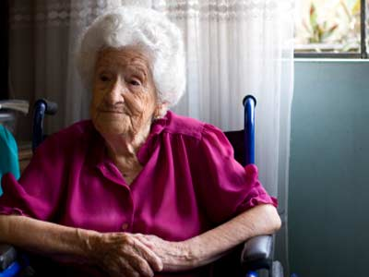

Age 80 with High Risk Cancer:
What treatment will you recommend?
To weigh the risks and benefits
Functional Age vs.
Chronological Age

Slide 4
What is old?
65

Slide 5
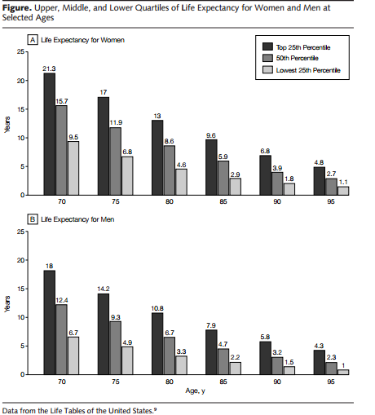
Remaining Life Expectancy
Walter et al. JAMA 2001

Slide 6
Initial Assessment
Who is the patient?
What are the co-morbidities?
What is the risk for
chemotherapy toxicity?
Are the risk factors modifiable?
Perform a
Geriatric
Assessment

Slide 7
Geriatric Assessment
Factors other than chronological age that predict morbidity & mortality in older adults
Functional status
Comorbid medical conditions
Cognition
Nutritional status
Psychological state
Social support
Medications (polypharmacy)
Comprehensive
Geriatric
Assessment (CGA)

Slide 8
Geriatric Assessment: Functional Status
Activities of Daily Living (ADLs)
Basic self-care skills
Dressing
Bathing
Toileting
Transfer
Continence
Eating

Slide 9
Assistance with ADLs
Predictive of:
  Prolonged hospital stay
  Worsening of function in the hospital
  Greater home care use
  Nursing home placement
  Death
Functional dependence associated with ↓ survival:
Assistance in > 1 ADLs: average life expectancy of < 3 yrs
Narain et al, JAGS 1988

Slide 10
Geriatric Assessment: Functional Status
Instrumental Activities of Daily Living
Higher order function
Required to maintain independence in the community
Shopping
Housekeeping
Transportation
Laundry
Telephone
Finances
Medications

Slide 11
Assistance in IADLs
Understanding need for assistance with IADLs is critical for cancer treatment planning:
- Transportation
- Medications
Predicts survival in older patients with NSCLC
Balducci et al, the Oncologist 2000
Maione et al, JCO 2005
Notes:
Barberger-Gateau: Functional impairment in instrumental activities of daily living: an early sign of dementia? J Am Geriatr Soc 1999;47: 456-462
Monfardini S. Validation of a multidimensional evaluation scale for use of for use in elderly cancer patients. Cance 1996: 77: 395-401

Slide 12
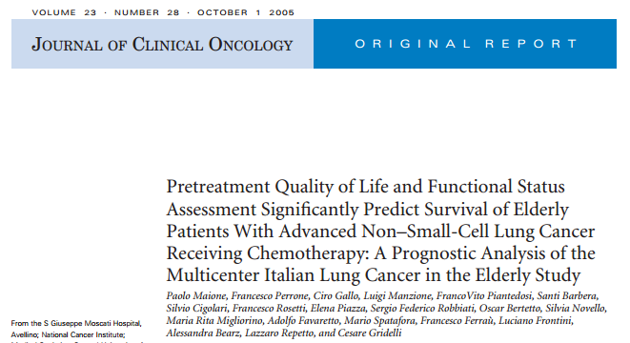
Impact of functional status on survival

Slide 13
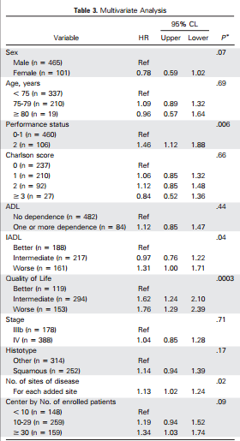
Impact of functional status on survival
Better values of baseline QoL (P.0003) and IADL (P.04) were signiﬁcantly associated
with better prognosis, whereas ADL (P.44) and Charlson score (P.66) had no prognostic
value. Performance status 2 (P.006) and a higher number of metastatic sites (P.02) also predicted shorter overall survival.

Slide 14
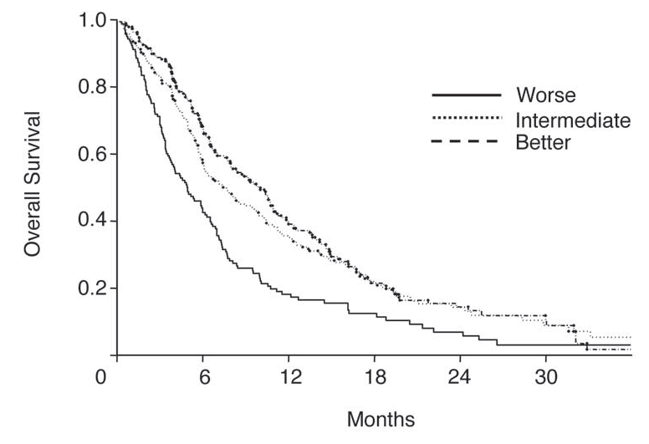
Assistance with IADLs → Worse Survival in Patients with Lung Cancer
Categories of IADLs:
Better:
Score of 100%
Intermediate:
Score of 51-99%
Worse:
Score of 0-50%
Better
Intermediate
Worse
Maione et al, J Clin Oncol, 2005
Notes:
14
shows that pre-treatment functional status predicts survival
-Purpose: prognostic value for overall survival of baseline assessment of functional status, comorbidity, and quality of life (QoL) in elderly patients with advanced non–small-cell lung cancer treated with chemotherapy.
-Sample: 566 patients; median age: 74
-Measures: functional status was measured as activities of daily living (ADL) and instrumental ADL (IADL).
-Findings: Better values of baseline QoL and IADL were significantly associated with better prognosis, whereas ADL and Charlson score had no prognostic value. Performance status 2 and a higher number of metastatic sites predicted shorter overall survival. Pretreatment global QoL and IADL scores, but not ADL and comorbidity, have significant prognostic value for survival of elderly patients with advanced non–small-cell lung cancer who were treated with chemotherapy. Baseline IADL had an independent prognostic role that appears mostly relevant for the lower quarter of patients.

Slide 15
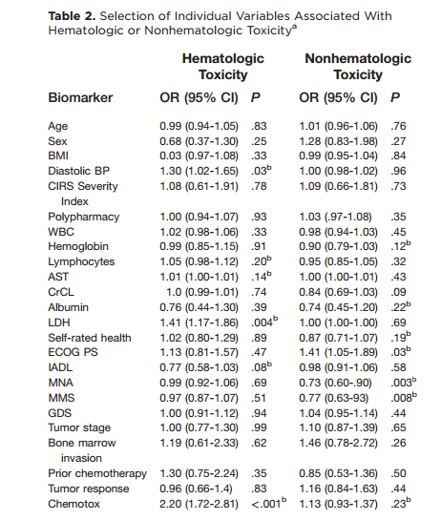
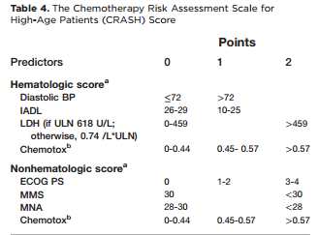
Extermann et al. Cancer. 2012
Predicting the Risk of Chemotherapy Toxicity in Older Patients: The Chemotherapy Risk Assessment Scale for High-Age Patients (CRASH) Score

Slide 16
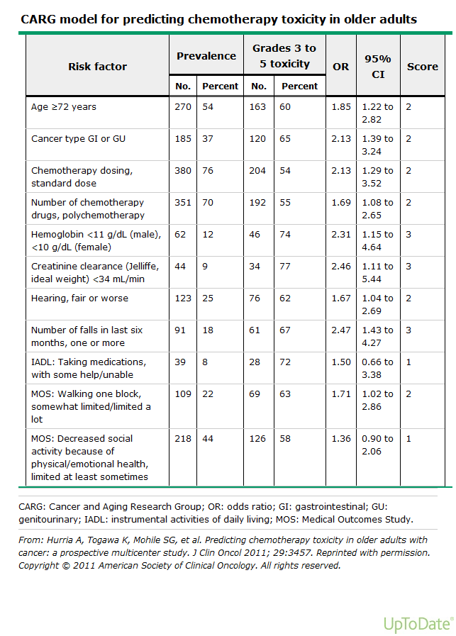
Predictors of chemotherapy toxicity
Geriatric Assessment Variables
Falls in the last six months
Limitations in walking one block
Need for assistance with taking medications
Decreased social activities
Hurria et al, J Clin Oncol, 2011

Slide 17
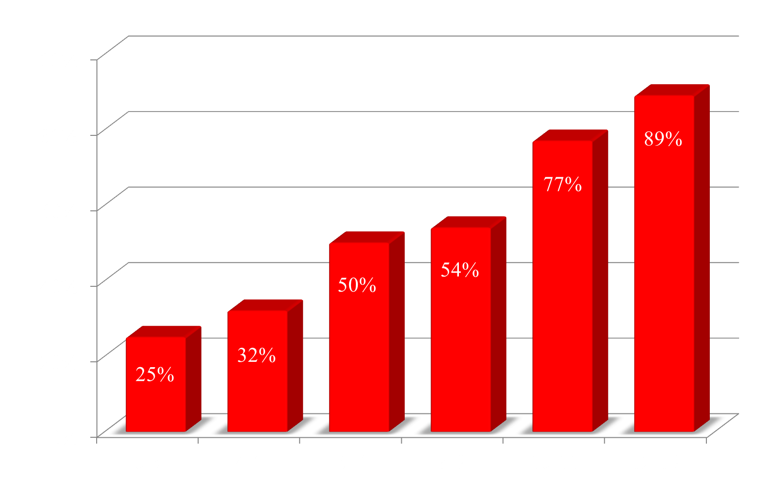
Risk of Toxicity by Score
High (83%)
Medium (52%)
Low (30%)
Grade 3-5 Toxicities
Total Risk Score

Slide 18
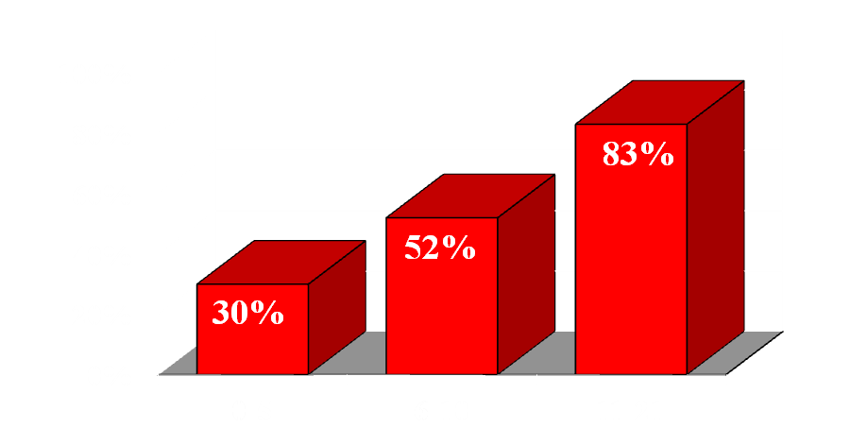
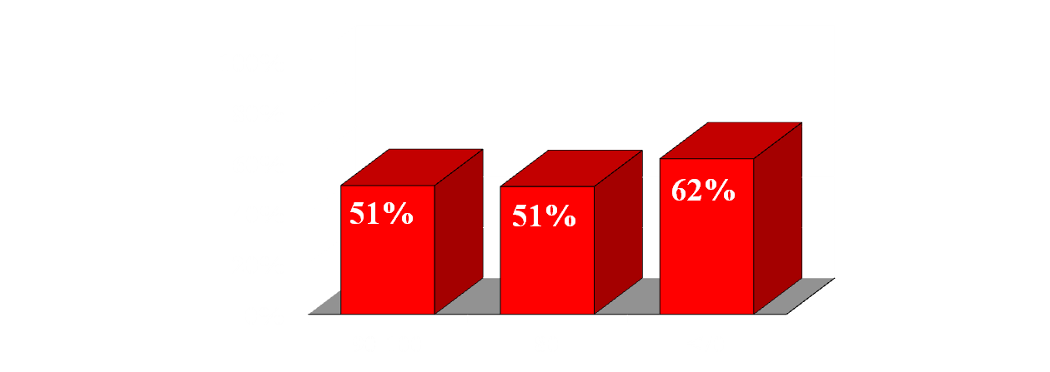
MD-rated KPS vs. Predictive Model
Low
Medium
High
Chi-square test p=0.19
Grade 3-5 Toxicities
MD KPS
High
Medium
Low
Chi-square test p<.0001
Predictive Model score

Slide 19
Updated Recommendations of SIOG on Breast Cancer in elderly patients: 2010
General health and functional status can be captured in a multidomain geriatric assessment
A screening assessment is a reasonable ﬁrst step in identifying patients that may beneﬁt from an extended CGA
Active intervention for CGA-identiﬁed reversible geriatric domains can reduce morbidity and mortality, and improve quality of life
Serial geriatric assessment can identify incident deterioration, for which intervention might improve outcomes

Slide 20
The G8 Screening Questionnaire
 | Items | Possible answers (score)
A | Has food intake declined over the past 3 months due to loss of appetite, digestive problems or chewing or swallowing difficulties? | 0: severe decrease in food intake 1: moderate decrease in food intake 2: no decrease in food intake
B | Weight loss during the last 3 months | 1: weight loss>3 kg 1: does not know 2: weight loss between 1 and 3 kg 3: no weight loss
C | Mobility | 0: bed or chair bound 1: able to get out of bed/chair but does not go out 2: goes out
E | Neuropsychological problems | 0: severe dementia or depression 1: mild dementia or depression 2: no psychological problems
F | Body Mass Index | 0: BMI <18.5 1: BMI 18.5-<21 2: BMI 21 to <23 3: BMI 23 and >23
H | Takes more than 3 prescription drugs per day | 0: yes 1: no
P | In comparison with other people of the same age, how do they consider their health status? | 0: not as good 0.5: does not know 1: as good 2: better
 | Age | 0: >85 yr 1: 80-85 yr 2: <85 yr
Total Score |  | 0-17
8 questions
Nurse administered
Takes 5-10 min to perform
-Appetite, weight loss, BMI
-Mobility
-Mood and cognition
-Number of medications
-Patient-related health
-Age categories
Abnormal if score <14
-Preliminary analysis
-Sensitivity: 89.6%
-Specificity: 60.4%
Bellera et al, Ann Oncol, 2012

Slide 21
Flemish TRST Screening Tool
Item | Score
 | Yes | No
Presence of cognitive impairment (disorientation, diagnosis of dementia, or delirium) | 2 | 0
Lives alone or no caregiver available, willing or able | 1 | 0
Difficulty with walking or transfers or falls in the past 6 months | 1 | 0
Hospitalized in the last 3 months | 1 | 0
Polypharmacy: > 5 medications | 1 | 0
Score >2 indicates a high risk geriatric profile
Kenis et al, Crit Rev Oncol Hematol, 2006

Slide 22
The Vulnerable Elders Survey (VES) 13 scale
Domain | Score
Age
75-85 | 1
>85 | 3
Self-rated health
Good, very good, and excellent | 0
Fair and poor | 1
ADL/IADL
Needs assistance with
Bathing or showering | 1
Shopping | 1
Money management | 1
Transfer | 1
Light housework | 1
Difficulty in special activities
Kneeling, bending and stooping | 1
Performance of housework | 1
Reaching out and lifting upper extremities above the shoulder | 1
Lifting and carrying 10 pounds | 1
Walking ¼ of a mile | 1
Writing or handling and grasping small objects | 1
Score >3: Vulnerable Elderly
Saliba et al, J Am Geriatr Soc 2001

Slide 23
Geriatric Assessment: Comorbidity
Definition:
Concurrent, independent health condition which may be a predictor of survival and resource requirements
Questions:
1) Is the patient going to die from cancer or another medical problem?
2) Will another medical problem limit the ability to tolerate chemotherapy?

Slide 24
Comorbidity Increases with Age
Number of
Comorbidity
Age (yrs)
Yancik et al, Cancer 1997

Slide 25
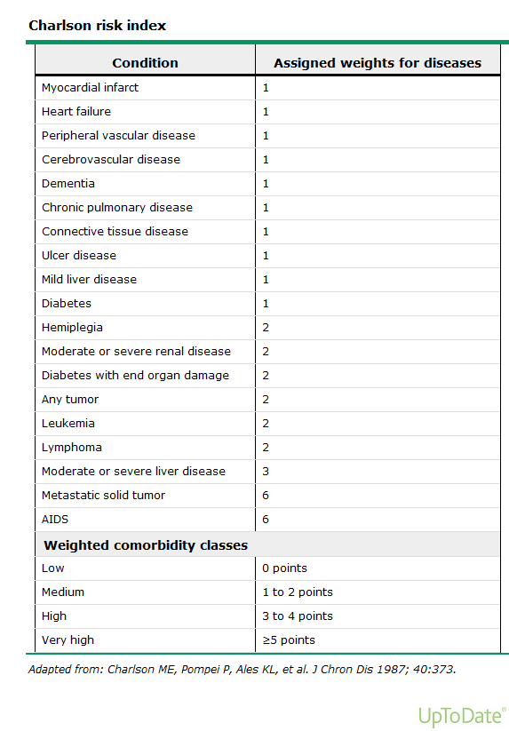
Charlson Comorbidity Index
Charlson et al J Chron Dis 1987

Slide 26
Linear Decline Of Organ Reserve
With Increasing Age
100
2
1
80
3
Percent
Reserve Capacity Remaining
4
5
60
40
1
Cellular Water
20
2
Kidney Blood Flow
3
Maximum Breathing Capacity
4
Nerve Conduction Velocity
5
Heart Output
0
0
20
40
60
80
Age (years)
Baker and Martin, Geriatric Medicine, 1996

Slide 27
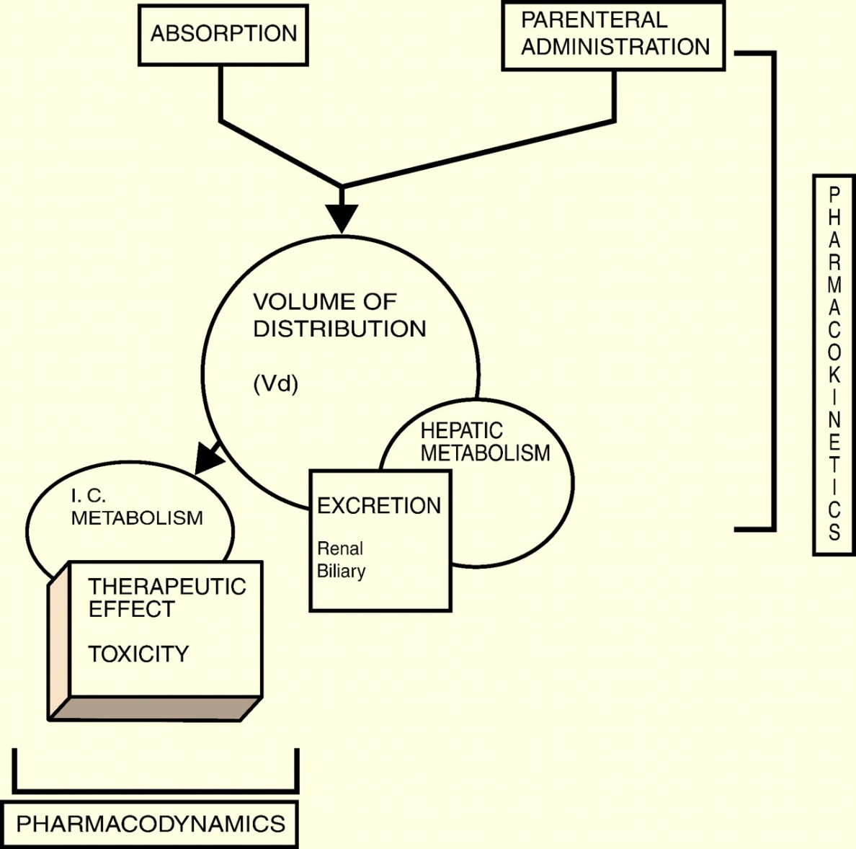

Drug Pharmacokinetics
Vd is a function of body composition, serum albumin, and RBC concentration
Type 1 and 2 reactions
Decline in hepatic blood flow and mass
Decline in intracellular activity of P450 cytochrome enzymes (more in frail patients)
Hepatic drug interactions increase with age as polypharmacy increases
Balducci L , and Extermann M, The Oncologist, 2000
Notes:
PK and pharmacodynamic parameters.

Slide 28
Calculating Creatinine Clearance
Creatinine Clearance Equations
Cockroft & Gault Jeliffe | Commonly used Not validated in older adults
MDRD | More accurate in pts with chronic renal disease Ethnicity, BUN, & albumin are taken into account
None are perfect
All are better than creatinine alone
Hurria & Lichtman, BJC 2008
Notes:
What would you get if you used the other formulas?
For our case (age 80, height 5’5” and weight 130, creatinine 1.3) CrCl is…
Cockroft and Gault: 31 (with ideal body weight calc (using height); 32.2 (using actual body weight)
Jeliffe: 33.0
MDRD: 41.9

Slide 29
Renal Function Decreases with Aging
Example: Weight - 130 lbs
Age | Creatinine (mg/dL) | CrCl* (ml/min)
40 | 1.3
50 | 1.3
60 | 1.3
70 | 1.3
80 | 1.3
90 | 1.3
100 | 1.3
Age | Creatinine (mg/dL) | CrCl* (ml/min)
40 | 1.3 | 54
50 | 1.3 | 48
60 | 1.3 | 43
70 | 1.3 | 38
80 | 1.3 | 31
90 | 1.3 | 27
100 | 1.3 | 21
Creatinine: Not an adequate measure of renal function
Notes:
A serum creatinine does not adequately reflect creatinine clearance because muscle mass is decreased in the elderly and therefore the rate of creatinine formation is decreased.
Decline in GFR of 0.75 ml/min after age 40
CrCl calculated based off of case (5’5’, 130lb, 80 years old, female)

Slide 30
Drug Pharmacodynamics
Delay in DNA repair
Delay in intracellular drug catabolism
Multidrug resistance to cytotoxic chemotherapy
Balducci L , and Extermann M, The Oncologist, 2000
Notes:
PK and pharmacodynamic parameters.

Slide 31
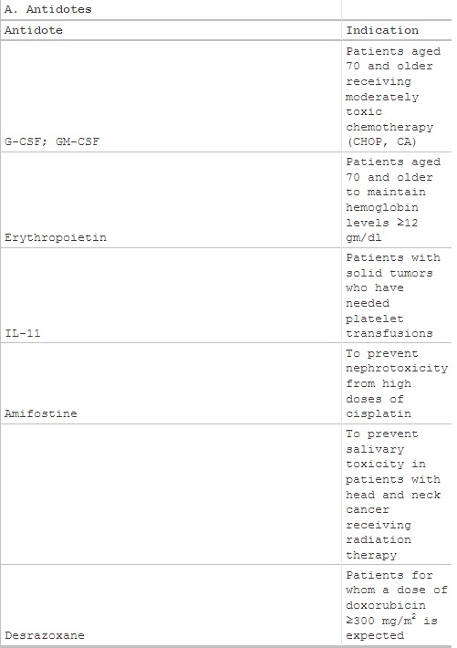
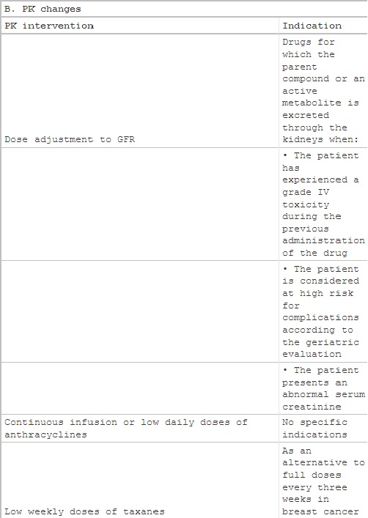
Provisions that may reduce complications of cytotoxic chemotherapy in older cancer patients
Balducci L , and Extermann M, The Oncologist, 2000

Slide 32
Frailty: definition (Fried)
Operationally defined as:
A clinical syndrome in which three or more of the following are present:
unintentional weight loss (10lbs/4.5kgs in last year)
self-reported exhaustion
weakness (grip strength)
slow walking speed
low physical activity
Fried et al. Frailty in older adults: evidence for a phenotype.
J Geront 2001;56:M146-M156

Slide 33
Why is measurement of frailty important?
Frailty predicts:
  falls
  ED visits and hospitalisation
  entry into residential care
  death
Frailty stratification can predict risk of institutional care, or help plan interventions

Slide 34
Key Factors Contributing to
Decision Making
Age
Cancer Stage
Cancer Therapeutics
Comorbidities
Organ Function
Functional Status
Psychological Status
Individual’s Treatment Decision
Cognition
Polypharmacy
Social Support
Finances
Culture
Literacy
Spirituality

Slide 35

Conclusions
Assessing an older adult for cancer therapy
  Understanding the benefit
  Quantifying the risks
  Assessing capacity to make a decision
  A geriatric assessment can help to obtain key
  information
Decision to take therapy is an individual decision
    Supporting the patient through the decision process

Slide 36
Thank you!
Geriatrics
Geriatric Oncology
Oncology

Slide 37

Questions ?

