Slide 1
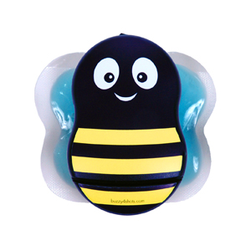
EFFECT OF BUZZY® APPLICATION ON PAIN AND INJECTION SATISFACTION IN ADULT PATIENTS WHO RECEIVED INTRAMUSCULAR INJECTION
MSc RN Melek ŞAHİN Prof. Dr. İsmet EŞER
75th Year Milas State Hospital Ege University Nursing Faculty

Slide 2
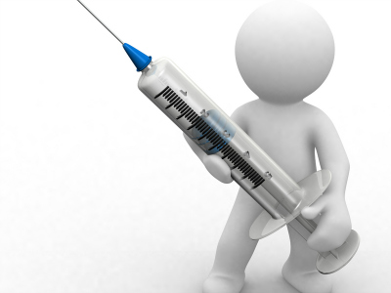
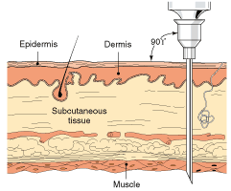
Within the category of parenteral medications are intramuscular (IM) injections (WHO, 1999).

Slide 3
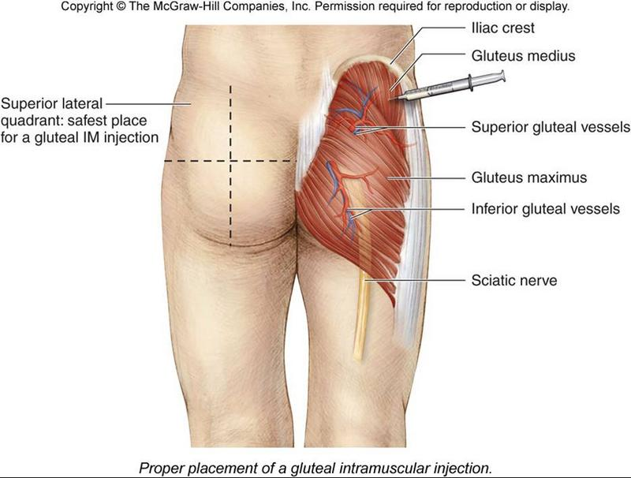
The administration of intramuscular (IM) injection is a basic nursing skill and is a common nursing procedure in the clinical setting.
Tuğrul E., Khorshid L., Effect On Pain İntensity of Injection Sites and Speed of Injection Associated with Intramuscular Penicillin, International Journal of Nursing Practice 2014; 20: 468–474.

Slide 4
IM injections usually cause some degree of pain at the injection site.
Kara D., Güneş Ü. Y., The effect on pain of three different methods of intramuscular injection: A randomized controlled trial, International Journal of Nursing Practice 2014.

Slide 5
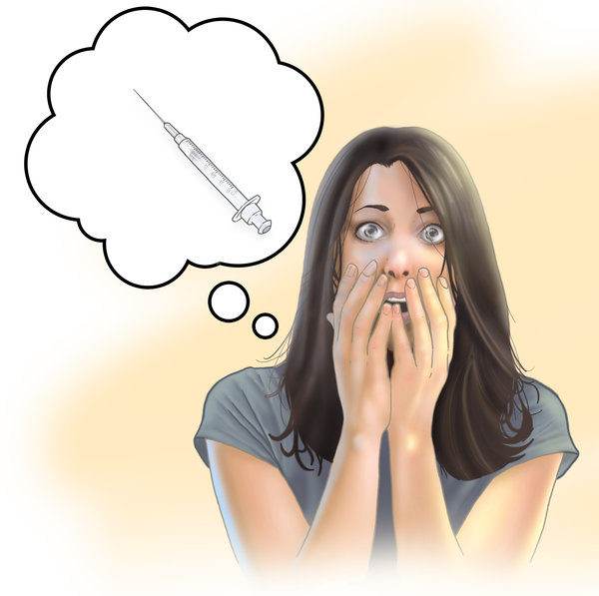
Patients are often afraid of receiving injections
because they perceive that it will be painful.
Kanika K.H.R., Shobha P., Effect of massage on pain perception after administration of Intramuscular Injection among adult patients. Nursing and Midwifery Research Journal, Vol-7, No. 3, July 2011
Workman B. Safe injection technique. Nursing Standard 1999; 13: 47–53.

Slide 6
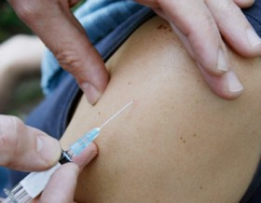
Injection pain is related to the penetration of the skin by the needle and to the mechanical and chemical effects of the drug during and after its injection.*
*Kanika K.H.R., Shobha P., Effect of massage on pain perception after administration of Intramuscular Injection among adult patients. Nursing and Midwifery Research Journal, Vol-7, No. 3, July 2011

Slide 7
Unnecessary pain can damage the nurse- patient relationship, whereas knowledge of alternative techniques can improve patient care and satisfaction.
Hasanpour M, Tootoonchi M, Aein F, Yadegarfar G., (2006). The Effects Of Two Nonpharmacologic Pain Management Methods For Intramuscular Injection Pain In Children. Acute Pain, 8: 7–12.

Slide 8
Over the years, clinicians have tried to explore various methods to reduce pain, including the pain of injections.
Kara D., Güneş Ü. Y., The effect on pain of three different methods of intramuscular injection: A randomized controlled trial, International Journal of Nursing Practice 2014.

Slide 9
In the literature, there are a number of studies that investigate the reduction of pain in IM injections. (sunumda görünmeyecek)
These studies have examined the effect of different factors and interventions, such as
cold,
manual pressure,
acupressure,
needle temperature,
two-needle technique,
injection speed,
patient positioning and
the Z-track technique.
Kara D., Güneş Ü. Y., The effect on pain of three different methods of intramuscular injection: A randomized controlled trial, International Journal of Nursing Practice 2014.
Hasanpour M, Tootoonchi M, Aein F, Yadegarfar G., (2006). The Effects Of Two Nonpharmacologic Pain Management Methods For Intramuscular Injection Pain In Children. Acute Pain, 8: 7–12.
Ağaç E., Güneş Y.P. (2010). Effect On Pain Of Changing The Needle Prior To Administering Medicine Intramuscularly: A Randomized Controlled Trial. Advanced Nursing, 67(3), 563–568

Slide 10
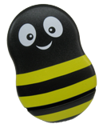
Another method “ Buzzy device” with cold pack and vibration is used for time reduction of IM injection. (sunumda görünmeyecek)
In the literature there are few studies related to the usage of Buzzy device for reducing the pain of IM injection and there isn’t any study for the adult about it yet.

Slide 11
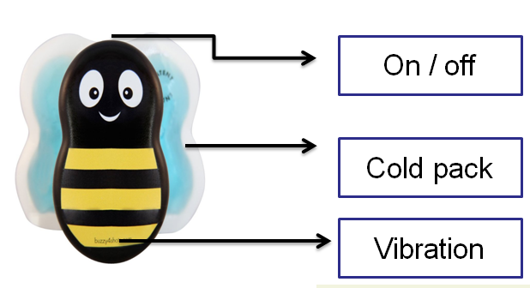
How is the buzzy’s mechanizm?
There is a cold pack on the part of the device where it contacts the skin. It works with batteries and conducts cold application and vibration on the area.
The on/ off button at the top , cold pack at the back and the vibration is below of device.

Slide 12
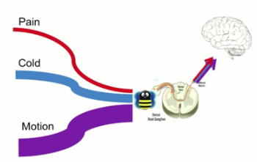
Buzzy device (cold and vibration) is one of the non- pharmacologic methods used and acts through local skin desensitisation according to gate- control theory.
Russell K., Nicholson R., Naidu R., Reducing the pain of intramuscular benzathine penicillin injections in the rheumatic fever population of Counties Manukau District Health Board, Journal of Paediatrics and Child Health 50 (2014) 112–117
Hasanpour M, Tootoonchi M, Aein F, Yadegarfar G., (2006). The Effects Of Two Nonpharmacologic Pain Management Methods For Intramuscular Injection Pain In Children. Acute Pain, 8: 7–12.

Slide 13
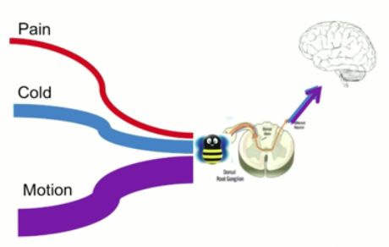
Buzzy which combination of cold and high frequency vibration is between brain and pain, and the pain is blocked out.
https://www.youtube.com/watch?v=r3NSpi1Ilqc

Slide 14
Buzzy is blocked the pain according to
gate control theory.
At the same time, Buzzy with distraction causes the reduce of the injection pain and anxiety on the patient.
Kozier B., Erb G. (2008) Fundamentals of Nursing: Concepts, Process, and Practice, 8th edn. Prentice Hall Health, Upper Saddle River, NJ.
Özveren H. (2011). Ağrı Kontrolünde Farmakolojik Olmayan Yöntemler. Hacettepe Üniversitesi Sağlık Bilimleri Fakültesi Hemşirelik Dergisi,83-92
Potter P.A., Perry A.G. (2005). Fundamentals Of Nursing. Mosby. St. Louis, 6th Edition. 000

Slide 15
OBJECTIVE
This research was carried out as a single-blind, randomized, controlled study in order to investigate the effect of Buzzy application on pain and injection satisfaction before and during injection.

Slide 16
TIME AND PLACE OF RESEARCH
This research was carried out in Physical Therapy Service of 75th Year Milas State Hospital in Turkey between
12 November 2012 and
11 January 2013.

Slide 17
Patients were chosen;
Who haven’t injections in recent week,
Who have no injection site abscess, haematoma, necrosis,

Slide 18
who have no problem of seeing and hearing,
who were between 25 and 85 years of age and

Slide 19
who could understand the visual analog scale (VAS)

Slide 20
RANDOMİZATİON

Slide 21
The patients randomized according to age and sex by drawing lots.
The patients who received research rules
Famale
Application group
Control group
Male
Application group
Application group
25- 55
56- 85
25- 55
56- 85
25- 55
56- 85
25- 55
56- 85

Slide 22
RESEARCH SAMPLE;
A total of 65 patients (application group=33, control group=32) for whom IM diclofenac sodium injection was ordered and who met the selection criteria comprised the sample of research.

Slide 23
Data collection instruments
Patient Information Form,
Visual Analog Scale (VAS)
Buzzy®

Slide 24
Patient Information Form
Age
Gender
Length
Weight
Body mass index (BMI)
Educational level

Slide 25
Visual Analog Scale (VAS)
PAİN
INJECTION SATISFACTION

Slide 26
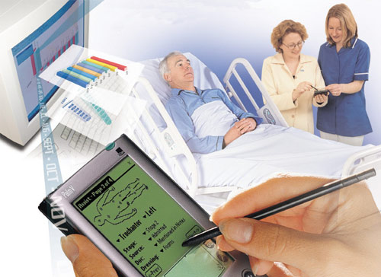
Data Collection Procedure

Slide 27
Patients who met the selection criteria comprised the sample of research.
Randomızatıon
Applıcatıon Group
Control Group
All participants received an explanation of the study before participating and gave informed written consent before voluntary participation.
The device is placed on injection area and 30 second later, it is placed above 3 centimeters of the application area.
Standard injection was applied to control group.
After application of injection pain and injection satisfaction scores were evaluated according to visual analog scale (VAS).

Slide 28
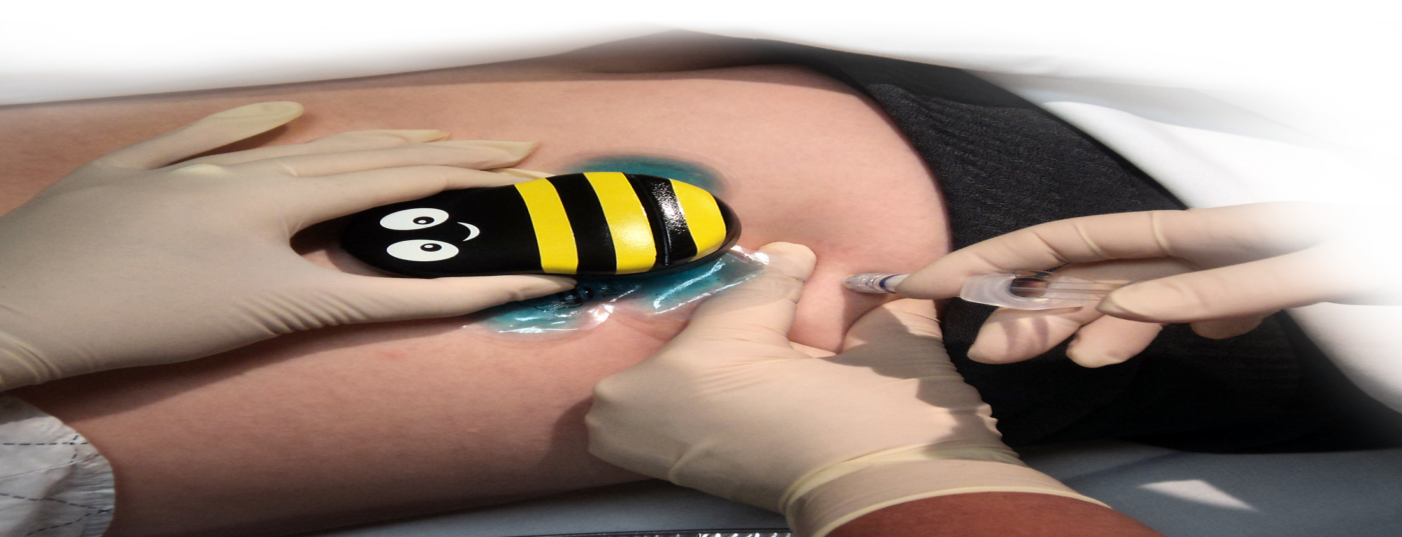
Application of buzzy device on a patient
K. Russell, R. Nicholson, L. Legge, E. Leauanae, A. Olsen, S. Marsh. R. Naidu. (2011). Reducing the pain of Bicillin injections in the Rheumatic Fever population of CMDHB. Counties Manukau District Health Board: Paediatric Pharmacy.

Slide 29
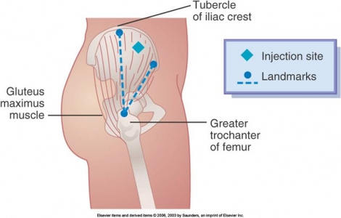
Intramuscular injections were applied to ventrogluteal site.

Slide 30
DATA ANALYSIS
Statistical analysis was performed with Statistical Package For Social Science (SPSS) 20.0 .
In evaluation of data
chi-square,
Mann-Whitney U and Kruskal Wallis
tests were used.

Slide 31
ETHİCAL APPROVAL
For the research;
The study was approved by the local ethics committee
and the hospital.
All participants received an explanation of the study before participating and gave informed written consent before voluntary participation.

Slide 32
RESULTS
60 patients were recruited to the study, with ages ranging from 25 to 85 years, mean age 52.17 years (SD=1.65).

Slide 33
PAİN SCORE
There was a significant lower pain intensity score application group than control group (M-U= 83) (p= 0.000).

Slide 34
INJECTION SATISFACTION SCORE
There was a significant higher injection satisfaction score application group than control group (M-U= 114.5) (p= 0.000).

Slide 35
 | PAIN |  | SATISFACTION
Age Group | Application | Control | Application | Control
25- 55 | 5.56±6.41 | 18.50± 6.78 | 94.39±6.26 | 87.25±16.91
56-85 | 3.60±1.92 | 16.88±12.37 | 95.33±2.87 | 82.88±16.09
 | M-U* = 112.5 p=0.409 | M-U*= 97.5 p=0.249 | M-U*= 134.5 p= 0.985 | M-U*= 121.5 p= 0.806
There was no statistically significant difference pain and injection satisfaction score in age between application and control group.

Slide 36
 | PAIN |  | SATISFACTION
GENDER | Application | Control | Application | Control
Famale | 3.70±2.32 | 17.23±7.59 | 95.85±2.96 | 84.73±15,62
Male | 6.15±7.26 | 18.70±14.07 | 93.23±6.88 | 85.80±6.86
 | M-U*= 89.5 p= 0.130 | M-U*=104 p= 0.807 | M-U*= 100 p= 0.266 | M-U*= 92 p= 0.463
There was no statistically significant difference pain and injection satisfaction score in gender between application and control group.

Slide 37
 | PAIN |  | SATISFACTION
EDUCATİONAL LEVEL | Application | Control | Application | Control
primary school and below | 4.00±2.14 | 17.85±10.42 | 95.27±3.13 | 83.96±14.21
Middle school and over | 7.14±10.11 | 16.80±6.72 | 93.14±9.30 | 91.00±4.95
 | M-U* = 89.5 p= 0.947 | M-U*=61.5 p=0.755 | M-U*= 61.5 p= 0.807 | M-U* = 37 p= 0.112
There was no statistically significant difference pain and injection satisfaction score in educational level between application and control group.

Slide 38
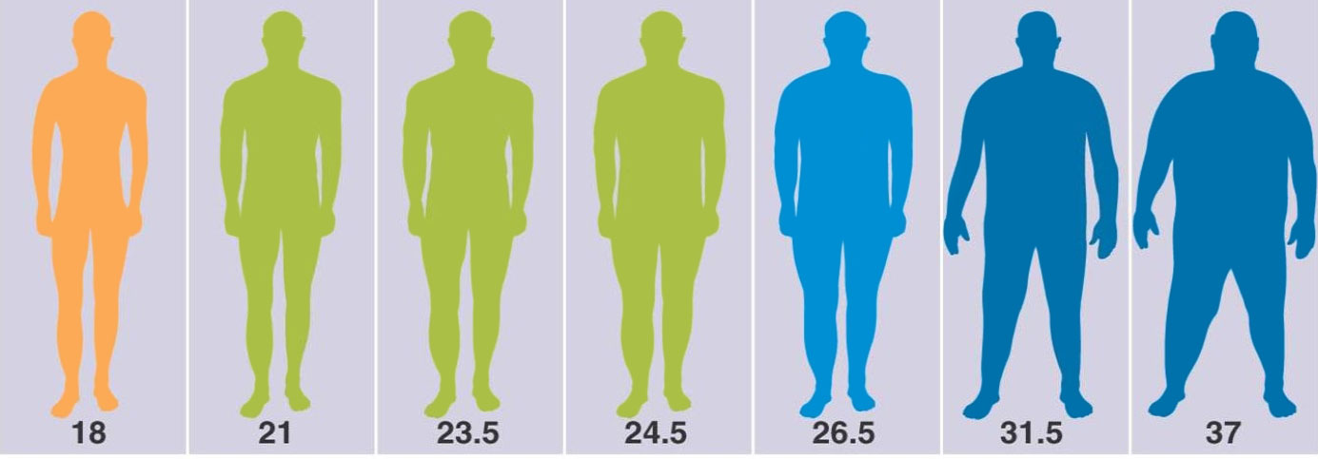
 | PAIN |  | SATISFACTION
BMI (Body Mass Index) | Application | Control | Application | Control
Normal weight | 4.43±2.15 | 13.67±7.89 | 95.29±3.50 | 87.33±7.12
Overweight | 6.75±7.61 | 13.85±4.74 | 93.50±7.26 | 82.54±19.84
Obese | 4.43±2.15 | 23.38±11.96 | 95.71±2.81 | 86.54±15.81
 | H**= 6.059 p= 0.048 | H**=7.825 p= 0.020 | H** = 0.365 p= 0.833 | H** = 0.021 p=0.941
Overweight patients reported increased pain intensity compared with normal and obese patients in application group.
Obese patients reported increased pain intensity compared with normal and overweight patients in control group.
There was no statistically significant difference injection satisfaction score in BMI between application and control group.

Slide 39
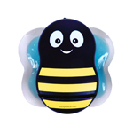
CONSEQUENTLY;
it was determined that Buzzy® device was an effective method in decreasing injection pain
and in improving post-injection satisfaction.

Slide 40
In the literature;
It has been learnt that the studies
with Buzzy are also applied at IM injection, vaccination and venipuncture on the children.
Baxter AL, Cohen LL, McElvery HL, Lawson ML, von Baeyer CL., An integration of vibration and cold relieves venipuncture pain in a pediatric emergency department. Pediatr Emerg Care. 2011 Dec;27(12):1151-6.
Russell K., Nicholson R., Naidu R., Reducing the pain of intramuscular benzathine penicillin injections in the rheumatic fever population of Counties Manukau District Health Board, Journal of Paediatrics and Child Health 50 (2014) 112–117
İnal S., Kelleci M. (2010). Externel Thermomechanical Stimulation And Distraction Are Effective On Pain Relief Of Children During Blood Draw. 14th International Nursing Research Conference, Burgos
Canbulat N, Ayhan F, Inal S. Effectiveness of External Cold and Vibration for Procedural Pain Relief During Peripheral Intravenous Cannulation in Pediatric Patients.Pain Management Nursing, 2014 Jun 6 S1524-9042.
Whelan HM, Kunselman AR et al. The Impact of a Locally Applied Vibrating Device on Outpatient Venipuncture in Children. Clin Pediatr 2014 Jun 12. N=64 children, 7 phlebotomists
Inal S, Kelleci M. Buzzy relieves pediatric venipuncture pain during blood specimen collection. MCN Am J Matern Child Nurs 2012 Sep;37(5):339-45.
Baxter AL, Leong T, Mathew B. External thermomechanical stimulation versus vapocoolant for adult venipuncture pain : Pilot data on a novel device. Clin J Pain, 2009 October ;25(8):705-10.

Slide 41
All the studies
with
Buzzy
(different sample and method)
confirm our study.

Slide 42
RECOMMENDATIONS
Buzzy should be used for reduce IM injection pain by nurses ,
It should be compared another methods which reduce IM injection pain
In order to improve the development of evidence-based on different age group should be research.

Slide 43
THANKS…

