Slide 1
Can architectural space be healing? A virtual stress experiment
LARS Brorson Fich
Cand. Arch. MAA. Ph.D.

Slide 2
Background:

Slide 3
Background:
1984 Graduated as an architect

Slide 4
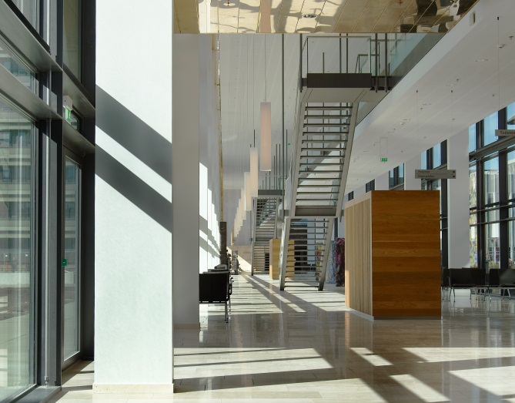
Background:
1984 Graduated as an architect
1984 – 2008
Worked at an architectural office 1998– 2008 as a partner.
.

Slide 5
Background:
1984 Graduated as an architect
1984 – 2008
Worked at an architectural office 1998– 2008 as a partner.
2007 – 2008 Project manager; ICU

Slide 6
Background:
1984 Graduated as an architect
1984 – 2008
Worked at an architectural office 1998– 2008 as a partner.
2007 – 2008 Project manager; ICU
2008 –
Aalborg University

Slide 7
Background:
1984 Graduated as an architect
1984 – 2008
Worked at an architectural office 1998– 2008 as a partner.
2007 – 2008 Project manager; ICU
2008 –
Aalborg University

Slide 8
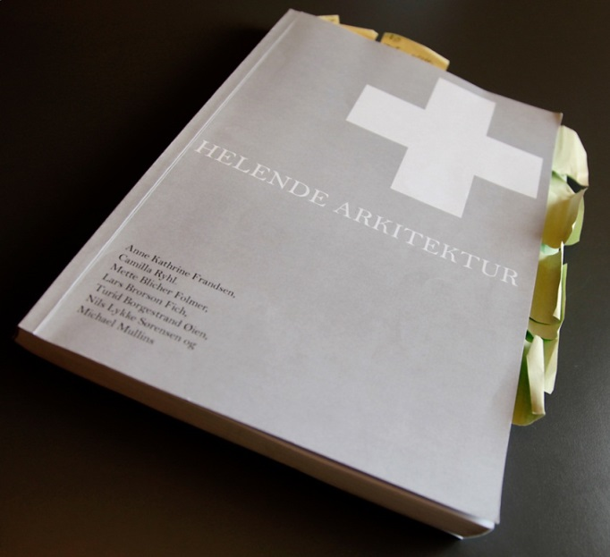
Background:
2007 – 2008 Project manager; ICU
2008 – 2009
The “Helende Arkitektur” (“Healing Architecture”) Project in cooperation with Aalborg University.

Slide 9
Background:
2007 – 2008 Project manager; ICU
2008 – 2009
The “Helende Arkitektur” (“Healing Architecture”) Project in cooperation with Aalborg University.
A review report of approx.. 200 articles how hospital design might influences treatment, patient and staff safety, way-finding in hospitals etc.

Slide 10
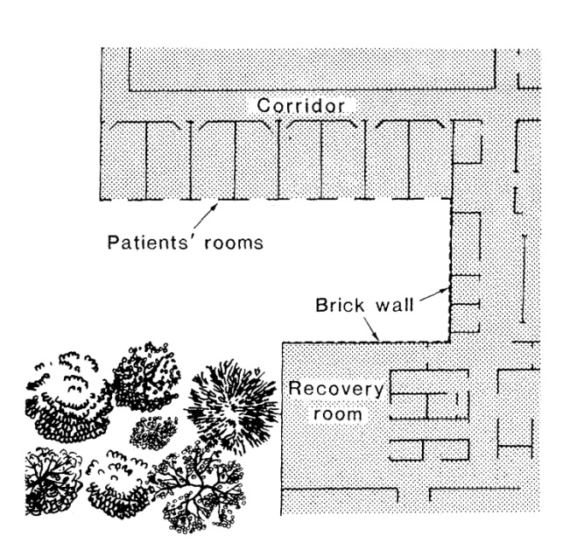
Background:
Patients who had undergone gall bladder surgery
Ulrich, 1984

Slide 11
Background:
Identical patient rooms
Patients who had undergone gall bladder surgery
Ulrich, 1984

Slide 12
Background:
Identical patient rooms
Patients who had undergone gall bladder surgery
Ulrich, 1984

Slide 13
Background:
Identical patient rooms
Patients who had undergone gall bladder surgery
Tree-group vs. wall-group:
Hospitalized 7.96 vs. 8.70 days
Ulrich, 1984

Slide 14
Background:
Identical patient rooms
Because the patient rooms are identical, no data about the architecture itself is produced.
Ulrich, 1984

Slide 15
Background:
Identical patient rooms
Because the patient rooms are identical, no data about the architecture itself is produced.
Although the effect is assumed to be connected to stress and anxiety, there is no physiological measure.
Ulrich, 1984

Slide 16
Background:
Identical patient rooms
Can the architecture itself influence the healing process by way of the stress system?
Ulrich, 1984

Slide 17
Background:
Identical patient rooms
Can the architecture itself influence the healing process by way of the stress system?
Architecture must be the variable
Ulrich, 1984

Slide 18
Background:
Identical patient rooms
Can the architecture itself influence the healing process by way of the stress system?
Architecture must be the variable
Data must be physiological.
Ulrich, 1984

Slide 19
The Trier Social Stress Test (TSST)
Psychosocial stress
Kirschbaum, et al.,1993.

Slide 20
The Trier Social Stress Test (TSST)
Psychosocial stress
Lab set-up:
Preparation room
Test room (committee)
Kirschbaum, et al.,1993.

Slide 21
The Trier Social Stress Test (TSST)
Protocol:
5 min. baseline recording
Kirschbaum, et al.,1993.

Slide 22
The Trier Social Stress Test (TSST)
Protocol:
5 min. baseline recording
Presentation of the assignments by the committee
Kirschbaum, et al.,1993.

Slide 23
The Trier Social Stress Test (TSST)
Protocol:
5 min. baseline recording
Presentation of the assignments by the committee
5 min. preparation of an oral presentation
Kirschbaum, et al.,1993.

Slide 24
The Trier Social Stress Test (TSST)
Protocol:
5 min. baseline recording
Presentation of the assignments by the committee
5 min. preparation of an oral presentation
5 min. oral presentation in front of the committee
Kirschbaum, et al.,1993.

Slide 25
The Trier Social Stress Test (TSST)
Protocol:
5 min. baseline recording
Presentation of the assignments by the committee
5 min. preparation of an oral presentation
5 min. oral presentation in front of the committee
5 min. second assignment: counting backwards from 1687 in steps of 13
Kirschbaum, et al.,1993.

Slide 26
The Trier Social Stress Test (TSST)
Protocol:
5 min. baseline recording
Presentation of the assignments by the committee
5 min. preparation of an oral presentation
5 min. oral presentation in front of the committee
5 min. second assignment: counting backwards from 1687 in steps of 13
40 min. relaxation in the preparation room
Kirschbaum, et al.,1993.

Slide 27
The Virtual Trier Social Stress Test (VR-TSST)
Protocol:
5 min. baseline recording
Presentation of the assignments by the committee
5 min. preparation of an oral presentation
5 min. oral presentation in front of the committee
5 min. second assignment: counting backwards from 1687 in steps of 13
40 min. relaxation in the preparation room
Architecture must be the variable
Jönsson et al., 2010

Slide 28
The Virtual Trier Social Stress Test (VR-TSST)
Data:
Heart rate variability as a measure of sympathetic (SNS)- and parasympathetic (PNS) nervous system activity.
Saliva samples as a measure of cortisol release by the HPA-axis.
Architecture must be the variable
Data must be physiological.
Jönsson et al., 2010

Slide 29
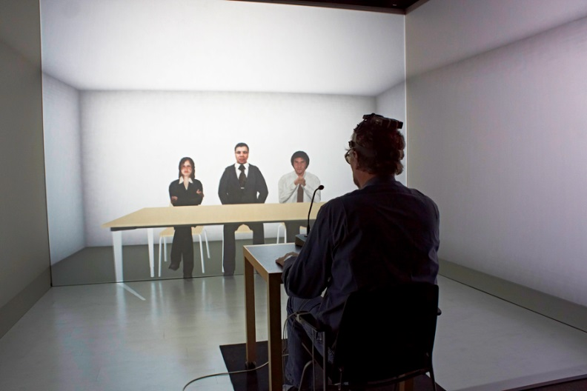
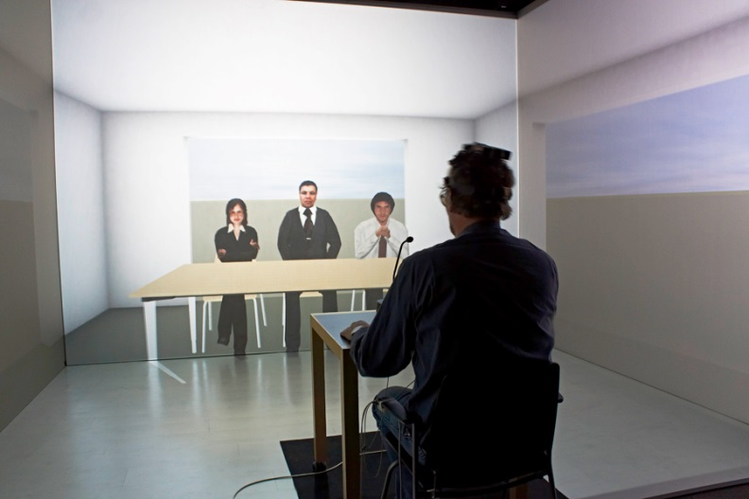
The Virtual Trier Social Stress Test (VR-TSST)
Enclosure.
Space with openings, potentially allowing for escape.
Fich et al. 2014

Slide 30
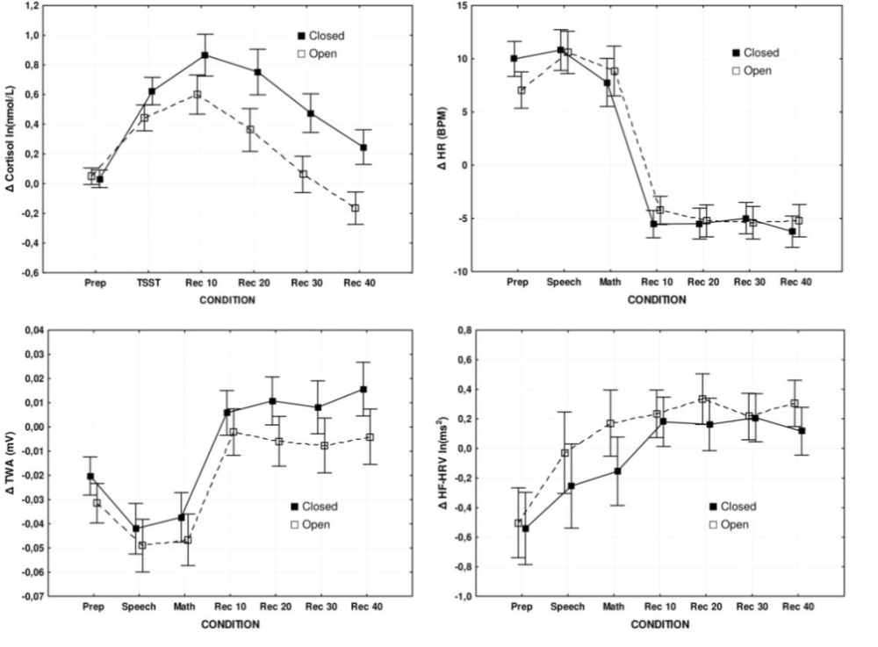
The Virtual Trier Social Stress Test (VR-TSST)
Results:
Solid curve = closed room
Dotted curve = open room
Fich et al. 2014

Slide 31
The Virtual Trier Social Stress Test (VR-TSST)
Results:
Data:
Heart rate variability as a measure of sympathetic (SNS)- and parasympathetic (PNS) nervous system activity.
Heart rate
Fich et al. 2014

Slide 32
The Virtual Trier Social Stress Test (VR-TSST)
Results:
Data:
Heart rate variability as a measure of sympathetic (SNS)- and parasympathetic (PNS) nervous system activity.
Heart rate
SNS
Fich et al. 2014

Slide 33
The Virtual Trier Social Stress Test (VR-TSST)
Results:
Data:
Heart rate variability as a measure of sympathetic (SNS)- and parasympathetic (PNS) nervous system activity.
Heart rate
SNS
PNS
Fich et al. 2014

Slide 34
The Virtual Trier Social Stress Test (VR-TSST)
Results:
Data:
Heart rate variability as a measure of sympathetic (SNS)- and parasympathetic (PNS) nervous system activity.
Saliva samples as a measure of cortisol release by the HPA-axis
cortisol
Heart rate
SNS
PNS
Fich et al. 2014

Slide 35
The Virtual Trier Social Stress Test (VR-TSST)
Results:
Results:
No part of the autonomous nervous system was sensitive to the spatial context.
cortisol
Heart rate
SNS
PNS
Fich et al. 2014

Slide 36
The Virtual Trier Social Stress Test (VR-TSST)
Results:
Results:
No part of the autonomous nervous system was sensitive to the spatial context.
The reaction of the HPA-axis did react with a less pronounced stress reaction in the room with openings as predicted.
cortisol
Heart rate
SNS
PNS
Fich et al. 2014

Slide 37
The Virtual Trier Social Stress Test (VR-TSST)
Results:
Conclusion:
No part of the autonomous nervous system was sensitive to the spatial context.
The fight-or-flight reaction can therefor not be responsible for the effect.
cortisol
Heart rate
SNS
PNS
Fich et al. 2014

Slide 38
The Virtual Trier Social Stress Test (VR-TSST)
Results:
Discussion:
We hypothesize, that the effect is due the role of the hippocampus as:
The hippocampus is part of the HPA feed-back mechanism.
The hippocampus is mapping space boundaries.
cortisol
Heart rate
SNS
PNS
Fich et al. 2014

Slide 39
The Virtual Trier Social Stress Test (VR-TSST)
Results:
Discussion:
The difference in cortisol is most pronounced after the TSST, when the SNS reaction is terminated.
It could be, that the SNS ‘counterbalances’ the reaction of the HPA-axis.
cortisol
Heart rate
SNS
PNS
Fich et al. 2014

Slide 40
The Virtual Trier Social Stress Test (VR-TSST)
Results:
Discussion:
Treatment or examination in a space with potential possibilities for “escape” might result in a lower cortisol level after treatment.
cortisol
Heart rate
SNS
PNS
Fich et al. 2014

Slide 41
THANK YOU FOR YOUR ATTENTION
Fich, L.B., Jönsson, P., Kirtkegaard, P.H., Wallergård, M., Garde, A.H., Hansen, Å., 2014. Can architectural design alter the physiological reaction to psychosocial stress? A virtual TSST experiment. Physiology & Behavior 135, pp. 91-97
Jönsson, P., Wallergård, M., Österberg, K., Hansen, Å.M., Johansson, G., Karlson, B., 2010. Cardiovascular and cortisol reactivity and habituation to a virtual reality version of the Trier Social Stress Test: A pilot study. Psychoneuroendocrinology, 35, 1397-1403
Kirschbaum, C., Pirke, K-M., Hellhammer, D.H., 1993. The ’Trier Social Stress Test’: A Tool for Investigating Psychobiological Stress Responses in a Laboratory Setting. Neuropsychobiology, 28, pp. 76-88
Ulrich, R., 1984. View through a Window May Influence Recovery from Surgery. Science 224(4647) pp. 420-421.

