Slide 1
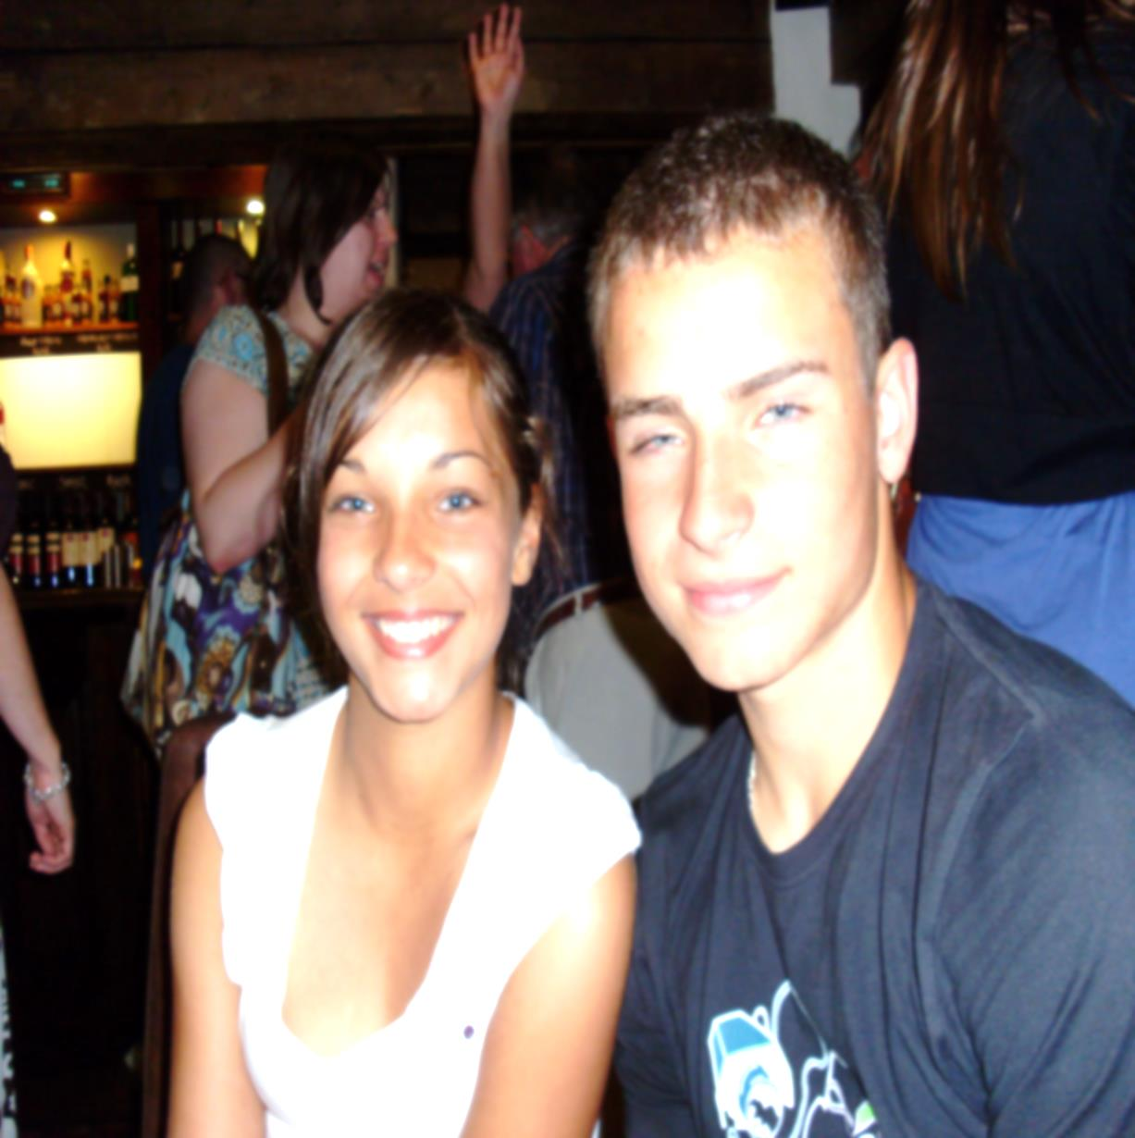
Disordered eating in first-year undergraduate students
Developing support mechanisms and health promoting outreach
Dr John J Power
The School of Nursing & Midwifery
Queen’s University
Belfast

Slide 2
Theoretical Basis
Positive Psychology
Spectrum theory
Liminality
Salutogenesis

Slide 3
Context
Disordered eating represents an over focus on body shape and weight with abnormal and disrupted attitudes to food patterns and eating(Quick and Byrd-Bredbenner 2013)
Can form part of the spectrum of disturbed eating patterns and behaviours with evidence of significant disability (clinical anorexia nervosa, Bulimia etc.) (Sanlier et al. 2008; Dissing et al.2011).
Or as subclinical and possibly concealed but with significant psychological social and physiological risk (Boyd 2006; Sanlier et al. 2008; Dissing et al.2011)

Slide 4
Stigma & Concealment
Disordered Eating like classic eating disorders caries a stigma =
Concealment=
Non-disclosure (Eisenberg et al. 2011)

Slide 5
Figures
Perhaps 90% of disordered eating occurs in individuals up to 25yrs (Sanlier et al. 2008)
Studies suggest variation
Simon- Boyd and Bieschke (2003), suggest possibly 36.6% of sample reflected evidence of disordered eating
Eisenberg et al. (2011) possibly 13.5% (F) 3.6%(M) college students reflected eating disorder symptoms.
Petrie et al. (2008) suggested evidence of disrupted eating patterns/disordered eating amongst almost 20% of the undergraduate male student population

Slide 6
The Study
A qualitative study exploring disordered eating in a small group of first-year undergraduate students studying for professional health care related degrees
Nursing , midwifery and medical students
(n=12)
Illustrating what support mechanisms and services are required for those 1st year students experiencing or at risk.

Slide 7
Methodology
In-depth Interviews
Thematic analysis
Narrative analysis
Conceptual Framework drawn from theory of Salutogenesis
A sense of Coherence
Comprehensibility
Manageability
Meaningfulness

Slide 8
Salutogenesis
Salutogenesis addressees our
understanding of health , health outreach and health promotion
Focuses within the positive promotion of health (including mental health)
and
Building Resilience
With emphasis less on pathogenesis and more on the social matrix which sustains, supports or helps to restore a sense of health and wellbeing (Antonovsky1984;1996)
Equipping for `The River of Life’

Slide 10
A Sense of Coherence
Salutogenesis in developing and sustaining a SOC uses social, psychological and cultural resources to promote health and to resist illness; which Antonovsky (1979)
= Generalised Resistance Resources (GRRs).
The extent of an individual's sense of coherence is substantially reflected in their GRR’s Antonovsky (1979) .
Include material resources, cognitive, emotional and interpersonal resources (including knowledge and understanding and their sense of self (their ego identity) and their inter-social and inter-relational attachments and support.
The development of a strong SOC reflects the growth of GRR’s within the individual (Antonovsky 1979;1993).

Slide 11
Comprehensibility
Comprehensibility reflects an individual’s sense of comprehension and understanding of significant issues in health
and
Their lived experience,
together with
An internalized assurance/ reassurance of a sense of existing order and social balance (Antonovsky 1996; Johnson 2004; Darling et al. 2007; Sanftner 2011).

Slide 12
Manageability
Manageability reflects a particular focus upon the individual’s perception, understanding and sense of control.
Manageability also reflects an individual’s response to stressors and an individual's access to and choice of coping skills and coping support.
Coping support is significantly reflective of prior experience and perceptions of the supportive matrix in which an individual might find themselves at a particularly stressful period (Antonovsky 1987; 1996; Cilliers and Kossuth 2002).

Slide 13
Meaningfulness
Meaningfulness reflects life as having a sense of purpose that it is understandable,
That the individual has value and primacy
and
There is real worth in the individual investing time and resources into significant challenges (Antonovsky 1979; 1987; 1996).

Slide 14
StAge 1 | StAge 2 | Stage 3 | StAge 4
Theory | Conceptual Framework | Emergent themes | Emergent sub themes and categories
Salutogenesis and a Sense of Coherence | Comprehensibility | Comprehension and insight | The experience
 |  |  | Understanding
 |  |  | Pre-existing pattern
 |  | Comprehensibility-social imbalance or pathology | Disengagement
 |  |  | Imbalance
 |  |  | Pathology
 |  |  | Body Image
 | Manageability | Manageability and control | Control
 |  |  | Stress and coping
 |  | Manageability-the prior context, supporting or driving | The family
 |  |  | The public perception
 |  | Manageability-disclosure and impact | The prior experience
 |  |  | Disclosure
 |  |  | Labelling
 |  |  | Academically and professionally
 |  | Manageability - and support | Emotional support
 |  |  | Supporting environment
 |  |  | Supporting outreach
 | Meaningfulness | Meaningfulness- towards a more salutogenic response | Positive challenge
 |  | Meaningfulness- supporting the context | Positive experience
The Conceptual Framework-Undergraduate Students and Disordered Eating

Slide 15
Psychiatry or psychology
The 1st year and significant stress
Pre-existing drivers
Mad or troubled/struggling
Control, Chronic Stress
and
Disordered Eating (NICE 2004:BEAT 2014)
Early outreach
A sense of wellbeing
Positive psychology (Seligman and Csikszentmihalyi 2000)
University the 1st year and a Liminal Opportunity

Slide 16
Key issues emerging
Lack of understanding to the nature/risks associated with disordered eating
The use of disordered eating as a stress coping mechanism
Stress & Isolation
Disordered eating perceived negatively as a mental health issue carried stigma and reticence to acknowledge = being wary of the academic/ professional consequences.
Possibly reflected in a sometimes concealed /sub-clinical experience.
Students wary of eating in more public refectories.
Students felt very positive about their arrival at university
and
That their experience with disordered eating could potentially add to their repertoire as future health care professionals.

Slide 17
Impact !
On self
On first and later years of study
Unstable self image/self efficacy
Waste of resources
↓Scholarly focus
↑ Acute /chronic stress

Slide 18
The University could
Further develop its outreach to new students with a more consistently supportive program including stress training and more support via student buddying
Enhance education/awareness of student support facilities particularly in terms of mental health stressors/resilience and the assurance of confidentiality
Extend its program on positive mental health to reduce a sense of stigma within the student population
Consistent more training in the understanding and person- centered approach to students experiencing disordered eating, particularly the sub-clinical group
Consider some small changes and adaptations to the refectory eating areas to better facilitate at-risk students.
Finally the University could perhaps better use the first few months of student's arrival at university to help embed a program to develop a stronger sense of coherence and wellbeing.

Slide 19
Reference List
Antonovsky, A. (1979) Health, stress and coping. San Francisco: Jossey-Bass.
Antonovsky, A. (1984b) The sense of coherence as a determinant of health. In Matarazzo, J.D. Weiss, S.M. Herd, J.A. Miller, M.E. and Weiss S.M (Eds.), Behavioural Health: a handbook of health enhancement and disease prevention (pp. 114-129). New York: Wiley Interscience.
Antonovsky, A. (1987) Unravelling the mystery of health: how people manage stress and stay well. San Fransisco: Josey-Bass.
Antonovsky, A. (1993) The structure and properties of the sense of coherence scale. Social Science and Medicine, 36, 725-733.
Antonovsky, A. (1996) The salutogenic model as a theory to guide health promotion. Health Promotion International, 11: 11-18.
Boyd, C. (2006) "Coping and Emotional Intelligence in Women with a History of Eating Disordered Behaviour," McNair Scholars Journal: 10 (1): 4-12.
Cilliers, F. and Kossuth, S. (2002) The relationship between organisational climate and salutogenic functioning. South African Journal of Industrial Psychology, 28: 8-13.
Darling C.A. McWey L.M. Howard S.N. and Olmstead S.B. (2007) College student stress: the influence of interpersonal relationships on sense of coherence, Stress and Health 23: 215-229.
Dissing A.S., Bak N.H., Pedersen L.E. and Petersson B.H.(2011) Femalmedical students are estimated to have a higher risk for developing eating disorders than male medical students. Danish Medical Bulletin, 58(1):207.
Eisenberg D. Nicklett E.J., Roeder K.M. and Kirz, N. (2011) Eating Disorder Symptoms among College Students: Prevalence, Persistence, Correlates, and Treatment-seeking. Journal of American College Health 59(8): 700-7.
Johnson M. (2004) Approaching the Salutogenesis of sense of coherence: The role of active self-esteem and coping, British Journal of Health Psychology, 9: 419-432.
Petrie T.A. Greenleaf C. Reel J. and Carter J (2008) Prevalence of Eating Disorders and Disordered Eating Behaviours Among Male Collegiate Athletes. Psychology of Men and Masculinity, 9(4): 267-277
Quick V.M. and Byrd-Bredbenner C. (2013) Disturbed eating behaviours and associated psychographic characteristics of college students. Journal of Human Nutrition and Dietetics 26(1): 53-63
Sanlier, N., Yabanci, N., and Alyakut, O. (2008) An evaluation of eating disorders among a group of Turkish university students. Appetite 51(3): 641-645.
Simon-Boyd G. Bieschke. J.K. (2003) predicting eating disorder continuum groups: hardness and college adjustment, Poster Presentation Annual Conference of the American Psychological Association. Available @ http://www.eric.ed.gov/ERICWebPortal/search/detailmini.jsp?_nfpb=true&_&ERICExtSearch_SearchValue_0=ED480488&ERICExtSearch_SearchType_0=no&accno=ED480488Ruggiero GM, (accessed 2 4 2013).

Slide 20
Thank you & Our Best Wishes !
Queen’s University Belfast

Slide 21
Issues
How to relabel mental distress rather than mental illness
Addressing stigma and the student population
Building an early stage resilience in the young undergraduate
The public health outreach to young students

