Slide 1
About OMICS Group
OMICS Group International is an amalgamation of Open Access publications and worldwide international science conferences and events. Established in the year 2007 with the sole aim of making the information on Sciences and technology ‘Open Access’, OMICS Group publishes 400 online open access scholarly journals in all aspects of Science, Engineering, Management and Technology journals. OMICS Group has been instrumental in taking the knowledge on Science & technology to the doorsteps of ordinary men and women. Research Scholars, Students, Libraries, Educational Institutions, Research centers and the industry are main stakeholders that benefitted greatly from this knowledge dissemination. OMICS Group also organizes 300 International conferences annually across the globe, where knowledge transfer takes place through debates, round table discussions, poster presentations, workshops, symposia and exhibitions.

Slide 2
About OMICS Group Conferences
OMICS Group International is a pioneer and leading science event organizer, which publishes around 400 open access journals and conducts over 300 Medical, Clinical, Engineering, Life Sciences, Phrama scientific conferences all over the globe annually with the support of more than 1000 scientific associations and 30,000 editorial board members and 3.5 million followers to its credit.
OMICS Group has organized 500 conferences, workshops and national symposiums across the major cities including San Francisco, Las Vegas, San Antonio, Omaha, Orlando, Raleigh, Santa Clara, Chicago, Philadelphia, Baltimore, United Kingdom, Valencia, Dubai, Beijing, Hyderabad, Bengaluru and Mumbai.

Slide 3
Green Chemistry at Merck –
A Development Chemist’s Perspective
Ingrid Mergelsberg
Merck Process Chemistry, Merck & Co., Inc., Whitehouse Station, NJ
International Summit on Past and Present Research Systems of Green Chemistry
August 25-27, 2014 Philadelphia, USA

Slide 4

About Merck
Named Merck in US and Canada; MSD elsewhere
More than 120 years old
Medicines, vaccines, animal health
(and consumer products)
Our mission is to discover, develop and provide meaningful, innovative products that save and improve lives
Do so in a sustainable fashion so we can continue serving patients for another 120 years

Slide 5
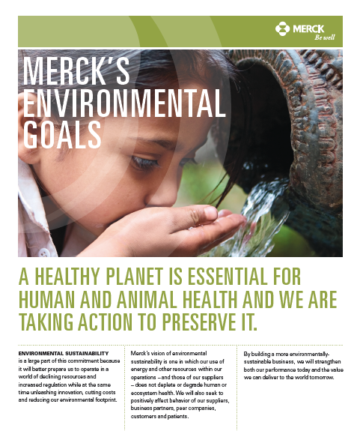
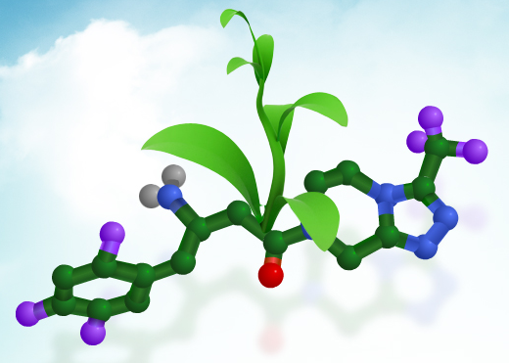
Green and Sustainable Chemistry at Merck
Greening Merck
Presidential Green Chemistry Award Winners
2005: Merck – A Redesigned, Efficient Synthesis of Aprepitant, the Active Ingredient in Emend®
2006: Merck – Novel Green Synthesis for β-Amino Acids Produces the Active Ingredient in Januvia™
2010: Merck – Greener Manufacturing of Sitagliptin Enabled by an Evolved Transaminase
Notes:
5

Slide 6
What Do Process Chemists Do?
Provide active pharmaceutical ingredient (API) for development
  Preclinical: 1-10 kg
  Ph I: 10-20 kg
  Ph II: 50-200 kg
  Ph III: 200-2000 kg
    Requires a good synthetic route: safe, robust, productive, impurity control, API phase, reasonable cost, freedom to operate (intellectual property) and environmentally benign
Identify the manufacturing route for commercial supply
  Requires a great synthetic route to support the product for years to come. Need the lowest-cost route (consider emerging market and expanded access) and must be sustainable

Slide 7
Key Message
Good science is the key to Green Chemistry and low-
cost synthesis
  If we focus on developing the best chemistry, then, almost always, this leads to the lowest cost and greenest process
  “Best chemistry at launch” provides environmental and economical benefit over the lifetime of the product
  Innovation is the key for unbeatable chemistry
“In every case I know, the green option is the low-cost option” David Constable, 2008

Slide 8

Diabetes: A Growing Worldwide Epidemic
27
85
14
33
132
18
24%
23%
57%
9
14
16
50%
23
1
44%
1.3
30%
Estimated incidence in 2000 (millions)
World
2000: 151 million
2010: 221 million (+46%)
Estimated incidence in 2010 (millions)
% increase from 2000 to 2010
Adapted from Amos AF et al. Diabet Med 1997;14:S7-S85.

Slide 9
Sitagliptin: DPPIV Inhibitor for
Diabetes Mellitus Type 2
Active Ingredient in Januvia® and Janumet®
First-in-class dipeptidyl peptidase-4 (DPPIV) inhibitor
Once-daily oral treatment
Approved by FDA in 2006
Notes:
For Asymmetric Autocatalysis Enables an Improved Synthesis of Efavirenz, see E. M. Carreira, Angew. Chem. Int. Ed. 2011, 50, 2957 –2961. http://onlinelibrary.wiley.com/doi/10.1002/anie.201006689/pdf

Slide 10
Efficient Synthesis: Sitagliptin, 1st GMP Delivery
>100 kg manufactured, 52% overall yield - 8 steps from acid 1
3 productive bond-forming steps (38% desired)
5 functional group manipulations (62% undesired)
Can we do it in only 3 steps?

Slide 11
Is This Reaction Possible?

Slide 12
Efficient Synthesis: Sitagliptin 1st-Generation Manufacturing Route: One-Pot Reaction
  82% yield
  PMI = 14
1 step (one-pot reaction, direction isolation) to ketoamide or enamine amide!
  Single solvent: compatible reagents to enable one-pot reaction
Need unprecedented asymmetric hydrogenation of unprotected enamine

Slide 13
Efficient Synthesis: Sitagliptin 2nd-Generation Manufacturing Route: Chemocatalysis
300
New asymmetric hydrogenation
2-step synthesis, 63% overall yield
No protecting groups
Implemented at factory scale
(>100 MT produced)
~80% reduction in PMI, no aqueous waste
1st Generation
250
New Route
200
150
Waste Generated (kg)
100
50
0
Total Waste
Aqueous Waste

Slide 14
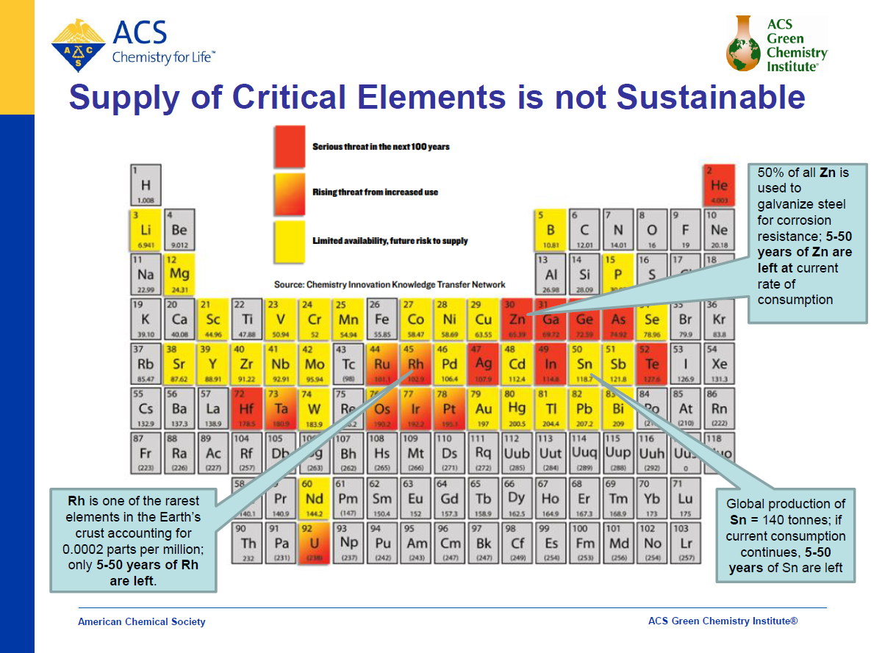
Supply of Critical Elements Is Not Sustainable
American Chemical Society
ACS Green Chemistry Institute®

Slide 15
Sitagliptin 3rd-Generation Route: Ideal Process
Avoid formation of intermediate enamine?
Improve ee and avoid isolation of crude sitagliptin for ee upgrade?
Eliminate the high-pressure hydrogenation and specialized equipment?
Eliminate heavy metal and carbon treatment to remove it?
  Rh: $1,000 - $10,000 per ounce
Can we use an enzyme for the direct conversion?

Slide 16
Efficient Synthesis: Biocatalysis With Enzymes
Environmentally benign technology
  Catalysts are grown in E. coli, renewable
  Operate in aqueous systems
Economically attractive
  Stable manufacturing costs
Enabling technology
  Opens access to unique synthetic sequences
More sustainable. It’s Green!

Slide 17
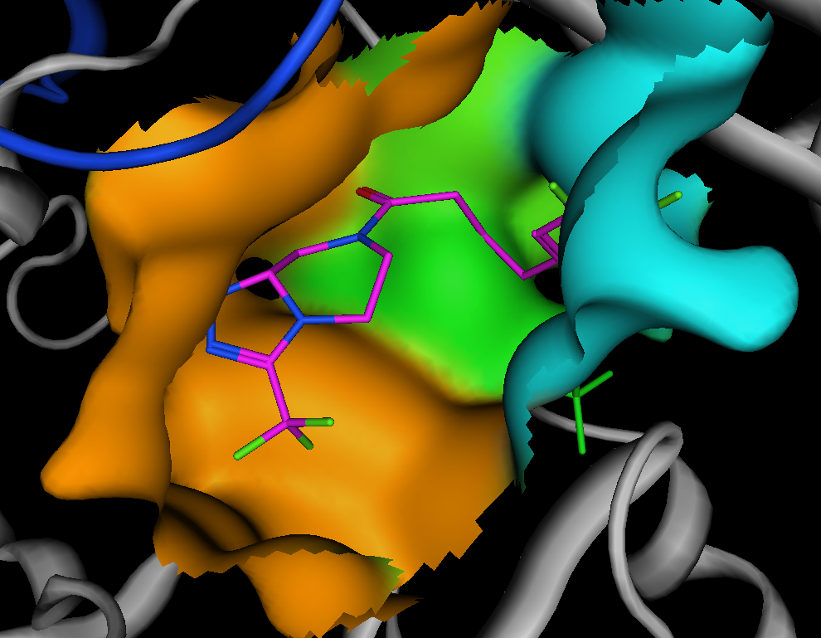
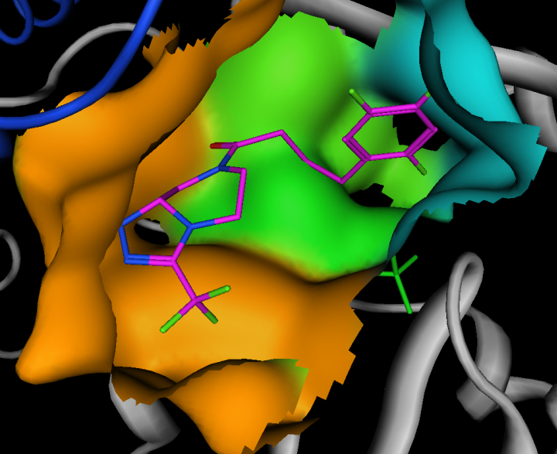
Can We Use a Transaminase Enzyme?
Problem….Our substrate looks nothing like the natural α-ketoacid substrate
cf
Starting protein homology model
Model with accumulated pocket mutations
Enzyme
Evolution
No activity with natural enzyme
Activity and selectivity established
Notes:
Modification and expansion of active site enabled pro-sitagliptin ketone to fit, establishing baseline activity. Only a single orientation of the substrate ketone (into the small and large binding pockets) prior to imine formation establishes the basis for selectivity.

Slide 18
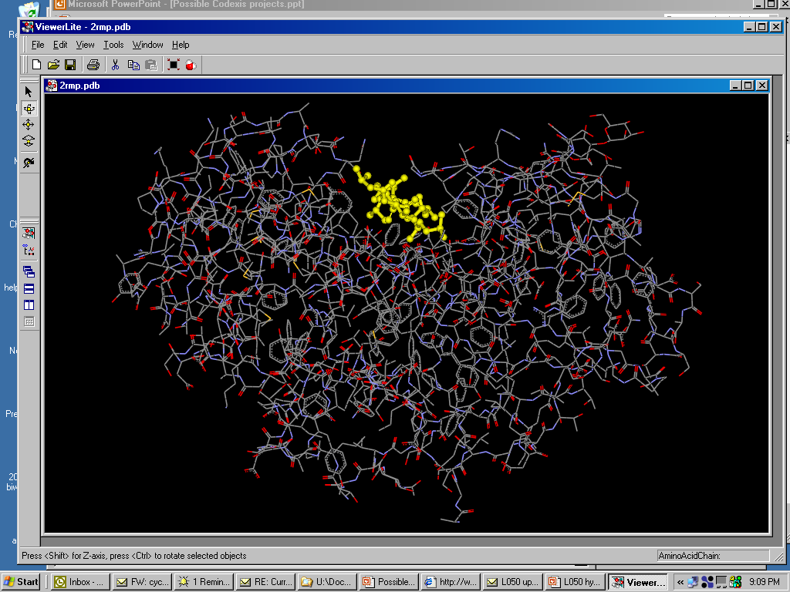
Codexis Collaboration – Enzyme Evolution
Unique technology for making enzyme improvements through amino acid changes
Define backbone: stable to solvents and temperature; easy to express, etc
Develop library of specificities on this backbone

Slide 19
Sitagliptin: The Ultimate
Manufacturing Process?
7th-round enzyme evolution (collaboration with Codexis), >95% conversion, >99.9%ee
PMI reduction from 30 to 23
Saves multi-million $/year versus the asymmetric hydrogenation approach
Lower costs enable the medicine to be available to emerging
markets such as India
2010 EPA Presidential Green Chemistry award
Notes:
The ultimate manufacturing route, which we are now using to makie sitagliptin employs a direct enzyme mediated amination of the same keto amide.
This occurs in high high yield and ee. We believe the reaction mechaniism proceeds via the well known biological enzymatic transamination mediated by an amino transferase and pyridoxal 5 phospahatre as co-factor. In this process isopropyl amine acts as N donor instead of alanaine in the natural process….acetone is removed to drive the process to completion….the key enzymatic step is the formal 1,3 shift that occurs in the catalytic site of the aminotransferase…
The amino transferase for this process was discovered in collaboratiin with a company called codexis….the initial yield in this reaction was about 1% with high

Slide 20

Conclusion
Green Chemistry is a Merck corporate commitment
Low costs, Green Chemistry and good science go
hand-in-hand
When it comes to developing a manufacturing route,
it’s easy being green
GOOD SCIENCE
NON-TOXIC
CATALYTIC
AVOID WASTE
GREEN
CHEMISTRY
ATOM EFFICIENT
ENVIRONMENTALLY
FRIENDLY
SUSTAINABLE
ENERGY EFFICIENT
SAFE

Slide 21
Let Us Meet Again
We welcome you all to our future conferences of OMICS Group International
Please Visit:
www.omicsgroup.com
www.conferenceseries.com
www.pharmaceuticalconferences.com

