Slide 1
Disseminating Information about HIV/AIDS Transmission Risk in Older Adults
Ilene Warner-Maron, PhD RN FCPP
Assistant Professor, Director Interdisciplinary Health Services
St. Joseph’s University
Philadelphia, PA
iwarnerm@sju.edu

Slide 2
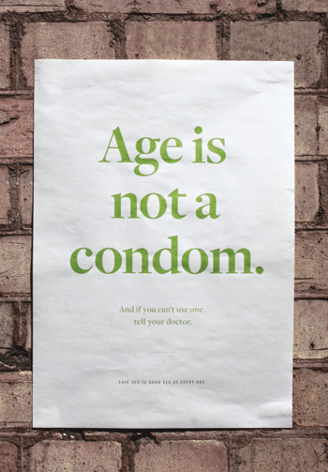

Slide 3
Older Adults
May feel embarrassed about a continued interest in sex, and lack resources about reducing the sexual risks
May be motivated to maintain sexual activity as an expression of youthfulness; diminished interest in sex may be an unwelcome indicator of “old age”
May want to remain sexually active out of a desire to sustain intimacy in both long-term and new relationships
Golub, Grov & Tomaselli (2009)
“If people don’t consider certain behaviors ‘sex’ they might not think sexual health messages pertain to them”
Dr. William Yarber, co-author of the Kinsey Study

Slide 4
For both men and women, those who rated their health as POOR were LESS likely to be engaged sexually.

Slide 5
Issues for Older Women and Men
Many older women don’t use protection during sex after menopause because there is no risk of pregnancy
With age, natural lubricant decreases and vaginal walls become thinner… putting women at greater risk for STDs
HIV/STDs have easier entry to the bloodstream of women compared to men during vaginal intercourse
Older widowers who recently lost wives are more likely to have a STD compared to married peers
Within six months-1 year: 16% more likely to have an STD
Since 1998, STDs among widowed men increased 83%!!! (ED drugs released in 1998—coincidence???)
Most common STD among widowers: Gonorrhea

Slide 6
Audience Poll
How many times have you:
Seen a billboard with the message that older adults may be at risk for HIV?
Heard of an HIV testing campaign older adults
Known about programs that teach older adults how to practice condom skills?
Know of a drug store that supplies female condoms?
Heard older people engaged in a discussion about sexuality in a social setting?
Read about HIV/AIDS issues in older adults in a professional journal during the past 5 years?
How often to older adult patients raise questions about sexual issues during your exam/interviews?

Slide 7
Older People Worldwide Face Rising HIV Risks
Adults 50+ much more likely to have unprotected sex than younger people
50% of all HIV/AIDS cases in the US in 2015 will be in people 50+
Many doctors, unaccustomed to talking with their older patients about sex, are too often failing to promote safer sex or to screen seniors for HIV infection.
Widespread belief among older people that HIV is a threat only to younger generations.
Condom use is very low among seniors
Use of erectile dysfunction drugs has allowed many seniors to engage in sex more often, which also boosts HIV and sexually transmitted diseases risks among older people.

Slide 8
Risk Factors and Barriers
Stigma
Poverty
Sexually transmitted diseases
Substance Use
Lack of Awareness of HIV Serostatus
Unprotected sex with multiple partners
Being a Gay or Bisexual Man, especially Men of Color
Sex with an injection drug user
Unawareness of partner’s sexual history
Not understanding the concept of SAFE SEX
Not having the ability to negotiate condom use
Not being able to use a male condom or buy a female condom

Slide 9
HIV Symptoms
As fatigue, weight loss, dementia, skin rashes, swollen lymph nodes are misdiagnosed frequently in older people who are, in fact, infected
The older adult additionally infected with HIV may feel another "loss" and endure more severe depression because of lower energy levels and restrictions in social routines (which can cause emotional/psychological problems)
How are these symptoms similar to geriatric syndromes and symptoms of diseases other than AIDS?

Slide 10
HIV/AIDS and AGING
Older adults face a double stigma: ageism and infection with a sexually-or-IV-drug transmitted disease
Men who have sex with men form the largest group of AIDS cases in the over-50 population and often struggle to find partners in late life
The number of cases in women infected heterosexually have been rising at a higher rate and comprise a greater percentage as age increases into the 60+

Slide 11
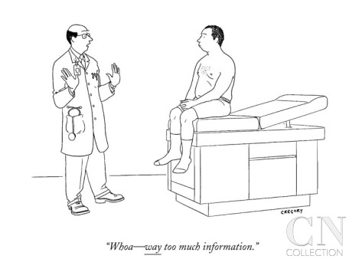

Slide 12
Barriers: A Physician’s Perspective
Lack of awareness of HIV/AIDS among older adults
Lack of recognition of sexuality among older adults
Lack of journal/conference/materials describing issues and guidance for care
Embarrassment (for whom)?
Time
An inverse relationship between the number of diagnoses and the amount of time spent discussing sexuality/safe sex

Slide 13
Barriers: A Nurse Practitioner’s Perspective
Time
Embarrassment
“Low on the Radar Screen”
Lack of information to give to patients
Lack of awareness of HIV/AIDS as an issue among older adults
Bias that older adults are not sexually active

Slide 14
Barriers: A Patient’s Perspective
Provider does not raise the issue
Provider assumed the person was not sexually active
Time
Trust in provider
Gender
Fear of offending patient

Slide 15
Particular Issues with Women
Talking about sexual health issues with anyone traditionally taboo
Negotiating with men typically more difficult
Insisting on condom use in men unable/unwilling to use one may result in abandonment
Lack of knowledge/access to female condoms
Recurrent UTIs, thrush, infections, malaise attributed to aging, not HIV/AIDS
Social stereotypes of older women who are sexually active after reproduction ends
Hysterectomy and menopause may increase or decrease sexuality expressions

Slide 16
Integrative Model of Behavioral Prediction (IMBP)
Identifies factors that predict engagement in a behavior
Health communication, particularly how older adults raise questions and receive appropriate answers from health providers, can be assessed by understanding behavior and needs
Includes society’s perspectives as well as the individual health provider’s perceptions on a particular topic
Providers should explore their own prejudices, stereotypes and conflicts

Slide 17
To what degree does the older adult feel able to discuss sexuality, sexually transmitted diseases, safe sex or other related issues with a physician, nurse practitioner, physician’s assistant or any other provider?

Slide 18
What Will be the Provider’s Response
Talking about sexual health
Talking about sexual issues outside of marriage
Talking about sexual relationships with others not the patient’s spouse
Talking about a constellation of vague symptoms that may or may not be diagnostic of HIV/AIDS
Request for HIV testing
Talking about issues negotiating sexual issues with others
Talking about same sex partnerships

Slide 19
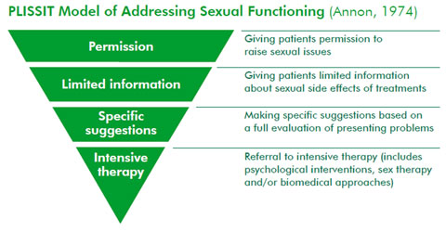

Slide 20
Should it be Standard of Care for all providers to ask all patients, regardless of age this simple question: “Do you need any information on safe sex”?

Slide 21
Emlet, Charles. “You’re Awfully Old to Have This Disease.” The Gerontologist 2006 Vol. 46, No 6. 781-790.
Hughes, AK, Rostant, OS and Curran, PG. “Improving Sexual Health Communication Between Older Women and Their Providers.” Research on Aging 2014 36:450.
Orel NA, et al. “No One is Immune: A Community Education Partnership Addressing HIV/AIDS and Older Adults.” J.Applied Gerontology June 2010 29(3):352-370.
Orel NA, Spence M and Steele J. “Getting the Message Out to Older Adults: Effective HIV Health Education Risk Reduction Publications.” J. Applied Gerontology 2005 24:490.
Pranjape, Anuradha et al. “Effect of Relationship Factors on Safe Sex Decisions in Older Inner-City Women.” J. Women’s Health. Vol. 15, November 1, 2006 90-97.
Roger KS, Mignone J and Kirkland S. “Social Aspects of HIV/AIDS and Aging”. Canadian Journal on Aging Vo.l 32 No. 3, Sept. 2013. 298-306.
Sormanti M and Shibusawa T. “Predictors of Condom Use and HIV Testing Among Midlife and Older Adult Women” J. Aging Health 2007. 19:705.
Warner-Maron, Ilene. “HIV Testing and Prevention for Older Adults: Is the Office the Proper Setting for Discussion?” Clinical Geriatrics Vol. 16; No. 8. August 2008.

