Slide 1
Physiological organization of immune response based on the homeostatic mechanism: implication in tumor and biotechnology
Malyshev Igor
Moscow State University of Medicine and Dentistry
Moscow, Russia

Slide 2
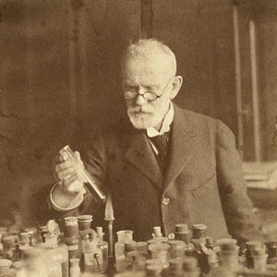
THE IMMUNE SYSTEM RESPONDS TO A PATHOGEN WITH SUCCESSIVE ACTIVATION OF INNATE AND ADAPTIVE RESPONSES
pathogen
L. Pasteur
INNATE RESPONSE
(antigen-independent)
É. Metchnikoff
ADAPTIVE RESPONSE
(antigen-dependent)
P. Ehrlich
The ideas on such organization of the immune system started developing in the 19th century

Slide 3
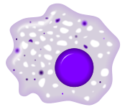
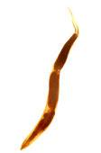
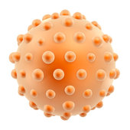
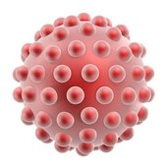
STUDIES OF THE RECENT 20 YEARS HAVE SIGNIFICANTLY SUPPLEMENTED THE “CLASSIC” MODEL OF IMMUNE RESPONSE
ADAPTIVE RESPONSE
antigen-dependent
Cellular response
Humoral response
Th1
CTL
Th2
B
IL-4, IL-13
Th0
IL-12, TNF-α
IL-10
Y
Th0
T
Y
Y
MHC-II
antibodies
IFN-γ
MHC-II
APC
MHC-I
IFN-γ
APC
М1
INNATE RESPONSE
antigen-independent
М2
Helminthes and fungi
IFN-γ
IL-12, TNF-α
IL-4, IL-13
IL-10, IL-13
Bacteria and viruses
- antigens
Natural killer
Neutrophils
Eosinophil
Basophil
The immune response is associated with the successive programming of immune cells
Notes:
Fig.2

Slide 4
Many facts have been accumulated, which contradict the classic model of the 19th-20th cs
IN THE EXISTING CONCEPT | NEW DATA
The innate response is Ag-independent | Ms can bind Abs and recognize Ags Ms can secrete PRM – ancient Abs Ag-specific Th cells program Ms
IS THE INNATE RESPONSE “ANTIGEN-INDEPENDENT”?
The adaptive response is Ag-dependent | The adaptive response T cells, can recognize tumor cell by its surface HSP60, although it is not an Ag
IS THE ADAPTIVE RESPONSE “ANTIGEN-DEPENDENT”?
The “adaptive response” - Th cell can adjust its phenotype to Th1/Th2 | Similar events also occur in the IR. The M can adjust its phenotype to M1/M2.
IS IT CORRECT TO USE THE WORD “ADAPTIVE” TO DIFFERENTIATE BETWEEN THE TWO TYPES OF IMMUNE RESPONSE?
Did not explain how the immunity recover the homeostasis | Obviously, a concept of homeostasis should help.

Slide 5
THE HOMEOSTASIS IS SUPPORTED BY A NEGATIVE FEEDBACK MECHANISM
homeostatic disorder
a negative feedback
mechanism
EFFECTOR
SENSOR
REGULATOR

Slide 6
A NEW HOMEOSTATIC MODEL OF THE IMMUNE RESPONSE
immune matrix - a biological template for immune reactions
to pathogens
matrix reprogramming –
the interdependent reprogramming
of cells in the immune matrix
antiinflammation, reparation and angiogenesis
the tissue damage
pathogenic cell
cytotoxicity, antibodies,
inflammation
a negative feedback
mechanism
REHABILITATOR M2 macrophages
an adequate immune response
EFFECTOR lymphocytes, NK macrophages
SENSOR macrophages or lymphocytes
cytokines and antigen
REGULATOR APC, Тreg and MDSC

Slide 7
WHAT HAPPENS WHEN THE TUMOR BEGINS TO GROW
“The matrix signature” of a tumor
attenuate inflammation, activate angiogenesis
In the presence of tumor
tumor cells
a positive feedback
IL-4, IL-10, TGF-β
TGF-β
Normal Ags
mechanism
REHABILITATOR protumor M2 macrophages
EFFECTOR lymphocytes, NK macrophages
SENSOR
protumor M2 macrophages
IL-4, IL-10, TGF-β
REGULATOR APC, Тreg and MDSC

Slide 8
HOW CAN WE USE NEW NOTIONS IN ANTI-TUMOR BIOTECHNOLOGY?

Slide 9
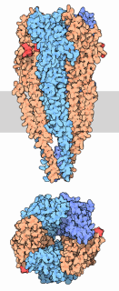
MACROPHAGES ARE VERY ATTRACTIVE TARGETS FOR BIOTECHNOLOGY TO POTENTIALLY CURE CANCER
approach is based on ramification of the TGF-β signalling pathway
protumor cytokines
TGF
macrophage TGF-β receptor
Smad-independent pathway
Smad-dependent pathway
p38 and AP-1
Smad 2/3/4
proinflammatory,
antitumor cytokines
anti-inflammatory,
protumor cytokines
“smart” macrophage
would prevent the protumor transformation of immune response.
will follow the feedback principle: the more protumor factors the tumor produces, the more antitumor factors the macrophages would release and vise versa.

Slide 10
administration of macrophages with antitumor smart M1 phenotype to mice with tumor almost doubled the mouse survival time
20
the mouse survival time
after tumor cells administration, days
10
0
CONTROL
macrophages with antitumor M1 phenotype

Slide 11
Thank you for your attention

