Slide 1
GENETIC FEATURES OF NO GENERATING SYSTEMS AND RESISTANT TO EHRLICH ASCITES CARCINOMA
Malyshev Igor
Moscow State University of
Medicine and Dentistry
Moscow, Russia

Slide 2
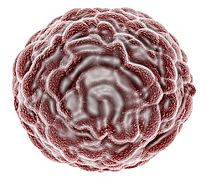
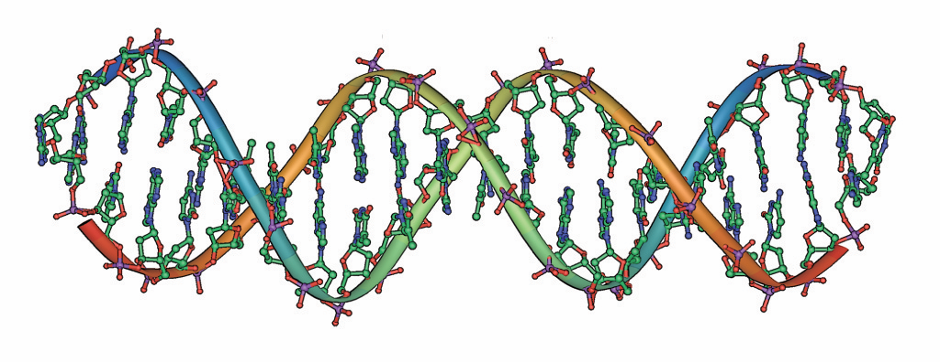

B A C K G R O U N D
VULNERABILITY TO TUMOR DEVELOPMENT
TUMOR
GENETIC PREDISPOSITION
In the immune system
NO AND EFFECTIVENESS OF THE NO-GENERATING SYSTEM
MACROPHAGE
ANTITUMOR IMMUNE DEFENCE
An individual genotype

Slide 3

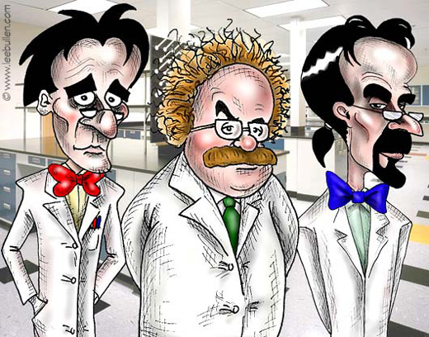
HYPOTHESES:
the vulnerability to tumors could be predetermined by genetic characteristics of the macrophage NO-generating system
I DOUBT VERY MUCH!
DO NOT DOUBT!!!
RESEARCHERS

Slide 4
THREE MAIN OBJECTIVES
were designed to achieve the study goal:
to evaluate susceptibility of different mouse substrains, C57BL/6J and C57BL/6N, to development of Ehrlich ascites carcinoma (EAC);
to study the role of NO in susceptibility to development of tumor using a NO scavenger, an inducible NO synthase inhibitor, and a NO donor;
to identify the macrophage phenotype and to evaluate the effectiveness of NO generation in macrophages from mice of different substrains.

Slide 5
Our first objective was to evaluate susceptibility of different mouse substrains to development of Ehrlich ascites carcinoma (EAC)

Slide 6
C57BL/6N MICE WERE SIGNIFICANTLY
MORE RESISTANT TO THE DEVELOPMENT
OF TUMOR THAN C57BL/6J MICE
an i.p. injection of EAC cells
~15 days
~19 days
resistance of mice to EAC was assessed by survival time

Slide 7
Our second objective was to study the role of NO in susceptibility to development of tumor using a NO scavenger, an iNOS inhibitor, and a NO donor

Slide 8
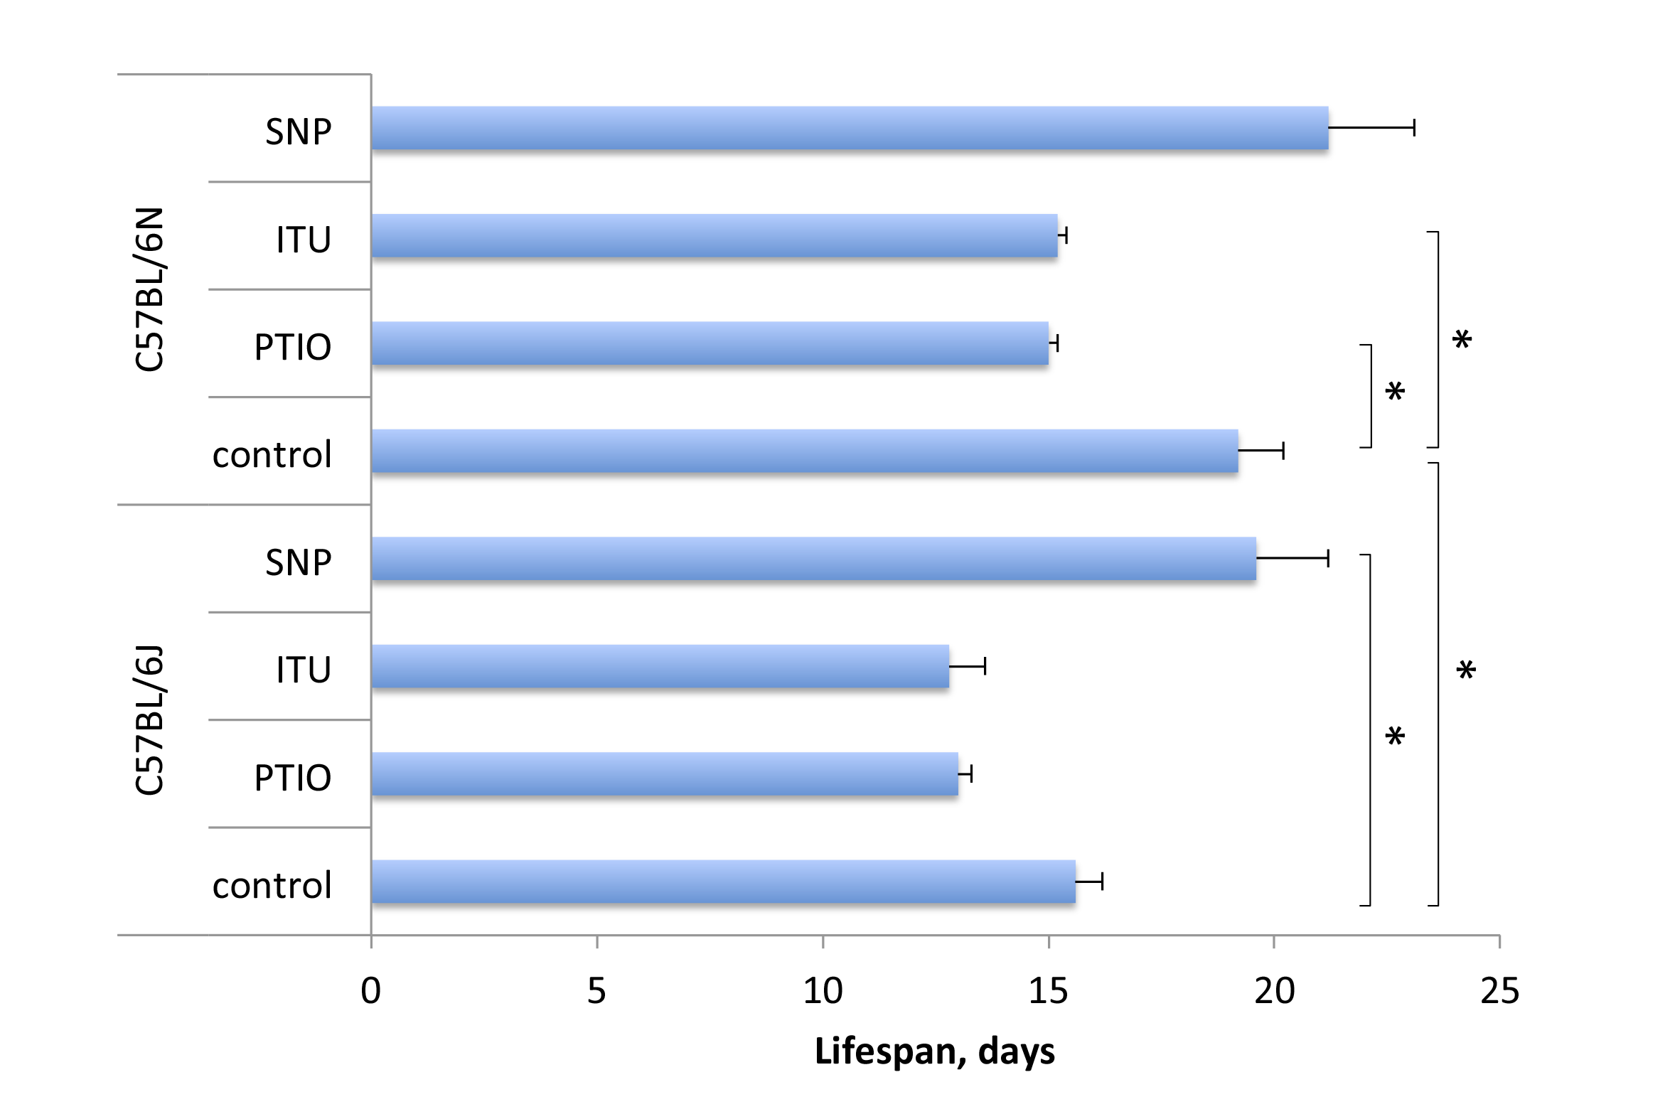
increased NO production prolongs while reduced NO production shortens survival of mice with tumor
+ NO, 10%
- NO, - 23%
mice with tumor
- NO, - 23%
+ NO, +26%
- NO, - 17%
mice with tumor
- NO, - 17%

Slide 9
Our third objective was to identify the macrophage phenotype and to evaluate the effectiveness of NO generation in macrophages from mice of different substrains

Slide 10
NO production was higher in macrophages of C57BL/6N mice than in macrophages of C57BL/6J mice
HR
LR
the macrophage phenotype of C57BL/6N mice can be defined as a more distinct proinflammatory M1 phenotype compared with macrophages of C57BL/6J mice

Slide 11
NITRIC OXIDE plays a dual role in carcinogenesis
NO can exerts anti-tumor effects
by inhibiting synthesis of anti-apoptotic Bcl-2
by increasing expression of proapoptotic Bax
can induce APOPTOSIS
by increasing expression of proapoptotic p53
NO
TUMOR
by nitrosylating caspases
by activating HSP70 synthesis
can restrict APOPTOSIS
by inhibiting of Complex IV in mitochondria
NO can exerts pro-tumor effects

Slide 12
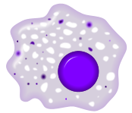
NO exerted an anti-tumor effect
+ NO, 10%
М1
- NO, - 23%
possess a more expresed PI-M1 phenotype
- NO, - 23%
+ NO, +26%
- NO, - 17%
- NO, - 17%

Slide 13
?
What determines the genetically higher potency of NO-generating systems in macs of C57BL/6N mice compared with macs of C57BL/6J mice
!
The fact that NO plays an important role in the prolonged survival under EAC, makes it promising to develop new approaches to anti-tumor treatment by manipulating NO in the tumor

Slide 14
THE MAIN CONCLUSIONS OF OUR WORK
1. C57BL/6N mice were significantly more resistant to the development of EAC than C57BL/6J mice as shown by the parameters of survival duration.
2. Increased NO production prolongs while reduced NO production shortens survival of mice with EAC.
3. Macs of HR to tumor C57BL/6N mice have more powerful NO generating system and a more distinct M1 phenotype than macs of LR C57BL/6J mice.

Slide 15
HYPOTHESES:
the vulnerability to tumors is predetermined by genetic characteristics of the macrophage NO-generating system
I HAVE NO DOUBT!!!
DO NOT DOUBT!!!
RESEARCHERS

Slide 16
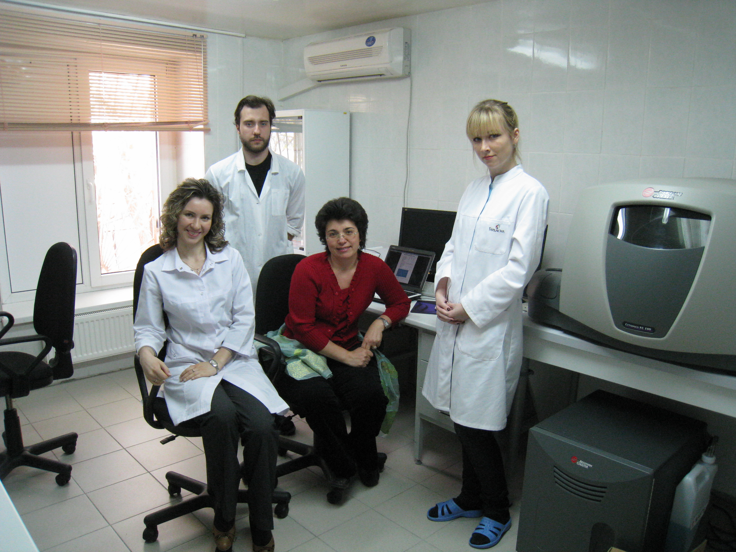
I appreciate deeply:
my colleagues from my Lab, doctors Lyamina and Kalish and students from department of Pathophysiology for cooperation in this research.
the Ministry of Science and Education of Russia for financial support. Agreement №14.604.21.0020, Unique identifier applied research RFMEFI60414X0020

Slide 17
Thank you for your attention

