Slide 1
Removing the mask: Women returning to work after a depression
Heather MacDonald RN PhD

Slide 2
Canada
New Brunswick

Slide 3
University of New Brunswick

Slide 4
Literature on Depression
Urgent and complex
Leading cause of disease worldwide
70% of one million Canadians with depression are working
Productivity plummets
More lost work days than any other medical conditions
5 to 10 times more common than other diseases
Length of episodes longer
Depression affects more women than men at a ratio of 2:1
May be due to multiple roles

Slide 5
Purpose
The purpose of this grounded theory study is to expand our gender-based knowledge, inform policy and practice by exploring the experiences and implications of workplace re-entry for women’s health and well being following a lapse in employment due to depression.

Slide 6
Methodology
Qualitative Research
Grounded Theory
40 women who have returned to work after depression
Used an interview guide
Conversational approach
Pilot project with 10 women

Slide 7
Sample continued
Convenience and purposive sampling techniques – posters, newspapers
Wanted a community sample rather than a single workplace
Sample included women from universities, hospitals, government offices, retail businesses, teachers, etc.

Slide 8
Sample
40 English speaking women over 19 years of age who have returned to work following depression. Age range 23 to 64. Mean age 46.5
19 Single – 21 Married
One First Nation, 5 Francophone
Ten were mothers
Currently employed full-time, part-time or seasonal
At least a 3 month lapse from work that was due to depression

Slide 9
Data Collection and Analysis
Audio recorded interviews
Transcribed verbatim
Used data analysis platform Nvivo
Line by line open coding
Constant comparison
Categories
Theoretical sampling
Theory development

Slide 10
The Depression Experience
“Black Hole”
Overwhelming Fatigue and Sadness
Poor Memory and Inability to
Concentrate
Changes in Eating and personal grooming
Disinterest in Normal Activities

Slide 11
Depression and Work
“Couldn’t get out of bed. Lived on the couch”
“Got really behind at work. Couldn’t keep up
with e-mail”
“Avoided social contact”
“Had to put on a face”
“Overwhelmed by the amount of
work”
“Couldn’t focus”
“No attention span”

Slide 12
“Relief that I didn’t have to go out of my house” “Didn’t have to put on a face” “No more acting” “Worried about what people would think” “No contact from work”

Slide 13
Returning to Work
“Need a gradual return”
“Memory poor and no concentration”
“No support. If I had had a broken leg there would have been support.”
“Once you’re back the work is
piled on as if you’re fixed”
“Was put at a desk with nothing
to do”

Slide 14
Returning to Work
“I am at the end of a hallway and I don’t see anyone. I only see them if they go to the photocopier. I have nothing to do and no one to talk to. It is very strange. A broken boardroom chair that I’m sitting on and a 1960 desk. “ Interview 27

Slide 15
Barriers to Returning to Work
Stigma and discrimination
Fear of self-disclosing
Concentration and memory issues

Slide 16
Stigma
“Because once you are tagged with mental illness you’re a problem to the corporation. You are either going to be laid off or fired or you are just seen as somebody that cannot handle responsibility, that’s too fragile. I cannot tell you the amount of prejudice in the workplace.” Interview 3

Slide 17
“…one person that I told that I was off for anxiety and depression said oh yeah we’re all stressed here but we don’t get to take the summer off.” Interview 1

Slide 18
Benefits to Returning to Work
Economics
Structure helpful in recovery
Combats social isolation

Slide 19
Reoccurring Theme Battling Adversity
Battling Depression
Battling the Workplace
Battling the Institution
Institutional Focus
- institution
- workplace
- health care system

Slide 20
Battling Adversity
“I was told by the insurance company that I had to return to work or my benefits would be cut off. I wasn’t ready but I went back. After my 30 day progressive return I met with HR and they told me that my corporate values differed from theirs and that they were laying me off. Then the security guard accompanied back to my office and I picked up my stuff. They gave me $25,000 dollars to shut up. I was disgusted but too weak to fight them.” Interview 7

Slide 21
Reoccurring Theme: The Active Practice of Silence
Concealing their Depression
Strategic Disclosure
Secrecy within workplace

Slide 22
Concealing Depression
“So I didn’t tell them I had a depression I just told them I had surgery, it’s easier that way.” Interview 8

Slide 23
Concealing Depression
“I didn’t disclose. I had taken some time off and so they knew I was taking off for sick reasons, initially it was just vacation days and stuff like that and in all honesty I wasn’t getting any support.” Interview 6

Slide 24
Secrecy within Workplace
“ Yeah, it’s the silence. If I had arthritis they would be saying hey you want to check out this book or that site but with depression it is so silent.” Interview 9

Slide 25
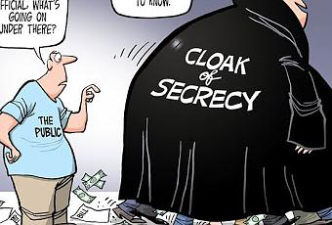
Secrecy in Workplace
“ Part of my depression was a feeling of loneliness and so I’m still feeling lonely within my work environment. I’ve been back now for 3 weeks , nobody has come down to my office to see how I’m doing.” Interview1

Slide 26
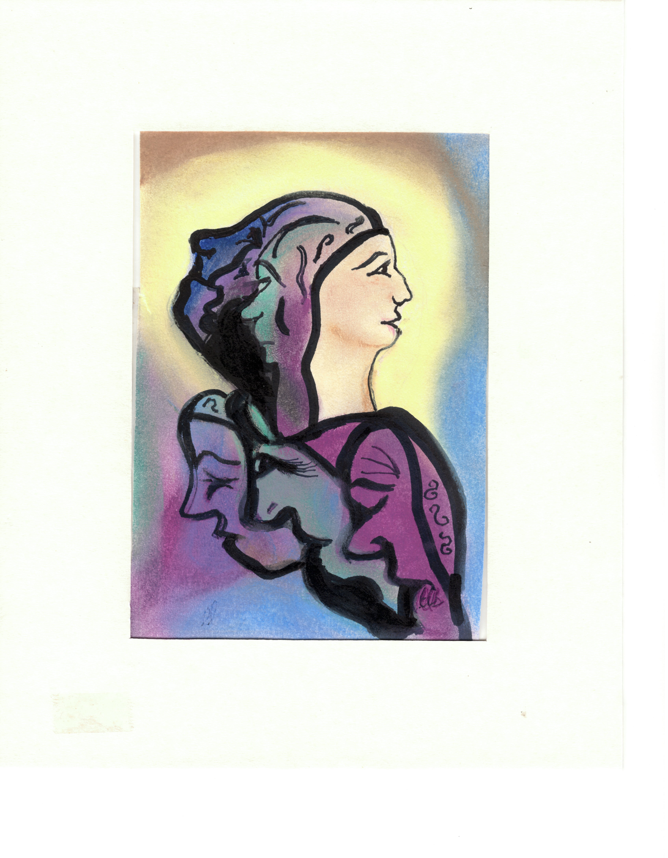

Slide 27
Questions

