Slide 1
GABA- LOADED HALLOYSITE NANOTUBE SYSTEM: RELEASE CHARACTERISTICS and EFFECT on SEIZURE PARAMETERS in EPILEPTIC RATS
Dr. Gülsel YURTDAŞ KIRIMLIOĞLU, Prof.Dr. Yasemin YAZAN, Prof.Dr. Kevser EROL, Res.Assis. Çiğdem ÇENGELLİ
4TH INTERNATIONAL CONFERENCE & EXHIBITION ON NEUROLOGY AND THERAPEUTICS, ROME
Notes:
Thank you Mr./Ms. Chairman for your kind introduction.
Distinguished participants,
First of all I would like to thank the organizing committee for inviting me.
I am going to present a part of our study on ‘Release characteristics of gamma-aminobutyric acid (GABA)-loaded halloysite nanotube system: Investigation of seizure parameters in epileptic rats.

Slide 2
OUTLINE
INTRODUCTION
EXPERIMENTAL
Characterization
RESULTS and DISCUSSION
In vitro study
In vivo study
Methods
4TH INTERNATIONAL CONFERENCE & EXHIBITION ON NEUROLOGY AND THERAPEUTICS, ROME
Notes:
The outline of my presentation will be as follows: OKU
In experimental studies, halloysite nanoparticles were prepared for loading GABA for extended antiepileptic activity. Formulations were characterized with different methods. In the in vivo study, effects of nanotube formulations on seizure parameters were investigated in epileptic rats.

Slide 3
EPILEPSY
• ‘epilepsy’
generalized or paroxysmal focal reaction of brain
• convulsion provoked by inhibition of GABA synthesis, blockage of release or postsynaptic reaction
4TH INTERNATIONAL CONFERENCE & EXHIBITION ON NEUROLOGY AND THERAPEUTICS, ROME
Notes:
Epilepsy is one of the most common neurological diseases worldwide. Generalized or paroxysmal focal reaction of brain is called “epilepsy”.
Studies on epilepsy determined convulsion provoking by inhibition of GABA synthesis, blockage of release or postsynaptic reaction.

Slide 4
γ-Aminobutyric Acid (GABA)
• Major inhibitor neurotransmitter in central nervous system
• -COOH and –NH₂ groups
• Regulation of impulse transmission, induction of hypotensive, diuretic and tranquilizer effects
• Changes in GABA metabolism may play an important role in the origin and spreading of seizure activity in epilepsy
4TH INTERNATIONAL CONFERENCE & EXHIBITION ON NEUROLOGY AND THERAPEUTICS, ROME
Notes:
GABA is a major neurotransmitter where it usually inhibits impulse transmission. It consists of carboxyl and amino groups. GABA has different biological functions, such as regulation of impulse transmission, induction of hypotensive, diuretic and tranquilizer effects.
Changes in GABA metabolism may play an important role in the origin and spreading of seizure activity in epilepsy.

Slide 5
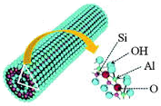
HALLOYSITE NANOTUBE (HNT)
Tubular structure
Good biocompatibility and very low cytotoxicity
Two-layered aluminosilicate
Outer diameter 50-100 nm, length 0.5-2 µm
4TH INTERNATIONAL CONFERENCE & EXHIBITION ON NEUROLOGY AND THERAPEUTICS, ROME
Notes:
Halloysite nanotube is an unusual clay mineral having a hollow tubular structure in the submicron range. The nanotubular structure, good biocompatibility and very low cytotoxicity make halloysite a promising carrier for drug delivery.
Halloysite nanotube is a two-layered aluminosilicate. For the enhancement of stability and release characteristics of GABA, with the consideration of tubular structure and non-toxic properties, halloysite was selected as the carrier material.

Slide 6
AIMS
Incorporation of GABA into halloysite
- nanosized
- nontoxic
- biocompatible
- highly specific and high affinity formulations
Providing GABA entrance into brain
Modifying GABA release from formulations
Minimizing serious side effects
Enhancing patient compliance
4TH INTERNATIONAL CONFERENCE & EXHIBITION ON NEUROLOGY AND THERAPEUTICS, ROME
Notes:
Depending on the most recent theory regarding the reduced GABA level in epileptic brain,
incorporation of GABA into halloysite was the purpose of this study for developing brain-targeted, nanosized, nontoxic, biocompatible, highly specific and high affinity halloysite nanotube formulations with an attempt to provide entrance of GABA into the brain.
Modifying GABA release from formulations and minimizing serious side effects of anti-epileptics for patient compliance enhancement were also aimed.

Slide 7
EXPERIMENTAL
Notes:
DURING THE EXPERIMENTAL STUDIES

Slide 8
PREPARATION of GABA-LOADED HNTs
Loading Methods
Under vacuum (100 mmHg)
1:1 molar ratio
HNT-GABA VAC
Heat treatment (80ºC, 2 hr)
Heat treatment + Washing + Centrifugation
1:1 molar ratio
HNT-GABA H1
Heat treatment + Washing + Centrifugation
1:2 Molar ratio
HNT-GABA H2
Heat treatment + Frezee- drying
1:1 Molar ratio
HNT-GABA H3
4TH INTERNATIONAL CONFERENCE & EXHIBITION ON NEUROLOGY AND THERAPEUTICS, ROME
Notes:
Different techniques were used for loading GABA into halloysite nanotubes. One of the methods was performed under vacuum. Vacuum was applied to intact halloysite prior to the addition of GABA solution. Vacuum was reapplied to the resulting halloysite-GABA suspension for 30 minutes. This process was repeated two times in order the increase the loading efficiency.
Heat treatment was the other method used. GABA solution was added to halloysites swollen in bidistilled water. Resulting suspension was kept for another 1 hr at 80°C. Suspensions were then washed with bidistilled water, centrifuged and dried.
Third formulation with no washing procedure was prepared using the same heat treatment method and the suspension obtained was lyophilized.

Slide 9
CHARACTERIZATION
CHARACTERIZATION
Particle Size
pH Value
Morphology
Thermal Analysis (DSC)
X-Ray Diffraction (XRD) Analysis
Infrared (IR) Analysis
Cytotoxicity
Zeta Potential
4TH INTERNATIONAL CONFERENCE & EXHIBITION ON NEUROLOGY AND THERAPEUTICS, ROME
Notes:
For the characterization studies, zeta potential and particle sizes were measured with Malvern Nanoseries. Morphology of the particles was determined using SEM and the structure of halloysite nanotubes were analyzed using DSC, XRD and FT-IR.
Viability of cells in the presence of nanotubes were investigated using MTT assay.

Slide 10
DETERMINATION of GABA in HNTS
Cihaz | Schimadzu- 20A
Column | 4.6 x 100 mm, 3 µm C₁₈ Inertsil CDS column, particle size 100 Å
Oven Temperature | 30°C
Mobil Phase | Methanol:Na₂HPO₄ buffer (40:60) (pH 6.7)
Dedector | Fluorescence dedector
Wavelength | 280 nm – 450 nm
Flow Rate | 0.8 mL.min⁻¹
Injection vVlume | 27 µL
4TH INTERNATIONAL CONFERENCE & EXHIBITION ON NEUROLOGY AND THERAPEUTICS, ROME
Notes:
For the determination of GABA a modified HPLC method was used. The method used is summarized here.

Slide 11
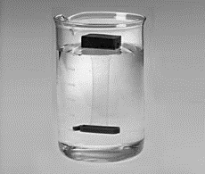
In Vitro Drug Release
Dialysis bag (3500-5000 Da)
pH 7.4 phosphate buffer
Validated HPLC method
4TH INTERNATIONAL CONFERENCE & EXHIBITION ON NEUROLOGY AND THERAPEUTICS, ROME
Notes:
Release of GABA from nanotubes was tested using dialysis bags. Nanotubes were placed in a cellulose acetate dialysis bag and an approximately 1 mL of dissolution media (PBS) was added which was then sealed at both ends. The dialysis bag was dipped into the receptor compartment containing PBS maintained at 37°C while stirring continuously at 100 rpm.
Samples were withdrawn at regular time intervals and the same volume was replaced by fresh dissolution medium. Samples were then tested by the validated HPLC method.

Slide 12
IN VIVO STUDY PROTOCOL
Eskişehir Osmangazi University Scientific Ethical Committee
(Protocol No: 265/2012)
Wistar rats
Group Code | Treatment
Group 1 | PBS (ip)
Group 2 | GABA solution (100 mg.kg⁻¹) (ip)
Group 3 | HNT-GABA H1 (100 mg.kg⁻¹ GABA) (ip)
4TH INTERNATIONAL CONFERENCE & EXHIBITION ON NEUROLOGY AND THERAPEUTICS, ROME
Notes:
For the in vivo studies Wistar rats were used.
All animal experiments were conducted under the protocols approved by the ethical committee.
Rats were kept under controlled environmental conditions. Standard laboratory food and tap water were allowed ad libitum.
Animals were divided into three groups consisting of seven rats per group. PBS, solution of GABA and nanotube formulation selected according to the in vitro tests were administered to separate groups.

Slide 13
IN VIVO STUDY PROTOCOL
Pentylenetetrazole (70 mg/kg) induced epileptic model
Latency to myoclonic jerks and incidence of generalized tonic clonic seizures with loss of righting reflex noted for 30 min
Rats decapitated under ether anaesthesia
Brains removed immediately and Stratum corsatum isolated
GABA concentration in Stratum corsatum ELISA kit
4TH INTERNATIONAL CONFERENCE & EXHIBITION ON NEUROLOGY AND THERAPEUTICS, ROME
Notes:
Penthylenetetrazole (pentilenetetrazol) was used for generating epilepsy model. After four hours of injecting formulations, penthylentetrazole was injected via ip route to induce seizures.
In the observation period, the latency to myoclonic jerks and incidence of generalized tonic clonic seizures with the loss of righting reflex were noted for 30 minutes.
At the end of the observation period, rats were decapitated under ether anaesthesia (anesteja). Brain was immediately removed and Stratum corsatum was isolated. Tissue samples were homogenized with PBS. GABA concentrations in Stratum corsatum samples were investigated by enzyme immunoassay analyser using Rat GABA ELISA Kit.

Slide 14
As a result of the analyses
RESULTS and DISCUSSION
Notes:
As a result of the analyses

Slide 15
CHARACTERIZATION
Particle Size, Zeta Potential, pH value
 | HNT-GABA VAC | HNT-GABA H1 | HNT-GABA H2 | HNT-GABA H3 | HNT (pure)
Particle size (nm) | 554.20 ± 25.18 | 444.20 ± 2.36 | 530.70 ± 5.06 | 807.70 ± 10.72 | 446.80 ±23.71
PI | 0.67 ± 0.02 | 0.27 ± 0.10 | 0.45 ± 0.07 | 0.68 ± 0.09 | 0.42 ± 0.06
Zeta potential (mV) | -32.70 ± 0.58 | -28.80 ± 0.38 | -25.30 ± 2.78 | -30.20 ± 2.44 | -22.30 ± 0.09
pH value | 7.28 ± 0.01 | 7.42 ± 0.01 | 7.45 ± 0.00 | 7.29 ± 0.01 | 7.38 ± 0.00
PI: Polydispersity index, SE: Standard error
4TH INTERNATIONAL CONFERENCE & EXHIBITION ON NEUROLOGY AND THERAPEUTICS, ROME
Notes:
Here are the particle size and distribution, zeta potential and pH values of halloysite nanotube formulations.
Particle size analyses showed homogeneous size distribution considering the polidispersity indices. The smallest particle size was determined for formulation prepared with heat treatment.
Zeta potential values measured displayed the negatively charged characteristic of the formulations.
pH values of pure halloysite and GABA loaded nanotubes were found to be in the physiological pH range. Therefore no pH adjustment was required before ip application to rats.

Slide 16
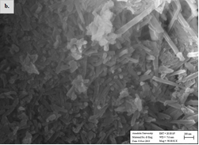
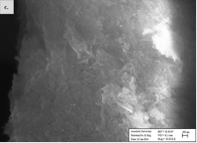
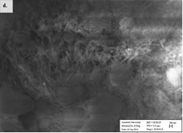
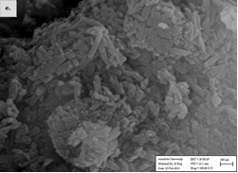
CHARACTERIZATION- Morphology
HNT-GABA VAC
HNT-GABA-H1
HNT-GABA H3
HNT-GABA H2
HNT (PURE)
Notes:
Morphological studies demonstrated that all particles prepared were in tubular shape and nanometer-sized.

Slide 17
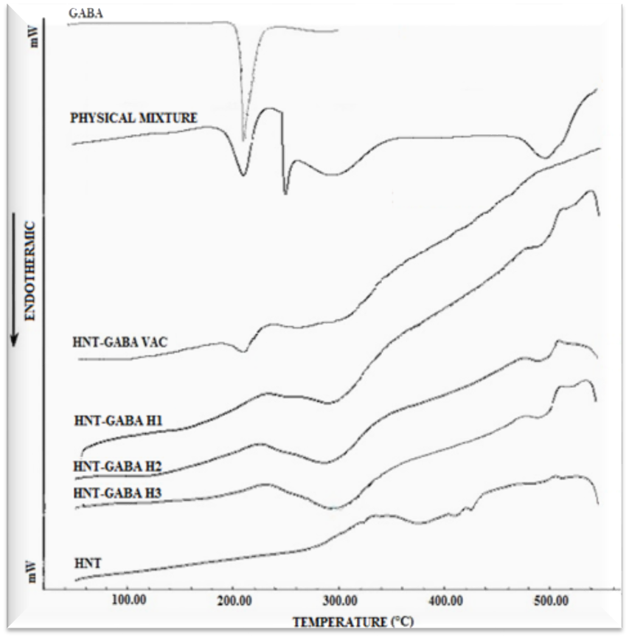
CHARACTERIZATION- Thermal Analysis
Notes:
In DSC analyses, GABA-halloysite physical mixture showed a sharp melting endotherm which is characteristic to GABA melting. This peak was not observed in DSC profiles of formulations prepared with heat treatment while a broad endothermic peak was observed at 300°C as seen in Figure.
Disappearance or decrease in intensity of drug endothermic peak may be related to possible drug-matrix interaction or loss of drug crystallinity.

Slide 18
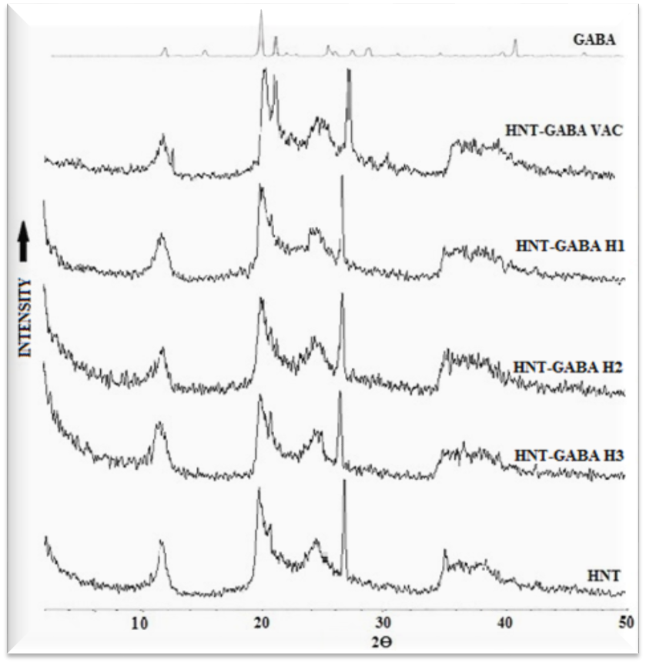
CHARACTERIZATION- XRD Analysis
Notes:
All peaks observed for halloysite samples are similar to that of pure halloysite as shown in the Figure. Due to the tubular structure of halloysite, GABA detected in profiles may be attributed to GABA filling internal tubes while disappearance of GABA overlapped by halloysite peaks may be attributed to the low quantity of GABA in nanotube formulations.

Slide 19
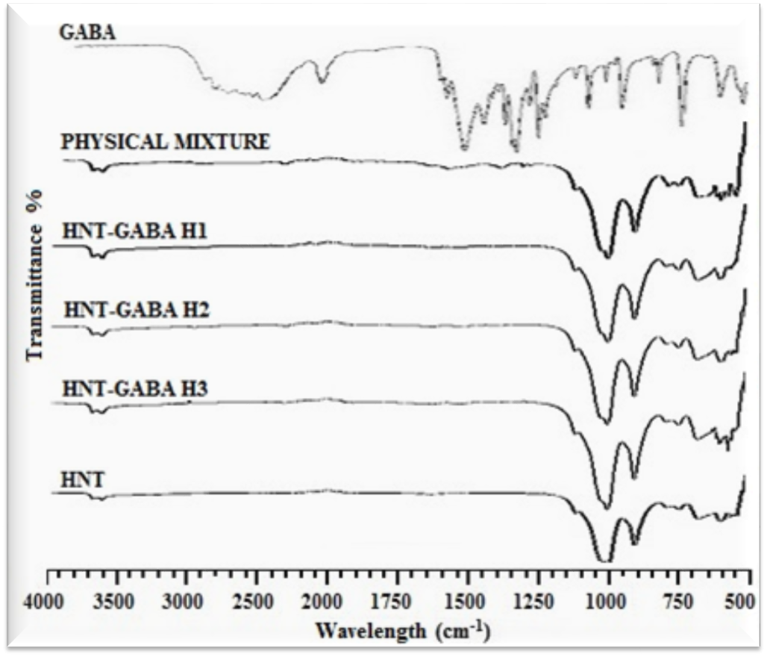
CHARACTERIZATION- FT-IR Analysis
Notes:
In FT-IR analyses, disappearance of GABA band corresponding to the carboxylate group at 1574.55 cm⁻¹ (GÖSTER) in spectra of nanotube formulations suggested interaction of GABA and halloysite. However, spectral results of HNT-GABA H1 showed shifting of internal hydroxyl bands to Si-O-Si stretching bands.

Slide 20
GABA loading of nanotube formulations is shown in the Table.
DETERMINATION of GABA in HNTS
 | % GABA Loading ± SE
HNT-GABA H1 | 1.720 ± 0.030
HNT-GABA H2 | 0.733 ± 0.007
HNT-GABA H3 | 8.543 ± 0.106
4TH INTERNATIONAL CONFERENCE & EXHIBITION ON NEUROLOGY AND THERAPEUTICS, ROME
Notes:
GABA loading of nanotube formulations is shown in the Table.

Slide 21
IN VITRO RELEASE STUDY Dialysis Bag
4TH INTERNATIONAL CONFERENCE & EXHIBITION ON NEUROLOGY AND THERAPEUTICS, ROME
Notes:
Formulations prepared with heat treatment were further tested for in vitro release. GABA release from all nanotube formulations was much lower than its pure form.
Time-dependent release profiles of GABA from different nanotube formulations are presented in the Figure. Prolonged release of GABA was ascribed to the release of lumen loaded GABA.
Considering both characterization and in vitro release properties: HNT-GABA H1 possessing intense interaction between the active agent and Halloysite and having the smallest particle size with more uniform release pattern was selected for the in vivo studies.

Slide 22
CYTOTOXICITY
4TH INTERNATIONAL CONFERENCE & EXHIBITION ON NEUROLOGY AND THERAPEUTICS, ROME
Notes:
It is remarkable to note that GABA-loaded halloysite formulation and pure halloysite demonstrated higher cell viability values than pure GABA. In other words, in vitro cytotoxicity results of formulations showed clear evidence of reduction in cytotoxicity of GABA preserving its potency.

Slide 23
IN VIVO STUDIES
Seizure parameters | GABA Solution | PBS (pH 7.4) | HNT-GABA H1
Latency ± SD (min) | 01.13 ± 00.13 | 01.12 ± 00.18 | 01.31 ± 00.48
Ending time of the convulsion ± SD (immobility) (min) | 25.35 ± 04.43 | 21.21 ± 08.51 | 17.59 ± 09.36
Duration of severe convulsion ± SD (min) | 02.37 ± 01.34 | 04.25 ± 01.57 | 01.35 ± 01.02
Time of death ± SD (min) | 10.58 | 12:42 | -
Mortality ratio (%) | 4/7 (57.1) | 3/7 (42.8) | 0/7 (0)
PBS: Phosphate buffer saline, SD: Standard deviation
 | HNT-GABA H1
Groups | Latency ± SD (min) | Ending time of the convulsion ± SD (immobility) (min) | Duration of severe convulsion ± SD (min)
PBS | * | * | **
GABA solution | * | ** | **
SD: Standart deviation, p > 0.05: No significant difference, *: p < 0.05, **: p < 0.01, ***: p < 0.001
Notes:
Seizure parameters obtained using PTZ model in this study can be followed in the Table. Depending on the statistical results evaluated by paired t-test: A significant retardation in latency time, a significant decrease in ending time of convulsion and a significant decrease the duration of severe convulsion were determined for GABA loaded formulation when compared to PBS and GABA solution. Moreover, mortality ratio decreased to zero percent.
It can be concluded that incorporation of GABA into halloysite nanotube formulation provides prevention of seizures and mortality and also extension of lifetime.

Slide 24
GABA AMOUNT in Stratum Corsatum
4TH INTERNATIONAL CONFERENCE & EXHIBITION ON NEUROLOGY AND THERAPEUTICS, ROME
Notes:
According to immunoassay GABA concentration in Stratum corsatum, there seems to be no significant increment of GABA quantity in Stratum corsatum for the formulation when compared to PBS or pure GABA.
In terms of seizure parameters, it was seen that GABA-loaded halloysite formulation interfered with the epileptic mechanism in comparison to pure GABA solution and PBS. GABA delivered to the brain using the nanotube formulation may be assumed to accumulate in other regions of the brain such as the cortex.

Slide 25
CONCLUSION
Notes:
As a conclusion

Slide 26
HNT-GABA H1
Nanosize
Tubular shape
Succesful incorporation of GABA
Sustained release manner
Low cytotoxicity
• Brain delivery and seizure inhibition
• Retardation of latency time
• Decrease in ending time of convulsion
• Decrease of duration of severe convulsion
• Reduction of mortality ratio
PTZ induced epileptic rat model
Notes:
In this study, halloysite nanotubes were prepared for brain delivery of GABA. Among the nanotube formulations prepared, HNT-GABA H1 was selected for animal studies depending on characterization and in vitro release studies. This formulation possessed sustained release manner and low cytotoxicity.
In vivo studies performed provided evidence for brain delivery and seizure inhibition of GABA in PTZ-induced epileptic rat model. HNT nanotubes containing GABA presented retardation in latency time, decrease in ending time of convulsion, duration of severe convulsion and mortality ratio. On the contrary, no significant increment of GABA concentration was found in Stratum corsatum samples.
It can be concluded that GABA-loaded halloysite nanotubes seem to be highly promising candidates for brain delivery to treat epilepsy due to enhancements in seizure parameters.

Slide 27
gyurtdas@anadolu.edu.tr
Notes:
I would like to thank Çanakkale Ceramic for supplying halloysites and my colleagues for their professional support. Finally, I would like to introduce you my university.
Thank you for your attention.

