Slide 1
Does bitter melon (Momordica charantia) have antibacterial property?
Debolina Ghosh,
Hathaway Brown High School, Shaker Heights, Ohio, USA

Slide 2
Background
Bitter Melon (Mormodica charantia)
Popular in Southern Asia
Used mainly for culinary purposes
Claimed to work against diabetes, cancer, and cardiovascular diseases
Substance responsible for regulating the body metabolism and transporting glucose from blood into the cells
Africa: Gastrointestinal parasitic disease treatment
Anecdotal antimalarial and antiviral properties

Slide 3
Background
Infection: bacteria, viruses, or fungi invade body tissues and produce inflammation and tissue damage
Bacteria
Gram positive: thick cell wall, 50-90% peptidoglycan
Gram negative: thin cell wall, 10% peptidoglycan
Antibiotics
Bactericidal: kill the bacteria damaging cell wall/ membrane or altering necessary bacterial enzymes.
Bacteriostatic: inhibit the active growth of the bacteria without killing them

Slide 4
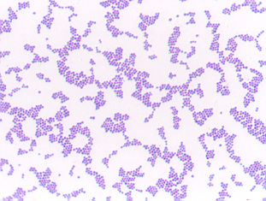
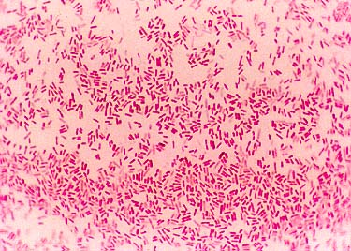
Background
Bacteria:
Gram +ve: Staphylococcus aureus
has golden yellow hue-
skin infections, pneumonia, sepsis
Gram -ve: Escherichia coli-
GI problems, sepsis
Antibiotics:
Bactericidal against gram +ve: Penicillin
Bacteriostatic against gram +ve: Erythromycin
Bactericidal/bacteriostatic against gram -ve: Gentamicin
http://faculty.ccbcmd.edu/courses/bio141/lecguide/unit3/bacpath/diseases/staphaureus/gpstaph.html
http://faculty.ccbcmd.edu/courses/bio141/labmanua/lab16/gramstain/gnrod.html

Slide 5
Background
Bitter melon contains glycosides, terpenoids, and momordicin-1
Momordicin-1 inhibits production of ribosomal proteins, therefore may have bacteriostatic activity
Has chemical that inhibits 30s ribosomal protein, similar to aminoglycosides like Gentamicin (effective against gram negative bacteria)
Hypothesis: bitter melon extract will either kill or inhibit growth of bacteria (gram positive or negative)

Slide 6
Objectives
To examine if bitter melon has any antibacterial property
If it has antibacterial property, to see the effect on gram positive and/or gram negative bacteria
To know whether the antibacterial effect is through bactericidal or bacteriostatic mechanism

Slide 7
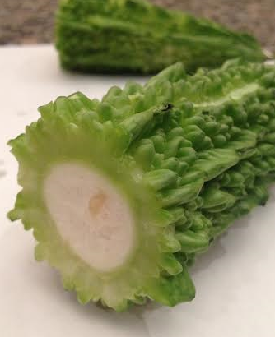
Materials and Methods
Bitter melon extracts prepared from interior core, middle, and exterior skin after homogenization and dissolving with sterile distilled water
Exterior skin
Middle skin
Interior core

Slide 8
Materials and Methods
Bacterial colonies of Staphylococcus aureus* and Escherichia coli* inoculated on nutrient agar gel media containing petri dishes
Agar gel disk diffusion method used to assess antibiotic efficacy
*Obtained from Carolina Biological Supply Company

Slide 9
Materials and Methods
The following disks* (5 in each dish) placed on petri dishes (n=7) with Staphylococcus aureus:
Positive control: commercially available Penicillin, Erythromycin disks
Negative control: un-medicated dry and distilled water-soaked disks
Test: bitter melon extract-soaked disks (interior core, middle skin and exterior skin).
*Obtained from Carolina Biological Supply Company

Slide 10
Materials and Methods
The following disks* (5 in each dish) placed on petri dishes (n=6) containing Escherichia coli:
Positive control: commercially available Gentamicin disk
Negative control: unmedicated dry and distilled water-soaked disks
Test: bitter melon extract-soaked disks.
*Obtained from Carolina Biological Supply Company

Slide 11
Materials and Methods
All petri dishes put inside an incubator at 37° C
After 24 hours of incubation petri dishes were taken out and clear zones of inhibition around the disks were measured
The whole experiment repeated on following day

Slide 12
Materials and Methods
Assessment of the mechanism of action of bitter melon against infection (bactericidal vs. bacteriostatic):
Extracts mixed with the liquid microKwik culture vials* containing Staphylococcus aureus (yellow) and Escherichia coli (white)
After 24 hour incubation at 37 °C, noted any color change of the media
*Obtained from Carolina Biological Supply Company

Slide 13
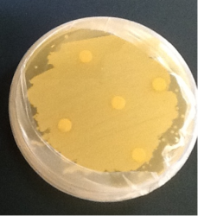
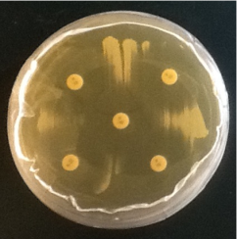
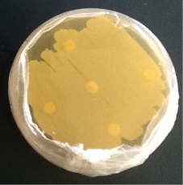
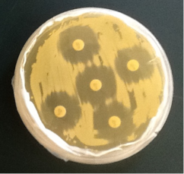
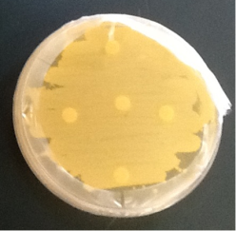
Results
No clear zones of inhibition around bitter melon extract-soaked disks
Interior core
Penicillin
Middle skin
Erythromycin
Exterior skin

Slide 14
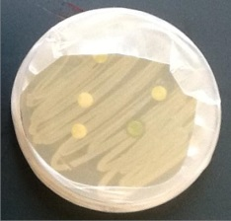
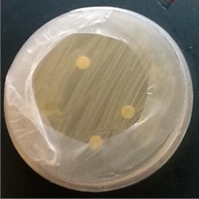
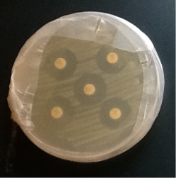
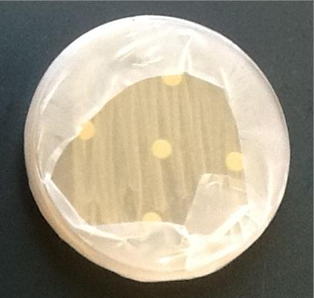
Results
No clear zones of inhibition around bitter melon extract soaked disks
Middle skin
Inner skin
Gentamicin
Exterior skin

Slide 15
Results
No color change in the bitter melon extract treated liquid microKwik culture vial containing Staphylococcus aureus (yellow) and Escherichia coli (white) after 24 hours of incubation at 37°C when compared to those vials without bitter melon extract

Slide 16
Discussion
Bitter melon (Momordica charantia) does not have antibiotic properties when tested against Staphylococcus aureus and Eschericia coli
Removes the erroneous perception that eating bitter melon will prevent bacterial infections

Slide 17
Discussion
Agar gel disk diffusion method (measuring clear zones of inhibition) used to determine presence of antibacterial property in bitter melon
For reproducibility of the data, repeated a second set of experiments following same methodology
Penicillin more potent Erythromycin against gram positive bacteria
Both negative and positive control improved quality of the study

Slide 18
Discussion
Assessing the mechanism of bitter melon’s action against infection:
No color change observed in the bitter melon extract treated liquid microKwik culture vial containing Staphylococcus aureus and Escherichia coli after 24 hours of incubation
Further proof that bitter melon does not have any bactericidal action against those bacteria

Slide 19
Limitations
Cannot completely rule out the presence of antibacterial compound in bitter melon as it may be in too minute a quantity to be picked up from the crude extract
Did not test other health benefits bitter melon may have in humans

Slide 20
Conclusions
No antibacterial action of bitter melon as proven by the lack of any zone of inhibition around bitter melon extract impregnated disks in Staphylococcus aureus and Escherichia coli colonies
No effect in the liquid microKwik culture vials after mixing with the bitter melon extract, thus disproving any bactericidal action
Even though bitter melon may not have antibacterial activity, this study does not disprove other health benefits this vegetable may have

Slide 21
Acknowledgements
Mrs. Berneice Boyle, Hathaway Brown School
Hathaway Brown School
Dr. Debabrata Ghosh, Associate Professor, Neurology and Pediatrics, Nationwide Children’s Hospital and Ohio State Medical Center, Columbus, Ohio
Dr. Sudeshna Mitra, Pediatric Neurologist, Cleveland Clinic, Cleveland, Ohio

Slide 22
Suggested Readings
Signore A (2013). About inflammation and infection. EJNMMI Res. Feb 1; 3(1):8.doi:10.1186/2191-219X-3-8.
LD (2004) Clinical Relevance of Bacteriostatic versus Bactericidal Mechanism of Action in the Treatment of Gram-Positive Bacterial Infections. Clin Inf Dis; 38: 864-870.
Lederberg J (1957) Mechanism of action of Penicillin. J Bacteriol; 73: 144.
Arioli V, Berti M, Carniti G, Randisi E, Rossi E, Scotti R (1981) Antibacterial activity of DL 473, a new semisynthetic rifamycin derivative; 34: 1026-1032.
Yoshizawa S, Fourmy D, Pugilisis JD (1998) Structural origins of gentamicin antibiotic action. The EMBO Jl; 22: 6437-6448.
Basch WE, Gabardi S, Ulbricht C (2003) Bitter Melon (Momordica charantia):Am J Health-Syst Pharm; 60: 356-359.
Ray RB, Raychoudhuri A, Steele R, Nerukar P (2010) Bitter Melon (Momordica charantia) Extract Inhibits Breast Cancer Cell Proliferation by Modulating Cell Cycle Regulatory Genes and Promoted Apoptosis. Cancer Res; 70: 1925-1931.
Sarkar S, Pranava M, Marita R (1996) Demonstration of the hypoglycemic action of Momordica charantia in a validated animal model of diabetes. Pharmacol Res; 33 : 1-4.
Grover JK, Yadav SP (2004) Pharmacological actions and potential uses of Momordica charantia: A review. J Ethnopharmacol; 93:123-132.
Nhiem NX, Kiem PV, Minh CV, Ban NK, Cuong NX, et al (2010) Alpha-Glucosidase inhibition properties of cucurbitane-type triterpene glycosides from the fruits of Momordica charantia. Chem Pharm Bull; 58: 720-724.
Sasa M, Inoue I, Shinoda Y, Takahashi S, Seo M, et al (2009) Activating Effect of Momordin, Extract of Bitter Melon (Momordica Charantia L.), on the Promoter of Human PPARdelta. J Atheroscler Thromb; 16: 888-892.
Driscoll AJ, Bhat N, Karon RA, O’Brien KL, Murdoch DR (2012) Disc Diffusion Bioassays for the Detection of Antibiotic Activity in Body Fluids: Applications for the Pneumonia Etiology Research for Child Health Project. Clin Inf Dis; 54 (Suppl 2): S159-S164.

Slide 23
Thank you!

