Slide 1
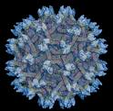
Unique IL-4R antagonist and IL-13Ra2 adjuvanted pox viral vector-based HIV vaccines
HIV/AIIDS & Mucosal Vaccines
Charani Ranasinghe
Molecular Mucosal Vaccine Immunology Group
John Curtin School of Medical Research
Australian National University

Slide 2
Restricted Info..
For more Information Contact Charani Ranasinghe

