Slide 1
Funding : Florida Nurses Foundation
Pressure Ulcers & Nutritional Deficits in Elderly Long-Term Care Patients: Effects of a Comprehensive Nutritional Protocol on Pressure Ulcer Healing, Length of Hospital Stay & Health Care Charges
Beverlin Allen, PhD, RN, MSN, ARNP

Slide 2


Slide 3

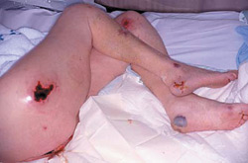
Pressure Ulcers in Combination with Malnutrition
Pressure ulcers in combination with malnutrition are accruing at an alarming rate among the elderly institutionalized patients.

Slide 4
Under-nutrition
Under-nutrition amongst older people is a global crisis that is set to increase.
Under- nutrition and protein–energy malnutrition ranges from 23% to 85% of the elderly population.
More than 91% of the subjects admitted to subjects admitted to sub-acute care are either malnourished or at risk of malnutrition.

Slide 5
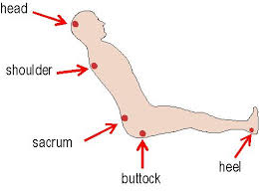
Pressure Ulcers
Pressure ulcers are wounds caused by persistent pressure or friction that damages the skin and its underlying architecture.
Most common over bony prominences, mainly back of the head, sacrum, and heels.
Develops at sites where tissue has been compressed causing ischemia and hypoxia.

Slide 6
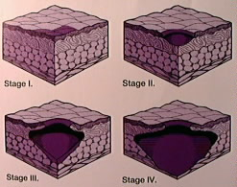
Classification of Pressure Ulcers
Stage 1 – intact skin with erythema
Stage 2 – partial thickness loss of
dermis
Stage 3 – full thickness tissue loss
Stage 4 – full thickness tissue loss
with exposed bone,
tendon or muscle
Deep tissue injury
Unstageable pressure ulcer
(National Pressure Ulcer Advisory Panel, 2007)

Slide 7
Significance
Over one million patients develop pressure ulcers annually.
In hospitals, the pressure ulcer rate is 16%.
One in 10 patients in nursing homes has pressure ulcers.
Long term care facilities varies between 2.4% to 23%, with a reported incidence as high as 24%

Slide 8
Significance
Death rate of 1 in 8 when pressure ulcers were included as a secondary diagnosis.
Estimates indicate that hospital stays for pressure ulcers total $11 billion.

Slide 9
Study Purpose
In elderly long-term care patients with pressure ulcers the purpose of this pre/post intervention study was to compare the effects of a comprehensive, interdisciplinary, nutritional protocol on:
  pressure ulcer wound healing
  length of hospital stay
  health care charges for pressure ulcer management

Slide 10

29 be acute long term care facility located inside of Mercy Hospital.
Annual number of patients: approximately 375.
Annual number with pressure ulcers: approximately 210.

Slide 11

Inclusion Criteria
A convenience sample of 100 patients with pressure ulcers:
  50 pre-intervention(10/1/2008 – 9/31/2009)
  50 post intervention (10/1/2009 – 7/31/2010)
All patients with Stage II or Stage III pressure ulcers
Male and Female 60 years old and above all races
ethnicities

Slide 12
Measures- Risk Assessment
Braden Scale: Risk assessment for pressure ulcers.
Composed of six sub-scales: sensory perception,
moisture, activity, mobility, nutrition, and friction/shear.
Five of the subscales: sensory perception, mobility,
activity, moisture, and nutrition have scores that range
from 1 to 4, 1 = the lowest score and 4 = the highest
score.

Slide 13
Measures- Ulcer Wound Healing
Measurement includes:
Wound size, depth, edges, undermining, necrotic tissue type, necrotic tissue amount, exudates type, exudates amount, skin color surrounding wound, peripheral tissue edema, peripheral tissue indurations, granulation tissue, and epithelialization.
PSST scores ranges from 13-65, and reflect wound
health.
Scores were classified into 3 categories:
Tissue Health (PSST scores 1– 13)
Tissue Regeneration (PSST scores 14 – 20)
Tissue Degeneration (PSST scores > 21)

Slide 14
Post-intervention Ulcer Care Protocol
Diet
Tube feeding (rate of the tube feed was adjusted based on the type of formula (example calories per kg of body weight; for protein 59 kg x 1.8-2.5g/kg)
Interdisciplinary team:
Physical and Occupational therapists: evaluated all patients and developed interdisciplinary goals to assist patients with strengthening exercises, mobility and activities of daily living.
Speech therapists: evaluated patients and would treat patients when required to avoid aspiration and to increase nutritional intake.

Slide 16
Age N=100

Slide 17
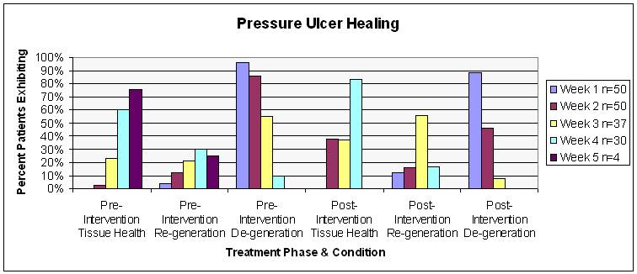

Slide 19
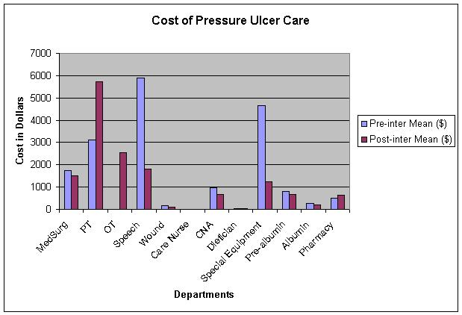

Slide 20
Conclusion
Study findings indicate that this comprehensive
nutritional intervention was effective in improving
pressure ulcer wound healing. Decreasing both hospital
length of stay for treatment of pressure ulcer and total
hospital length of stay while showing no significant
additional charges for treatment of pressure ulcers.

