Slide 1
Microsensors for instrumented medical tools for their real time monitoring
Agnès Bonvilain
Agnes.bonvilain@imag.fr
TIMA Laboratory
Micro & Nano System Group
GRENOBLE, France
1/19
Notes:
Thank you

Slide 2
Outline
Context
Previous works
Microfabrication of the microsensors
First experimentations
Improvement of the GF
Integration of the connections
Conclusion and Perspectives
2/19

Slide 3
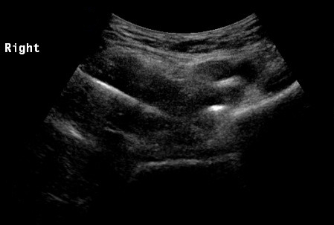
Context
Goal : give in real time the deformation of the needle during its use
3/19

Slide 4
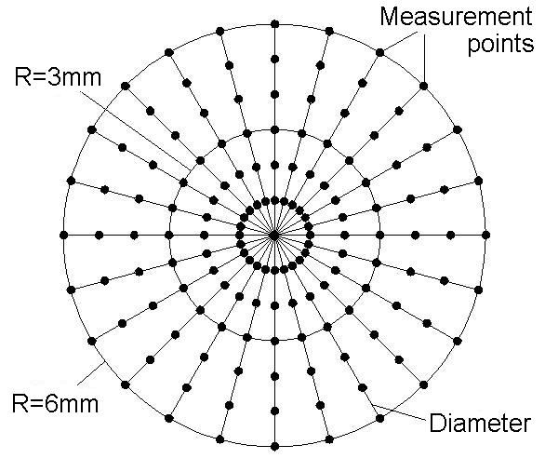
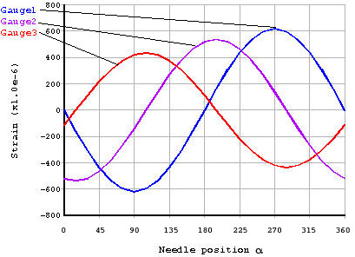
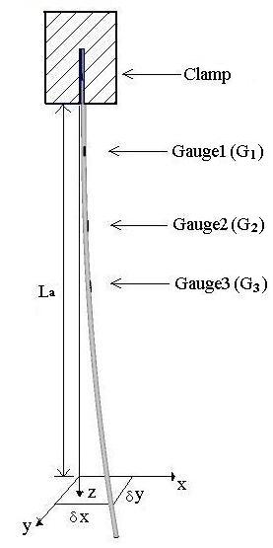
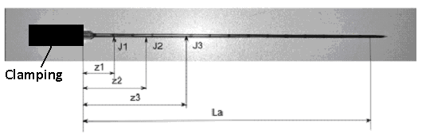
Previous works
y
x
4/19

Slide 5
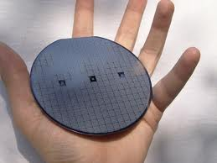
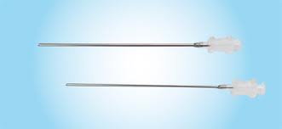
Microfabrications
Diameter = 4’’
Diameter = 0.6 mm
Length = 10 cm
5/19

Slide 6
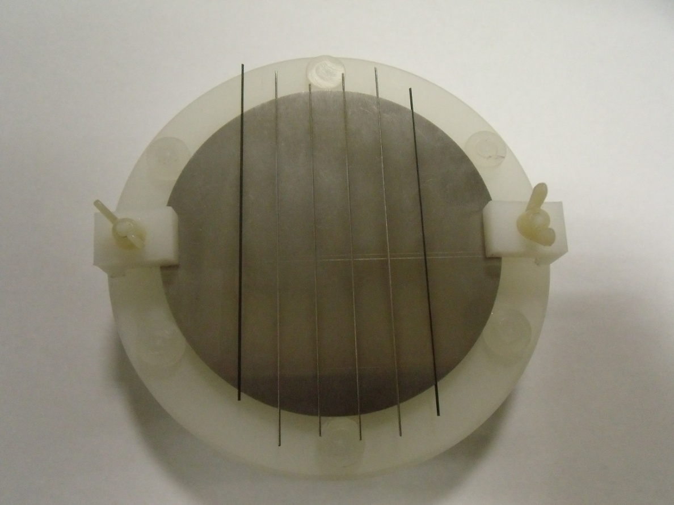
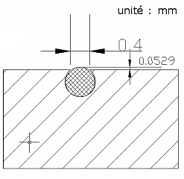
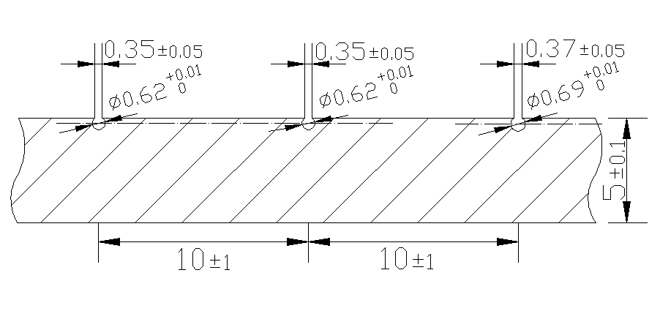
Microfabrications
6/19

Slide 7
Microfabrications
Sputtering of Si₃N₄ (200 nm)
Evaporation of Ge + Au (400 + 20 nm)
Cristallization Annealing (2h at 300°C)
Au Etch
Evaporation of Cr/Au (10 + 200 nm)
Wire bonding
Needle
7/19

Slide 8
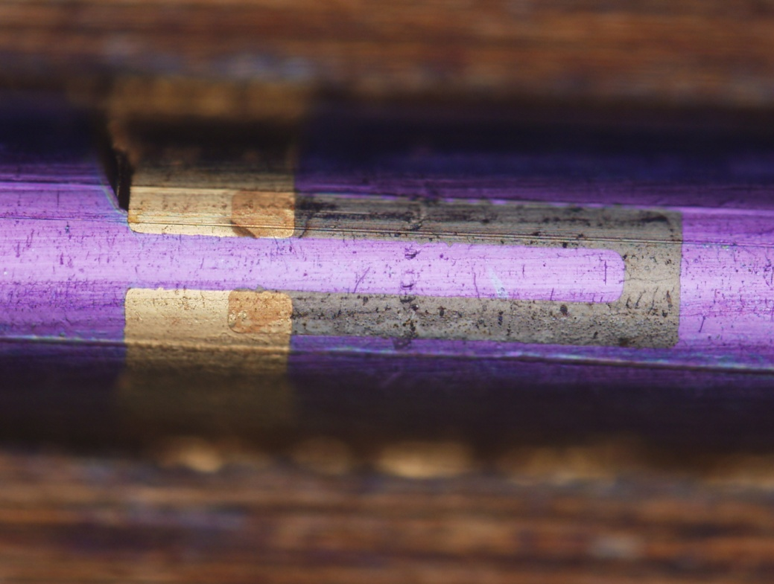
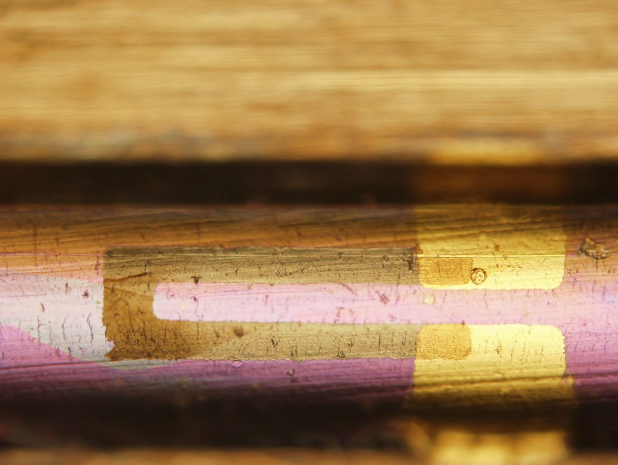
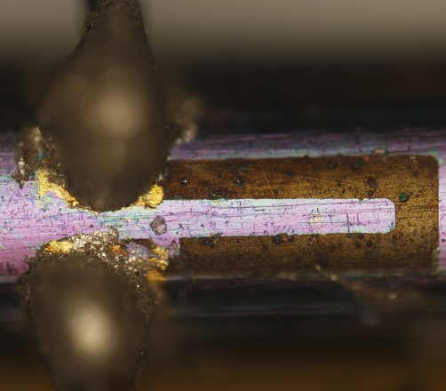
Microfabrications
Microsensors on stainless steel medical needle
500 µm
500 µm
8/19

Slide 9
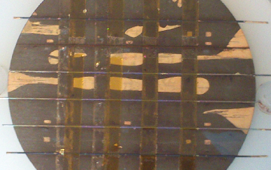

Microfabrications
9/19

Slide 10
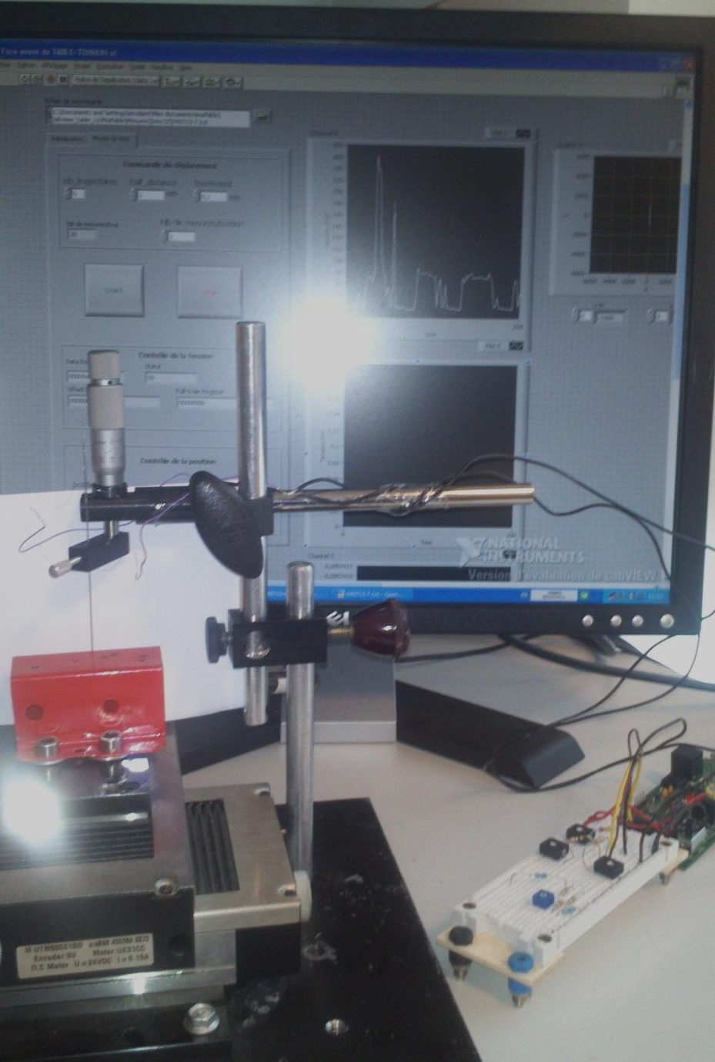
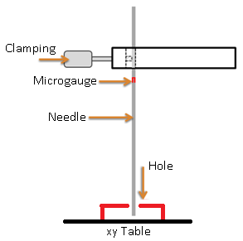
First experimentations
x
y
10/19

Slide 11
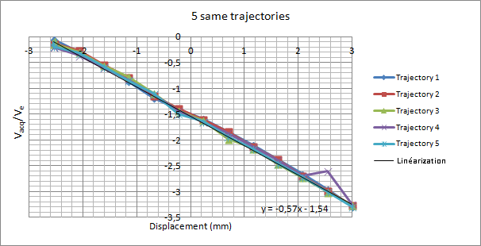
First experimentations
Experimentations of the instrumented needle
GF = 3 (compared to the commercialized gauges which have a GF = 2)
11/19

Slide 12
Improvement of the GF
We have worked on the material aspect of the Ge layer to improve the GF.
The cristallization annealing has three important parameters : the temperature, the duration and the thickness of the metal layer.
In the litterature we find that a 20nm layer of gold allows the MIC under 300°C.
X-ray diffractometry allow us to show that the layer must be 40nm, because with 20nm the begining of the cristallization must be 325°C.
12/19

Slide 13
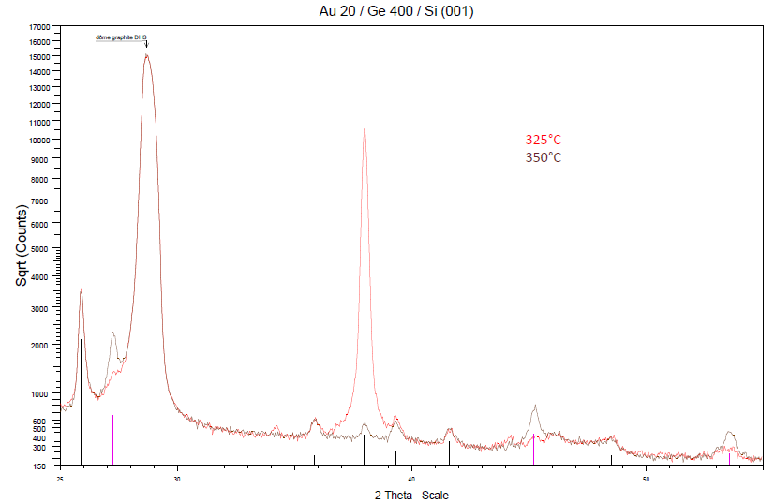
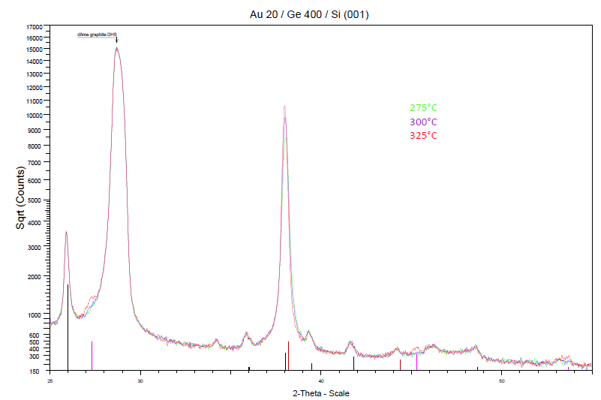
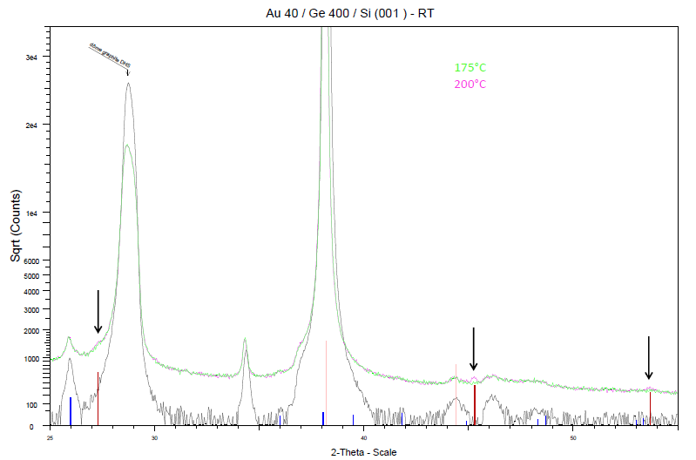
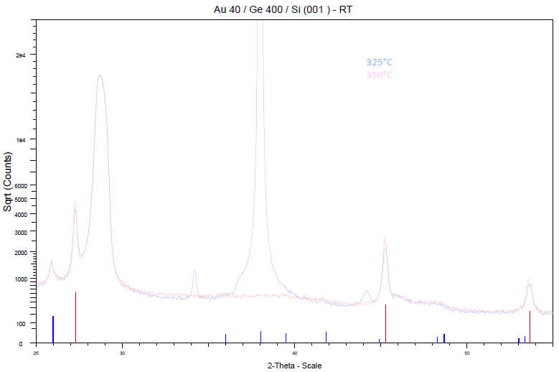
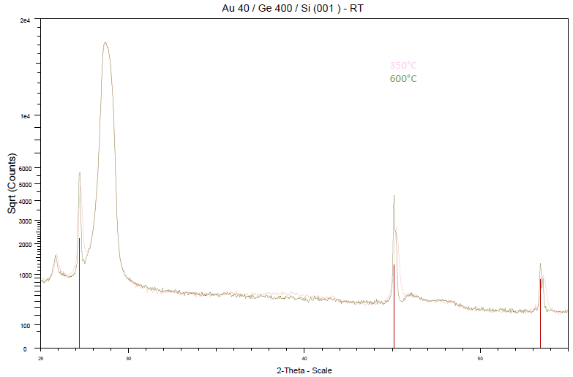
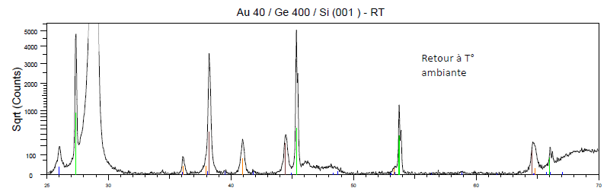
Improvement of the GF
13/19

Slide 14
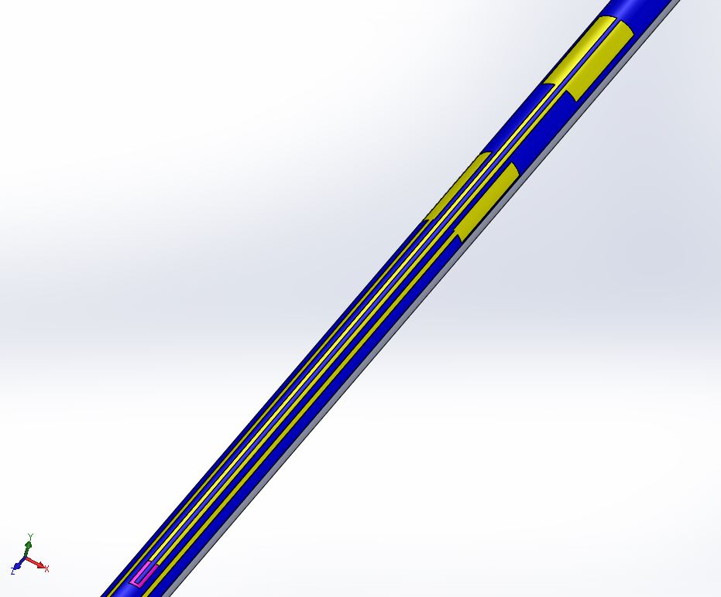
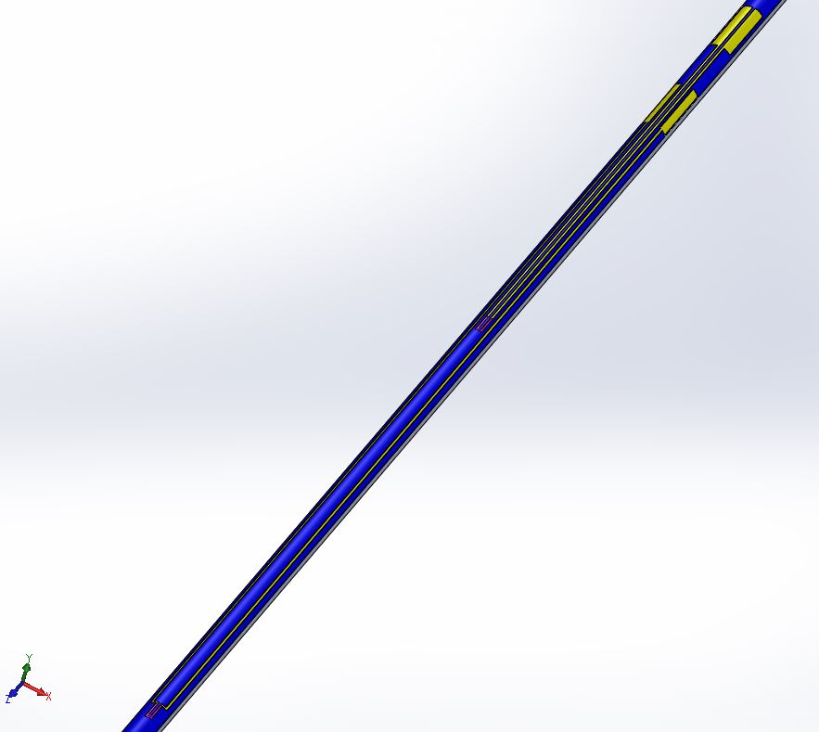
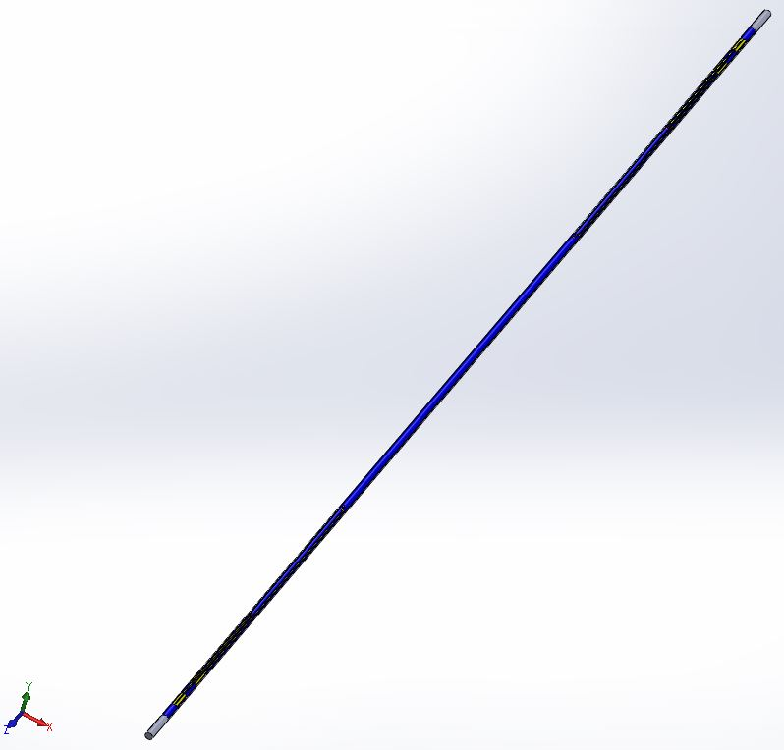
Integration of the connections
14/19

Slide 15
Integration of the connections
We have adapted the microfabrication to have a better GF,
Modification of the cristallization annealing parameters,
Do not do the Au etching (which do not change the resistivity of the Ge layer and avoid damages of the KI-I² etching),
No connecting pads but smaller connecting tracks
15/19

Slide 16
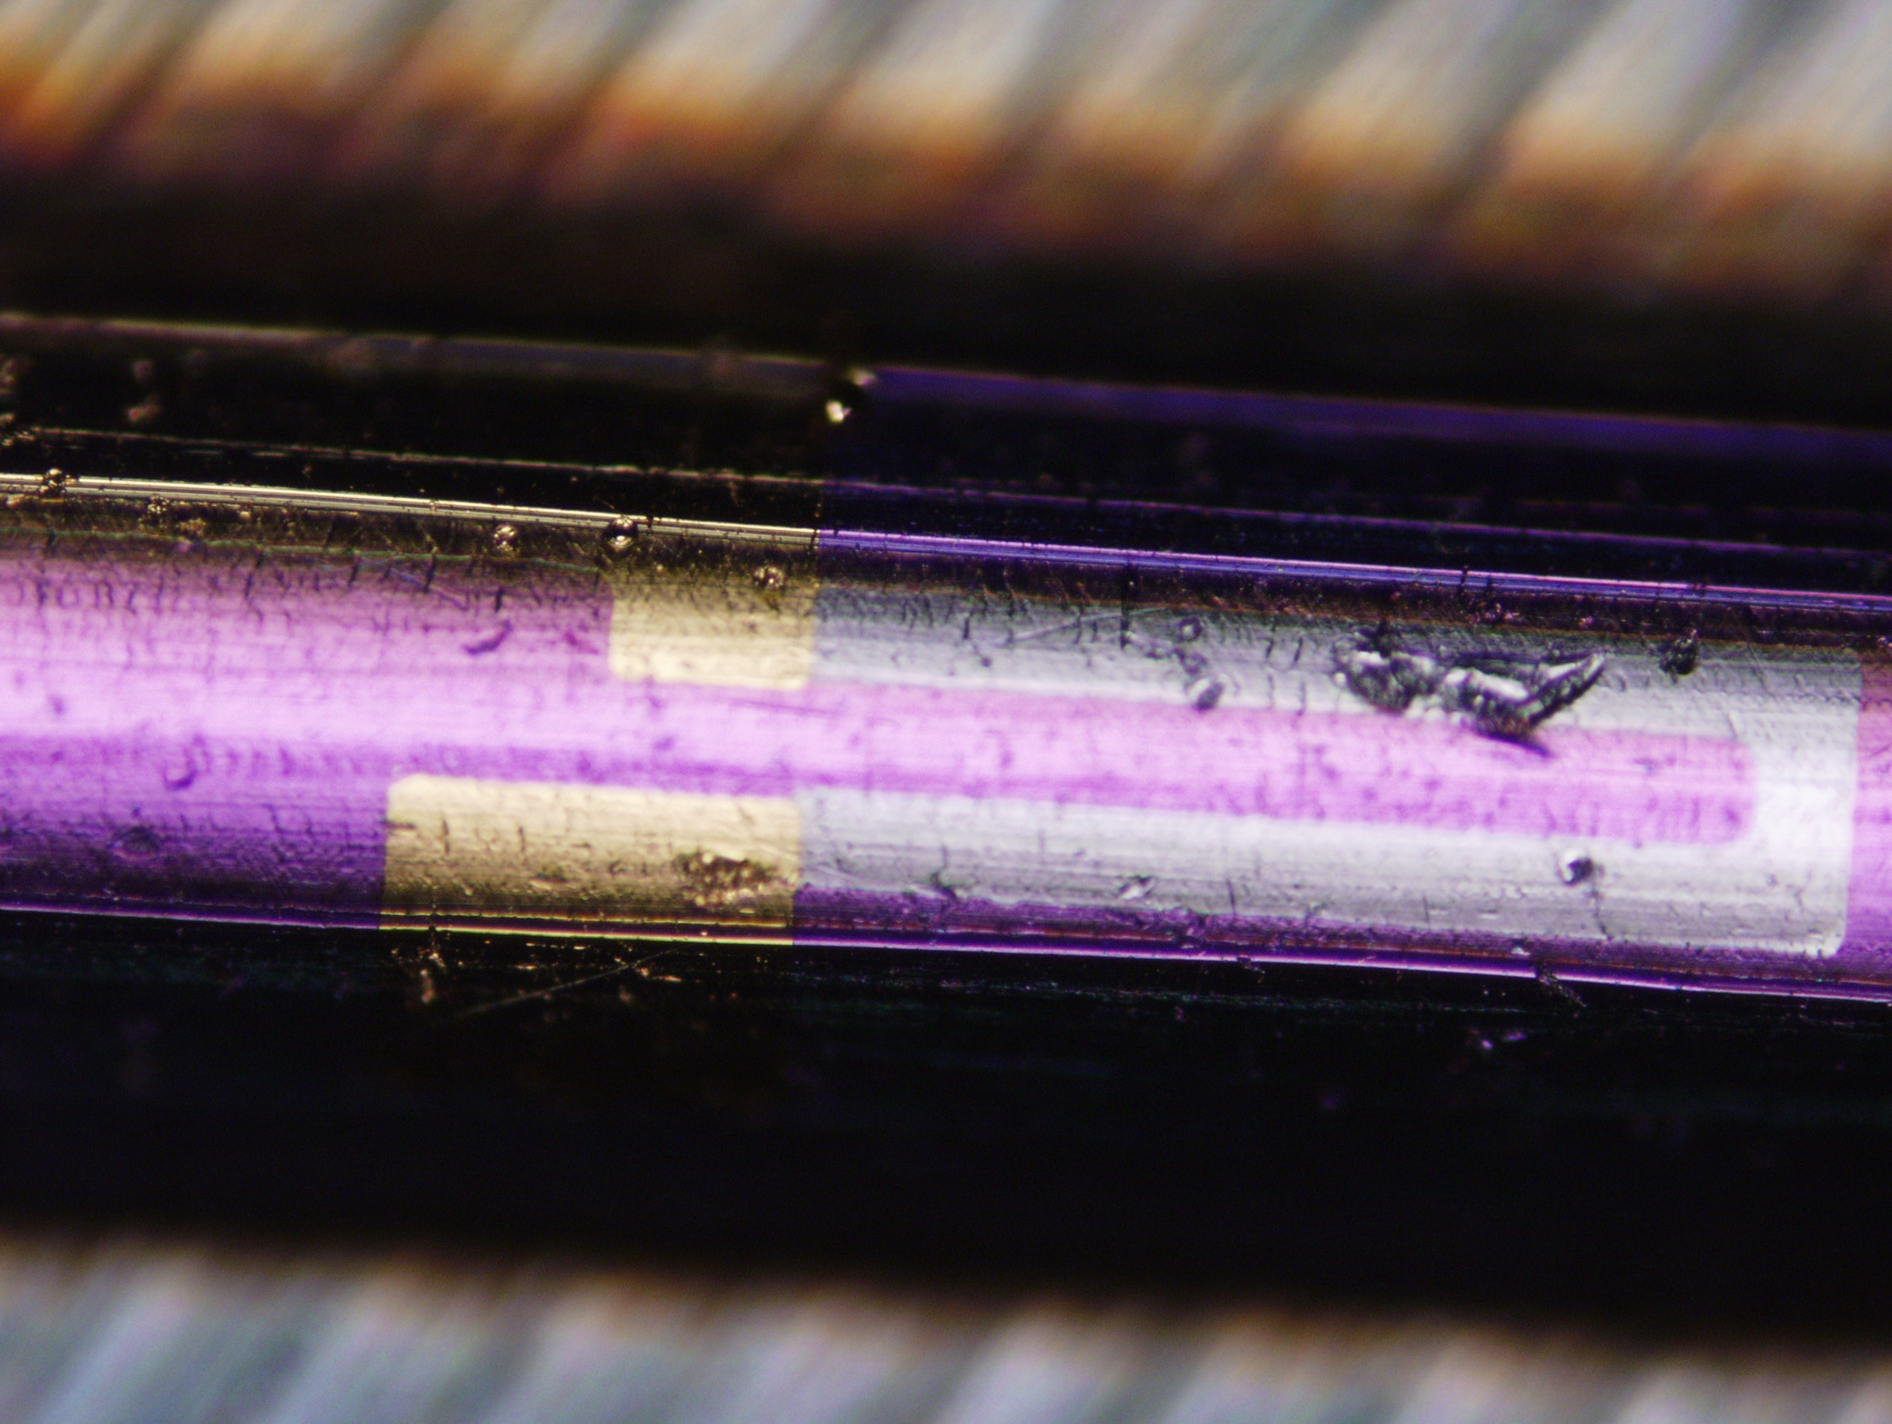
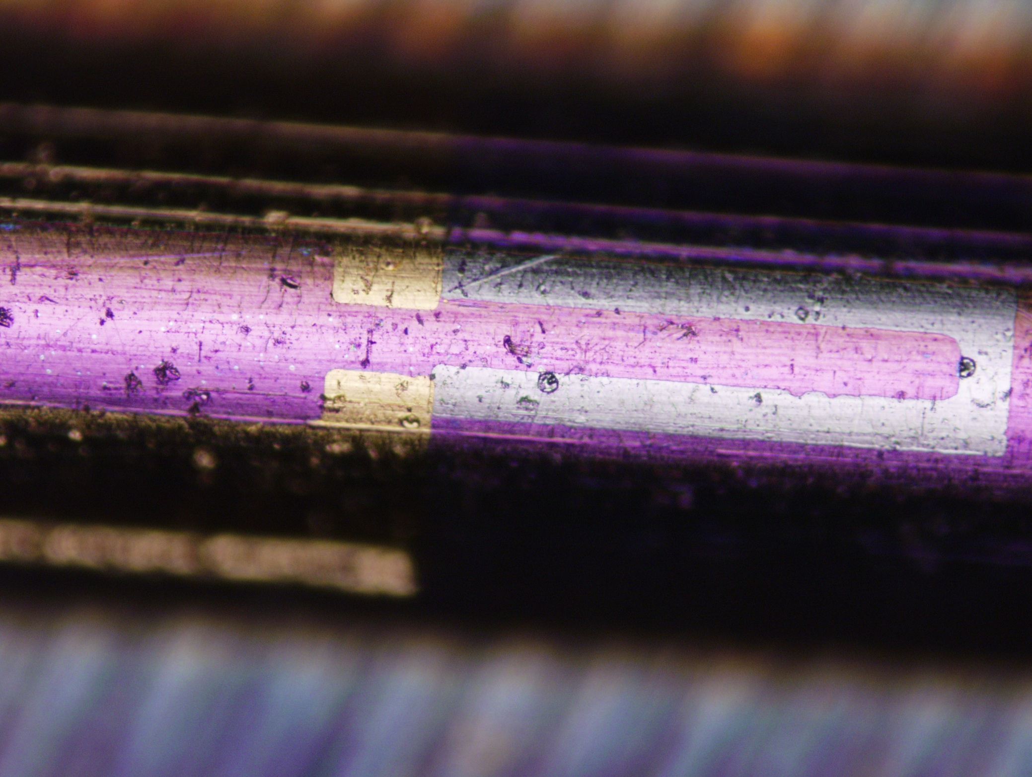
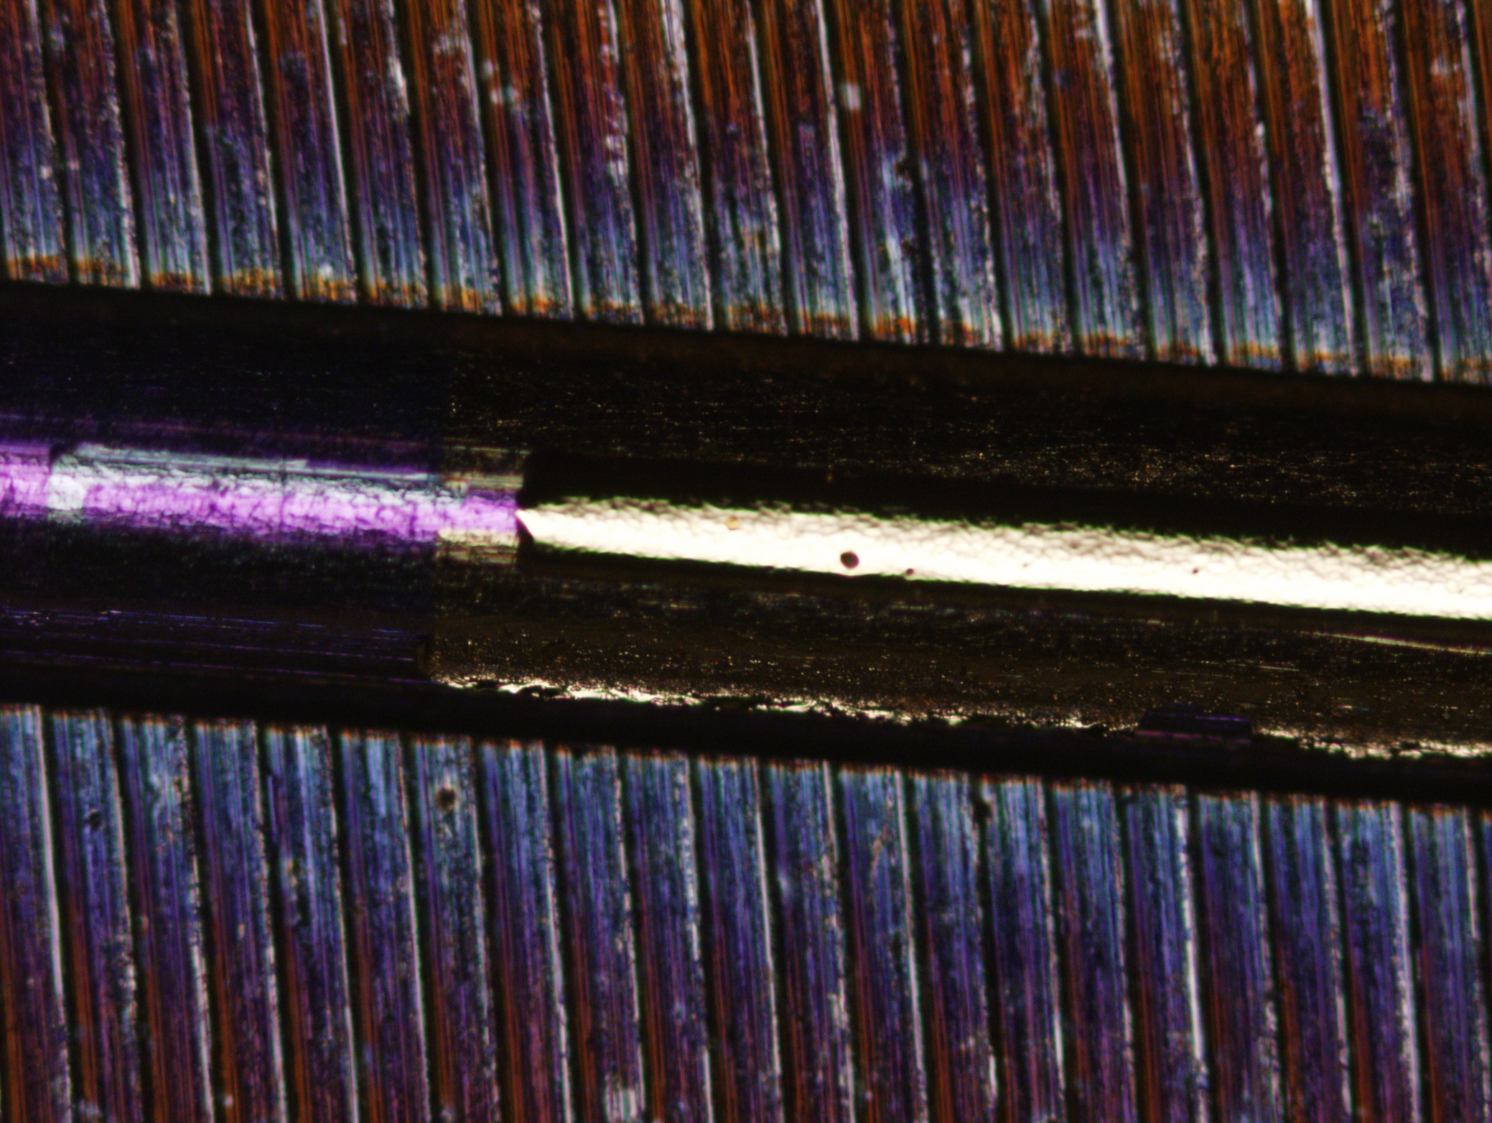
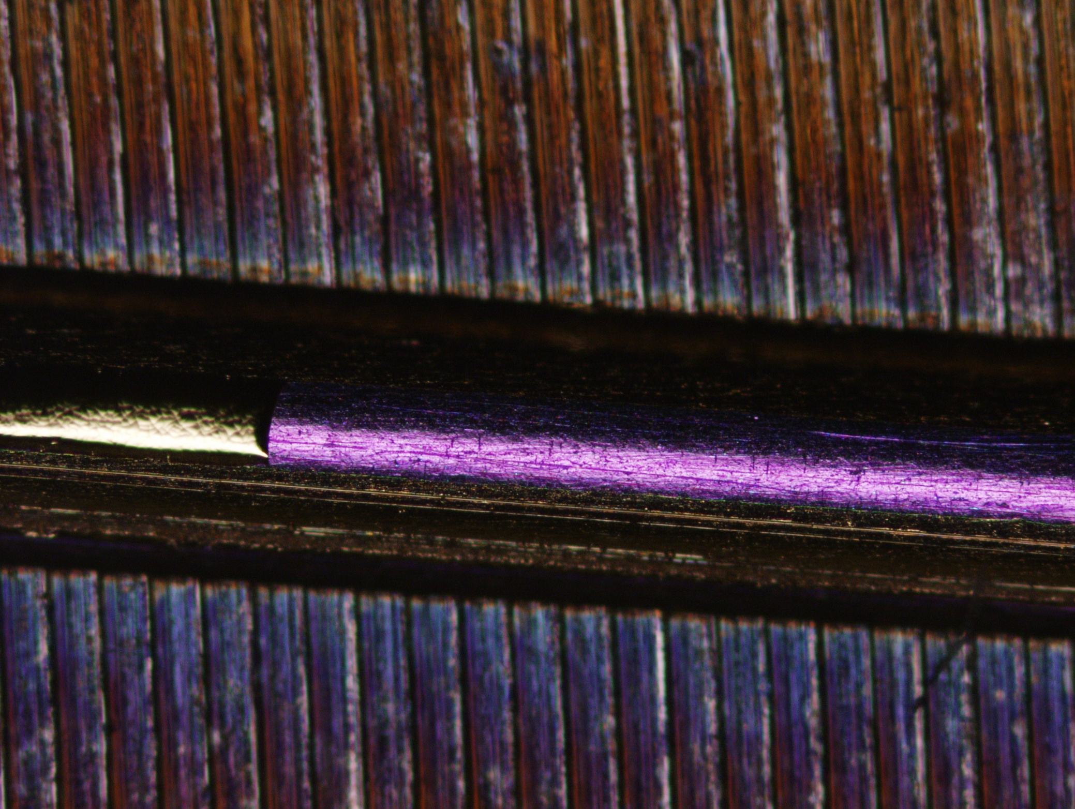
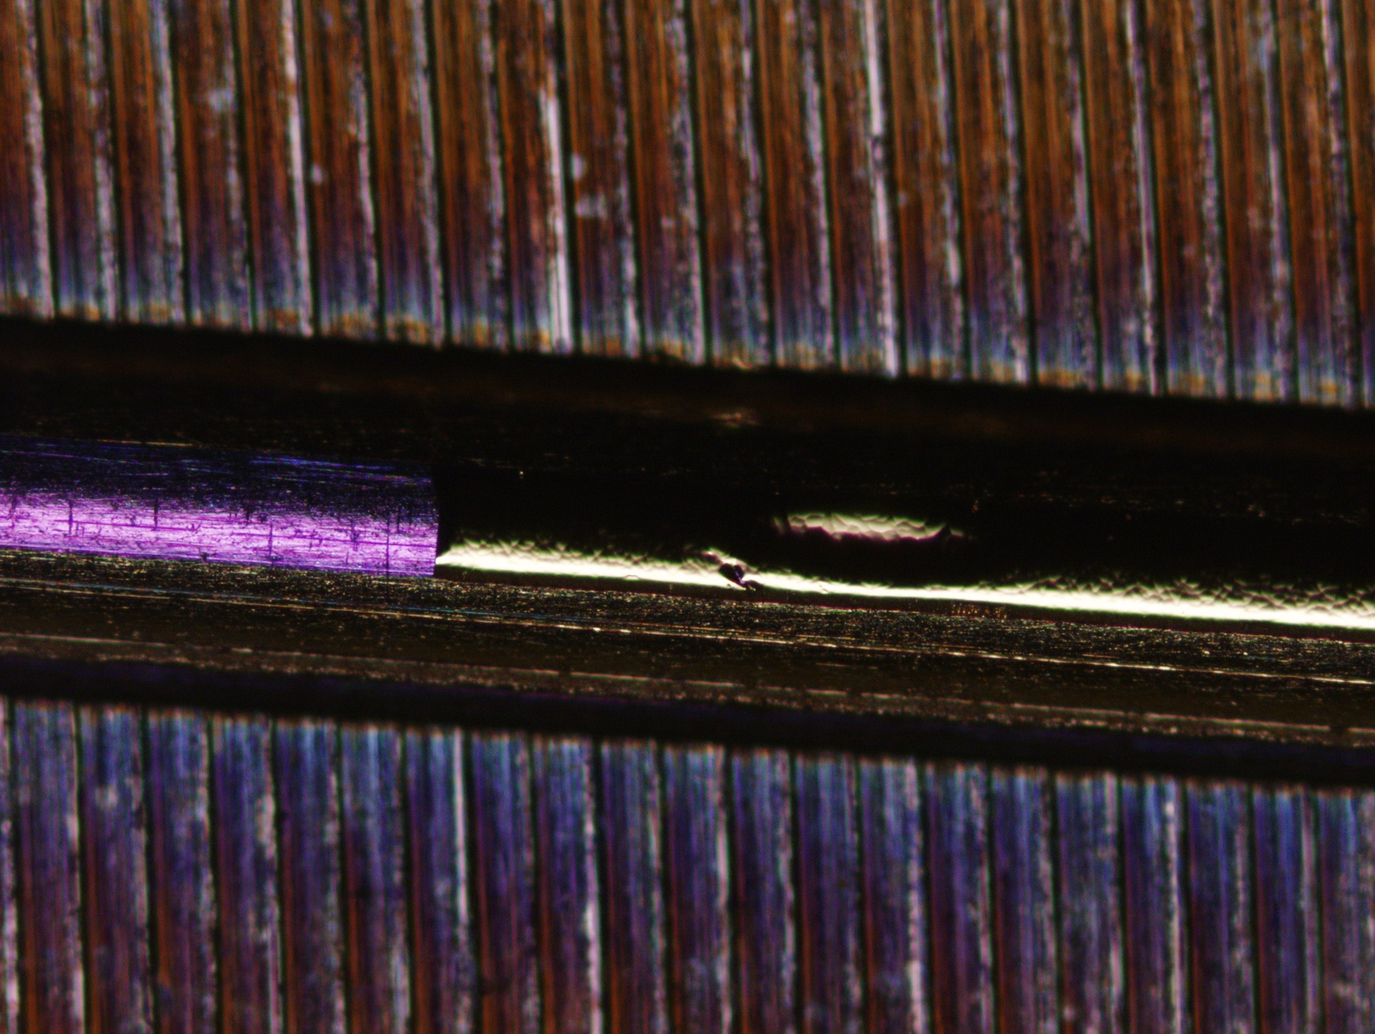
Integration of the connections
16/19

Slide 17
Conclusion
The experimentations of the new microgauges with their connections at the extremity of the needle are in progress. We always use the bonding which is very fragile.
We want now to put three microgauges at 120° with their connections at the extremity of the needle.
We design a connector to get free of the bonding.
The next goal will be to fabricate a prototype that we can integrate in a microlocalization system to test it.
17/19

Slide 18
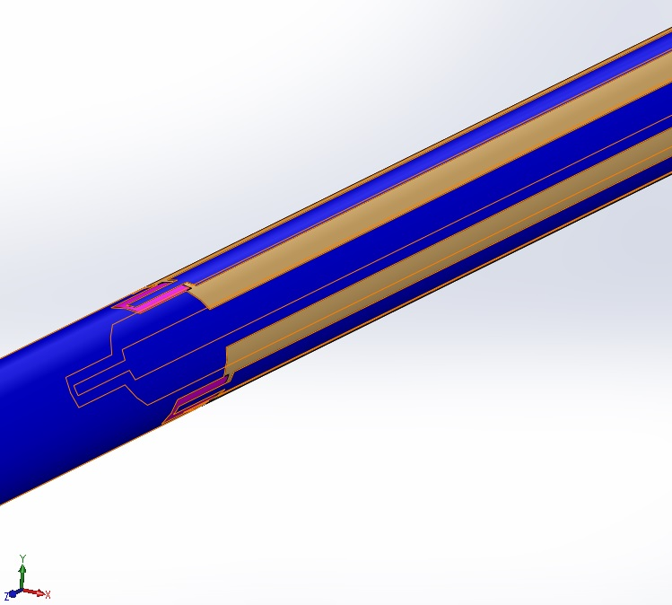
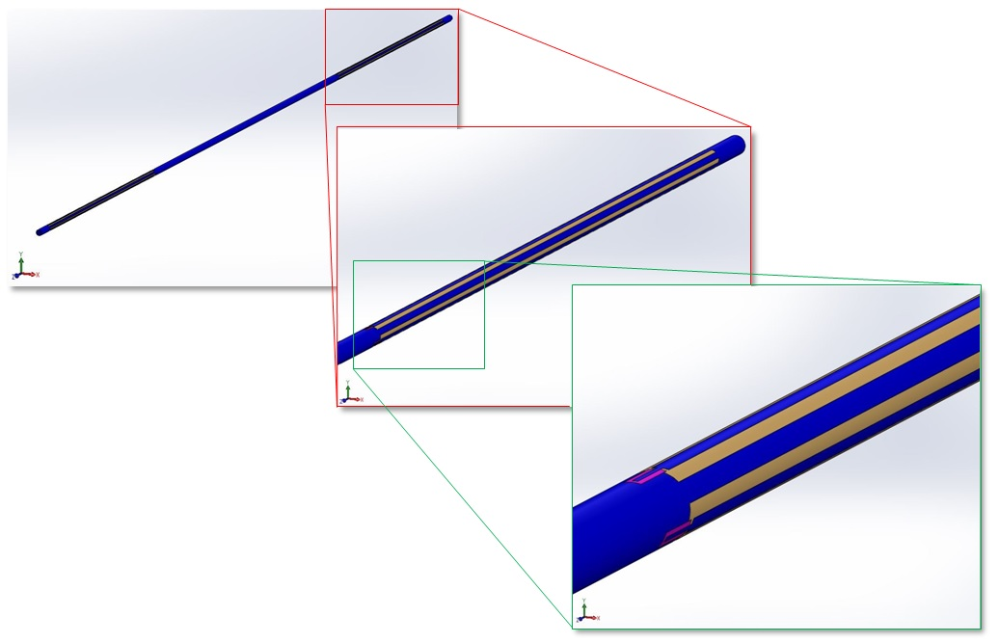
Conclusion and Perspectives
Prototype of an instrumented needle to integrate in a microlocalization system
18/19

Slide 19
Conclusion and Perspectives
We have shown in this work that it is possible to instrument a medical tool to monitor it.
We have open a dent in the field of microfabrications applicated to medical instruments with unconventional shape and material. So we can expected now the development of the instrumentation of other medical tools.
19/19

Slide 20
Acknowledgment
Wenbin Yang
Mathilde Gangneron
Léo Zanardelli
ANR (Agence Nationale de la Recherche)

