Slide 1
Endomicrobiota and autoantibodies as a unique tandem of tools to manage mental health through the view of PPPM
Prof Afaf K. El-Ansary, PhD
King Saud University (Dept. of Biochemistry)
P.O Box 22452, Zip Code 1149
Riyadh, Kingdom Of Saudi Arabia
Tel: 009661-4769137 ext. 1396
FAX: 009661-4769137
Email : elansary@ksu.edu.sa
afafelansary@yahoo.com
Notes:
Of PPPM

Slide 2
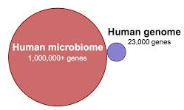
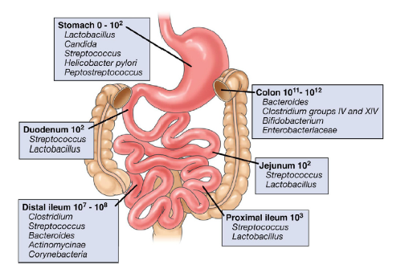
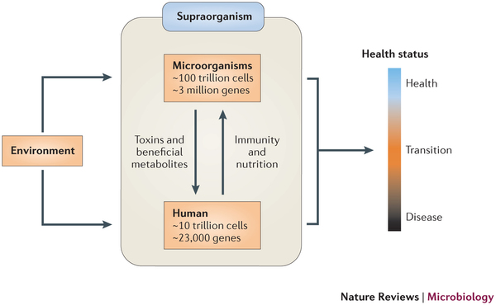
Endomicrobiota
The healthy human small and large intestine is home to hundreds of trillions of bacteria, viruses, and fungi and so it is the largest and most complex component of the immune system.
Humans are supraorganisms consisting of both human cells and microbial cells, particularly the gut microbiota. The gut microbiota interacts with host genetics and the environment (mainly diet) to influence the health of the human host…

Slide 3
Harmful/pathogenic effects
Health promoting functions / effects
2
Ps. aeruginosa
Pathogenic, including production of toxins
Proteus
No/g Faeces (log₁₀)
Staphylococci
Clostridia
4
Inhibition of growth of harmful bacteria
Production of carcinogens
Veillonellae
Enterococci
E. coli
Stimulation of immune functions
Intestinal putrefaction
Lactobacilli
Streptococci
Aid in digestion or absorption of nutrients
Eubacteria
Bifidobacteria
Bacteroides
Synthesis of vitamins
(Gibson & Roberfroid, J. Nutr. 125, 1995)
11

Slide 4
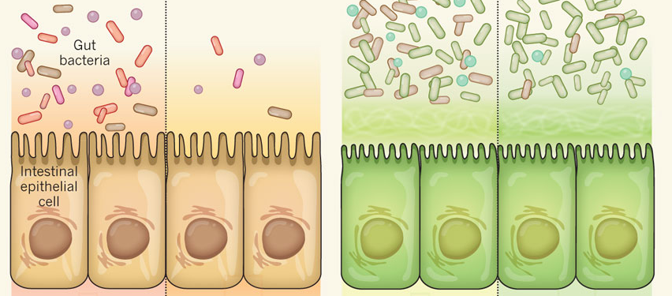
Immune mechanisms to manage and to maintain intestinal homeostasis
Minimizing contact of intestinal bacteria with the epithelium.
To prevent or control access to the systemic circulation and the systemic immune system.
This is accomplished by the secretion of mucus as well as a variety of antimicrobial agents by different intestinal epithelial cells.

Slide 5
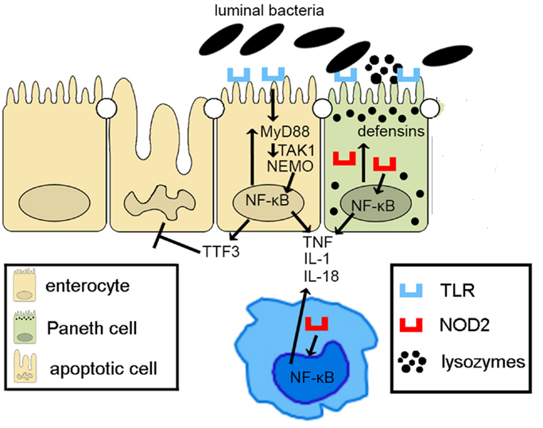
Production of antimicrobial peptides (AMPs) and antibodies
It is well known that epithelial cells express TLRs and NOD-like receptors, whose signaling activates NF-κB, leading to reinforcement of the epithelial barrier through release of anti-microbial peptides (i.e., defensins) and paracellular secretion of proinflammatory cytokines (e.g., TNF, IL-1, and IL-18) that enhance mucosal defense to bacterial penetration and the production of trophic factors, such as intestinal TFF3 that can block IECs apoptosis.
A third mechanism utilized by the intestinal immune system for reducing contact between enteric bacteria and epithelial cells is the secretion of immunoglobulin A (IgA).

Slide 6
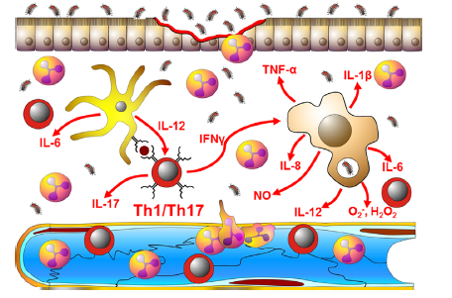
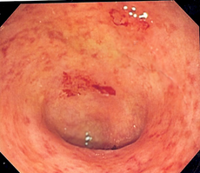
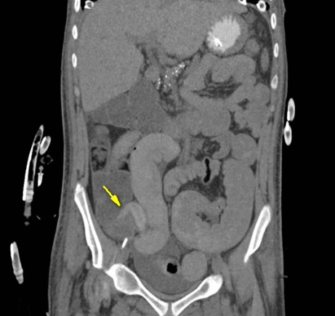
Induction of chronic intestinal inflammation
A breakdown in homeostasis
In the absence of appropriate regulatory mechanisms, the sustained overproduction of the various inflammatory mediators promotes epithelial and endothelial injury and dysfunction.
This Leads to:
Ulcerations,
Fibrosis
Edema.

Slide 7
Life style changes and alteration of gut microbiota
Environmental factors contribute to IBD:
Many of the changes associated with a modern life style involve major improvements in sanitation and hygiene thereby decreasing exposure of newborns and children to infectious microorganisms.

Slide 8
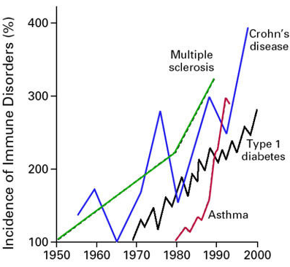
Implementation of these environmental changes has been proposed as the basis for the “hygiene hypothesis” to explain the increased incidence of autoimmune diseases in developed countries.

Slide 9
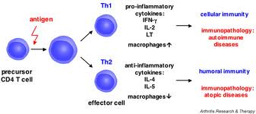
Bacterial antigen
Many bacteria and viruses induce a TH1 type of immune response which has the ability to down-regulate mediators of TH2 responses.
If surfact markers on some human cells are similar to markers found on an infecting bacteria, the body's immune system may attack and damage the human host.
The incidence of inflammatory bowel disease (IBD, multiple sclerosis (MS), and type I diabetes, which are autoimmune diseases linked with an overactive TH1 immune response.

Slide 10
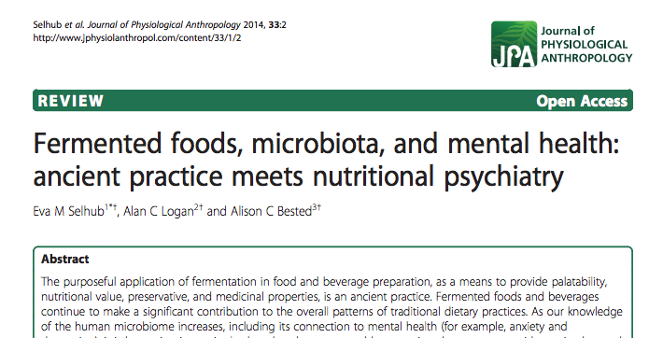
In recent years, interdisciplinary investigation has unveiled strong evidence for the existence of a bidirectional signalling between the intestine and the brain, the so called “gut–brain axis”. This communication system integrates neural, hormonal and immunological signalling between the gut and the brain (Collins et al., 2012).
Moreover, the axis concept can be expanded to a “microbiota–gut–brain axis”, since not only the intestinal tract itself can affect the brain, but also its microbial inhabitants.

Slide 11
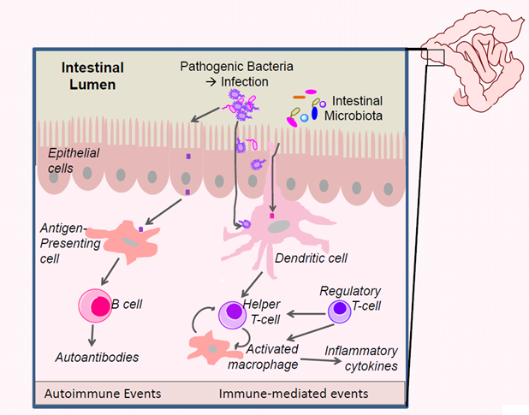
Based on the concept of molecular mimicry ,such microbial intestinal antigens could potentially trigger the production of autoAbs cross-reacting with regulatory peptides.
i.e. Autoimmune could be induced through‘mistaken-identity’ immune response.

Slide 12
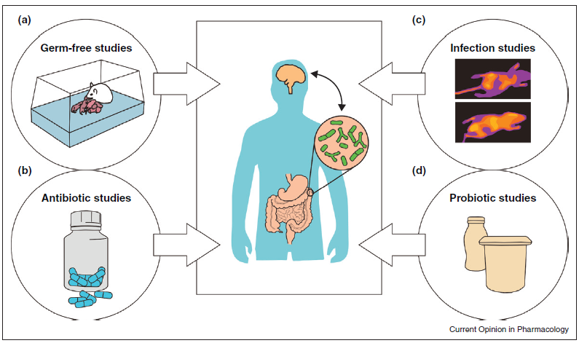
Strategies used to prove the interaction between microbiota-brain axis:
Germ-free animal studies, where animals are born and reared in sterile conditions, allow to evaluate the effects of microbiota on CNS function.
Treating animals with wide-spectrum antibiotics can greatly affect intestinal microbiota composition, a modulation that has been shown to affect behavior.
(C) Infection with intestinal pathogenic bacteria can induce anxiety-like behaviours in animals.
(D) Probiotic treatment which promote beneficial effects on intestinal health, and also improve behaviors associated with stress-related psychiatric conditions.

Slide 13
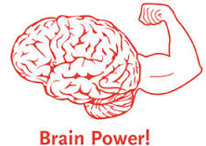
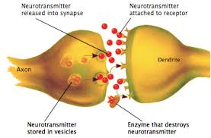
Gut–brain axis and neurochemistry
A critical question facing neuroscientists is:
whether changes in behavior mediated by microbiota are a result of long-term changes in central signaling systems? OR not?
To date, investigators have provided evidence:
Neuroplasticity-related systems and
Neurotransmitter systems are influenced by the gut–brain axis.

Slide 14
Bidirectional signaling in gut–brain axis.
Multiple potential direct and indirect pathways exist which include:
Endocrine (cortisol),
Immune (cytokines) ,and
Neural (vagus and enteric nervous system) pathways.
Effect of brain on gut microbiota:
e.g: under conditions of stress.
The hypothalamus–pituitary–adrenal axis regulates cortisol secretion, and cortisol can affect immune cells (including cytokine secretion) both locally in the gut and systemically. Cortisol can also alter gut permeability and barrier function, and change gut microbiota composition.
John F. Cryan & Timothy G. Dinan Nature Reviews Neuroscience 13, 701-712 (October 2012)

Slide 15
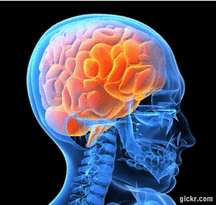
The gut microbiota can alter the levels of circulating cytokines, and this can have a marked effect on brain function. brain function.

Slide 16
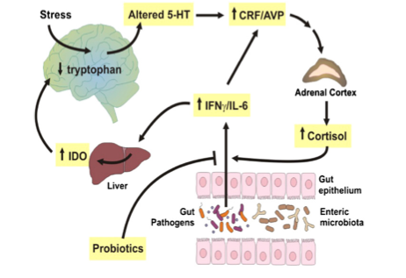
Both the vagus nerve and modulation of systemic tryptophan levels are strongly implicated in relaying the influence of the gut microbiota to the brain.
In addition, short-chain fatty acids (SCFAs) are neuroactive bacterial metabolites of dietary fibres that can also modulate brain and behaviour.
(IDO): the rate-limiting enzyme indoleamine-2,3-dioxygenase

Slide 17
Dysregulated gut-brain axis crosstalk
Dysregulated cross-talk between the brain and the gut immune system may be an important contributor to the pathogenesis of several neurological conditions, including:
schizophrenia,
mood disorders,
obsessive-compulsive disorder,
autism,
attention-deficit/hyperactivity disorder,
anorexia nervosa, and
chronic fatigue syndrome.

Slide 18
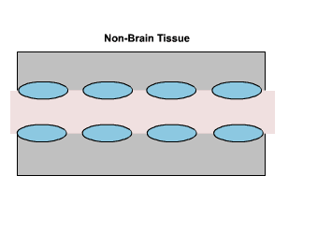
In genetically susceptible individuals, altered gut microbiota may lead to disruption of the blood brain barrier and generation of brain-reactive autoantibodies.

Slide 19
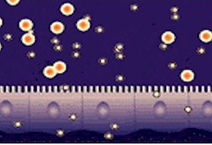
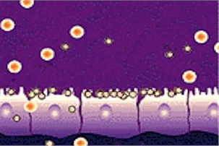
Disruption of the intestinal barrier
Healthy mucosa permits nutrients to pass the barrier while blocking the entry of toxins.
While in leaky gut, the barrier is dysfunctional, blocking nutrients at the damaged villi while permitting toxins to enter the blood stream.
Hornig M. The role of microbes and autoimmunity in the pathogenesis of neuropsychiatric illness. Curr Opin Rheumatol. 2013, 25(4):488-795

Slide 20
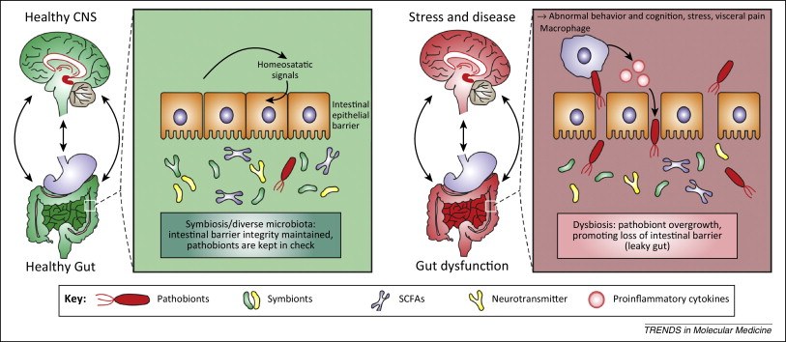
Changes in the microbiome may alter the central nervous system via disruption of the integrity of the epithelial barrier of the intestine by the entry of bacterial proteins with neuroactive properties into the circulation.

Slide 21
Autoantibodies mediating gut-brain axis
Recently new data further validates a role for auto antibodies in mediating the gut–brain axis.
Gut microbiota and several key neuropeptides implicated in the regulation of behaviour and emotion are believed to share similar protein sequences with certain human proteins or peptides (Fetissov and Dechelotte, 2011).

Slide 22
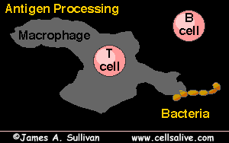
Molecular mimicry has been attributed to be the cause of co-occurring modified mood and appetite often observed in individuals (Garcia et al.,2012).

Slide 23
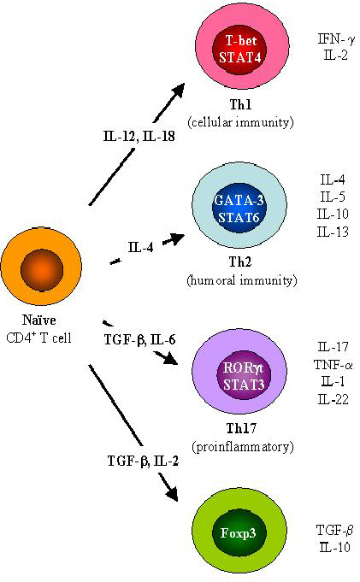
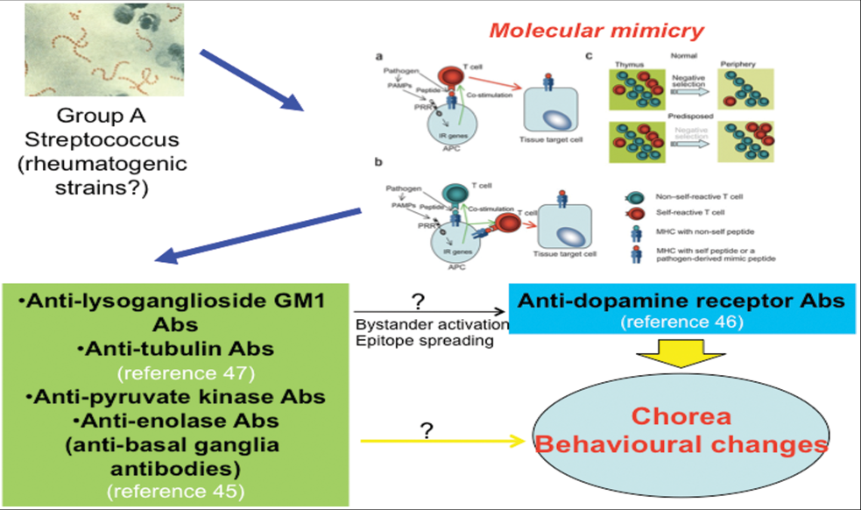
Whereas infection with certain pathogens can trigger autoantibody production through molecular mimicry,
commensal bacteria that comprise the gut microbiota probably set the stage for the development of autoimmune responses by directing the immune responses toward overproduction of Th17 cells and reduction in numbers and function of Tregs cells.

Slide 24
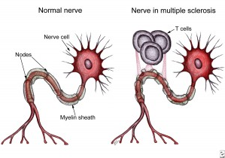
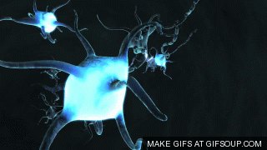
Molecular mimicry in multiple sclerosis
DNA of Chlamydia pneumoniae was isolated from 97% of 64 MS patients.
in addition anti-C. pneumoniae antibodies were isolated from CSF of MS patients.
This work inspired Lenz et al. (2001) to identify a protein from C. pneumoniae, Cnp0483, with similarity to Myelin basic protein (MBP). An MBP68–86 homologue peptide, was used to induce MS in Lewis rats.

Slide 25
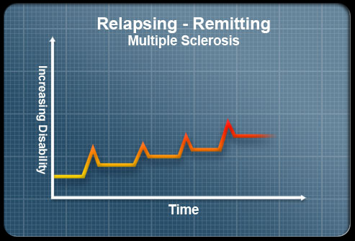
Role of gut-flora in MS
Commensal gut flora—in the absence of pathogenic agents—is essential in triggering immune processes, leading to a relapsing–remitting MS disease driven by myelin-specific CD4⁺ T cells.
The recruitment and activation of autoantibody-producing B cells from the endogenous immune repertoire depends on availability of the target autoantigen, myelin oligodendrocyte glycoprotein (MOG), and commensal microbiota.

Slide 26
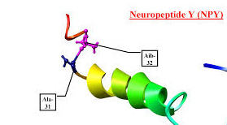
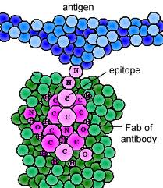
Molecular Mimicry and neuropeptides
Immunoglobulins reactive with neuropeptides such NPY have been identified in humans and their levels or affinities associated with several neuropsychiatric condition including depression (Fetissov and Dechelotte, 2011).
Specifically, IgG and IgA autoantibodies against alpha-melanocyte-stimulating hormone, NPY, ghrelin, leptin and some other neuropeptides/peptides involved in appetite control are present in the human blood.

Slide 27
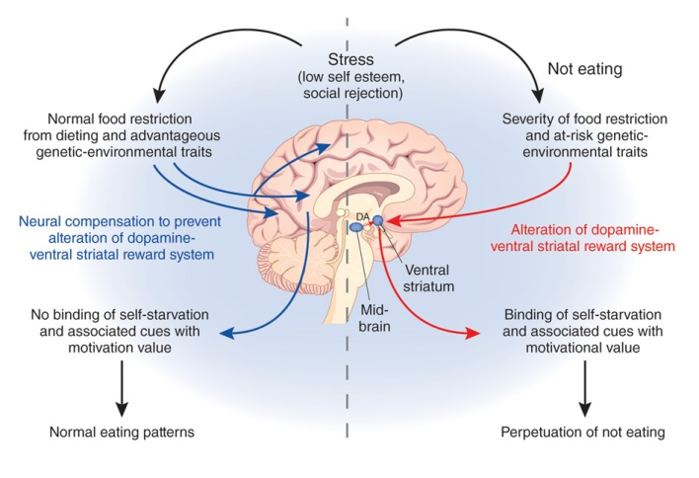
anorexia nervosa.
Numerous intestinal microbes including Lactobacillus, Bacteroides, Helicobacter pylori, Escherichia coli and Candida species contain proteins that have amino acid sequences identical to these appetite-regulating peptides.
The circulating levels of autoantibodies against alpha-melanocyte-stimulating hormone are increased in anorexia nervosa.

Slide 28
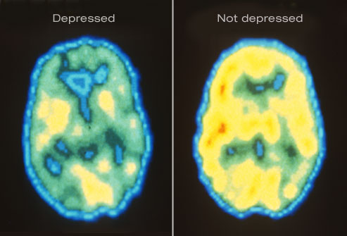
Autoantibodies and depression
In particular, autoantibodies against NPY is reported in depression.
NPY is low in depression and observed to increase after antidepressant and electroconvulsive therapy (Fetissov and Dechelotte, 2011).

Slide 29
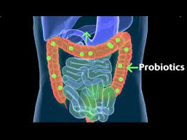
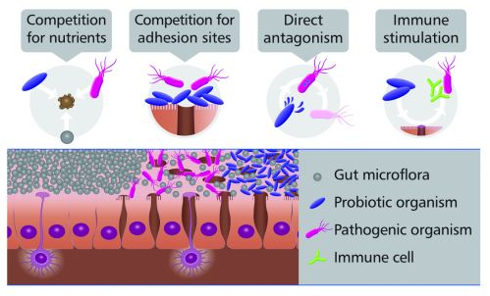
Probiotic and correction of microbial balance
Competition for nutrients
Competition for adhesion sites
Improvement in digestion
Lactic acid production
Increase the levels of cell-signalling chemicals and the effectiveness of white blood cells.

Slide 30
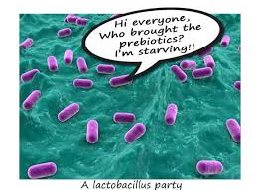
Prebiotics
A prebiotic is a selectively fermented ingredient that allows specific changes, both in the composition and ⁄ or activity in the gastrointestinal microbiota that confers benefits upon host well-being and health.

Slide 31
31 Volunteers fed Prebiotic Biscuits for 21 days
Active biscuits  Control biscuits 

Slide 32
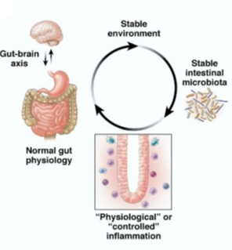
Conclusions:
Symbiotic interaction between gut-microbiota and mental wellbeing and the integrity of both of these factors is essential to maintain the homeostasis.

Slide 33
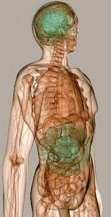
Conclusions:
Genetically predisposed and thus susceptible individuals may generate brain-reactive autoantibodies when exposed to certain infectious agents or commensal microorganisms.

Slide 34
Under inflammatory conditions, BBB disruption facilitates trafficking into the CNS, binding of autoantibodies to cross-reactive epitopes may contribute to cognitive and behavioral impairment.

Slide 35
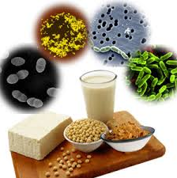
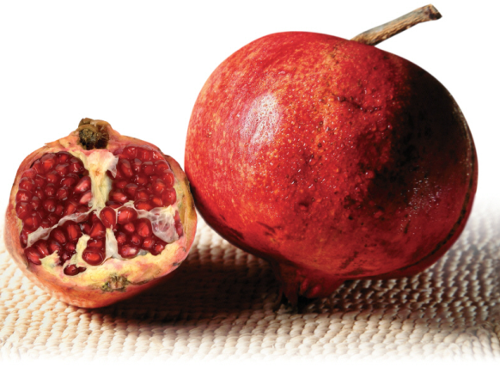
Conclusions:
Interventions that correct the microbial balance or diminish autoantibody binding may be effective in diverse neuropsychiatric conditions mediated by autoimmunity.

Slide 36
Sharing My Secrets of Health

