Slide 1
A Qadeer Negahban
Cardiologist
Barnsley Hospital
United Kingdom

Slide 2
Tako Tsubo Cardiomyopathy
Transient left ventricular (LV) apical
ballooning syndrome
Broken heart syndrome
Stress induced myocardial stunning

Slide 3
History
First described in 1991 by Japanes interventional cardiologists Dote and his team and named tako tsubo-like LV dysfunction in reference to the associated LV morphological features

Slide 4
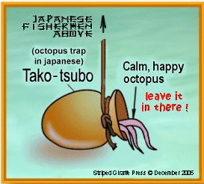
What Tako-Tsubo means?
„Tako“= octupus „Tsubo“=pot
Takosubo is a pot with a round bottom
and narrow neck used for trapping
octopuses in Japan

Slide 5
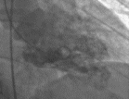
Normal LV contraction
Apical balooning
LV graphy
3 month later

Slide 6
Epidemiology
1- 2% of cases diagnosed as acute
coronary syndrome
mostly affects women in their
post-menopausal age
often emotional or physical stress

Slide 7
Etiology&pathophysiology
Unclear
Catecholamine mediated cardio-toxicity
Coronary microvascular constriction

Slide 8
Clinical and imaging characteristics of TTC
Chest pain
ECG changes (STE, STD, TWI)
Slightly raised Troponin
Transient LV dysfunction
TTC imitates ACS
Frequently misdiagnosed as an acute coronary syndrome

Slide 9
The diagnostic criteria according to Mayo Clinic are as follows:
New abnormalities on ECG (ST-segment elevation and/or T-wave inversion) and/or cardiac Troponin elevation
Transient (reversible) akinesia or dyskinesia of the left ventricular mid segments, eventually also with involvement of the apex, independently of vascular distribution
Absence of obstructive coronary artery disease at coronary angiography
Absence of Myocarditis or Pheochromocytoma
Original criteria also included an absence of head injury or intracranial haemorrhage

Slide 10
Treatment
Symptomatic
Supportive
Analgesia
Oxygen
Diuretics
ACEI
BB
Inotrops and IABP in cardiogenic shock

Slide 11
Prognosis
in-hospital mortality is around 2%
Long-term prognosis is mostly
favourable with complete resolution
Recurrence of TTC around 5%

Slide 12
Complications
Cardiogenic shock
Arrythmia
Pulmonary oedema

Slide 13
In a snowy mountain range of an unfortunate stressed, resentful and angry giraffe running after some scrumptious food.
Conclusion from this study: Even maximally stressed giraffes don't get tako-tsubo syndrome......
But there is no need for those fancy experiments...... how about studying non-human primates stuck for life in zoos? I would not be surprised that some tako-tsubo cases could be found there....... future will tell....

Slide 14
Case presentation
56 y/o female presented to the Emergency with chest pain and hypertension after a car accident when she was annoyed due to indecency of the second participant in this accident .

Slide 15
Case presentation
Blood tests
Troponin-I level 0.48 μg/L
Max TNI 0.72 μg/L
(normal values 0.014 μg/L)
TTE on admission
posterobasal hypokinesis of the inferior wall and slightly reduced LFSF
ECG Q wave in III,aVF with TWI in I, III,aVF and in lead V5–V6

Slide 16
Case presentation
patient has received Clopidogrel+ASA-LMW heparin as per ACS protocol
transferred to the Cath Lab
Coronary angiography & Ventriculography - normal coronary arteries - posterobasal hypokinesis of inferior wall
an atypical pattern of Tako-Tsubo cardiomyopathy was suspected
two days later patient was D/C home
Medication: metoprolol 25mg once daily ASA 100 mg once daily
ECG and TTE on discharge showed the same finding as on admission
patient was F/U for 2/12

Slide 17
Case presentation
2nd TTE 2/52 after discharge
only slight posterobasal hypokinesis of inferior wall
CMRI confirmed
posterobasal hypokinesis of inferior wall
No scar in the myocardium, as a sign of AMI was found in the late gadolinium enhancement
3rd TTE 5/52 after discharge
normal segmental and global left ventricular function was found
ECG showed no Q wave or T wave inversion in inferior leads

Slide 18
Conclusion
The findings in cardiac MRI, as well as the complete resolution of ventricular wall motility and rearrangement of the ECG , were thus consistent with the first proposed diagnosis of TTC.

Slide 19
References
A.Q.Negahban, et al. ,Uncommon type of Tako-Tsubo cardiomyopathy ’ Case report and current view
Cor et Vasa (2013) http://dx.doi.org/10.1016/j.crvasa.2013.09.004

Slide 20
Thank You for
listening

Slide 21
What support Catecholamine mediated theory?

Slide 22
What support micro-vaso-constriction theory?
Effect of Adrenaline/Noradrenaline on α1 and α2
TIMI frame count showed impaired microcirculatory flow
PET – reversible impairment of coronary flow reserve
Contrast ECHO showed impaired myocardial perfusion

Slide 23
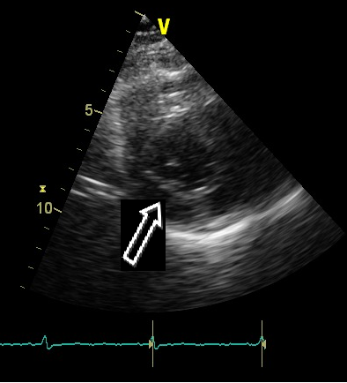
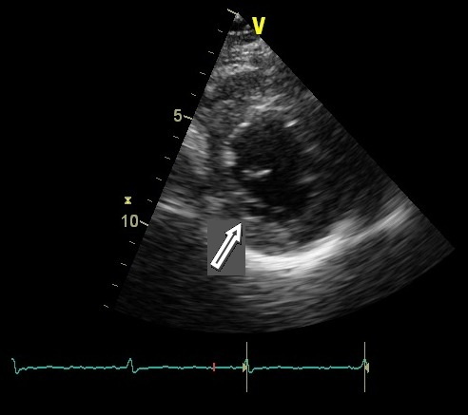
ECHO on admission
Parasternal short axis (PSAX)
at the level of papillary muscles
End-diastole – area of hypokinesis (arrow)
PSAX at the level of papillary
muscles
End - systole area of hypokinesis
(arrow)

Slide 24
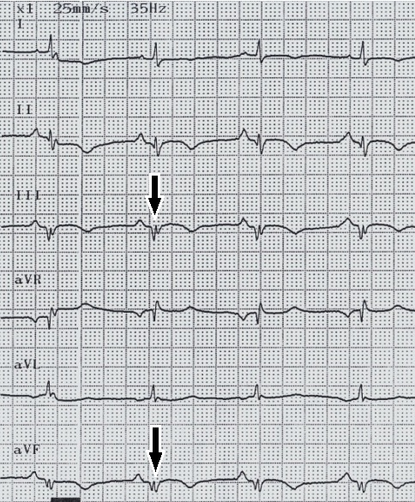
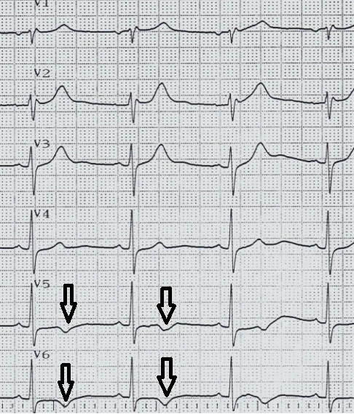
ECG on admission
Extremity leads, Q wave in III,aVF (arrows)
Chest leads, negative T wave in V5-V6 (arrows)

Slide 25
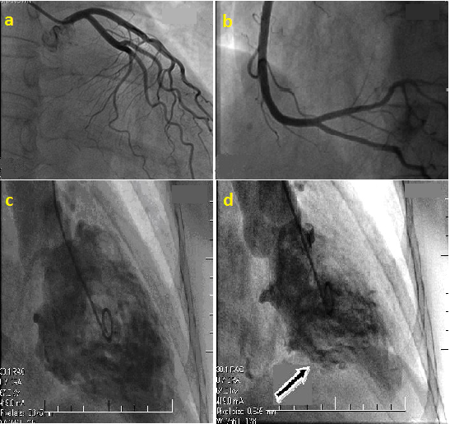
Coronary Angiogram & Ventriculogram

Slide 26
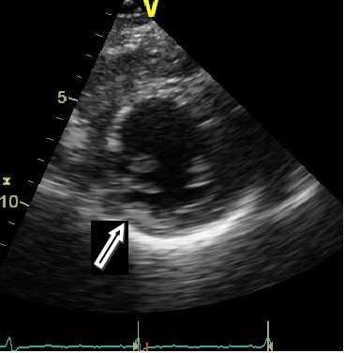
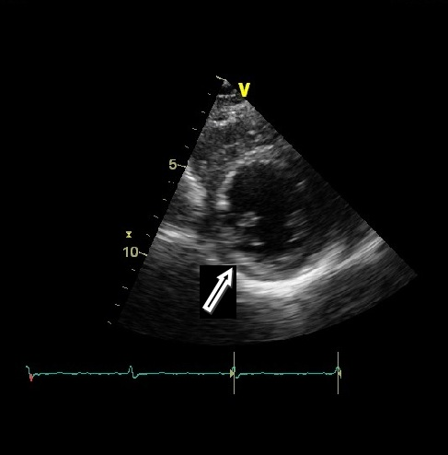
ECHO 2/52 after D/C
Parasternal short axis (PSAX)
at the level of papillary muscles
End-diastole – area of hypokinesis (arrow)
PSAX at the level of papillary
muscles
End - systole area of hypokinesis
(arrow)

Slide 27
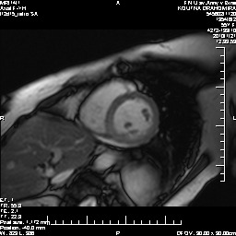
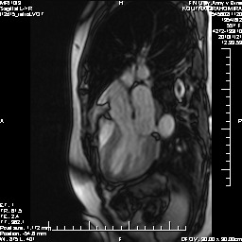
Cardiac MRI
T1 IR sequence after injection of contrast medium (Gadolinium)
Left ventricular outflow tract (LVOT) view
Area of hypokinesis (arrows)
No Late Gadolinium Enhancement finding
End-systole
T1 IR sequence after injection of contrast medium (Gadolinium)
Left ventricular outflow tract (LVOT) view
Area of hypokinesis (arrow)
No Late Gadolinium Enhancement finding
End-diastole
T1 IR sequence after injection of contrast medium (Gadolinium)
Short axis view (SAX)
No Late Gadolinium Enhancement finding
Area of hypokinesis (arrow )

Slide 28
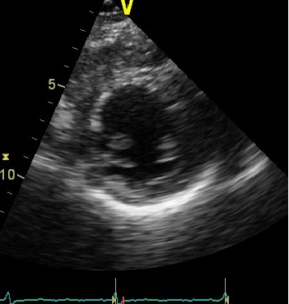
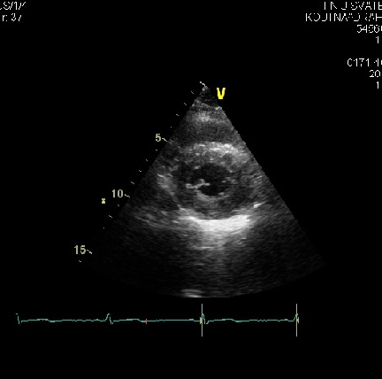
ECHO 5/52 after D/C
Parasternal short axis (PSAX)
at the level of papillary muscles
End-diastole – No hypo kinesis- complete Recovery
PSAX at the level of papillary
muscles
End - systole area No hypo
kinesis - complete Recovery

Slide 29
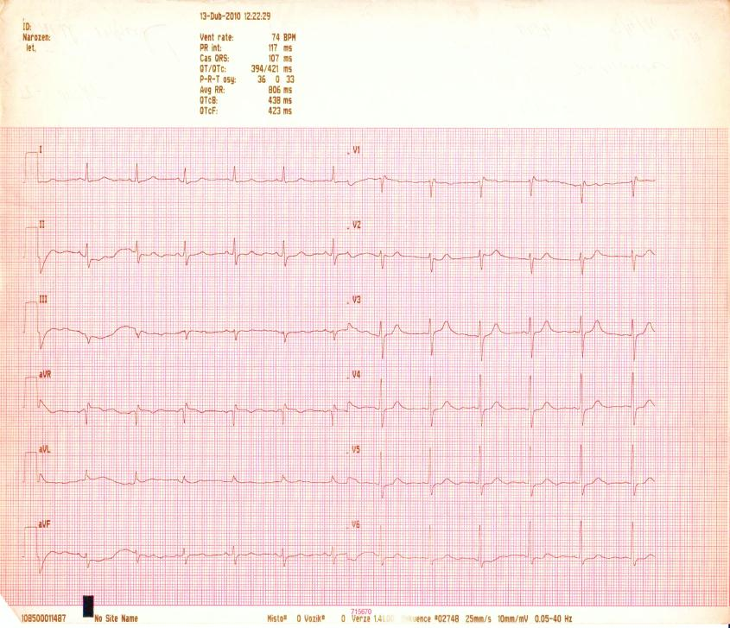
ECG 5/52 after D/C

