Slide 1
TENTATIVE PROGRAM
11th International Conference on
Nuclear& Radio
Chemistry
Dec 7-8 , 2022| Barcelona, spain
Theme:
Emphasizing Novel Researches and Frontline Advances of Nuclear and Radiochemistry
Nuclear Chemistry 2022
MAIL:nuclearchemistry@sciencesum
URL: https://nuclearchemistry.conferenceseries.com/ /

Slide 2
DAY 1
THURSDAY,8thDec,2022
08:30-09:00 | Registrations
09:00-09:30 | Introduction
09:00-09:30 | COFFEE BREAK
09:50-11:50 Meeting Hall 01 | KEYNOTE LECTURES
09:00-09:30 | Introduction
09:00-09:30 | MEETING Hall 02
11:50-13:10 | MEETING Hall 01 | MEETING Hall 02
 | Radioactive Decay Nuclear Reaction An Introduction to Nuclear Medicine | Physicochemical Application of Radiotracer Methods Isotopes Industrial Application of Radioisotopes
03:10-13:15 | GROUP PHOTO
13:15-14:00 | LUNCH BREAK
11:50-13:10 | MEETING Hall 01 | MEETING Hall 02
 | Coordination chemistry of the radioactive elements Radionuclide speciation Technical Aspects of Analytical Chemistry | Radiopharmaceutical chemistry, labeled compounds Production and application of radionuclides Radiation chemistry
16:00-16:20 | COFFEE BREAK

Slide 3
DAY 2
THURSHDAY,8thDec,2022
08:30-09:00 | Registrations
09:00-09:30 | Introduction
09:00-09:30 | COFFEE BREAK
09:50-11:50 Meeting Hall 01 | KEYNOTE LECTURES
09:00-09:30 | Introduction
09:00-09:30 | MEETING Hall 02
11:50-13:10 | MEETING Hall 01 | MEETING Hall 02
 | Environmental radioecology Radiation detection and imaging Radiochemical analysis | Advanced chemistry Nuclear forensics Radionuclides in the environment, radioecology
13:10-13:15 | GROUP PHOTO
13:15-14:00 | LUNCH BREAK
11:50-13:10 | MEETING Hall 01 | MEETING Hall 02
 | Nuclear analytical methods Chemistry of actinide elements Chemistry of Trans actinide | Radiation detection and imaging Nuclear Chemistry Nuclear Energy Production
16:00-16:20 | COFFEE BREAK

Slide 4
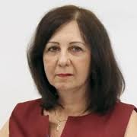
nuclearchemistry@sciencesum
ORGANISING COMMITTEE MEMBERS
Maria Eugênia Gimenez Boscov
Department
Department of Structural Engineering
Ioan Iorga senior researcher Romania
Meot Francois Brookhaven National Laboratory USA
Rupayan Bhattacharya
Emeritus Fellow, Department of Physics, University of Calcutta
Nuclear structure theory
Albina I. Orlova Nizhny Novgorod State university, Russia Russia
Juan Manuel Navarrete Tejero
CEO & Founder
@ Regenerage Medicine
Mexico
Turan Unak
Professor
Nuclear chemistry 2016
Vladimir Zaichick Professor Research Centre RUSSIA

Slide 5
PAST AFFILIATIONS
Esesua E. Pogoson Queens University, Belfast, UK | Abdeen Omer Energy Research Institute (ERI), UK | Alexander Ajai Federal University of Technology, Nigeria | Ebrahim Sadeghi Shomal University, Amol, Iran | Sherin. M. Khodier Suez Canal University, Egypt
Valencia Browning-Keen Sam Houston State University, USA | Paloma Collado National Distance Education University (UNED) Spain | L.D Lina Rammal Diet Center Beirut-lebanon | Kenneth Joseph C. Bureros University of the Philippines, Philippines | Seong-Jun Cho Kangwon National University, South Korea
Atsuko Kawamura Yamaguchi University, Japan | Dipanwita Saha, University of North Bengal, India | Patti Murphy Public Health Agency of Canada, Canada | Sherry Strong Founder of Sweet Freedom and Return to Food, Canada | Nurul Aman Sam University of Massachusetts, USA
Martyn Caplin Royal Free Hospital Sudan | Li-Shu Wang Medical College of Wisconsin USA | Myriam Abboud Zayed University, UAE | Julia Riendeau Public Health Agency of Canada, Canada | Beiquan Mou Agricultural Research Service, USA

Slide 6
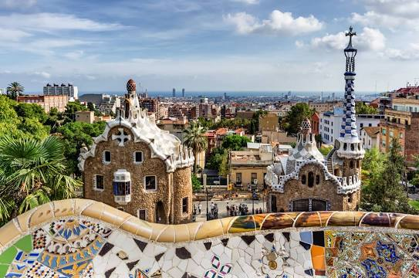
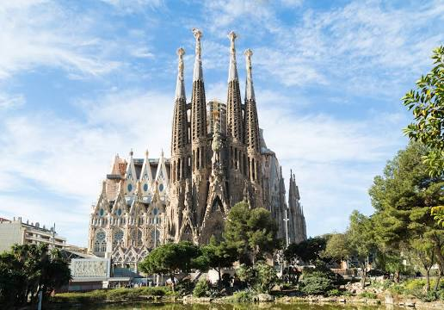
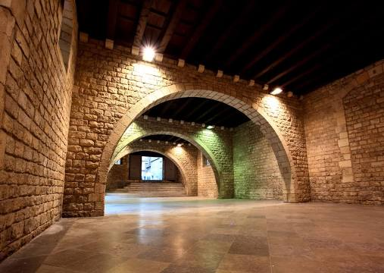
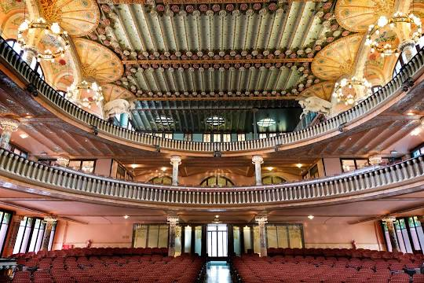
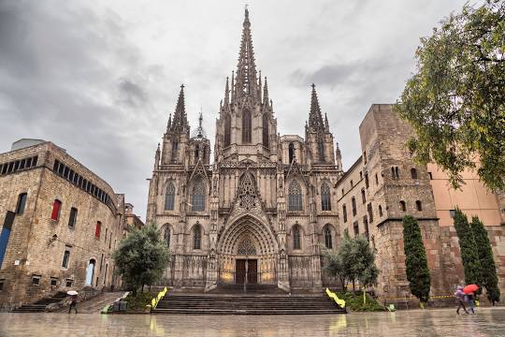
CITY ATTRACTIONS
La Sagrada Familia
Park Güell
Casa Mila
Capitoline Museums
Palau de la Música Catalana
Cathedral of Barcelona

