Slide 1
TENTATIVE PROGRAM
41th GLOBAL NANOTECHNOLOGY CONGRESS
April 11 – 12 , Amsterdam, Netherlands
Theme:
Endless possibilities with nanotechnology conference
NANOTECHNOLOGY 2024
MAIL: easypharma29@gmail.com
URL:https://nanotechnology.nanotechconferences.org /

Slide 2
DAY 1
THRUSDAY, 11 APRIL
08:30-09:00 | Registrations
09:00-09:30 | Introduction
09:00-09:30 | COFFEE BREAK
09:50-11:50 Meeting Hall 01 | KEYNOTE LECTURES
09:00-09:30 | Introduction
09:00-09:30 | MEETING Hall 02
11:50-13:10 | MEETING Hall 01 | MEETING Hall 02
 | Nanomedicine Nano metrology Nanotechnology & Energy | Nanotechnology in Water Treatment Pharmaceutical Nanotechnology Nanomaterials
03:10-13:15 | GROUP PHOTO
13:15-14:00 | LUNCH BREAK
11:50-13:10 | MEETING Hall 01 | MEETING Hall 02
 | Nanostructure Nano physics Nanotechnology Environmental effects and Industrial safety. | Nano-Electronic Devices and Micro/Nano systems Nano biotechnology Composite Material
16:00-16:20 | COFFEE BREAK

Slide 3
DAY 2
FRIDAY, 12 APRIL
08:30-09:00 | Registrations
09:00-09:30 | Introduction
09:00-09:30 | COFFEE BREAK
09:50-11:50 Meeting Hall 01 | KEYNOTE LECTURES
09:00-09:30 | Introduction
09:00-09:30 | MEETING Hall 02
11:50-13:10 | MEETING Hall 01 | MEETING Hall 02
 | Nanotechnology in the basophil activation test Nanotechnology based drug delivery systems for kidneys Nanotechnology “Impact on the food services | Nanotechnology in pulmonary medicine Nanotechnology in ovarian cancer
13:10-13:15 | GROUP PHOTO
13:15-14:00 | LUNCH BREAK
11:50-13:10 | MEETING Hall 01 | MEETING Hall 02
 | Nanolithography Carbon nanotube | Nanosponges Nanoparticles
16:00-16:20 | COFFEE BREAK

Slide 4
Steven H Voldman Director Steven H Voldman LLC USA
Osman Adiguzel
Professor Firat University Turkey
EDITORIAL BOARD MEMBERS
Francesco Zirilli
Professor
Sapienza University of Rome
Italy
Cristi Spulbar
Executive Director of CEBAFI
University of Craiova
Romania
Vladimir V. Rumyantsev
Professor
A.A. Galkin Donetsk Institute for Physics and Engineering
Ukraine
Abdel-Badeh Mohamed Salem
Professor
Ain Shams University
Egypt

Slide 5
PAST AFFILIATIONS
Alexander Ramm Kansas State University, United States USA | Ramesh Agarwal McKelvey School of Engineering, United States UK | Hossein Hosseinkhani Innovation Center for Advanced Technology, Matrix, Inc., United States UK | Mario F S Ferreira University of Aveiro, Portugal Portugal
Robert K DeLong Kansas State University USA USA | Karina Bugan Debs Universidade Federal de São Paulo Brazil | Elena Angeli University of Genova Italy Italy | Mahi R Singh Western University Canada

Slide 6
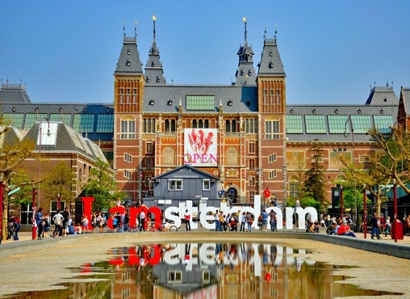
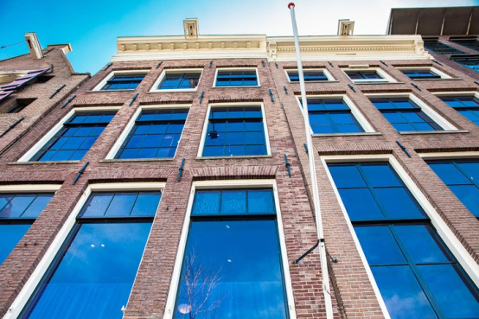
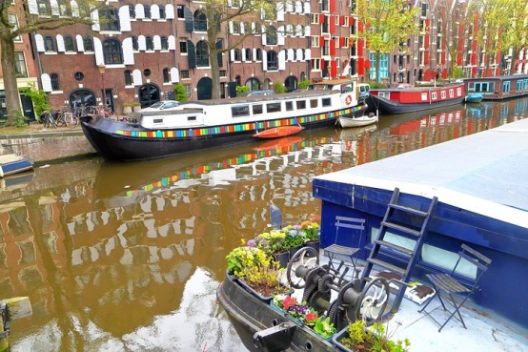
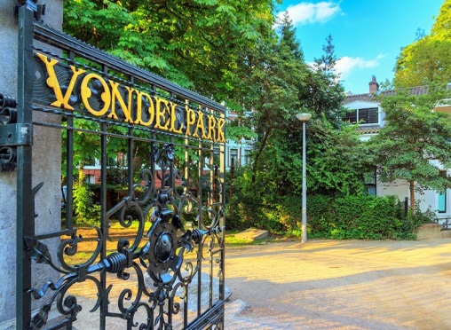
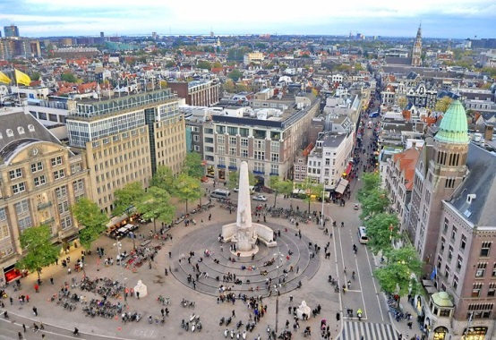
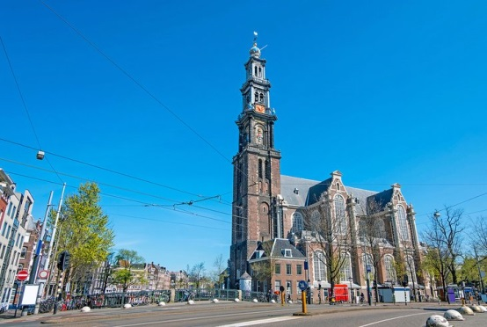
CITY ATTRACTIONS
Art Collections at the Rijksmuseum
Anne Frank House
Jordaan Neighborhood
Vondelpark
Dam Square
West Church (Westerkerk)

