Slide 1



16th World Drug Delivery Summit
September 06-07, 2023 |Paris, France
Theme:
Pharmaceutical Drug delivery and Technology Advancements
Drug Delivery 2023
MAIL: drugdelivery@meetingsnexpo.com
URL: https://drugdeliveryeurope.pharmaceuticalconferences.com/

Slide 2
REGISTRATION & TIMINGS
September 06, 2023 (8:00AM to 6:00PM)
September 07, 2023 (8:00AM to 6:00PM)
GROUP PHOTO TIME
Drug Delivery 2023
10:45 AM - 10:50 AM;September 06-07, 2023
LONDON, UK
Please try your best to attend the Conference. If you could not attend, please let us know
:https://drugdeliveryeurope.pharmaceuticalconferences.com/
https://drugdeliveryeurope.pharmaceuticalconferences.com/

Slide 3
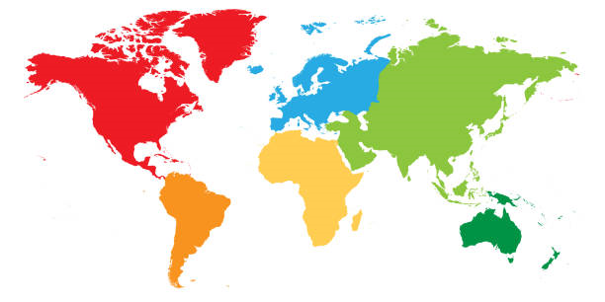
VENUE
London, UK
Drug Delivery 2023
SPEAKERS’ PPT
You may submit your presentation to any of our onsite organizers on the day of your talk. If your presentation is not compatible with our laptops, then you may use your own laptop.
To Register Online, Please visit
https://drugdeliveryeurope.pharmaceuticalconferences.com/

