Slide 1



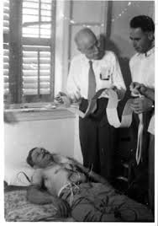
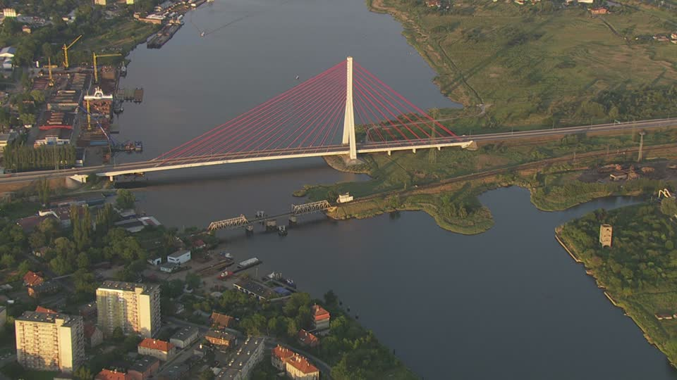
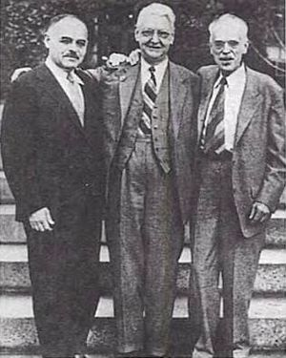
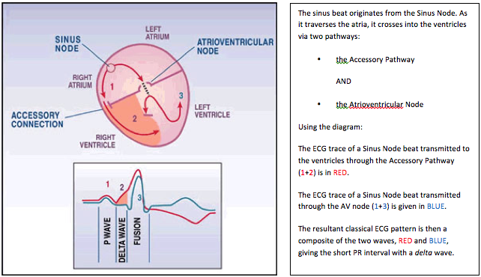
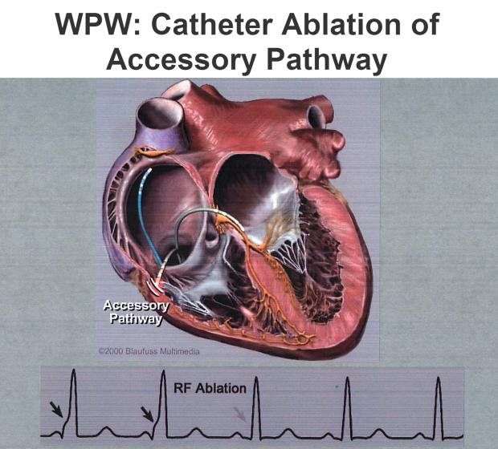
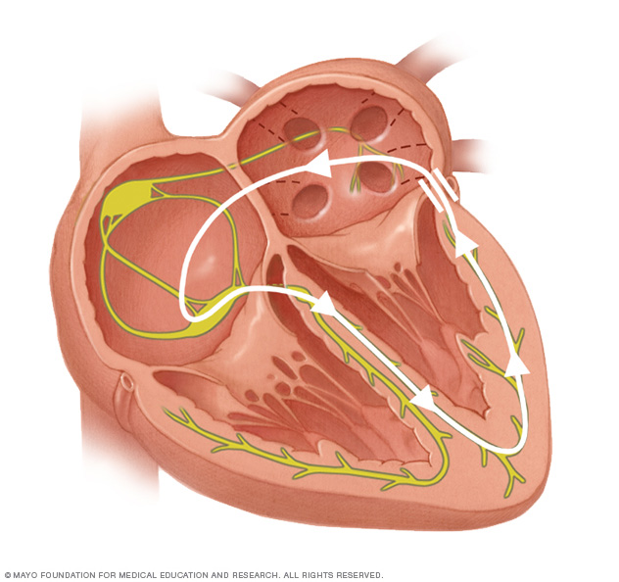
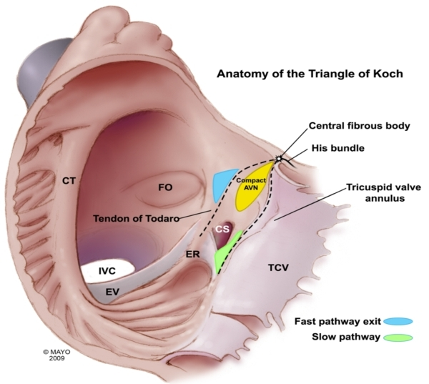
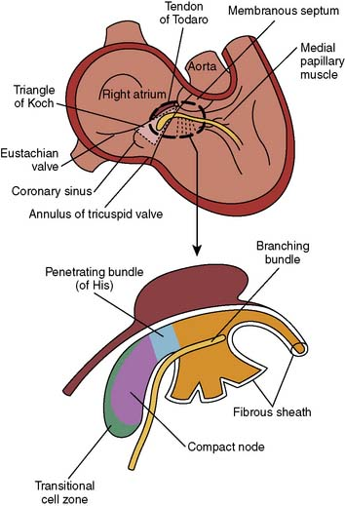
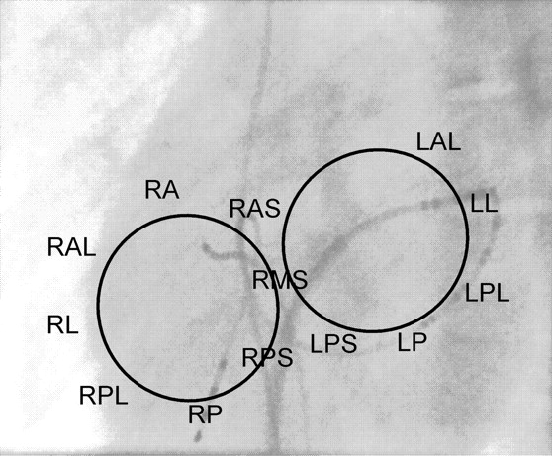
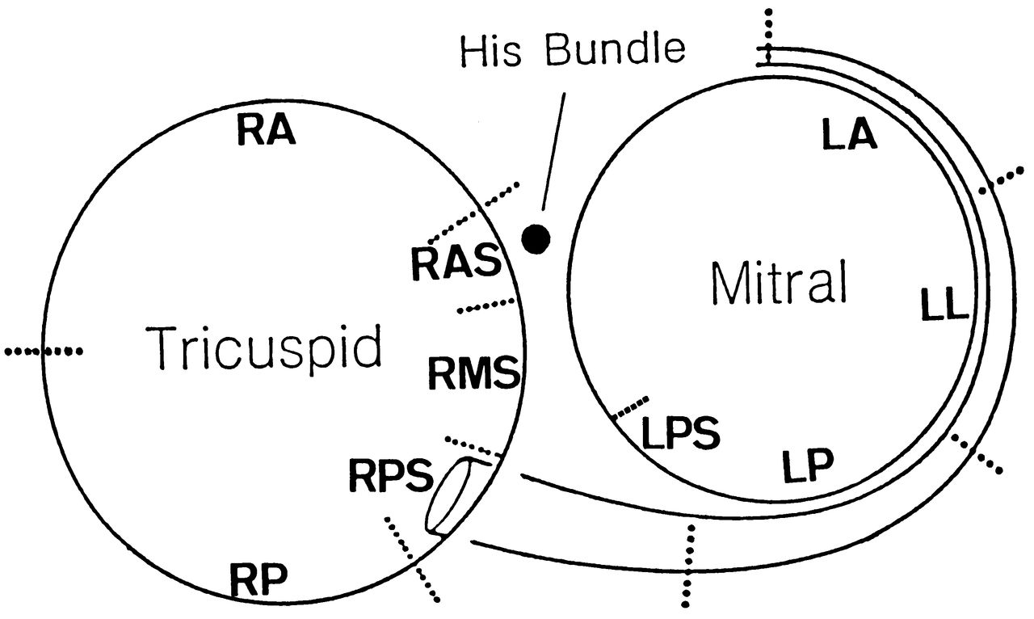
12-LEAD ECG FEATURES OF ACCESSORY PATHWAYS LOCALIZATION IN TYPICAL WOLFF-PARKINSON-WHITE SYNDROME PATIENTS
Si Dung Chu, MD, Doctorate^{1,2}; Khanh Quoc Pham, MD, Prof.,PhD^{1,2}; Dong Van Tran, MD, PhD²
¹SMP,Vietnam National University (Hanoi), ²Vietnam Heart Institute, Bachmai Hospital
RESULTS
189 patients, 99 men (52.4%) & 90 female (47.6%), p > 0.05, 42.7 ± 14.6 years of age.
3.1. Characteristic of 12-lead ECG for localization of accessory pathways (n=189)
3.1.1. Characterization of delta wave polarity in V1 lead with left or right side accessory pathways:
Left side group had positive delta wave was most common at V1 lead found in 106/109 patients (97.2%) and right side group had negative delta wave was most common at V1 lead found in 67/80 patients (83.8%).
3.1.2. Characterization of the QRS complex transition on 12-lead ECG with septal or free wall lateral location
Classified transition of septal location was most common at V1,V2 lead (between V2V3 including) found in 58/65 patients (89.2%); While classified transition of lateral free wall location was most common at after V1V2(V3-V6)/before V1 found in 108/124 patients (87.1%). Right free wall lateral had QRS complex transition at after V1V2 (V3-V6) found in 36/40 patients (90%); Left free wall lateral had QRS complex transition at V1V2(V3-V6) or before V1 lead found in 72/84 patients (85.7%).
3.1.3. Characterization of delta wave polarity in at least 2/3 inferior lead with antero or postero group
Classified antero pathways group had positive delta wave was most common at least 2/3 inferior lead (DII, DIII, aVF) found in 31 of 31 patients (100%); While postero pathways group had negative delta wave was most common at least 2/3 inferior lead found in 81/87 patients (93.1%).
3.2. Characterization of 12-lead ECG for each localization (10 regions)
3.2.1. Characterization of 12-lead ECG for localization of right free wall accessory pathways
Table 3-1: Characterizaton of positive/negative delta wave in at least 2/3 inferior
Note: (+): positive delta wave; (-): negative delta wave.
Right anterolateral (RAL) pathways had positive delta wave was most common at least 2/3 inferior lead (DII, DIII, AVF) found in 9 of 9 patients (100%); while right posterolateral (RPL) pathways had negative delta wave was most common at least 2/3 inferior lead found in 20 of 21 patients (95.2%). Beside, right lateral (RL) pathways had negative delta wave was most common at least 2/3 inferior lead found in 9 of 10 patients (90%). Thus, both in “includes RL/RPL pathways” had negative delta wave was most common at least 2/3 inferior lead found in 29 of 31 patients (93.5%).
Table 3-2: Characterizaton of positive/negative QRS complex in at least 2/3 inferior
Note: (+): positive QRS complex; (-): negative QRS complex.
Classified QRS complex polarity of inferior lead (DII, DIII, aVF) for the RL and RPL pathway: RL was most common with positive QRS complex at least 2/3 inferior lead found in 9 of 10 patients (90%); While, RPL was most common with negative QRS complex at least 2/3 inferior lead in 20 of 21 patients (95.2%).
3.2.2. Characterization of 12-lead ECG for localization of left free wall accessory pathways
Table 3-3: Characterizaton of positive/negative delta wave in at least 2/3 inferior
Note: (+): positive delta wave; (-): negative delta wave.
Group of “includes LAL/LL pathways” had positive delta wave was most common at least 2/3 inferior lead (DII, DIII, aVF) found in 69 of 72 patients (95.8%); While LPL pathways had negative delta wave was most common at least 2/3 inferior lead as above (91.7%).
Table 3-6: Characterizaton of R/S ratio in V1 lead for the left anterolateral or left lateral
LAL was most common with R/S > 1 at V1 lead found in 13 of 17 patients (76.5%). LL pathways was most common with R/S < 1 (62,3%) or QRS complex’R morphology (25.5%) at V1 lead found in 41 of 55 patients (74.5%).
3.2.3. Characterization of 12-lead ECG for localization of septal accessory pathways
Classified transition of Left septal or right septal had positive or negative delta wave was most common at V1 ( 92% & 87.5%). RAS or PS(LPS/RPS) had positive or negative delta wave was most common at least 2/3 inferior lead found in 5/5 patients (100%) or 50/54 patients (92.6%).
Classified morphology QRS complex (Qrs, qRs, qrS) of midseptal location was most common at inferior lead found in 5/6 patients (83.3%), no midseptal pathways (RAS/RPL/LPL) only found 8/59 patients’s LPL and RPL (13.6%) had morphology QRS complex as below.
ABSTRACT
INTRODUCTION
Objective: This study was designed characteristics of 12 lead electrocardiogram to compare the position of accessory pathway in the typical Wolff-Parkinson-White syndrome, can be build a new electrocardiogram algorithm for the localization of accessory pathways. Subject and method: In 189 patients with typical Wolff-Parkinson-White syndrome have a single anterogradely conducting accessory pathways on 12-lead electrocardiogram parameters were compared with the localization of accessory pathways identified by successful radiofrequency catheter ablation. Result: We found that the 12 lead electrocardiogram parameters in typical Wolff-Parkinson-White syndrome such as polarity delta wave in V1, R/S ratio in V1, the transition of the QRS complex, polarity delta wave/polarity QRS complex and morphology QRS was “QRS pattern” in inferior (DII, DIII, AVF) leads in diagnosis for the localization of accessory pathways by with hight accuracy predicted from 74.5% to 100%. Conclusion: The surface electrocardiogram parameters in typical Wolff-Parkinson-White syndrome closely related to accessory pathways localization and can be used to a new electrocardiogram algorithm for the localization of accessory pathways by using simple parameters as above.
Keywords: Localization of accessory pathways, 12-lead ECG, electrocardiogram algorithm, Wolff-Parkinson-White syndrome.
Wolff-Parkinson-White (WPW) syndrome associated with an accessory AV connection (called Kent Bundle); The 12-lead ECG is characterized by a shortened PR, prolonged QRS, with Delta wave [1], [2].
Nowaday, Radiofrequency catheter ablation (RCFA) of Accessory pathway (AP) requires precise localization of the AP along the mitral and tricuspid annulus (gold standard) [2]. 12-lead ECG is the first step for localization of AP in patients with WPW syndrome, still now. The data Obtained from the ECG parameters can be helpful in planning and shortening the RCFA and X-ray procedure [2], [3].
Some algorithms based on ECG criteria have been published predicting locations of accessory pathways. However, many studies known to be difficult to ablate as compared to those in other locations, some ECG algorithms had difficult paramaters in using or only for some locations [1], [2], [3], [4], [[5]. Therefore, the purpose of this study was to analyse the 12-lead ECG of accessory pathway localization’s successful RCFA to develop new ECG algorithm using simple parameters, and test this algorithm to predict accessory pathway location.
Location (+)/(-) delta wave in inferior |  | Right anterolateral | Right lateral | Right posterolateral | Total
Positive delta wave in at least 2/3 inferior | n | 9 | 1 | 1 | 11
 | % | 100% | 10% | 4.8 | 27.5%
Negative delta wave in at least 2/3 inferior | n | 0 | 9 | 20 | 29
 | % | 0% | 90% | 95.2% | 72.5%
Total (n): |  | 9 | 10 | 21 | 40
Location (+)/(-) QRS complex in inferior |  | Right anterolateral | Right lateral | Right posterolateral | Total
Positive delta wave in at least 2/3 inferior | n | 9 | 9 | 1 | 19
 | % | 100% | 90% | 4.8 | 47.5%
Negative delta wave in at least 2/3 inferior | n | 0 | 1 | 20 | 29
 | % | 0% | 10% | 95.2% | 52.5%
Total (n): |  | 9 | 10 | 21 | 40
Location (+)/(-) delta wave in inferior |  | Left anterolateral | Left lateral | Left posterolateral | Total (n)
Positive delta wave in at least 2/3 inferior | n | 17 | 52 | 1 | 70
 | % | 100% | 94.5% | 8.3
Negative delta wave in at least 2/3 inferior | n | 0 | 3 | 11 | 14
 | % | 0% | 5.5% | 91.7%
Total (n): |  | 17 | 55 | 12 | 40
Location R/S ratio in V1 lead |  | Left anterolateral |  | Left lateral |  | Total (n)
 |  | n | % | n | %
1 | R/S ratio > 1 | 13 | 76.5 | 14 | 25.5 | 27
2 | R/S ratio < 1 | 2 | 11.8 | 34 | 61.8 | 36
 | QRS: R morphology | 2 | 11.8 | 7 | 12.7 | 9
Total (n): |  | 17 |  | 55 |  | 72
DISCUSSION
METHODS AND MATERIALS
4. Discussion
4.1. Characterization of 12-lead ECG for localization of accessory pathways
4.1.1. Characterization of delta wave polarity in V1 lead with left or right side:
Characteristic electrocardiogram in a patient with left side pathway had strongly positive delta waves at V1 lead are noted (97.2%), while right side pathway had strongly negative delta waves at V1 leasd are noted (83.8%). This is very useful in selecting the approach of the catheter is the vein or artery; All right-sided AP were ablated with the use of transvenous atrial approach through the femoral vein, while left-side AP were ablated with retrograde arterial approach; if this approach failed the pathway was ablated using antegrade transeptal approach [2.
Some ECG algorithms have been published predicting locations of left-sided or right-sided accessory pathway by positive of negative delta wave [1], [2], [3], [6]. Beside, some other studies showed that diagnosis left or right-side accessory pathway by other ECG parameters such as D’ Avila [4], Chern-En Chiang [7], Mauricio S. Arruda [8], Muhammad [6], and Noriko [9].
4.1.2. Transition characteristics of the QRS complex on 12-lead ECG with septal or free wall lateral location
Characteristic ECG in a patient with septal location pathway was most common at V1,V2 lead are noted (89.2%), While free wall lateral location pathway was most common at after V1V2/before V1 lead are noted (87.1%).
Some algorithms based on ECG not-yet finding different between anteroseptal with right anterolateral APs, difficult in posteroseptal with posterolateral (left or right). However, many studies were showed that transition of QRS complex can be used to predicting locations of septal or free wall accessory pathway [1], [2], [6].
4.1.3. Characterization of delta wave polarity in at least 2/3 inferior lead (DII,DIII,aVF) with antero or postero group
Characteristic electrocardiogram in a patient with antero group pathway had strongly positive delta waves in at least 2/3 inferior are noted (100%), while postero group pathway had strongly negative delta waves in at least 2/3 inferior leads (II, III, aVF) are noted (93.1%).
Some ECG algorithms have been published predicting locations of antero or postero accessory pathway by positive or negative delta wave in inferior as below [1], [2], [6]. However, some studies were only forcus on some positions in antero and postero accessory [10].
4.2. Characterization of 12-Lead ECG for the each location (10 regions)
4.2.1. Characterization of 12-Lead ECG for the right free wall location (3 regions)
The results showed that build to a group of “RAL pathways” had positive delta wave was most common at least 2/3 inferior lead are noted (95.8%), and group of ‘includes RL/RPL pathways” had negative delta wave was most common at least 2/3 inferior lead as above (93,5%), beside results showed that very dificulty in localizing betwween two position were RL and RPL APs, can be explained by the two locations have similar in electrophysiological side.
According to the statistics as above, the RL and RPL pathways are often found in the negative delta way in at least 2/3 inferior lead; Therefore, We performed the characteristic of QRS complex polarity at least 2/3 inferior lead in these two regions. Result showed that the RL position was most common with positive QRS complex at least 2/3 inferior lead (90%); While, the RPL was most common with negative QRS complex at least 2/3 inferior lead (95.2%). Thus, this parameter (QRS complex polarity) helped to suggesting that the RL or RPL pathways. Many studies showed that difficulty in localizing between other positions of right free wall pathways. Andre D’ Avila [4], Pedro Iturralde selected two locations of right free wall were RA region and RIP/RI region [5]. Noriko Taguchi selected two locations were RA/RL region and RPL/RP region [9].
Thus, We have been predicted “RAL region” or ‘’includes RL/RPL region” by positive/negative delta wave in at least 2/3 inferior, different between RL and RPL location by positive or negative QRS complex in at least 2/3 inferior lead; which can help the doctors to perform a rapid onset of accessory pathway location on the tricuspid valve forwards or backwards, or within 1-2 cm of the valve; help to facilitate mapping techniques and shorten time radiofrequency ablation [1], [2], [3].
4.2.2. Characterization of 12-lead ECG for the Left free wall location (3 regions)
Characteristic ECG in a patient with LAL pathway had strongly positive delta waves in at least 2/3 inferior leads (II, III, aVF) are noted (100%), while LPL pathway group had strongly negative delta waves in at least 2/3 inferior leads are noted (91.7%). Specialists, LL pathway had positive delta wave was most common at least 2/3 inferior leads are noted (94,5%) as the same characteristic LAL pathway. Therefore, build to a group of “includes LAL/LA pathways” had positive delta wave was most common at least 2/3 inferior lead (95.8%), and “LPL pathways” had negative delta wave was most common at least 2/3 inferior lead as above (91,7%).
According to the statistics as above, the LAL and LL pathways are often found in the positive delta way in at least 2/3 inferior lead. We performed the characteristic of R/S ratio at V1 lead in these two regions. Result showed that the LAL position was most common with R/S ratio >1 at V1 lead (76,5%); While, the LL pathway region was most common with R/S < 1 or QRS complex’s R morphology at V1 lead (74,5%). Thus, this parameter (R/S) helped to suggesting that the LAL or LL pathways but it’s not high accuracy, can be explained by between two location have plenty of sequential zones and similar in electrophysiological angle, so there are many similarities [1].
Many studies showed that difficulty in localizing between LAL or LL pathways as well as difficulty in different between other positions of left free wall pathways. Pedro Iturralde (1996) selected two locations of left free wal were “includes LPL & LAS pathways” and “include LIP & LI pathways” [5]. Noriko Taguchi (2013) selected two locations were “includes LA & LL pathways” and “includes LP & LPL pathways” [9].
Thus, We have been suggested “includes LAL/LL pathways” and “LPL pathway’’ by positive/negative delta wave in at least 2/3 inferior, different between LAL and LL posotion by R/S ratio > 1 or R/S < 1, R in V1 lead; which can help the doctors to perform a rapid onset of accessory pathway location on the mitral valve forwards or backwards, or within 1-2 cm of the valve; help to facilitate mapping techniques and shorten time radiofrequency ablation [1], [2], [3].
4.2.3. Characterization of the QRS complex on 12-lead ECG with septal location (4 regions)
Classified transition of septal location was most common at V1,V2 lead are noted (87.8%). The septal accessory pathway location with Anatomic relation of the atrioventricular junction in relation to other cardiac structures, especially in the septal region’s transitional cell zone [11].
Anteroseptal (AS) or posteroseptal (PS) pathway had strongly positive or negative delta waves in at least 2/3 inferior leads (II, III, aVF) are noted [1], [3], [7]; However, some studies were only forcus on some positions in RAS and PS accessory pathway [10]. Successful ablation was performed at a location on the anteroseptal annulus where a His bundle electrogram was being recorded. Ablation was very anterior, and thus not in the vicinity of the compact AV node [11], [12]. Midseptal pathways are inserted into the triangle of Koch region, close to the compact AV node. Accurate assessment of pathway slant and ablation preferably of the ventricular insertion site along with the use of cryoenergy may all be required to minimize the risk of AV block when ablating pathways in this region [12].
Classified QRS complex morphology (Qrs, qRs, qrS) of midseptal location was most common at inferior lead (DII, DIII, aVF) found in 5/6 patients (83.3%). This “Qrs pattern” in at least 1/3 inferior lead in differences in the QRS morphology to distinguish midseptal AP from other septal localizations. Andre showed that the negative QRS complex in lead DIII was characterized by a large “Q’ wave followed by a small “r” wave and an “s” wave. [4]. We were using for inferior lead (DII, DIII, aVF) and not only used to DIII lead.
Thus, we had a new ECG algorithm in predicting localization of APs with 10 region in typical WPW syndrome.
CONCLUSIONS
Study design: Observational, cross-sectional, retrospective and prospective study.
Study contents: We studied 189 patients with typical WPW syndrome who had a single anterograde AP identified by successful radio frequency catheter ablation were enrolled to build a new ECG algorithm for localizing APs using simple parameters from Jannuary 2001 to June 2016.
WPW syndrome was defined as the 12-lead ECG is characterized by a shortened PR interval < 120 milliseconds, prolonged QRS duration ≥ 110 milliseconds, with a delta wave. Secondary ST and T wave changes which are directed opposite to the major Delta wave and QRS vector [1]. Localization of accessory pathways was identified by successfully ablated by RCFA (gold standard) [2].
Statistical Analysis: IBM SPSS 21.0 software for analyzing data.
Fig.: Anatomic definition of accessory pathway location. A schematic diagram of the heart from the left anterior oblique projection shows the relation among the tricuspid annulus (TA), mitral annulus (MA), His bundle (HIS), coronary sinus (CS), and the anatomic locations of the accessory pathways. Accessory pathway locations are divided into 10 main regions, LA: left anterior lateral; LL: left lateral; LP: left posteriorlateral; LPS: left posteroseptal; MS: midseptal; RPS: right posteroseptal; RA: right anteriorlateral; RAS: right anteroseptal; RL: right lateral; RP: right posteriorlateral.
We have developed a new algorithm in localizing accessory pathways by 12-lead ECG with simple parameters. We found that the right side or left side had had negative delta wave (83.3%) or positive delta wave (97.2%) was most common at V1 Lead. Antero location had postive delta wave (100%) was most common at least 2/3 inferior lead (100%) and postero location had negative delta wave had negative delta wave (93.1%) was most common at least 2/3 inferior lead. Septal location had QRS complex transition was most common at V1, V2 lead (89.2%) and free wall lateral location had QRS complex transition was most common at after V1,V2 (V3-V6) lead or before V1 lead (87.1%).
Different between right lateral and right posterolateral by positvie (90%) or negative QRS complex (95.2%) was most common at least 2/3 inferior lead. Defferent between anterolateral and left lateral by R/S > 1 (76.5%) and R/S < 1 or R (74.5%). Midseptal location had QRS complex morphology’s negative QRS with specify morphology (Qrs, qRs, qrS) in at least 1/3 inferior lead (83.3%).
n =9 (4.8%)
n =17
(9.0%)
Step 1
Delta wave polarity in V1
RL
n =5 (2.6%)
n = 55 (29.1%)
Right side: (-) dela wave
Left side: (+) delta wave
n =10 (5.3%)
n = 6 (3.2%)
Step 2
n =25 (13.2%)
Figure: Stepwise Surface ECG algorithm for the determination of accessory pathway location
n = 21 (11.1%)
Right free wwall: QRS complex transition at after V1,V2 (V3-V6)
Right Septal: QRS complex transition at V1,V2
Left Septal: QRS complex transition at V1,V2
Left free wwall: QRS complex transition at after V1,V2 (V3-V6) or before V1
n =29 (15.3%)
Step 3
RAS: (+) delta wave in at least 2/3 inferior lead, no Qrs in inferior
LAL: (+) delta wave in at least 2/3 inferior lead, R/S > 1 in V1
LL: (+) delta wave in at least 2/3 inferior lead, R/S < 1 or R
CS
n =12 (6.3%)
RAL: (+) delta wave and (+) QRS complex in at least 2/3 inferior lead
RL: (-) delta wave and (+) QRS complex in at least 2/3 inferior lead
RPS: (-) delta wave in at least 2/3 inferior lead, no Qrs in inferior
RMS: (+)/(-) delta wave in at least 2/3 inferior, Qrs in inferior
LPL: (-) delta wave in at least 2/3 inferior lead
RPL: (-) delta wave and (-) QRS complex in at least 2/3 inferior
LPS: (-) delta wave in at least 2/3 inferior lead, no Qrs in inferior
References
1. Borys S et al (2008). Chou’s Electrocardiography in clinical practice: Adult and Pediatric. Elservier Saunders.
2. Tarek Basiouny et al (2012). Prospective validation of a sezer ECG agorithm for localization of accrssory pathways in patients with Wolff-Parkinson-White syndrome. AAMJ; 10, Suppl-2.
3. Robert L, Douglas LW et al (1987). Value of the resting 12 lead electrocardiogram and vectorcardiogram for locating the accessory pathway in patients with the Wolff-Parkinson-White. Bristish Heart Journal: 324-332.
4. Andre D' avila, Brugade J, Vassilis Skeberis et al (1995). A fast and reliable algorithm to localize accessory pathways based on the polarity of the QRS complex on the surface ECG. During Sinus Rhythm. PACE. 1995; 18, pp.1615-1627.
5. Pedro Iturralde, Vivien Araya-Gomez, et al (1996). A new ECG algorithm for the localization of accessory pathways using only the polarity of the QRS complex. Journal of Electrocardiology; 29(4): 289-299.
6. Muhammad AD, Abdul RA et al (2008). Localization of accessory pathways according to AP Fitzpatrick ECG criteria in patients with Wolff-Parkinson-White syndrome in our population. Pakistan Heart Journal: 41.
7. Chern-En C, Wee ST et al (1995). An accurate stepwise electroardiographic algorithm for localization of accessory pathways in patients with Wolff-Parkinson-White syndrome from a Comprehensive Analysis of Delta Waves and R/S Ratio During Sinus Rhythm. The American Journal of Cardiology; 76: 40-46.
8. Arruda MS, Wang X et al (1998). Development and validation of an ECG algorithm for identifying accessory pathway ablation site in Wolff-Parkinson. J Cardiovasc Electrophysiol; 9: 2-12.
9. Noriko T, Yasuya I et al (2013). A simple algorithm for localizing accessory pathways in patients with Wolff-Parkinson-White syndrome using only the R/S ratio. Journal of Arrhythmia.
10. Thomas R, Daniel S et al (2008). A new algorithm for concealed accessory pathway localization using T-wave-subtracted retrograde P-wave polarity during orthodromic atrioventricular reentrant tachycardia. J Interv Card Electrophysiol; 22:55-63.
11. Paula G Macedo, Susan E Bisco, and Samuel J Asirvtham (2010). Septal Accessory Pathway: Anatomy, Causes for Difficulty, and an Approach to Ablation. Indian Pacing Electrophysiol J. 10, 292-309.
12. Alan Cheng, Charles W. Houge. (2015). Cardiac Electrophysiology: Diagnosis and Treatment. Anesthesiology. Kaplans Cardiac Anesthesia Expert Consult Premium 6e.
Fig.4-1: ECG of midseptal AP on 11/3/2016 (Male 35 years of age). Negative delta wave in V1 lead, QRS complex transition in V1 lead, Negative QRS complex morphology as Qrs in DIII lead (red cycle)
CONTACT
Email: Chudungsi@gmail.com
Phone: +84 906 086 168
Website:
Dr. Chu Dung Si, MD., Doctorate
SMP, Vietnam National University(Hanoi) & Vietnam Heart Institute, Bachmai Hospital

